Slide 1
Joint Coding and Modulation Diversity with LRA MMSE VP by QR precoding MIMO
Doc.: IEEE 11-14-0614-00-00ax
Date: 2014-05-05
Authors:
Name | Affiliations | Address | Phone | Email
Ningbo Zhang | Beijing University of Posts and Telecommunications (BUPT) | Xitucheng Road 10, Haidian District, Beijing, China | 15810007211 | nb52zhang@gmail.com
Guixia Kang |  |  | 13911060877 | gxkang@bupt.edu.cn
Ruyue Dong |  |  | 13683123069 | d.Ruyue@gmail.com

Slide 2
Outline
Doc.: IEEE 11-14-0614-00-00ax
This contribution proposes an improved MIMO-OFDM scheme based on LRA MMSE VP by QR precoding[1] MIMO to achieve better system performance.

Slide 3
Introduction
Doc.: IEEE 11-14-0614-00-00ax
Higher demand for future WLAN[2]：
  Higher throughput and data rates.
  Higher speed of data processing.
  increased number of mobile devices
The combination of OFDM and MIMO is still a key technology for increasing the system throughput and reliability in the next generation WLAN.
In order to enhance the system performance, we propose a LRA MMSE VP by QR precoding MIMO as the key PHY layer technology for the next-generation WLAN.

Slide 4
Precoding strategy
Doc.: IEEE 11-14-0614-00-00ax
MMSE VP precoding
  Better system performance
  Increased computational complexity compared to LRA MMSE VP precoding
LRA MMSE VP precoding
  Lower computational complexity than MMSE VP precoding
  Performance degradation compared to MMSE VP precoding

Slide 5
Proposed Transmitter/Receiver Description
Doc.: IEEE 11-14-0614-00-00ax
  NOTES[3]
  In this figure, the precoding algorithm MU MIMO are MMSE VP precoding/ LRA MMSE VP precoding respectively.

Slide 6
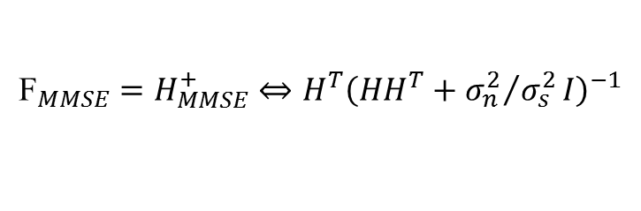
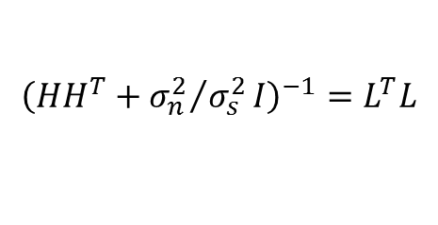
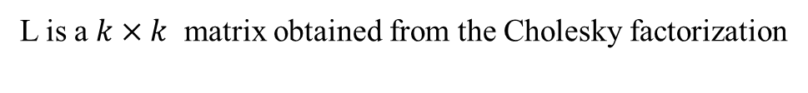
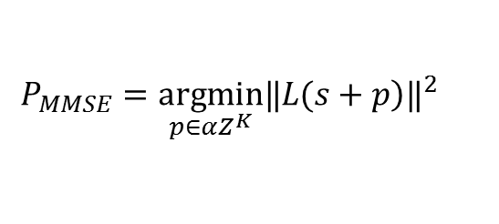
LRA MMSE VP Precoding
Doc.: IEEE 11-14-0614-00-00ax
The first step is to suppress the multi-user interference ,and the second step is to optimize system performance. In the second step ,the communication between BS and users can be seen as SU-MIMO.
In the second step, MMSE approach makes an optimal tradeoff between the residual interference and noise to reduce the noise amplification effect. For MMSE VP [3], the precoding matrix is a MMSE version inverse of channel matrix
Perturbation vector is found by the searching rule
Where ,
$${\text{F}}_{MMSE}=H_{MMSE}^{+}⇔H^{T}{\left(HH^{T}+{σ_{n}^{2}}/{σ_{s}^{2}}I\right)}^{−1}$$
$$P_{MMSE}=\underset{p∈αZ^{K}}{argmin}{‖\left.L(s+p\right)‖}^{2}$$
L is a $k×k$ matrix obtained from the Cholesky factorization
$${\left(HH^{T}+{σ_{n}^{2}}/{σ_{s}^{2}}I\right)}^{−1}=L^{T}L$$

Slide 7
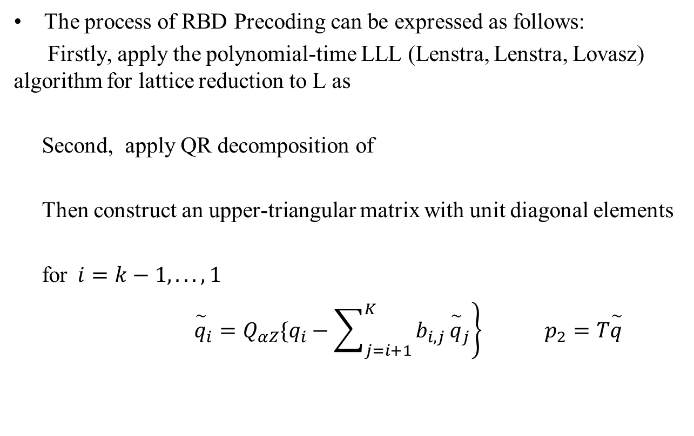


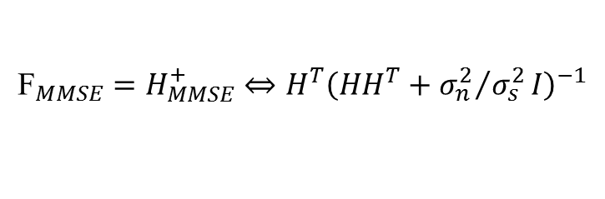
LRA MMSE VP Precoding
Doc.: IEEE 11-14-0614-00-00ax
The process of RBD Precoding can be expressed as follows:
Firstly, apply the polynomial-time LLL (Lenstra, Lenstra, Lovasz) algorithm for lattice reduction to L as
Second, apply QR decomposition of
Then construct an upper-triangular matrix with unit diagonal elements
for$i=k−1,...,1$
$\left.{\overset{\sim }{q}}_{i}=Q_{αZ}\{q_{i}−\sum_{j=i+1}^{K}{b_{i,j}}{\overset{\sim }{q}}_{j}\right\} p_{2}=T\overset{\sim }{q}$
$${\text{F}}_{MMSE}=H_{MMSE}^{+}⇔H^{T}{\left(HH^{T}+{σ_{n}^{2}}/{σ_{s}^{2}}I\right)}^{−1}$$
$$QR=L_{red}$$
$$QR=L_{red}$$

Slide 8
Summary
Doc.: IEEE 11-14-0614-00-00ax
An improved MMSE VP precoding called LRA MMSE VP by QR precoding is proposed.
LRA MMSE VP by QR precoding is more simple and efficient comparing with MMSE VP precoding.

Slide 9
Reference
Doc.: IEEE 11-14-0614-00-00ax
  [1] Liu F, Jiang L, He C. Low complexity MMSE vector precoding using lattice reduction for MIMO systems[C]//Communications, 2007. ICC'07. IEEE International Conference on. IEEE, 2007: 2598-2603.
  [2] 11-14-0214-00-0hew- High Efficiency WLAN Overview
  [3] Lenstra A K, Lenstra H W, Lovász L. Factoring polynomials with rational coefficients[J]. Mathematische Annalen, 1982, 261(4): 515-534.

