Slide 1
Discussions on adaptive frame length in MAC based on block ACK
Doc.: IEEE 11-14-0613-00-00ax
Date: 2014-05-05
Authors:
Name | Affiliations | Address | Phone | Email
Ningbo Zhang | Beijing University of Posts and Telecommunications (BUPT) | Xitucheng Road 10, Haidian District, Beijing, China | 15810007211 | nb52zhang@gmail.com
Guixia Kang |  |  | 13911060877 | gxkang@bupt.edu.cn
Bingning Zhu |  |  | 13811625409 | 407549401@qq.com

Slide 2
Background
Doc.: IEEE 11-14-0613-00-00ax
Frame length is an essential impact on performance of WLAN
Next generation WLAN network expects for higher throughput and more adaptive schemes in MAC layer
Frame length directly impacts the throughput and efficiency of MAC layer
It seems necessary to get the optimal frame length in different situation
Frame aggregation and BA (Block Acknowledgement) are discussed in previous study
In the latest IEEE 802.11ac [1] and 802.11ad [2], above technologies are both introduced and enhanced
In [3], step by step detailed procedure for a system simulation based on MAC/PHY features of 802.11 is discussed
In [4], MAC efficiency is analyzed considering both frame aggregation and BA for dense deployment scenarios
This contribution is to discuss adaptive frame length

Slide 3
Current enhanced MAC scheme
Doc.: IEEE 11-14-0613-00-00ax
Variable, no more than
maximum length
CW (variable)
Actual data
pr
RTS
SIFS
pr
Aggregated
Frame
SIFS
pr
Aggregated
Frame
SIFS
DIFS
pr
CTS
SIFS
pr
BA
SIFS
pr
BA
overhead
overhead
overhead
Total MAC payload (bits)
MAC throughput =
Time consumed for transmitting total MAC payload (sec)
MAC throughput
MAC efficiency =
PHY rate
Two main technologies: Frame Aggregation and Block Acknowledgement
MAC efficiency is influenced by
Number of blocks in an aggregated frame
Number of BAs
Number of retransmission

Slide 4
Frame aggregation
Doc.: IEEE 11-14-0613-00-00ax
The frame aggregation structure is illustrated in the figures
Frame aggregation schemes mainly include A-MSDU and A-MPDU, which are classified by different sub-frames being aggregated.
In MAC layer, MSDU(MAC Service Data Unit) combines with header, additional information to form MPDU(MAC Protocol Data Unit).

Slide 5
Block Acknowledgement
Doc.: IEEE 11-14-0613-00-00ax
The BA scheme is illustrated in the figure above
BA always used to enhance the performance of frame aggregation schemes.
The receiver sends a BA frame to feedback that it has received the data frame.
The bit map in BA indicates whether each block is transmitted correctly or not.

Slide 6
Performance analysis of current MAC
Doc.: IEEE 11-14-0613-00-00ax
Advantages
Frame aggregation and BA obviously decrease MAC header, inter-frame space, number of BAs and other additional overhead;
Furthermore, the media contention time is incurred only once in the transmission of the large frame instead of multiple small packets;
Thus can increase throughput and efficiency in MAC layer.
Disadvantages
As wireless links are error-prone and changeable, the probability of the successful transmission of a large frame might be smaller than multiple small packets.
Find the optimal frame size → decrease retransmission number
& get the highest efficiency

Slide 7
Proposed adaptive frame length scheme
Doc.: IEEE 11-14-0613-00-00ax
Self adaptive frame size scheme: based on the block ACK in each BA frame.
Detailed description for the scheme:
1. Set initial parameters at the transmitting terminal:
Block numbers in aggregated frame as $n_{f}$ and its maximum value as $n_{max}$, error block numbers computed based on BA frame as $n_{e}$, threshold of $n_{e}$ to determine the change of $n_{f}$
2. the adaptive value of $n_{f}$ based on $n_{e}:$
$\left\{\begin{aligned}n_{f}++ and {n_{f}<n}_{max} if n_{e}<threshold \\ n_{f}=n_{f} if n_{e}=threshold \\ n_{f}−− if n_{e}>threshold\end{aligned}\right.$
3. The transmitter sends a frame with $n_{f}$ blocks. The receiver responds with BA frame. Then the transmitter updates the parameters’ value based on the information in BA frame and starts to transmit again.

Slide 8
Performance Analysis -----parameters
Doc.: IEEE 11-14-0613-00-00ax
Name | Description | 802.11ac
threshold | Threshold of error sub-frames | 1
Slot | Slot time | 9 us
SIFS | SIFS duration | 16 us
DIFS | DIFS duration | 34 us
Lrts | RTS frame size | 20 bytes
Lcts | CTS frame size | 14 bytes
Lback | Block ACK frame size | 24 bytes
Lhdr | MAC overhead | 34 bytes
LmaxPL | Maximum MAC payload | 5000 bytes
CWmin,max | Contention window size | {15,127}
N_{AMSDU} | Number of aggregated MSDU | {1,8}
δ | Propagation delay | << 1 us
Pervious study has proved that MAC access mechanisms and the number of nodes have less effect on the optimal frame length. For simplicity, we set access mechanism, the number of nodes and frame aggregation scheme as DCF with RTS/CTS, 5 and A-MSDU, respectively. Other detailed parameters are shown in the right table.

Slide 9
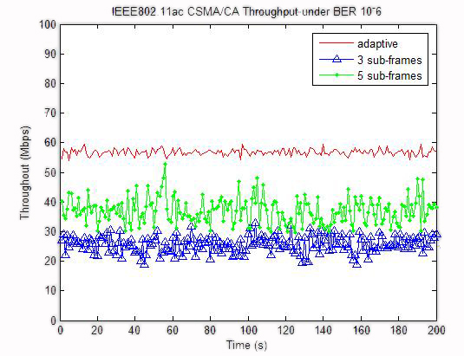
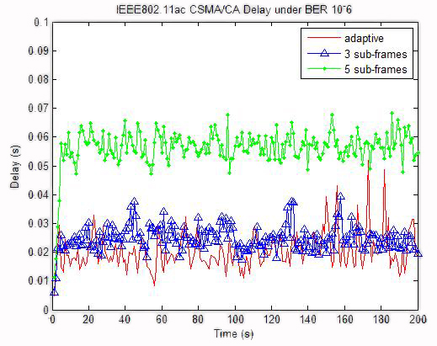
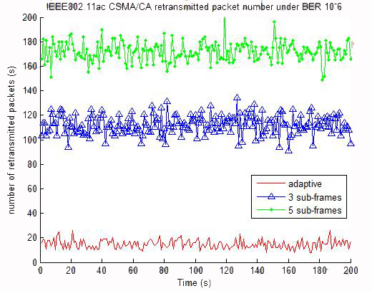
Performance Analysis -----results
Doc.: IEEE 11-14-0613-00-00ax
(a) Throughput
(b) Delay
(c) Retransmission number
System performance including throughput, delay and number of retransmission are illustrated above.
Red curve indicates the performance of adaptive frame size scheme. Compared to fixed number of sub-frames, it is clear that the performance of proposed scheme are significantly improved.

Slide 10
Summary
Doc.: IEEE 11-14-0613-00-00ax
Virtue of Self adaptive frame length scheme
Not much additional modification compared to IEEE 802.11 standards.
Adaptive to interference and environment change.
Clearly, adaptive scheme achieves higher throughput and better performance than non-adaptive scheme.
Next step
Work out an optimal set of parameters for self adaptive frame length scheme.
Calibrate the WLAN system performance with the adaptive frame length scheme for a number of simulation scenarios.

Slide 11
References
Doc.: IEEE 11-14-0613-00-00ax
[1] IEEE 802.11ac-2013, “Part 11: Wireless LAN Medium Access Control (MAC) and Physical Layer (PHY) Specifications--Amendment 4: Enhancements for Very High Throughput for Operation in Bands below 6 GHz,” 2013.
[2] IEEE 802.11ad-2012, “Part 11: Wireless LAN Medium Access Control (MAC) and Physical Layer (PHY) Specifications Amendment 3: Enhancements for Very High Throughput in the 60 GHz Band,” 2012.
[3] 11-14-0070-00-0hew-joint-mac-phy-evaluation-methodology.
[4] 11-13-0505-00-0hew-mac-efficiecy-analysis-for-hew-sg.

