Slide 1
Calibration Procedures towards Integrated System Level Simulation
Date: 2014-05-11

Slide 2
Abstract
This presentation discusses calibration procedures contributing to an integrated system level simulation, with emphasis on metrics and methods of each calibration box.
The presentation provides preliminary results of instantaneous SINR, PHY SLS and Integrated SLS of HEW scenarios to promote the calibration progress.

Slide 3
Background
Step-by-step calibration procedures of integrated system level simulation were discussed in [1, 2].
Six companies have validated Long-term SINR calibration [3] for HEW scenarios of residential, enterprise, indoor and outdoor defined in [4].
According to recent offline discussion on evaluation methodology, calibration procedures are recommended to be divided into several boxes:
Box 0 - PHY abstraction
Box 1 - Long term SINR calibration
Box 2 - Instantaneous SINR calibration
Box 3 - MAC SLS calibration
Box 4 - PHY SLS calibration
Box 5 - Integrated SLS calibration

Slide 4
Box 0: PHY Abstraction
In [5]~[8], several ESM based PHY abstraction methods were proposed to predict instantaneous PER, e.g. RBIR-CM/BICM, MMIB and capacity based ESM.
Considering the workload and difficulty to achieve consensus on a common PHY abstraction in a reasonable time period, and given that a common PHY abstraction method is not prerequisite so long as various PHY abstraction methods are sufficiently calibrated and validated, a generic PHY abstraction box 0 is warranted
Objective:
Ensure different PHY abstraction methods will provide similar PER prediction.
Method:
Compare the PER obtained from PHY abstraction methods and reference curves from link level simulation under same channel assumption.
Metric:
Opt 1: Effective SNR vs. PER (for all channel models)
Opt 2: Average SNR vs. PER (for each specific channel model)
In [5][6], RBIR was shown to provide a PER prediction with sufficient accuracy for integrated SLS.
The calibration of AWGN curves to be used as reference curves in ESM is a good starting point.

Slide 5
Box 1: Long Term SINR/SNR Calibration
Objective
Calibrate deployment, large scale fading/shadowing, station association
Method
No need to realize any channel access mechanism in this step
Several options were discussed on how to calculate the OBSS interference
Opt 1[9]: interference from all OBSS AP (DL only)
Opt 2[9]: interference from one randomly selected STA per OBSS (UL only)
Opt 3[9]: interference from one randomly selected STA or AP per OBSS (50/50 DL&UL)
Opt 4[2]: average interference over all nodes within each OBSS (i.e., every single interference term is weighted by one over the total number of nodes in that BSS.)
All communication links are considered in one calculation.
Six companies already achieved alignment with Opt 4 for all HEW scenarios. [3]
Metric
Separate DL/UL CDF of Long term SINR/SNR of each potential communication link

Slide 6
Box 2: Instantaneous SINR Calibration
Objective
Calibrate small scale fading channel of communication links and interference links
Method
Simple MAC is necessary to decide node to transmit.
Opt 1[9]: Dl only;
Opt 2[9]: UL only;
Opt 3[9]: 50/50 DL&UL;
Opt 4: CCA-only mechanism [10] with assumption of all nodes having the same channel access probability, which can be reused in the PHY SLS (i.e., box 4)
Opt 5[11]: EDCA need further calibration in MAC
Full buffer traffic
No need for MIMO calibration with MMSE receiver
1 Tx and 1 Rx are assumed; no antenna gain and cable loss
Metric
Opt 1: Separate CDF of DL/UL Instantaneous SINR/SNR per tone of all OFDM symbols
Offer all details for SINR distribution and can be reused by all effective SINR calculation
Opt 2: capacity based Effective SINR
There is no consensus on which effective SINR to use for PHY abstraction.

Slide 7
Simple MAC - CCA-Only
for drop = 1 : D
{
Drop STAs/APs and associate STAs with APs according to the deployment requirement defined by the scenario;
Assign each node (APs/STAs) an exclusive ordering_ID ∈ [1, N] where N is the total number of all network nodes;
for slot = 1 : S
{
All nodes are not activated at the beginning
Generate an N-element random array R(1:N) where R(n) ∈ [1, N];
for n = 1 : N
{ // Check whether the n-th node with ordering_ID =R(n) could be a transmitter ?
The n-th node is just the node R(n) ;
if (all BSSs have selected one and only one transmitter)
break;
elseif (the node R(n) has been activated passively as a receiver)
continue;
elseif (there is no activated transmitter in the BSS the node R(n) associated with)
The node R(n) checks its CCA status based on interference level from transmitter nodes that are already activated
if (CCA idle),
The node R(n) is activated as a transmitter;
if (the node R(n) is a STA),
its associated AP is also activated as the receiver;
if (the node R(n) is an AP),
one STA within the same BSS is randomly activated as the receiver;
elseif (CCA busy)
continue;
else
continue;
}
Instantaneous SINR for STAs (downlink) and APs (uplink) is collected based on current-slot Tx-Rx profile
}
}
Generate CDF of instantaneous SINR collected over multiple drops
A fixed CCA threshold for all nodes (e.g., -82dBm)
In each drop, assign each node (AP or STA) an exclusive sequence number from 1 to N (where N is the total number of all nodes)
Slot-by-slot simulation
- At the start of each slot, generate N different random numbers within [1, N]
Select a node one-by-one from the random number array. A transmitter is selected only if the CCA is idle at this node. Only single node-pair transmission is allowed in each BSS
SINR is computed at the active receiving nodes once the transmission node has been selected.

Slide 8
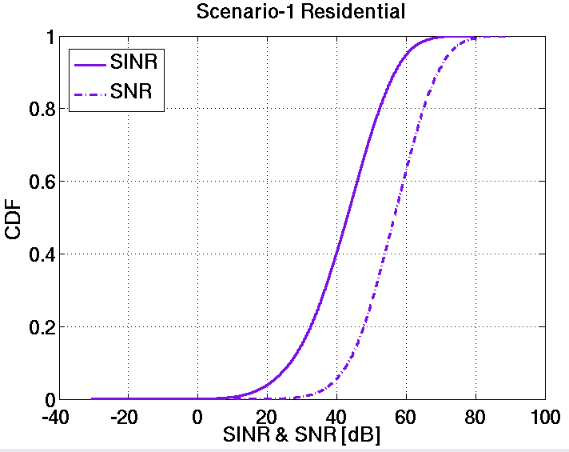
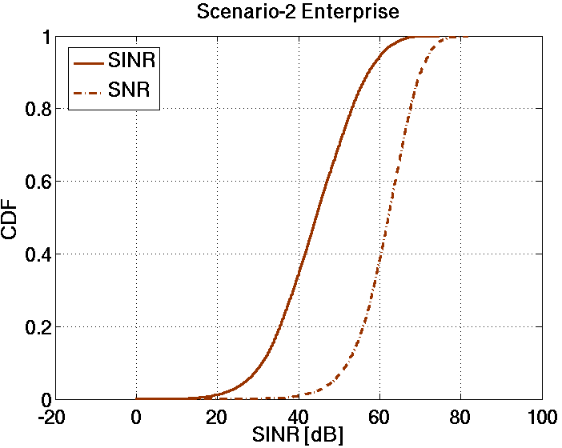
Box 2: Instantaneous SNR/SINR Calibration
These simulation results have been calibrated and validated with some other companies

Slide 9
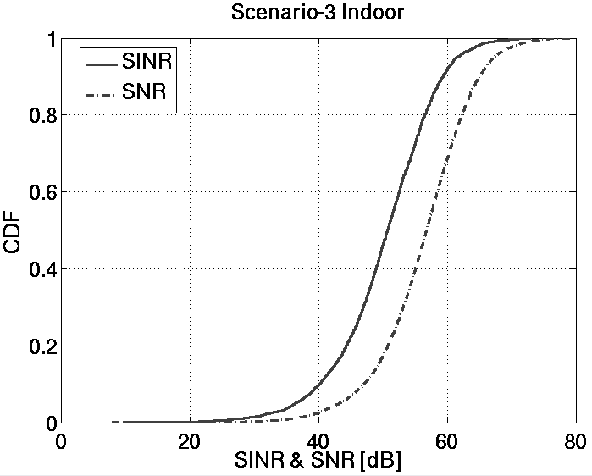
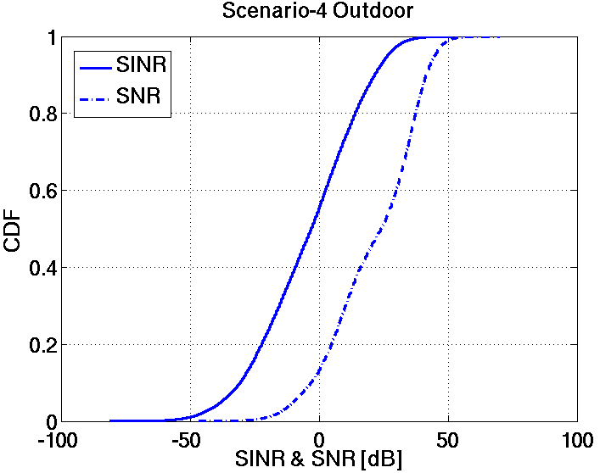
Box 2: Instantaneous SNR/SINR Calibration
These simulation results have been calibrated and validated with some other companies

Slide 10
Box 3: MAC SLS Calibration
Objective:
Calibrate the behavior of MAC functions
Method
Use simulation log to verify the protocol implementation of basic MAC features on point-to-point link;
Performance test in multiple STA scenarios
No need to include PHY features in MAC calibration because the results of other boxes, prior calibrated results can be reused.
Refer to our contribution for more details [12]

Slide 11
Box 4: PHY SLS Calibration
Objective
Provide accurate modeling of the PHY SLS using PHY abstraction and provide PHY SLS performance baseline
Metric:
CDF of per non-AP STA throughput
Assumption
Full buffer traffic;
Simple MAC mechanism, same as Box 2;
PHY abstraction (such as RBIR);
PHY features such as MIMO(e.g. 2x2 ), TxBF, link adaption and receiver algorithm (e.g MMSE)

Slide 12
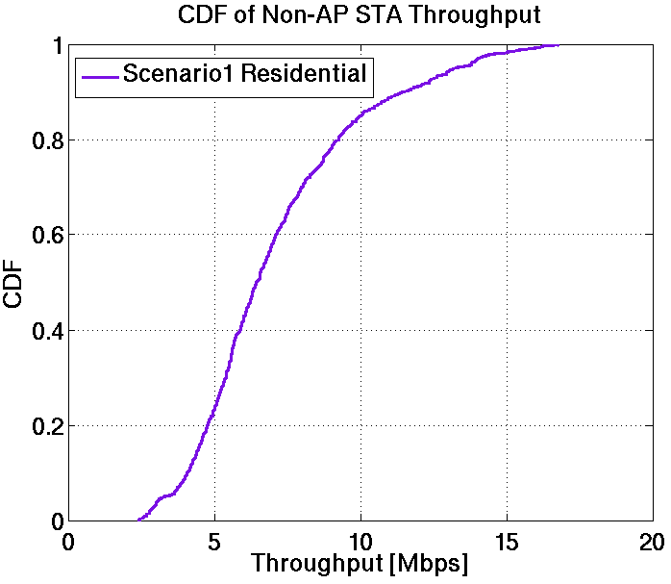
Box 4 : PHY SLS Calibration
PHY Assumptions
MIMO | 2x2 channel B
TxBF | Ideal CSI feedback, eigen vector beamforming with rank adaption
Receiver | MMSE
MCS selection | max goodput ensuring <10% PER
PHY-abs | RBIR
Time slot | 1ms
These simulation results have not been validated with other companies

Slide 13
Box 5: Integrated SLS Calibration
Objective
Calibrate full functions of system level simulation
Provide aligned 11ac performance baseline with both PHY and MAC
Metric
CDF of per non-AP STA throughput
Assumption
Use full buffer traffic for function tests
Use real traffic model, traffic mix and loading from the simulations scenarios document to obtain 11ac performance baseline.
Remarks
As we need to evaluate HEW techniques in each HEW scenario, a common baseline performance for each scenario is required.
Feature | Minimum List
MAC | CCA
 | Control frame (RTS/CTS/ACK/Block ACK)
 | EDCA
 | Aggregation (A-MPDU in 11ac)
 | Link Adaption
 | Transmission mode (SU-OL, Beamforming,…) selection
PHY | Beamforming vector
 | MMSE
 | Effective SINR Mapping and PER prediction
 | Energy detection

Slide 14
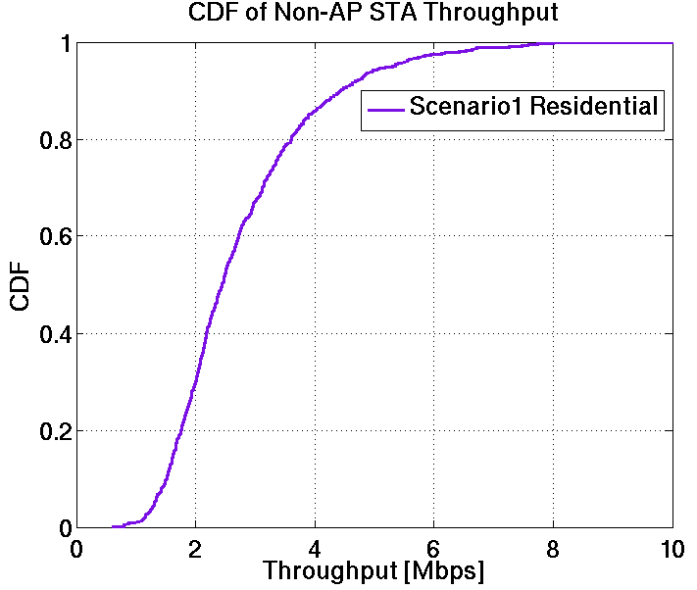
Box 5: Integrated SLS Calibration
MAC Assumptions
EDCA | on
Control frame | RTS/CTS/BA/AK
TXOP | AC_VI 3ms AC_VO 1.5ms AC_BE/AC_BK no limit
RTS threshold | 1000bytes
A-MPDU | Each MPDU 1500bytes Max 64 MPDU
Simulation time | 3s per drop
These simulation results have not been validated with other companies

Slide 15
Summary
The calibration procedures contributing to an integrated system level simulation are described
Some preliminary results on Instantaneous SINR, PHY SLS and Integrated SLS are shown.
For each box in the calibration procedures,
Companies can choose PHY abstraction method if its accuracy can be proven.
The assumptions of average interference seen from all nodes within each OBSS(opt 4) should be one of the metrics to calibrate long term SINR.
CDF of Instantaneous SINR per tone could be used to calibrate small scale fading channel assuming a simple MAC such as CCA-only.
MAC calibration should focus on MAC mechanism independent of any PHY features.
PHY SLS calibration provides a performance baseline of PHY only features.
Integrated SLS provides aligned 11ac performance baselines with both PHY and MAC features

Slide 16
References
[1] 11-13/1392r0 Methodology of calibrating system simulation results
[2] 11-14/0053r0 Further Considerations on Calibration of System Level Simulation
[3] 11-14/0336r0 Calibration of Long-Term SINR for System Simulator
[4] 11-13/1001r5 Simulation Scenarios Document Template
[5] 11-13/1131r0 PHY abstraction for HEW system level simulation
[6] 11-13/1390r0 PHY Abstraction for HEW System Level Simulation
[7] 11-13/1059r0 PHY abstraction for HEW evaluation methodology
[8] 11-13/1051r1 Evaluation Methodology
[9] 11-14/0307r0 PHY Calibration Results
[10] 11-13/1359r1 hew-evaluation-methodology
[11] 11-14/0335r0 Instantaneous SINR Calibration for System Simulation
[12] 11-14/0634r0 Consideration on MAC system calibration

Slide 17
Appendix-1 Basic Parameters for Calibration
Parameter |  | Value
 |  | Residential | Enterprise | Indoor | Outdoor
Central Frequency |  | 2.4 GHz | 2.4 GHz | 2.4 GHz | 2.4 GHz
Bandwidth |  | 20 MHz | 20 MHz | 20 MHz | 20 MHz
Channel Assignment |  | Random assignment of 3 non overlapping channels | chan = mod(BSS_index,4). That is, in each office, (ch1, ch2, ch3, ch4) and identical for each office. Ignore adjacent channel interference. | Frequency reuse 3 | Frequency reuse 1
Transmission Power | AP / STA | 23 dBm / 17 dBm | 24 dBm / 21 dBm | 17 dBm /15 dBm | 23 dBm /17 dBm
Antenna Configuration | Antenna type Antenna gain # of AP/STA antenna | omni-directional 0 dB {1, 2 (in Box4&5) } | omni-directional 0 dB {1, 2 (in Box4&5) } | omni-directional 0 dB {1, 2 (in Box4&5) } | omni-directional 0 dB {1, 2 (in Box4&5) }
Penetration Loss | Wall / Floor | 12 dB / 17 dB | 7 dB / N.A. | N.A. / N.A. | 100% outdoor
Noise Figure | AP / STA | 7 dB / 7 dB | 7 dB / 7 dB | 7 dB / 7 dB | 7 dB /7 dB
Channel Model | AP-AP AP-STA STA-STA | TGn Model B TGn Model B TGn Model B | TGn Model D TGn Model D TGn Model D | TGn Model D TGn Model D TGn Model B | ITU UMi ITU UMi ITU UMi
Antenna Height | AP STA | 1.5m 1.5m | 3m 2m | 1.5m 1.5m | 10m 1.5m
STA Number |  | 10 per apartment | 4 per cubicle | 30 per BSS | 50 per BSS (Box 1); 10 per BSS (Box 2,4,5)
AP-STA min distance (2D) |  | 1m | N.A. | 1m | 10m
Association |  | 100% STA associated to the AP in the same apartment | 100% STA associate with the strongest AP in the same office | 100% of STAs associate with the strongest AP | 100% of STAs associate with the strongest AP

Slide 18
Appendix-2 An Example of CCA-only Mechanism
No need to check the rest 6 nodes
e.g., N= 15, at one slot, R(1:15) = [5 2 11 13 8 12 3 4 7 6 1 10 15 14 9]
AP 11 is CCA idle and STA 12 is selected as receiver
There is no transmitter in BSS 1 and STA 5 is CCA idle
There has been one transmitter in BSS 1
There has been one transmitter in BSS 3
STA 8 is CCA busy
STA 12 has been selected as receiver
There has been one transmitter in BSS 1
There is no transmitter in BSS 2 and STA 7 is CCA idle
There has been one transmitter in BSS 1

