Slide 1
Next Generation 802.11ad:
30+ Gbps WLAN
Authors:
Name | Affiliation | Address | Phone | Email
Carlos Cordeiro | Intel |  |  | Carlos.Cordeiro@intel.com
SangHyun Chang | Samsung |  |  | s29.chang@samsung.com
Rob Sun | Huawei |  |  | Rob.Sun@huawei.com
Payam Torab | Broadcom |  |  | ptorab@broadcom.com
Rolf De Vegt | Qualcomm |  |  | rolfv@qca.qualcomm.com
Lei Huang | Panasonic |  |  | Lei.Huang@sg.panasonic.com
Gal Basson | Wilocity |  |  | Gal.Basson@wilocity.com
Brian Hart | Cisco |  |  | bhart@cisco.com
James Wang | MediaTek |  |  | James.wang@mediatek.com
Hongyuan Zhang | Marvell |  |  | hongyuan@marvell.com

Slide 2
Authors:
Name | Affiliation | Address | Phone | Email
Alexander Maltsev | Intel |  |  | Alexander.Maltsev@intel.com
Andrey Pudeyev | Intel |  |  | andrey.pudeyev@intel.com
Yan Xin | Huawei |  |  | Yan.Xin@huawei.com
Edward Au | Huawei |  |  | Edward.Au@huawei.com
Vinko Erceg | Broadcom |  |  | verceg@broadcom.com
Chiu Ngo | Samsung |  |  | chiu.ngo@samsung.com
Lei Wang | Marvell |  |  | leileiw@marvell.com
Mark Grodzinsky | Wilocity |  |  | Mark.Grodzinsky@wilocity.com

Slide 3
Motivation and purpose
Since the Nov/13 802.11 meeting, there have been several presentations promoting the creation of an 802.11 project to evolve 11ad for much higher rates
  13/1408r1, 14/114r0, 14/131r1, 14/136r3, etc.
In this presentation, we add to this by:
  Describing use cases that are driving the need to increase WLAN link speeds to the order of tens of Gbps (30+ Gbps)
  Demonstrating the technical feasibility of achieving this goal in the 60 GHz spectrum
On this basis, we propose the formation of a new 802.11 SG to create a PAR&CSD to evolve 802.11ad (DMG) to achieve significantly higher data rates

Slide 4
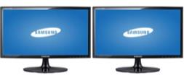








Application space
Connector free platform extension
Multi-gigabit cloud connectivity
& networking
High quality, low latency video
Device to Device collaboration

Slide 5



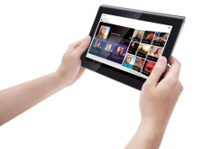
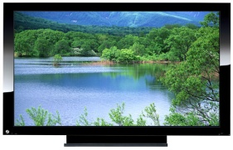
Example of driving applications (1): Mobile Devices
Based on [1], by the end of 2013 there existed about 1.4 billion smart phones and 420-million tablets used worldwide.
Mobile devices like smart phones and tablets may operate multiple functions (call, internet access, data transfer and/or video streaming etc.) simultaneously, some of which require very high data rate transmission.
Wi-Fi can offload data through the 60 GHz band and the 2.4/5 GHz bands.
Individual mobile users require good user experience with low mobility and/or a change of gesture.
Wi-Fi Offloading
Cellular
Offloading (60GHz)
Offloading (2.4/5GHz)
Mobile Display
3D, HD
Uncompressed video

Slide 6
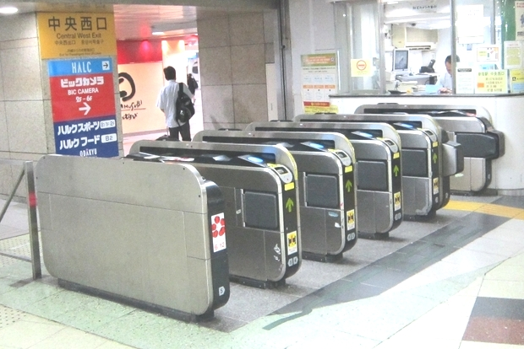





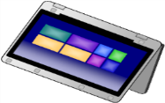

Example of driving applications (2): High speed download service
Very short range (TX/RX separation up to 10cm)
Huge content sync with “touch and go” usage (short connection times)
  CD (700 MB): 0.2sec@30Gbps
  2-hour Movie (3.6GB): 0.6sec@50Gbps
at Train Station
front of Digital KIOSK
Ad video, Drama,
Movie etc.
Book, Magazine, Newspaper
Music, Video etc.

Slide 7

Example of driving applications (3): AR and VR
Augment Reality (AR) and Virtual Reality (VR) are touting close-to- reality user experience with 3D video and 7.1 audio.
  The wearable device is subject to low mobility movement (Neck roll, pitch, yaw, etc)
  The video quality can support up to 3D 4K
  The operating environment is usually indoor within a range of 10ft
Features | Requirements | Notes
Distance | 10ft | Commercial products can support up to 7ft Wireless HD
Video Quality | 3D 4K* | HDMI 2.0
Range of Motion | Neck Roll** | 0.17 (s/60deg)
 | Neck Pitch** | 0.14(s/60deg)
 | Neck Yaw** | 0.13 (s/60deg)
* The projected resolution is based on 2013 CES.
**http://www.wpi.edu/Pubs/ETD/Available/etd-050112-072212/unrestricted/Fitzpatrick.pdf
Note: Serve Moto Speeds Obtained from output Link speeds

Slide 8
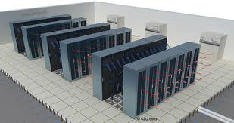
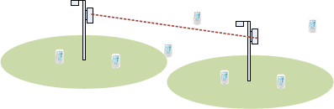
Example of driving applications (4)
Cable replacement, docking
Data center, enterprise
Interface | Version | Approx. max. data rate (Gbps)
DisplayPort | 1.0-1.1 | 8.6
 | 1.2 | 17.3
HDMI | 1.0-1.2a | 5
 | 1.3-1.4a | 10.2
 | 2.0 | 18
USB | 2.0 | 0.48
 | 3.0 | 5
 | 3.1 | 10
Thunderbolt | 1.0 | 10
 | 2.0 | 20
NLOS with reduced reflection loss
Storage area network
Data rates in the order of tens of Gbps
Wireless backhaul, offloading
Docking involves a combination of display and IO, which could lead to data rates well over 10 Gbps
Multi-Gbps throughput at long range (200-500m)

Slide 9

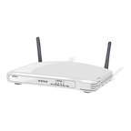
Example of driving applications (5): In-Flight/Train/Ship/Bus entertainment
APs are located in ceilings and seats
Passengers interact with AP through touch screens in front of them or wireless controllers
Video streaming, video gaming, audio, etc.
TFT touchscreen
TFT touchscreen
TFT touchscreen
TFT touchscreen

Slide 10
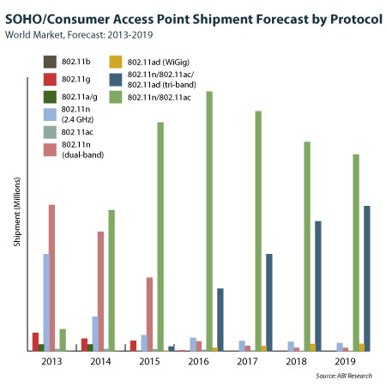
Related market trend: tri-band Wi-Fi
Tri-band Wi-Fi is inevitable: 11ad is just the start!

Slide 11
What does 11ad offer?
11ad
PHY data rate
Channelization
SC: 4.6 Gbps
OFDM: 6.7 Gbps
Beamforming
Supports multiple antennas, one at a time
Single stream
Supports channel feedback
Each channel is 2.16 GHz
No channel bonding
Channel access
Transmissions are directional, receptions can be directional or quasi-omni
All transmissions use the same channelization
Need to evolve both the DMG PHY and MAC to support envisioned applications

Slide 12
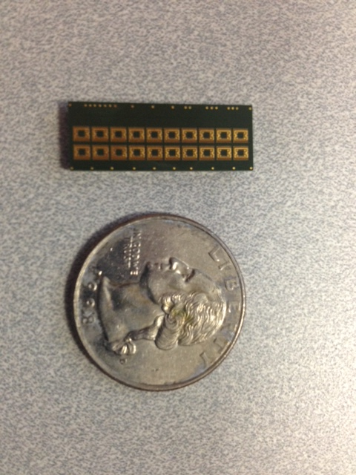
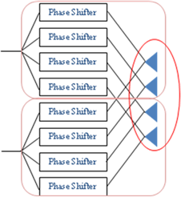
Support of MIMO (> 1 stream) modes
802.11ad antenna:
16 element array
3D beamforming
It is possible, for example, to create a MIMO system by combining multiple RF signals in one BB through a hybrid beamforming scheme (see figure on the left)
  Relatively simple modification to 11ad to support multi-stream
  Could also be with a single array
MIMO with existing
antenna architecture
MIMO with new
antenna architecture

Slide 13
An example: Hybrid beamforming
Hybrid beamforming consists of two stages: Coarse (RF) and Fine (BB) beamforming
  Coarse beamforming: sector sweep in
  RF to establish one or several independent
  links (rays) between TX and RX
  antennas
  Fine beamforming: optimal weighting
  done in BB in accordance with
  given criterion
Set of channels after coarse beamforming between different TX-RX beams may be treated as a virtual MIMO channel, and well-known MIMO techniques can be applied to those channels

Slide 14
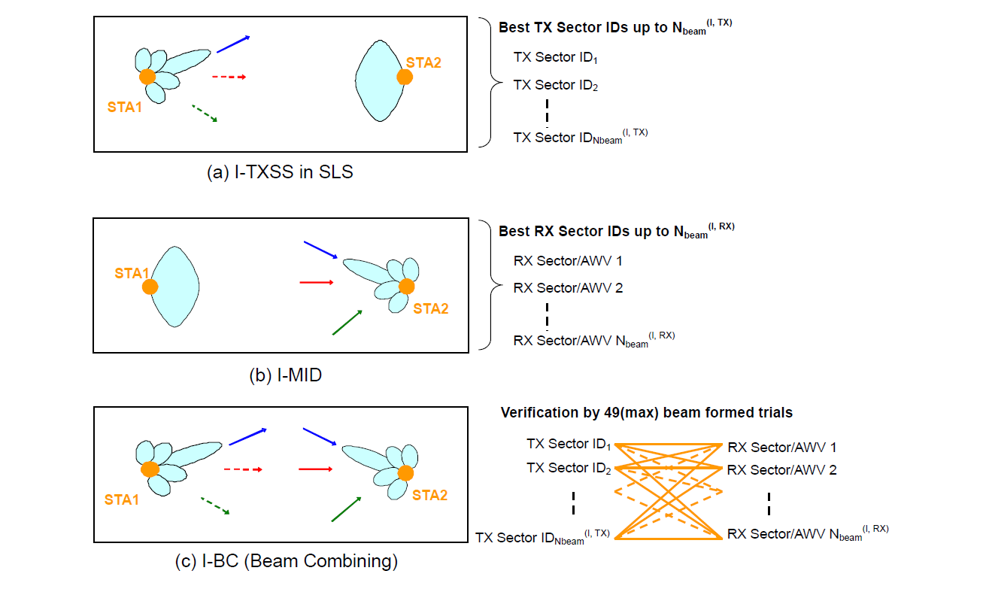
Hybrid beamforming: Coarse beamforming
Coarse beamforming can be implemented on top of 11ad
Different criteria may be used for ray set selection. Examples:
  Rays should provide highest signal power or SINR at the RX side
  Rays should be mutually uncorrelated, for example, they should come from different directions or be reflected from different objects
  Number of selected pairs should be equal to (or more) than the minimal number of TX and RX chains

Slide 15
Hybrid beamforming: Fine beamforming
Rays created during coarse beamforming are used to compose virtual MIMO channel matrix H
Could limit the max rank of the virtual MIMO channel to, say, 2
Optimal MIMO modes are selected to maximize the total throughput or robustness

Slide 16
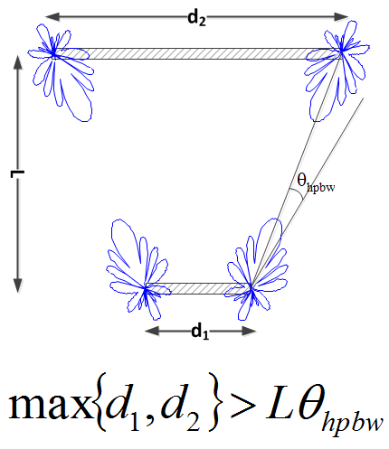
Hybrid beamforming applications
LOS MIMO mode
  Spatial separation of antenna signals is available for large coverage area
  Signal separation may be improved by using cross-polarized antenna arrays
High throughput mode (>=2 streams)
  Throughput increase by simultaneous usage of several spatial streams for data transmission
  Spatial streams created by independent paths/reflected rays
High reliability mode (1 stream)
  Used in cases when ray blockage probability is high/unacceptable from a QoS point of view
  Space-Time, Space-Frequency Block Coding may be used
reflector
Beam-forming
Link 2
2x8 antenna
array
2Tx
Null-forming
2Rx
Link 1

Slide 17
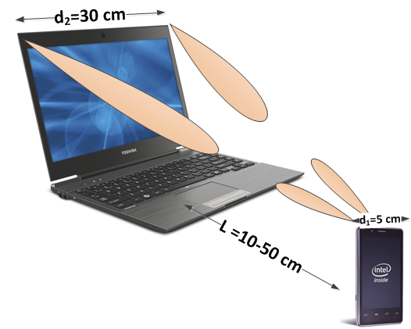
LOS MIMO performance evaluation
Simulated a “Sync and Go” scenario (see figure)
Parameter configuration:
Parameter | Value
Carrier frequency, F_{c} | 60 GHz
TX power per antenna | 0 dBm
Antenna element | Quasi-omni, 5 dBi gain
Antenna array | [1x4, 2x8] elements
Antenna array gain | [10, 15] dBi
RX thermal noise in band, P_{noise} | -70 dBm
Noise figure | 15 dB
TX antenna distance | 30 cm
RX antenna distance | 5 cm
MIMO mode | 2x2

Slide 18
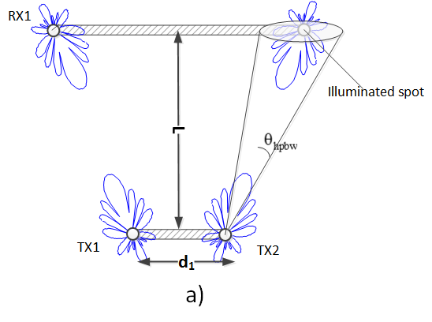
LOS MIMO signal processing schemes
Three signal processing schemes are evaluated
Spatial separation
  Antennas places separately so the illumination spot from one TX antenna will cover only one RX antenna
  Good performance at distances where nulls are set into the opposing antenna direction
Polarization separation
  Cross-polarized antennas used at the TX and RX to create separated signal streams
Hybrid RF-BB processing (beamforming)
  Coarse RF antenna beamsteering to maximize the SNR
  Fine BB interference mitigation to maximize SINR

Slide 19
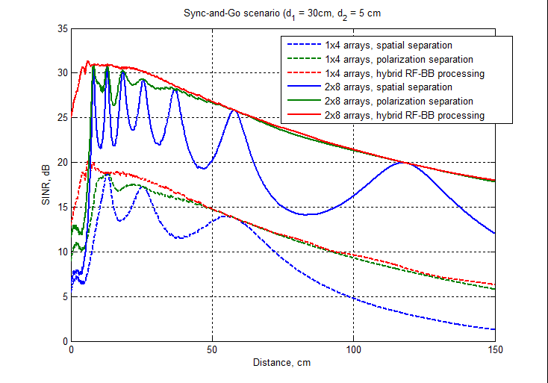
LOS MIMO evaluation: SINR
Orthogonal polarization of adjacent antennas provides substantial performance improvement over spatial separation, especially for large distances.
Simple spatial separation shows acceptable performance in close range

Slide 20
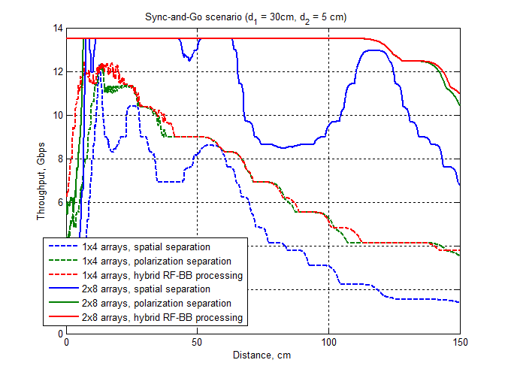
LOS MIMO evaluation: Throughput
Even very small antenna arrays (1x4 elements) can provide over 10 Gbps throughput at close range
2x8 antenna arrays can double the data rate at 1m distance for only a 0 dBm TX power!

Slide 21
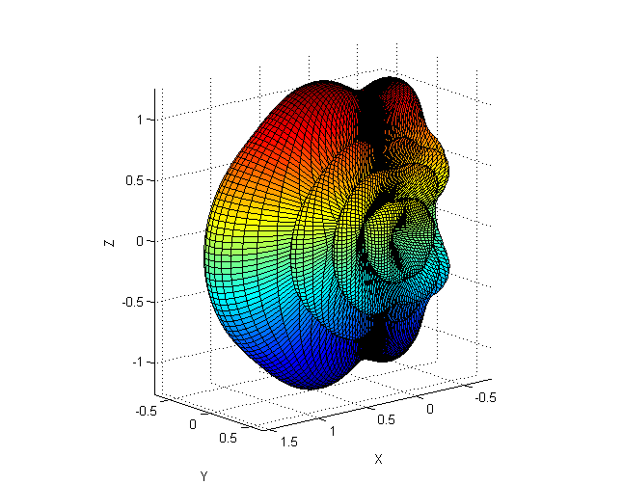
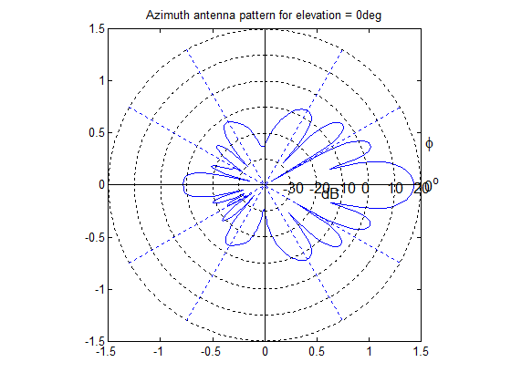
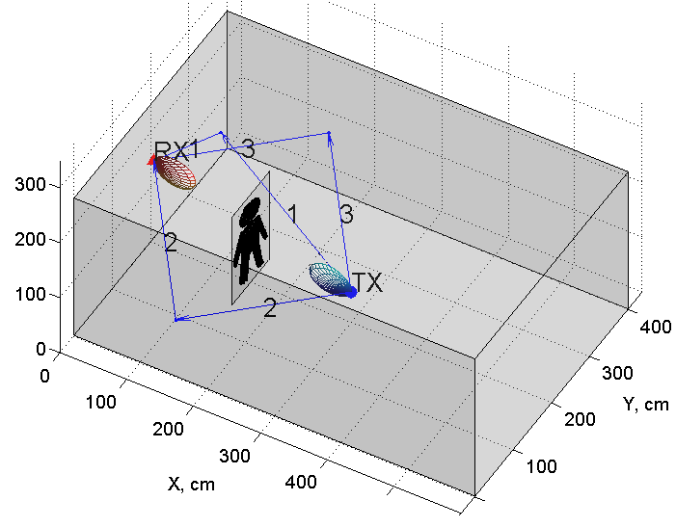
NLOS MIMO: High throughput and high reliability modes performance evaluation
Simulations were performed with ray-tracing
Simulation scenario (see figure):
  Living room environment (6x4x2.5m)
  Receiver (e.g., TV) is on the wall; transmitter (video player) is in the room
  Direct path from TX to RX is blocked by a person
Antenna setup
  2x8 phased antenna arrays; 10dBm TX power; 17dBi antenna gain

Slide 22
MIMO modes evaluated
Closed-Loop (CL) MIMO
  SVD fine subcarrier-wise beamforming
Open-Loop (OL) MIMO/STBC, optimal selection from:
  2x2 OL MIMO (two streams, double rate)
  2x2 Alamouti space-time coding scheme
Results are compared against 11ad, which is used as a benchmark
11ad OFDM PHY is employed

Slide 23
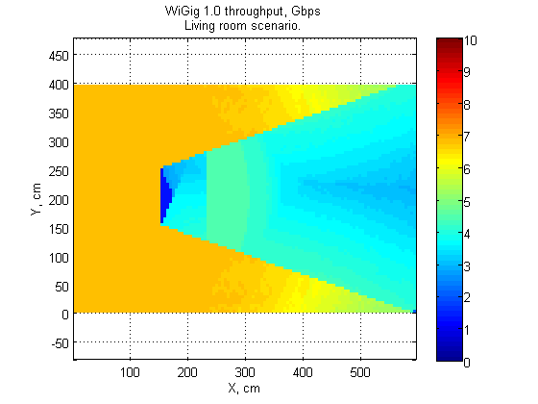
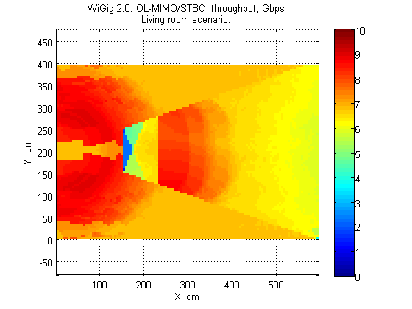
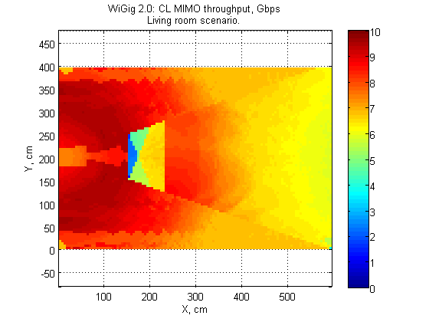
NLOS MIMO: 2D throughput distributions
Base 11ad throughput (Gbps)
OL-MIMO/STBC throughput (Gbps)
CL-MIMO throughput (Gbps)
11ad encounters severe degradation when switching from direct ray to the reflected ray
STBC/OL have almost the same performance as optimal CL-MIMO
Even in the shadow zone, CL MIMO can provide high throughput
Both CL and OL MIMO modes demonstrate almost the same throughput in the shadow zone
CL MIMO outperforms OL in LOS environment, where both rays (LOS and reflected) are very strong

Slide 24
Channel bonding: additional throughput multiplication
The use of channel bonding can increase the achievable throughput linearly with the number of bonded channels
Some existing 60 GHz RFs are already wide enough to support 4 channels
Practical ADC/DAC implementations possible [2]
Simple changes to the 11ad PHY can enable channel bonding, but more work will be required on the MAC side to ensure coexistence
> 2x2 MIMO
Channel bonding
30+ Gbps WLAN

Slide 25
Summary
New applications are driving the need for tens of Gbps WLANs. The 60 GHz band can meet this demand!
Extending 11ad for >2x2 MIMO (>1 stream) and channel bonding can enable 30+ Gbps WLANs
  Feasible with today’s technologies
We propose that 802.11 WG members consider starting a new project in this area

Slide 26
Next steps
It is our expectation that a motion to form a study group associated with this subject will be brought to this week’s mid-week or closing 802.11 plenary

Slide 27
References
http://www.businessinsider.com/smartphone-and-tablet-penetration-2013-10
https://mentor.ieee.org/802.11/dcn/13/11-13-1408-01-0wng-beyond-802-11ad-ultra-high-capacity-and-tpt-wlan.pptx

Slide 28
Backup

Slide 29
Tri-band Wi-Fi Value = Capacity
Connected Devices
Per Device Usage Growth
Mobile Data Traffic Offloaded
  2012 – 2017 CAGR
46%
CAGR: 24%
  Number of Devices (B)
  Exabytes per month
Substantial Growth in Connected Devices
Massive Growth in Demand per Node
Majority on Wi-Fi
mmWave adds capacity due to
bandwidth and spatial separation.
11ad is just a start
Sources: Gartner, 2013; Cisco VNI Mobile Forecast, 2013

