Slide 1
Uplink multi-user MAC protocol for 11ax
Date: 2014-05-11
Authors:
Name | Affiliations | Address | Phone | Email
Tran Thi Thao Nguyen | Kyushu Institute of Technology | 〒820-8502 Kawazu 680-4, Iizuka City, Fukuoka Japan | +81-948-29-7692 | nguyen@dsp.cse.kyutech.ac.jp
Leonardo Lanante | Kyushu Institute of Technology | 〒820-8502 Kawazu 680-4, Iizuka City, Fukuoka Japan | +81-948-29-7692 | leonardo@dsp.cse.kyutech.ac.jp
Hiroshi Ochi | Kyushu Institute of Technology | 〒820-8502 Kawazu 680-4, Iizuka City, Fukuoka Japan | +81-948-29-7692 | ochi@cse.kyutech.ac.jp
Tatsumi Uwai | Radrix co.ltd | 〒820-8502 Incubation Facilities, Kawazu 680-4, Iizuka City, Fukuoka Japan | +81-948-29-7937 | uwai@radrix.com
Yuhei Nagao | Radrix co.ltd | 〒820-8502 Incubation Facilities, Kawazu 680-4, Iizuka City, Fukuoka Japan | +81-948-29-7937 | nagao@radrix.com

Slide 2
Abstract
The support for Uplink multi-user (UL MU) for 802.11ax is currently unclear.
However, numerous studies have shown the benefit UL MU schemes in high-density environments.
This presentation aims to start the discussion to formally support UL MU in 802.11ax.
We also present a simple UL MU MAC Protocol to support our objective.

Slide 3
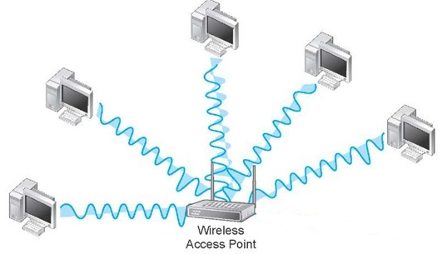
Background
In a highly dense Wireless LAN environment, many collisions occur reducing the total network throughput and possibly lead to congestive collapse.
Collision
Figure 1: Multi-user transmit their data to AP at the same time[1]

Slide 4
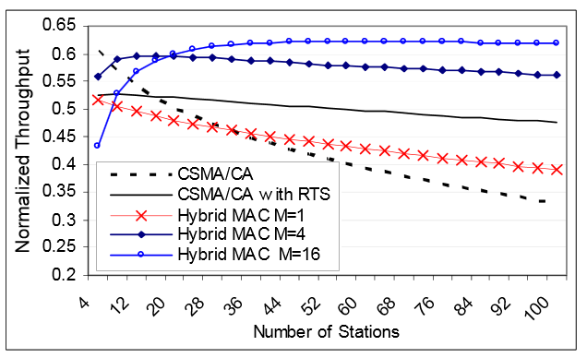
Background
Uplink Multi-user transmission reduces collision and hence the total throughput by allowing multiple transmission in a single TXOP. Multi-user transmission can be done in the frequency or spatial domain.
This figure is the result of combination of the OFDMA access and a CSMA scheme to improve efficiency.
By adjusting the number of sub-channels, as the number of stations grows → maintain a higher throughput than CSMA/CA based schemes.
M: Number of subchannels
Hybrid: OFDMA/CSMA
Figure 2: Benefit of UL MU (OFDMA) in frequency domain [2]

Slide 5
Uplink Multi-user Transmission
Definition
Users transmit their data to an AP at the same time. [3]
Type of uplink multi-user transmission
Type | Application
Frequency Domain Multiplexing (FDM) | OFDMA in a channel or in multiple channels such as LTE or WiMAX
Spatial Domain Multiplexing (SDM) | UL MU MIMO such as LTE
Code Domain Multiplexing (CDM) | UL feedback in cellular network such as 3G cellular E.g. IDMA, CDMA
Hybrid Multiplexing | E.g. Multicarrier-CDMA, OFDM-IDMA

Slide 6
UL MU MAC Protocol
The benefit of UL MU can be easily demonstrated by the figure below
However, the benefit of this scenario is limited because it is highly dependent on the transmitted DL frame.
DIFS+Backoff
SIFS
DIFS+Backoff
SIFS
DL MU frame
DL MU frame
AP
AP
User1
UL ACK
User1
UL ACK
User2
UL ACK
User2
UL ACK
User3
UL ACK
User3
UL ACK
User4
UL ACK
User4
UL ACK
Time
Time
Figure 3a: UL MU
Figure 3b: Conventional

Slide 7
UL MU MAC Protocol for general case
Data transmission opportunities are signaled by the AP.
STA inform the AP of transmission intent via a short request packet
AP schedules UL MU Traffic
UL MU Transmission
DIFS+Backoff
SIFS
SIFS
SIFS
SIFS
SIFS
SIFS
Sync
UL resource Scheduling info
AP
User1
Resource request
UL MU Frame
User2
Resource request
UL MU Frame
User3
Resource request
UL MU Frame
User4
Resource request
UL MU Frame
Time
Figure 4: An example of stand-alone UL data frame
- Many UL MU MAC protocol in literature follows this protocol [2][3]
In this protocol, the sequence is initiated by the AP similar to a point coordinator in PCF.
We refer to this as centralized UL MU

Slide 8
Our ideas
A UL MU MAC Protocol should be
Applicable to many scenarios to maximize its effect.
Initiated by a participating STA and not the AP.
Users that obtain TXOP should be able to send right away regardless of UL MU is used or not.
If UL MU is used, users with TXOP don’t have to wait for UL transmission timing. It means each users can initiate UL MU data frame transmission without any control from AP.
We call this kind of protocol as Distributed UL MU.
In contrast, in the case of Centralized UL MU protocol, frame transmission timing is always come from the AP.
Minimal overhead
Applicable in DCF/EDCA.

Slide 9
Environment scenario
BSS
Grouping concept here is the same as 11ac DL MU-MIMO grouping.
AP
Group1
User1
User2
User3
User7
User4
User5
User1
User2
11ax Users supporting UL MU belonging to Group 1
User6
User3
Group 2
User4
User5
11ax Users supporting UL MU belonging to Group 2
Figure 5: Environment scenario
User6
User7
Legacy device

Slide 10
Distributed UL MU frame transmission (Example)
Scenario 1 : UL MU permitted
- Transmission sequence -
BSS
BSS
AP
AP
Group1
Group1
RTS
User1
User1
G ACK
User2
G CTS
User2
User3
User7
User3
User7
User4
User4
User5
BSS
User5
User6
User6
Group 2
AP
Group 2
Group1
Figure 6a: RTS and Group-CTS exchange
User1
UL MU Frame
Figure 6c: Group-ACK transmission
User2
User3
User7
User4
User5
User6
Group 2
Figure 6b: UL MU Frame transmission

Slide 11
Distributed UL MU frame transmission (Example)
Scenario 1 : UL MU permitted
- Timing Diagram -
DIFS+Backoff
SIFS
SIFS
SIFS
DIFS+Backoff
G CTS
G ACK
AP
GID1 User1
UL MU Frame
GID1 User2
RTS
UL MU Frame
GID1 User3
UL MU Frame
Time
・
・
・
Figure 7: An example of Distributed UL MU frame transmission
GID1
Group 1
G CTS
CTS frame with Group ID for UL
G ACK
ACK frame with Group ID for UL MU Frame

Slide 12
Distributed UL MU frame transmission (Example)
Scenario 2 : UL MU not permitted
- Transmission sequence -
BSS
BSS
AP
AP
Group1
Group1
RTS
User1
User1
ACK
User2
CTS
User2
User3
User7
User3
User7
User4
User4
User5
BSS
User5
User6
User6
Group 2
AP
Group 2
Group1
Figure 8a: RTS and CTS exchange
User1
UL Frame
Figure 8c: ACK transmission
User2
User3
User7
User4
User5
User6
Group 2
Figure 8b: UL Frame transmission

Slide 13
Distributed UL MU frame transmission (Example)
Backward compatibility
When any legacy device use RTS, the 11ax AP will always send normal CTS for backward compatibility. Hence, a normal RTS/CTS frame exchange will occur.
When any legacy device hear a distributed UL MU sequence, it will be as if a normal RTS/CTS frame exchange has occurred.

Slide 14
Summary
 | Centralized | Distributed
Advantages | “Guarantees” latency. Might have better theoretical performance benefit than distributed. | Low overhead Symmetric with current 802.11ac DL MU scheme.
Disadvantages | High overhead Neighbor BSSes operating in the same mode will hinder performance. | Effect is dependent on whether users within the same group have the same traffic characteristics.

Slide 15
New frame type definition
The function same as 11ac CTS or ACK, but is for a Group.
G CTS frame ( Same control frame Subtype as CTS)
Frame
Control
Duration
Duration
RA
RA
FCS
b0 - b5
b6 – b47
Indication of group ID
Predefine pattern
Duration
Used to differentiate between CTS and G CTS
G ACK frame
Frame
Control
Duration
Duration
RA
RA
Group-ACK Bitmap
FCS
FCS
New control frame Subtype

Slide 16
Conclusion and Future Work
We show a UL MU MAC Protocol which has low overhead and easily applicable in frequency domain or spatial domain UL MU.
We plan to show MAC simulation results of the proposed scheme in a future contribution.

Slide 17
Straw Poll
Do you agree that TGax should support a mode of uplink multi-user transmission ?
Yes
No
Abstain

Slide 18
Straw Poll
Do you agree that any proposal for uplink multi-user transmission protocol for TGax should be a distributed type of protocol ?
Yes
No
Abstain

Slide 19
References
[1] “WLAN components (Data Communications and Networking), what-when-how In Depth Tutorials and Information”, http://what-when-how.com/data-communications-and-networking/wlan-components-data-communications-and-networking/
[2] Yaser Pourmohammadi Fallah, Salman Khan, Panos Nasiopoulos, Hussein Alnuweiri, “Hybrid OFDMA/CSMA Based Medium Access Control for Next-Generation Wireless LANs”, IEEE Communications Society ICC 2008
[3] Jinyoung Chun, Wookbong Lee, “Uplink multi-user transmission”, 11-13/1388r0, LG Electronics

