Slide 1
PHY Abstractions Types For HEW System Level Simulations
Date: 2014-04-08
Authors:

Slide 2
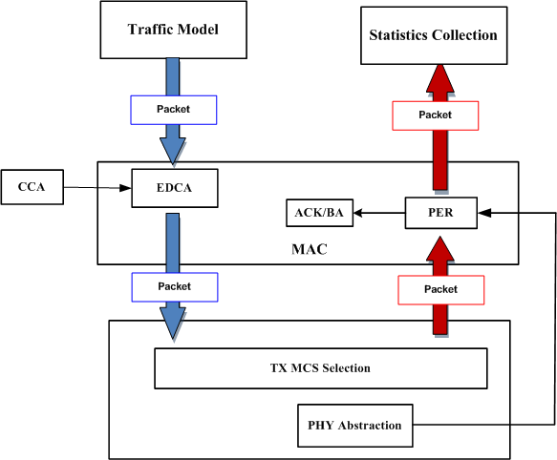
HEW System Level Simulation

Slide 3
Two Types of PHY Abstraction
Type I
In [2][3], it is named as long-term SINR
Simple: mainly for MAC protocols that does not affected by frequency-domain per tone SINRs
Option 1: path loss and AWGN channel
Option 2: path loss and different channel types
Type II
In [1][2], it is called instantaneous SINR or short-term SINR
Requires FFT and complicated effective SNR calculation for each channel generation, or each packet
Think about a simulation scenario with 1000 STAs, there are about100000 FFTs
Should be used only when per tone SINR or combinations of per tone SINRs are required

Slide 4
Type I PHY abstractions
For Type I abstraction, only time-domain SNR should be used based on path loss
In this case, the effective SINR is Average SINR over all subcarriers and spatial streams
For Average SINR, it is natural that SINR-PER mapping table share channel dependent
This is because of the slopes of PER-SNR curve are dramatically different for different channels
For each pre-defined Tgn/ac/ax outdoor channels, there exists one PER-SINR table
For any channels that are not those pre-defined channel types, Type II abstractions should be used.

Slide 5
Type II PHY Abstractions Procedure
Two steps for PHY abstractions
Effective SINR Modeling (ESM)
Mapping to PER (Parameter adjustment)
Three different ESM schemes have been proposed
RBIR method [1][2]: Mandatory ESM in 802.16
Mean Mutual Information per Bit (MMIB) ESM [4]: Optional ESM in 802.16
Capacity ESM [3].
Criterion of ESM
Accuracy, Integration complexity and channel/BW independent

Slide 6
Type II PHY Abstractions
ESM should not be correlated with channel types
Pre-defined tables for different channels is not a viable solution because in a lot of scenarios, there is no pre-defined channels, i.e., beamformed channels, OFDMA.
RBIR and MMIB methods shown little correlation with channels [5][6]
ESM Accuracy
PER v.s. effective SNR simulations for different channels and bandwidths show that RBIR and MMIB method is pretty accurate [5-7]
RBIR and MMIB methods have similar accuracy [5-7]
All methods has limited accuracy for a instantaneous realization[5]
Implementation complexity
RBIR and MMIB needs minimal number of look-up tables
Complexity mainly comes from FFT and frequency domain processing

Slide 7
Channel Variations and Interferences
Type I PHY abstractions can be used to simulate static scenarios
Type II PHY abstractions can be used to simulate dynamic scenarios
For each channel realization (channel variations are treated as new channel realizations), frequency domain processing is required to calculate effective SINR
To reduce the complexity, we can choose to whiten small interferences (treat those small interferences as noise floor) and only do frequency domain processing on large interferences (treat large interferences per tone basis)

Slide 8
Conclusions
Propose to have two Types of PHY abstractions
Type I PHY abstractions only use time-domain SINR for pre-defined Tgn/ac/outdoor channel types
Type II PHY abstractions should be chosen among using RBIR or MMIB methods
Channel variations and Interferences
Using Type II PHY abstractions, treat channel variation as new channel realization
Whitening the small interferences and treat large interferences per sub-carrier basis: threshold needs to be determined via simulations
More work can be considered if channel variations can be modeled in Effective SINR domain

Slide 9
Straw poll
Do you support to have two types of PHY abstraction described as follows
Type I PHY abstractions using time-domain SINR for pre-defined Tgn/ac/outdoor channel types
Type II PHY abstractions using RBIR or MMIB method
Y/N/A

Slide 10
Back Ups

Slide 11
On Effective SINR Calculation
Effective SINR is an average mapped equalizer-output SINR over all subcarriers and spatial streams.
ESM
[1][2] suggests using RBIR method
[3] suggest using capacity

Slide 12
Cont’s
[4] suggest Mean Mutual Information per Bit (MMIB) ESM
Modulation | Numerical Approximation
BPSK | K=1, a = [1], c = [2√2]
QPSK | K=1, a = [1], c = [2]
16-QAM | K=3, a = [0.5 0.25 0.25], c = [0.8 2.17 0.965]
64-QAM | K=3, a = [1/3 1/3 1/3], c = [1.47 0.529 0.366]
256-QAM | K=3, a = [0.6 0.36 0.04], c = [0.24 0.96 2.76]

Slide 13
Reference
[1] “PHY Abstraction for HEW System Level Simulation”, IEEE 802.11-13/1131r0, Zhang Jiayin, etc.
[2] “PHY Abstraction for HEW System Level Simulation”, IEEE 802.11-13/0117r0, Yakun Sun, etc.
[3] “HEW PHY Abstraction”, IEEE 802.11-14/0330r0, Sameer Vermani, etc.
[4] “Suggestion on PHY Abstraction for Evaluation Methodology ”, IEEE 802.11-14/0353r0, Dongguk Lim, etc.
[5] “PHY abstraction comparison”, IEEE 802.11-14/0647, Tianyu Wu, etc.
[6]”PHY Abstraction for TGax System Level Simulations”, IEEE 802.11-14/0527, Ron Murias , etc.
[7]” Further Discussions on PHY Abstraction” IEEE 802.11-14/0581, Yakun Sun, etc.

