Slide 1
A Backhaul Use Case for NG 11ad
Authors:
Date: 2014-05-13

Slide 2
Abstract
This contribution provides an overview of a Backhaul use case in support of a next generation (NG) Enhancements for Very High Throughput in the 60 GHz Band (11ad). Some supporting enabling technology is also reviewed.

Slide 3
Agenda
Introduction: Market need for small-cell backhaul
Requirements for small-cell backhaul
NG 802.11ad possible backhaul configuration and capabilities
Enabling Technologies
Conclusions

Slide 4
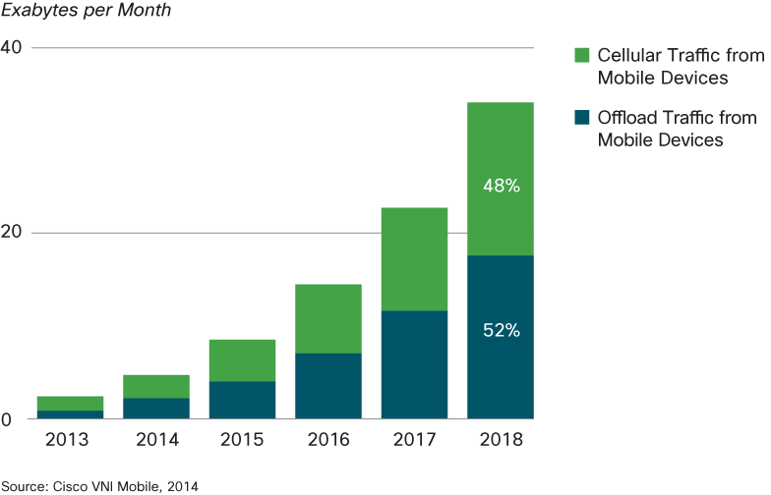
Introduction: Small Cells are Coming
The growth of demand for mobile device traffic is well documented and accelerating rapidly, a compound growth rate of 61% is predicted [1] (10.8x, in 5y, ~100x for 2010 to 2020)
To support this growth in data demand there must be growth in spectrum, spectrum efficiency, and density.
There is limited available growth in spectrum and spectrum efficiency available. Density offers the best path to growth [2].
Only Small Cells can provide the density growth needed.
Cisco Forecast of Mobile Device Traffic [1]

Slide 5
Small Cells Need: High Rate, Low Cost Backhaul
Low total cost of operation (TCO)
High capacity (~2Gbps peak per small-cell by 2020)
Small-footprint – Strict space and weight requirements for deployment on street furniture (zoning requirements)
Flexibility and quick installation by semi-skilled personnel
NG 802.11ad: Can Provide This Backhaul
Low-cost 802.11ad NG chipsets will allow for reuse of high volume consumer electronics investment, keeping cost low
  ABI Research: 1.5 billion WiGig devices by 2018
802.11ad NG can provide the high capacity required
High gain electrically steerable antennas will be available
  Enabling small antenna footprint
  Providing greater flexibility and longer range

Slide 6
To Achieve 100X Growth by 2020
We estimate:
~ 5X
more spectrum
x
~ 10X
spatial reuse
x
~ 2X
spectral efficiency
= 100X
Therefore we estimate per Small-cell backhaul needs to be:
Per Small-cell backhaul (2020) Mbps
 | Mean | Peak
U/L | 819 | 1471
D/L | 546 | 586
Total | 1365 | 2057
Extrapolated from: NGMN: “Guidelines for LTE Backhaul Traffic Estimation” [3], assuming 5x channels, 2x spectral efficiency improvement to 2X2, 20 MHz, cat 4 tri-cell w/IPsec.
NGMN recommendation for conservative lower Bound:
Backhaul for N cells = Max [peak + (N-1) x mean, N x mean]

Slide 7
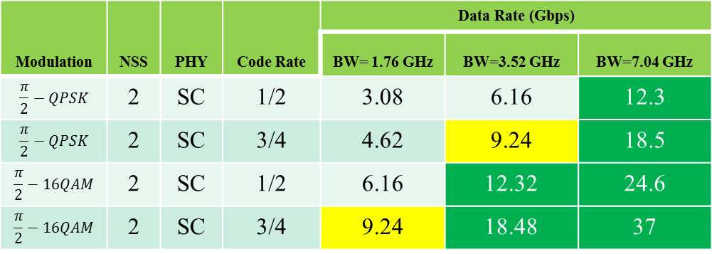
Requirements for small-cell backhaul (1)
Per-cell data rates require backhaul of ~1.4Gbps (mean 2020)
Assuming 5 small-cells are daisy-chained along a street, to reach an operator point of presence:
  The data rate requirement for an aggregation point is: ~7.5Gbps
Therefore to support data rates beyond 2020 and allow for growth
  A data rate requirement for an aggregation point of > 7.5Gbps should be supported.
Modulation | NSS | PHY | Code Rate | Data Rate (Gbps)
 |  |  |  | BW= 1.76 GHz | BW=3.52 GHz | BW=7.04 GHz
$$\frac{π}{2}−QPSK$$ | 2 | SC | 1/2 | 3.08 | 6.16 | 12.3
$$\frac{π}{2}−QPSK$$ | 2 | SC | 3/4 | 4.62 | 9.24 | 18.5
$$\frac{π}{2}−16QAM$$ | 2 | SC | 1/2 | 6.16 | 12.32 | 24.6
$$\frac{π}{2}−16QAM$$ | 2 | SC | 3/4 | 9.24 | 18.48 | 37
From [4]

Slide 8
Additional Requirements (2)
Typical small-cell ISD 100-200m
  From 500m dense macro ISD today to ~150m ISD (10x increase in density)
Link Reliability – Three 9’s

Slide 9
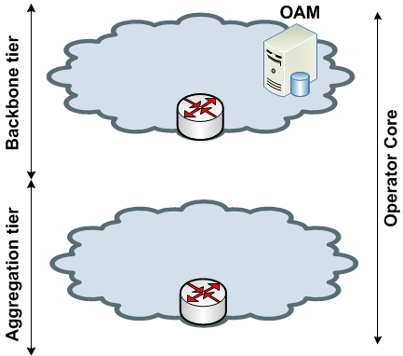




NG 802.11ad - Backhaul configuration
LMDS/E-band
FTTC
SmallCell
SmallCell
SmallCell
SmallCell
SmallCell
SmallCell
SmallCell
SmallCell
SmallCell
SmallCell
SmallCell

Slide 10
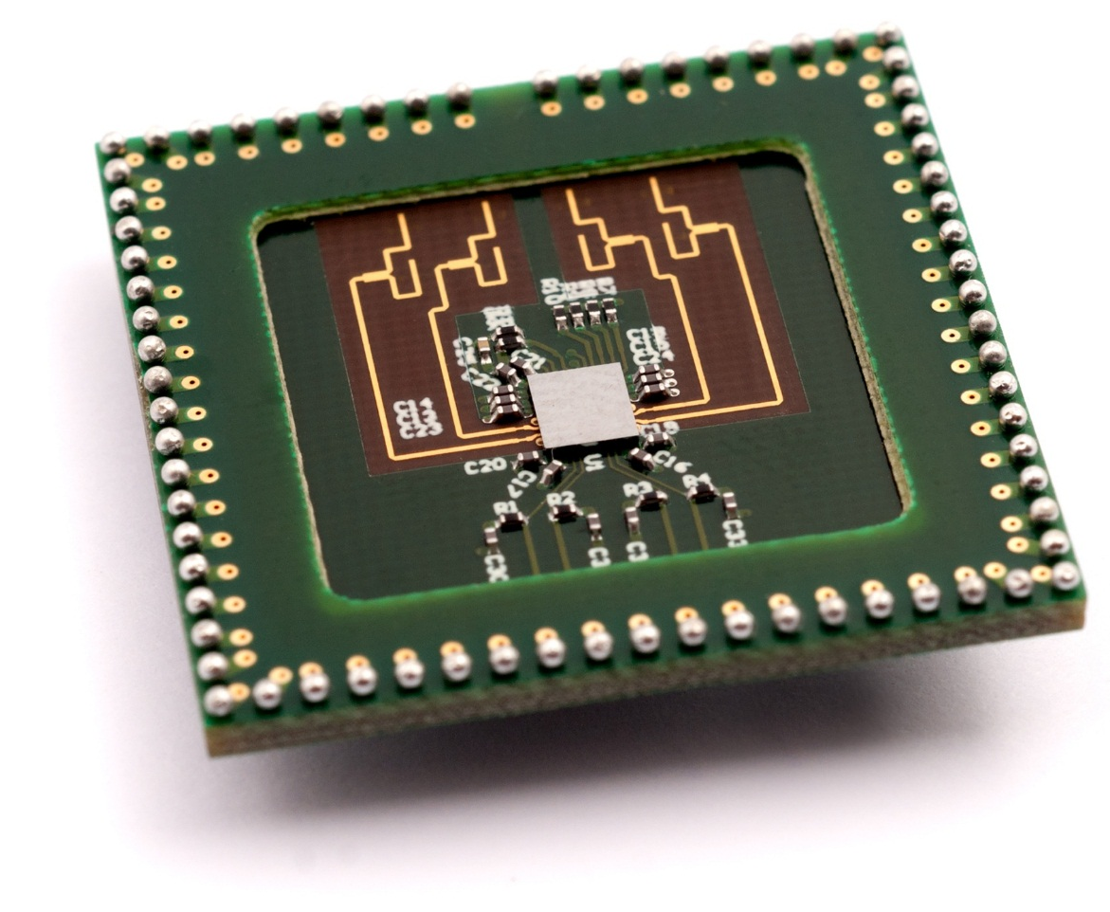
Phased-array module
  4-antenna path single-chip transceiver
  Demonstrated with external
  PHY/MAC baseband chip
  40nm LP CMOS
  Supports QPSK and QAM16 up to MCS12 (4.62Gbps)
  Current prototype with 4 antenna’s scaled up to achieve larger range!
  Chip currently redesigned for 2x2 MIMO+beamforming in
  28nm HPM CMOS
Technology is ready for large beamforming arrays

Slide 11
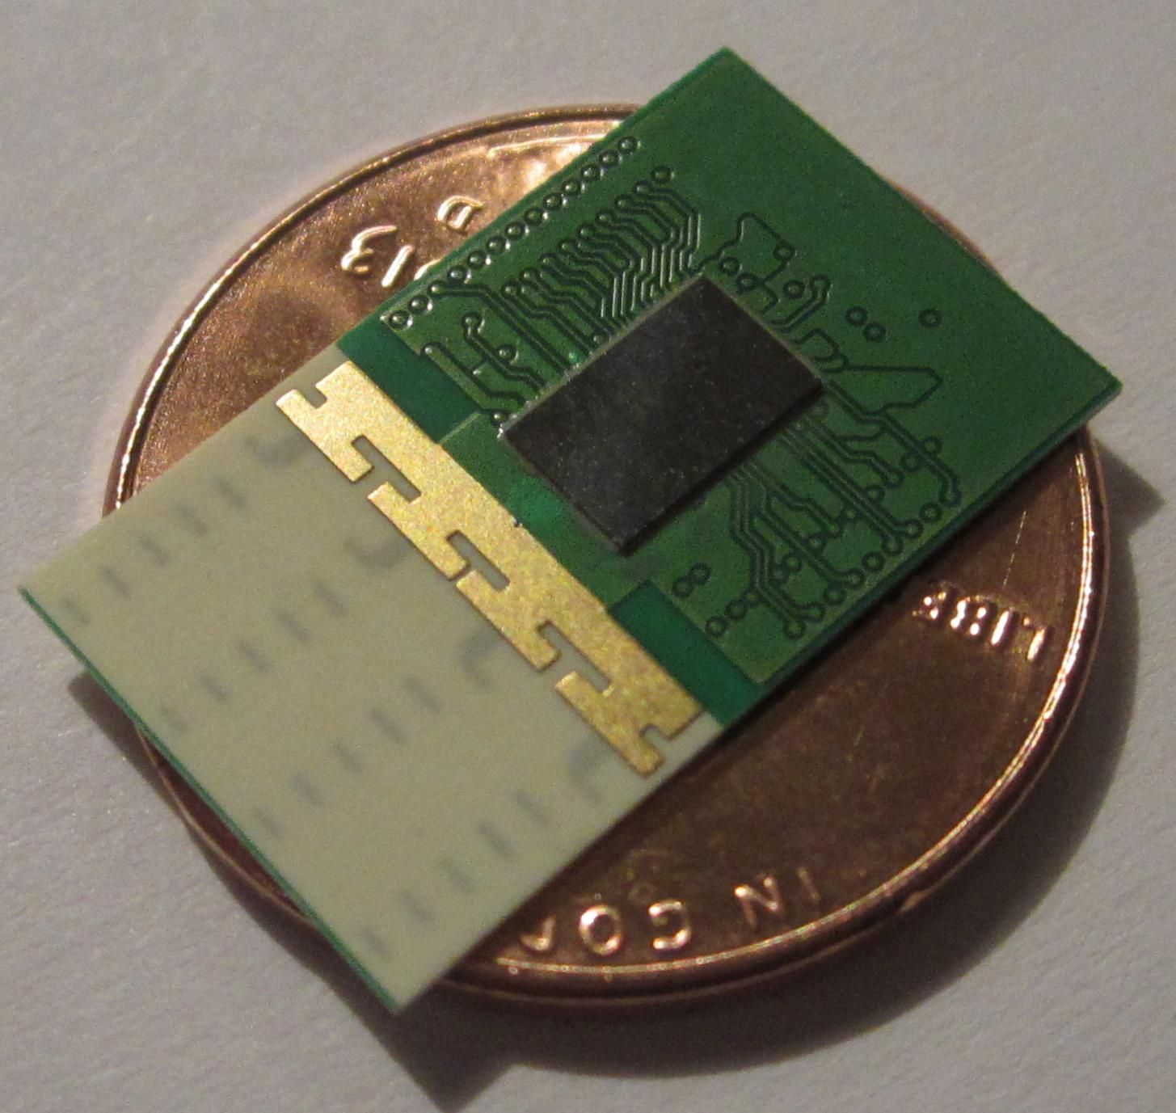
MAC/PHY Module
4 Antennas
High rate – 2.5 Gb/s
250 mW peak power
Contains both PHY and MAC

Slide 12
Conclusions
As the need for wireless data grows, small cells will provide a means to increase capacity in dense environments
Low cost and high performance wireless backhaul technology is required to support the growth of small cells
NG 802.11ad will enable data rate growth to support the future required data rates required for small cell deployments.

Slide 13
References
[1] Cisco Visual Networking Index: Global Mobile Data traffic Forecast Update, 2013-2018; Cisco; 5 February 2014
[2] The Myth of Spectrum Scarcity; Martin Cooper; March 2010
[3] Guidelines for LTE Backhaul Traffic Estimation; NGMN (next generation mobile networks) Alliance; 3 July 2011
[4]11-14/0136r2; Beyond 802.11ad – Ultra High Capacity and
Throughput WLAN 2nd presentation; Gal Basson (Wilocity), et al; January 2014

