Slide 1
Path Loss Model for Scenario 1
Date: 2014-05-13
Authors:

Slide 2
Overview
Originally specified (13/1001r3) 11nB channel model
  PL model: exponent 2 up to 5 m (breakpoint), exponent 3.5 beyond
14/0393r0 discussed possible indoor channel models for HEW
PL options in current simulation doc (14/1001r8)
  11n + walls & floors
  3GPP indoor femto
  WINNER II A1(room-to-room)

Slide 3
Desirable Attributes of PL Model
Explicit modeling of walls & floors
  Because STAs always associate to AP in same apartment (as opposed to strongest AP), we feel it is particularly important to capture the isolation provided by apartment walls/floors
Capture intra-apartment clutter and/or walls

Slide 4
PL Formulas
Model |  | PL exp | Walls | Floors | LA | Shadowing
11nD with walls/floors |  | 2/3.5 before/after 10m | 5*W | 18.3*(F^((F+2)/(F+1)-0.46) |  | 3/4 dB before/after 10m
3GPP indoor femto dual strip | As proposed for 11ax | 2 | 5*W | 18.3*(F^((F+2)/(F+1)-0.46) | .5 * d | 4/8 dB inside/outside room
 | 36.814 | 2 | 5*W | 18.3*(F^((F+2)/(F+1)-0.46) | .7 * d | 4/8 dB inside/outside room
 | QCOM proposal to 3GPP [5] | 2 | 5*W | 18.3*(F^((F+2)/(F+1)-0.46) | .3 * d | 4/8 dB inside/outside room
WINNER II A1, room-to-room through wall |  | 2 | 5*W/12*W for light/heavy | 17*(F>0) + 4*(F-1)*(F>1)
COST 231 MWM |  | 2 | 3.4*W/6.9*W for light/heavy | 18.3*(F^((F+2)/(F+1)-0.46)
COST 231 LAM |  | 2 |  |  | 0.62 * d
Modified walls/floors under 11n to match values of 3GPP indoor femto

Slide 5
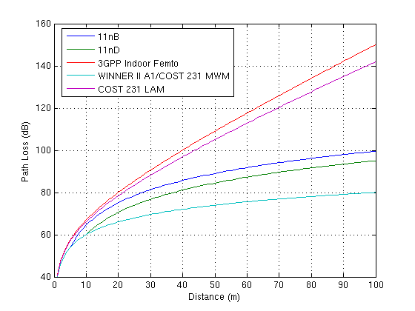
PL vs. distance (no walls/floors)
WINNER II/COST 231 MWM have considerably smaller PL than 11n, while 3GPP/COST 231 LAM have considerably larger PL than 11n

Slide 6
Discussion of Models
COST 231 MWM and WINNER II A1 have walls/floors and PL exp 2
  Appropriate for environment where walls & floors are only obstacles, but in scenario 1 we expect interior clutter and intra-apartment walls
  Whereas 11n model accounts for such clutter/intra-apartment walls via PL exp > 2 (3.5), and 3GPP indoor femto model via linear attenuation term
COST 231 LAM lacks wall/floor modeling
Based on above, narrow choices to 11n with walls/floors and 3GPP indoor femto
  11n: 5 dB walls, 18.3 dB floors, PL exp of 2/3.5
  3GPP: 5 dB walls, 18.3 dB floors, PL exp of 2, linear attenuation .7 dB/m

Slide 7
Modifications to 3GPP Indoor Femto
  Linear attenuation
    Past measurements have found linear attenuation in the range of .44 - .7 dB/m, for environments with many walls but without explicit wall modeling [2-4]
  5 dB per 10m separated walls (as defined in scenario 1) already corresponds to linear attenuation of 0.5 dB/m -> so additional linear attenuation term should be reduced by approximately 0.5
  Based on this, propose to reduce linear attenuation in 3GPP indoor femto model to 0.3 dB/m
    Same value proposed by QCOM for 3GPP indoor femto model [5]

Slide 8
Modifications to 3GPP Indoor Femto (2)
Shadowing
  Explicit modeling of walls/floor plus linear attenuation term should reduce variation of PL around its mean
  8 dB shadowing per link can lead to unrealistically large variations, especially because shadowing is iid per link
    Can get very different RX power from 2 interferers in neighboring room with basically identical location
    Device A in room (1,1), B in room (1,2), C in room (1,3), with B and C barely separated by a wall -> despite fact that C traverses same path as B plus with extra wall (5 dB loss), A hears C at a higher level than B with probability .3 if 8 dB shadow
      Probability reduced to .18 with 4 dB shadow
  Not clear why shadowing should be different inside/outside an apartment, especially given that intra- and inter-apartment link distances can be the same
  Based on this, propose to use 4 dB standard deviation shadowing for all links (inside & outside room)
    Similar to 11n models – fixed shadowing on top of distance dependent path loss formula
B
C
A

Slide 9
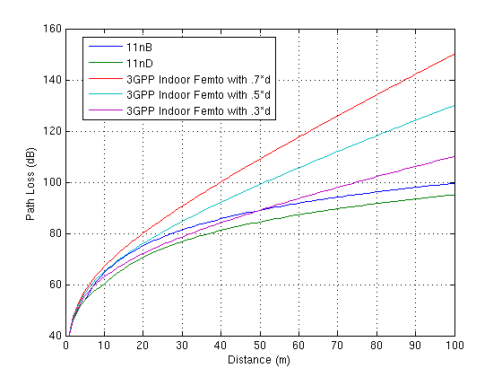
11n vs. 3GPP Indoor Femto
PL for 3GPP Indoor Femto with .3 dB/m linear attenuation quite similar to 11n models

Slide 10
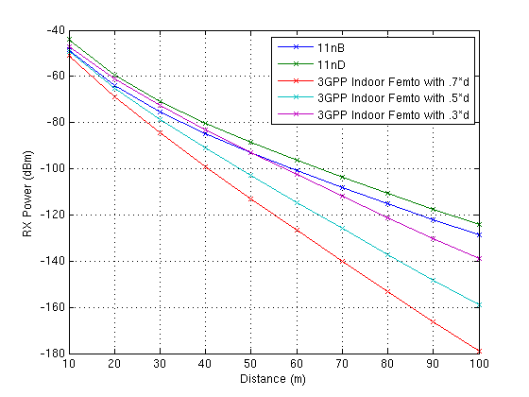
11n vs. 3GPP Indoor Femto (2)
RX power assuming 21 dBm TX, and wall every 10m
  X’s denote RX power for centrally located AP from centrally located AP in other apartments in one direction of building

Slide 11
Proposal
Option A: 11nB PL with 5 dB/wall and 18.3 dB per floor (non-linear summation), and 4 dB shadow for all links
    PL(d) = 40.05 + 20*log10(min(d,5)) + (d>5) * 35*log10(d/5) + 18.3*F^((F+2)/(F+1)-0.46) + 5*W
Option B: 3GPP indoor femto model with 0.3 * d term, and 4 dB shadow for all links
  PL = 40.05 + 20*log10(d)+.3 *d + 18.3*F^((F+2)/(F+1)-0.46) + 5*W
Numbers are for fc = 2.4 GHz; apply normal fc^2 scaling if fc changed

Slide 12
Straw Poll
Do you agree to use the11nB path loss model, as modified below, for all links in simulation scenario 1?
  11nB PL with 5 dB/wall and 18.3 dB per floor (non-linear summation), and 4 dB shadow for all links. Additional fc^2 term should be introduced for fc other than 2.4 GHz.
      PL(d) = 40.05 + 20*log10(min(d,5)) + (d>5) * 35*log10(d/5) + 18.3*F^((F+2)/(F+1)-0.46) + 5*W
Y: 49
N: 4
Abs: 48

Slide 13
References
[1] “Possible Indoor Channel Models for HEW System Simulations”, L. Wilhelmsson et. Al, IEEE 802.11-14/0393r0
[2] COST 231 Final Report, Chapter 4,
[3] “Simple and accurate path loss modeling at 5 GHz indoor environments with corridors,” J. Medbo and J.-E. Berg, Proceedings of VTC 2000.
[4] IST-4-027756 WINNER II D1.1.2 V1.2, WINNER II Channel Models, http://www.ist-winner.org/WINNER2-Deliverables/D1.1.2v1.2.pdf
[5] “Channel models for small cell deployment scenarios #2b and #3”, Qualcomm, 3GPP R1-131402, April 2013.

