Slide 1
Results of LB 201 on TGai D2.0
Date: 2014-05-12
Authors:

Slide 2
Abstract
Official results of LB201 on TGai D2.0 and additional analysis, assignment to volunteers to suggest resolutions, and reminders on how to draft resolution text.

Slide 3
Official results as announced by WG Chair
IEEE 802.11 Working Group Ballot Result
Ballot Number: 201
Ballot Group: TGai
Ballot Opened: 2014-04-07
Ballot Closed: 2014-05-07
Duration: 30
Pool (eligible voters): 336
Votes Received
Approve 195
Disapprove 34
Disapprove without comment (invalid) 6
Abstain 28
Total returns 263
Returns as % of pool: 78.27
Return requirement: >= 75%
Is number of returns sufficient? The 75% return requirement has been met
Abstains as % of returns: 10.65
Abstain requirement: < 30%
Is number of abstains sufficiently small? The 30% abstain requirement has been met
Approve as % of valid returns: 85.15
Approve requirement: >= 75%
Is number of approve votes sufficient? The 75% approval requirement has been met
Result Motion passes

Slide 4
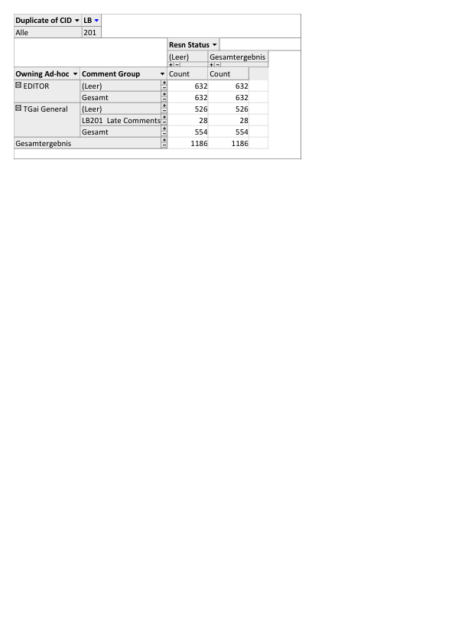
Editorial vs. Technical comments
All comments marked by the commenter as ‘editorial` are assigned to the TG Editor Lee. He will need to verify if all of those can be handled as purely editorial edits or need to require input from the TG

Slide 5
Initial assignment of CIDs to champions (1/2)
Initial assignment of champions to suggest resolutions for CIDs based on main author of the corresponding section in draft.
  Does not prohibit any other task group member to join the effort in providing a resolution or to come up with alternatives on how to resolve the comment
  Assignment has to be confirmed by champion. Please suggest an alternative TG member to work on a resolution of you feel the CID cannot be handled by you

Slide 6
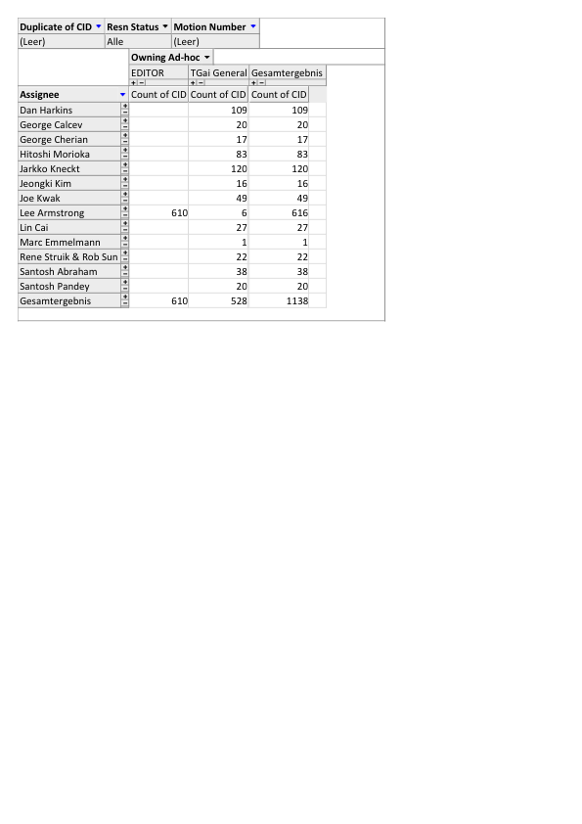
Initial assignment of CIDs to champions (2/2)

Slide 7
Goal for the week
Monday:
  every champion to go through his / hers assigned comments to confirm that assignment is correct
    Will like go into a 20-minute recess to give you time to do that
    Reassign CIDs if necessary
  Conclude on a final assignment of CIDs to champions
Rest of the week:
  Resolve as many comments as possible. Mixture between ad-hoc time and “presentation mode” to discuss resolutions.

Slide 8
Reminders for Comment Resolutions
We passed the 75% threshold and will need to be more formal in the process.
All resolutions will be visible to IEEE SA and the resolutions will be reviewed by IEEE SA for all unsatisfied no voters
  If you reference a document on mentor, you have to include the full URL to the document on mentor (not just the DCN).
  You must not refer to other CIDs. Every resolution has to stand for its own (you may though use a verbatim copy of an resolution for several CIDs.)
  There are only three valid resolution types:
    Accept – the resolution proposed by the commenter is accepted and is sufficiently detailed enough as such the Editor can incorporate it into the draft. If you accept a resolution, the resolution text must not contain any additional text except the word ‘accept’
    Reject – give a reason for rejection. Address the comment and not the commenter. The reason has to give technical justification. (Do not simply say we discussed the topic several times and did not agree / felt that we do not like the idea … )
    Revised – Basically everything that is not an ‘accept’ or ‘reject’. If the resolution suggested by the commenter is not detailed enough as that the Editor can directly implement it, we will have to provide such detailed information and set the resolution to revised (even if it basically does exactly what the commenter suggests)
Please review Adrian’s hitchhikers' guide for comment resolutions (11-13/230r1)

Slide 9
Goal of Resolution Process
We have to aim at increasing the approval ratio
  In general, that means responding to a comment as such the voter changes his/hers vote from ‘no’ to ‘yes’ …
  … but the changes should not cause another voter to switch from an approval vote to a negative vote
  We will have to get feedback from every voter if the response satisfies the comment
  → get in touch with them as early as possible if you have any questions regarding the comment. Involve them in discussing your proposed resolution to identify how they can be satisfied
We will have to accept that we cannot make everybody happy but we have to strive towards
>>95% happiness ☺

