Slide 1
FCC 14-30 U-NII Devices
Date: 2014-04-15
Authors:

Slide 2
Abstract
FCC 14-30,
Revision of Part 15 of the Commission’s Rules to
Permit Unlicensed National Information
Infrastructure (U-NII) Devices in the 5 GHz Band
Current Frequency Allocations
Expanding Utility of Existing U-NII Bands
Terminal Doppler Weather Radar Interference Issues
Transition Periods

Slide 3
FCC 14-30 1st Report and Order
Current Frequency Allocations
Expanding Utility of Existing U-NII Bands
Terminal Doppler Weather Radar Interference Issues
Transition Periods

Slide 4
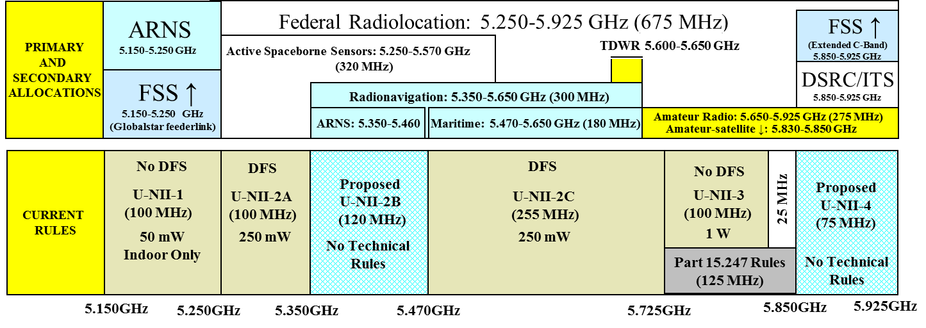
Current Frequency Allocations

Slide 5
Increasing the Utility of the U-NII-1 Band
Changes to the 5150 to 5250 MHz band
  No longer restricted to indoor operation
  Transmit power limit now 1W with 6dBi antenna = 4W e.i.r.p.
  Outdoor antennas limited to 125 mW e.i.r.p above 30 degrees elevation angle (skyward), (para 41 can file for waiver within 30 days for already installed U-NII-3 band systems)
  Outdoor fixed point-to-point can use up to 23 dBi antennas with no reduction skyward
  Client device transmit power limit 250 mW with 6dBi antenna = 1W e.i.r.p.

Slide 6
Security Features for All U-NII Bands
Manufacturers must take steps to prevent unauthorized software changes to their equipment in all of the U-NII bands. We leave the precise methods of ensuring the integrity of the software in a radio to the manufacturer, but require the manufacturer to document those methods in its application for equipment authorization. See NPRM, supra at 1785, para. 51.

Slide 7
U-NII-2 Bands
Dynamic Frequency Selection required for all U-NII systems operating in 5250-5725 MHz bands.
Specifically prohibit operators from using equipment without operational DFS in the U-NII-2 bands.
DFS Sensing Bandwidth shall be 100% of emissions bandwidth, up from 80% of emissions bandwidth.
-62dBm/20 MHz sensing threshold for U-NII-2 devices with maximum e.i.r.p. < 200 mW, have new 10 mW/MHz spectral density requirement.
New Bin 1 waveforms for DFS detection tests.
Uniform channel spreading requirement eliminated.
Updated method and level of channel loading for DFS testing

Slide 8
Terminal Doppler Weather Radar Decision
We direct OET to revise the 2006 DFS Compliance Measurement Procedures and other compliance measurement guidelines for U-NII devices, consistent with the decisions made in this First R&O. We further direct OET to publish the revised measurement procedures and guidelines online in the Knowledge Database (KDB).

Slide 9
U-NII-3 Band Features
Consolidated 15.247 digital device rules with 15.407 rules, with unlimited antenna gain for fixed point-to-point systems.
Minimum 6 dB bandwidth of 500 kHz.
30 dBm/500 kHz Power Spectral Density limit.
Will continue to authorize 15.247 frequency hopping devices.

Slide 10
Transition Periods
All certifications must be new devices 12 months after date of publication of the order in the Federal Register.
Manufacturing, marketing, sales and importation of non-compliant devices must cease two years after the order takes effect. Two years after the order takes effect, the FCC will no longer allow Class II permissive changes for devices previously certified.

Slide 11
References
http://www.fcc.gov/document/5-ghz-u-nii-ro
http://hraunfoss.fcc.gov/edocs_public/attachmatch/FCC-14-30A1.pdf

