Slide 1
1st Vice Chair Report May 2014
Date: 2014-05-12
Authors:

Slide 2
Abstract
This slide contains requested reports and status from the 802.11 1st Vice-Chair:
Monday:
  Meeting room locations
  Next meeting reminder
  Meeting registration
  Recording attendance
  File server
  Breakfast, breaks, social
Friday:
  Straw Poll of membership regarding this meeting location
  Future venues status and discussion

Slide 3
Monday–
802.11 Opening Plenary
802.11 First Vice Chair Report

Slide 4
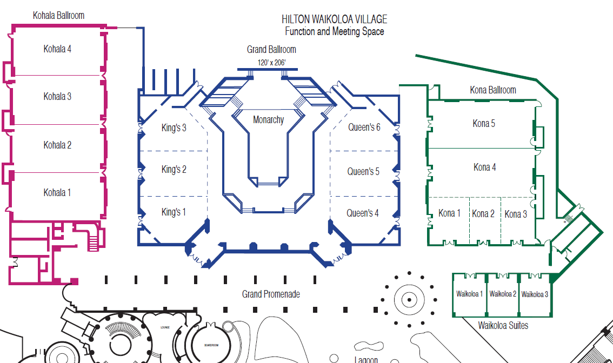
M3.5 Meeting Room Locations
JTC1

Slide 5
M3.6 Next Meeting – China Interim
May 21-22, China Interim, New Century Hotel, Beijing, China
  Meeting Registration and Hotel Registration – Open
For information and registration links, see http://www.ieee802.org/11/Meetings/Meeting_Plan.html

Slide 6
M3.6 Next Meeting
IEEE 802 Plenary session - July 2014
July 13-18, 2014
Manchester Grand Hyatt in San Diego, CA USA.
Meeting and Hotel registration are open.
Event Information Site: http://802world.org/plenary
Meeting registration
Hotel reservation
Registration (staying at Hyatt):
  Early - $800($500),
  Standard – $900 ($600),
  On-site - $1100 ($800)
Hotel rate: $189 + taxes

Slide 7
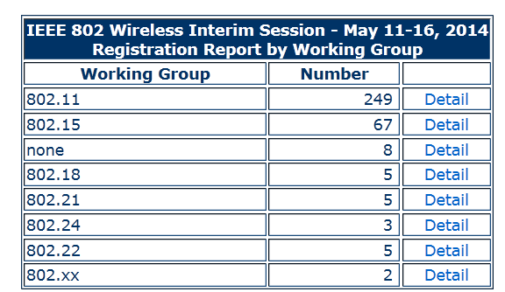
M3.7 Meeting Registration
As of 11 May 2014

Slide 8
M3.8 Recording Attendance
It is a requirement that attendees record their participation at an 802.11 session and declare their affiliation. This record is usually made using the IMAT attendance system.
  If you wish to participate without recording attendance, send an email per session to the WG 1st vice chair declaring your participation and affiliation.
    However, You cannot gain or maintain 802.11 voting membership using this method.
You must record 75% attendance of eligible 802.11 slots in a session for that session to count towards gaining or maintaining 802.11 voting membership
  You need a single IEEE-SA web account
    The IEEE SA web account requires a working email address
    do not remove your email address from the account
  Use the email address associated with that web account when registering attendance
    If you change email addresses, update the web account, don’t create a new web account, or your membership status may not be calculated properly.
  Record attendance using this URL: https://imat.ieee.org/attendance

Slide 9
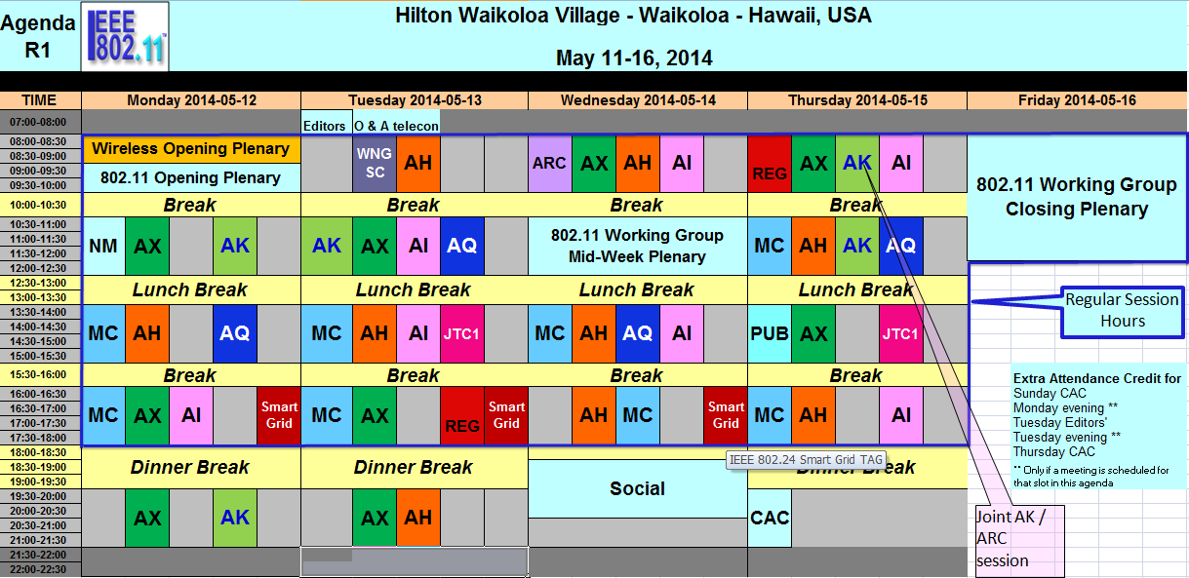
M3.8 Session graphic – May 2014
18 Normal slots
Extra slots: Sunday CAC, Monday evening, Tuesday editor’s Meeting, Tuesday evening, Thursday CAC
75% attendance requires 14 slots attended
Closing plenary requires only 1 registration for 2 slot credit
Register once
Source: 11-14/0470r4

Slide 10
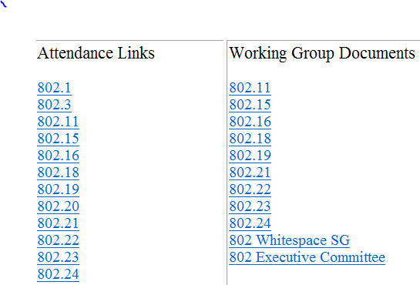
M3.9 Local File Document Server information
Local FTP server: ftp://griffin.events.ieee.org (anonymous)
External Document Server https://mentor.ieee.org/802.11/documents

Slide 11
M3.9 Synchronizing while at the meeting
While Particularly important when external bandwidth is limited and unreliable
Please Use anonymous ftp
  Host: ftp://griffin.events.ieee.org
  User: anonymous
  Password: <your-email-address-here>
  Destination directory: /802.11/13
Freeware tools are available, for example search for “syncback free” **
** Other tools are available. The IEEE does not endorse the use of any particular tool.

Slide 12
M3.10 FOOD & BEVERAGE
Breakfast 07:15 to 08:00 at the Lagoon Lanai **
Morning Coffee/Tea 09:30 to 10:30
Lunch Service 12:00 to 13:30 at the Lagoon Lanai **
Afternoon Coffee/Tea/Snacks 5:00 to 16:00
** Inside if it rains

Slide 13
M3.10 Social
WHEN: Wednesday May 14th, 6:30 PM to 8:30 PM
WHERE: Weather permitting we will be gathering at the Lagoon Lanai.
  If it rains we’ll head under cover to the Waters Edge Ballroom.
WHAT: Eat, Drink and socialize with your fellow IEEE 802 Wireless colleagues while playing a variety of interactive games such darts, ping pong, badminton.
  We’ll even have a Hula Hoop Contest for the brave.
Complimentary Bar Service (Beer, Wine, Juice, Water) between 6:30 PM and 7:30 PM
GUESTS: Guests welcome to attend. Guest Badges may be picked up at Registration Desk before 1:30 PM Wednesday.
http://802world.org/wireless/onsite-information/

Slide 14
HILTON WAIKOLOA LOVES IEEE 802 WIRELESS –
SELFIE CONTEST
Have you taken a moment to explore some of the amazing sights and sounds beyond the Lagoon Lanai and the meeting space? Well let us entice you. In cooperation with the Hilton Waikoloa Village there are some great prizes for IEEE 802 Wireless Attendees who take and upload a selfie on our IEEE 802W event webpage.
Complete Information is available at: http://802world.org/wireless/files/2014/05/Selfie-Contest-Rules-Locations-and-Prizes.pdf

Slide 15
Wednesday –
802.11 Mid-Week Plenary
802.11 First Vice Chair Report

Slide 16
Friday –
802.11 Closing Plenary
802.11 First Vice Chair Report

Slide 17
Local Venue Information
Next Plenary: San Diego, CA – 14-18 July 2014
Next Interim: Athens, Greece – 23-27 Sept 2014
Please suggest Restaurants, methods of getting from Airport to Hotel, local attractions…

Slide 18
Future Venues under consideration
Each Plenary the Exec Sec reports the Venues being considered.
Updated Future Venues File posted:
  https://mentor.ieee.org/802-ec/dcn/12/ec-12-0040-05-00EC-802-plenary-future-venue-contract-status.xlsx
Future Meeting Space allocation –
  Do not plan on more than 5 rooms in parallel.
    Size: 100% -75% -50% -25% -~20 people
    WG/TAGs less than 30 get only one room

Slide 19
802.11 Venue Strawpolls
Return to Waikoloa: Y; N

Slide 20
Athens, Greece Social Question
Strawpoll:
  1 – No Social
  2 – Social included in Meeting fee, but meeting fee may be higher
  3 – Social is pay to attend separate from meeting fee

Slide 21
Other Future Venues possibilities
Initial Site visits were done in Asia:
Grand Hyatt HKG
Centara Grand Hotel BKK Plaza Athenee Hotel BKK
Shangri-la BKK Conrad Hotel BKK
Berjaya Hotel K-L Ritz/Marriott K-L Shangri-la K-L
Sunway K-L Renaissance K-L
Grand Copthorne SIN Suntec SIN Shangri-la SIN
Potential choices to be reported later
US venues: New Orleans, Denver, Salt Lake City, Orlando, Seattle, etc.
Other NA venues: Vancouver, Toronto, Montreal
European venues: Berlin, Copenhagen, Barcelona, Prague, London, Geneva,

