Slide 1
802.11ak Figures
Date: 2014-03-18
Authors:

Slide 2
Abstract
Proposed figures to illustrate
- the 802.11GLK BSS
-an example of 802.11GLK architecture
for the 802.11ak specifications
These updated figures results from the 03/18/2014 802.11TGak meeting in Beijing,CN)

Slide 3
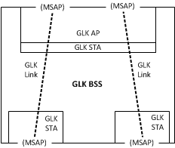
802.11ak BSS Figure

Slide 4
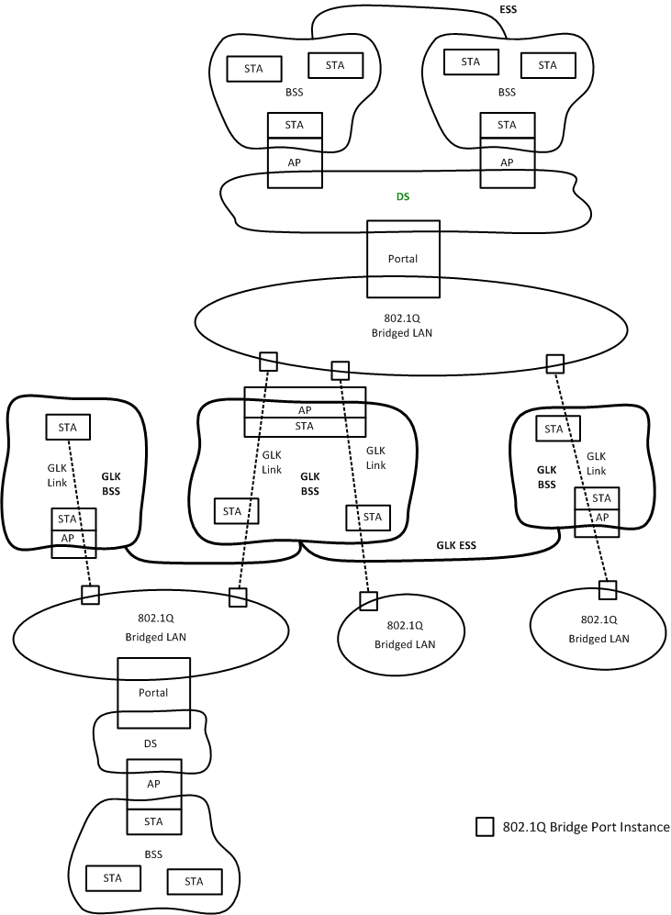
802.11ak Architecture Figure

