Slide 1
Small-Scale Characteristics of 45 GHz Based on Channel Measurement
Date: March 19, 2014
Presenter: Haiming WANG
Authors/contributors:
Name | Company | Address | Phone | Email
Haiming WANG | SEU/CWPAN | 2 Sipailou, Nanjing 210096, China | +86-25-5209 1653-301(ext.) | hmwang@seu.edu.cn
Jin ZHU |  |  |  | jinzhu@emfield.org
Wei HONG |  |  | +86-25-5209 1650 | weihong@seu.edu.cn
Nianzu ZHANG |  |  | +86-25-5209 1653-320(ext.) | nzzhang@seu.edu.cn
Shiwen HE |  |  | +86-25-5209 1653-3121(ext.) | hesw01@seu.edu.cn

Slide 2
Abstract
This presentation gives small-scale characteristics of 45 GHz band based on channel measurement.

Slide 3
Outline
Channel Measurement Scheme
  Transmission Scenarios
  Channel measurement setup
Small-Scale Characteristics at 45 GHz band
  Number of clusters and rays
  Power delay profile
  Angle of arrival and departure
  Time of arrival

Slide 4
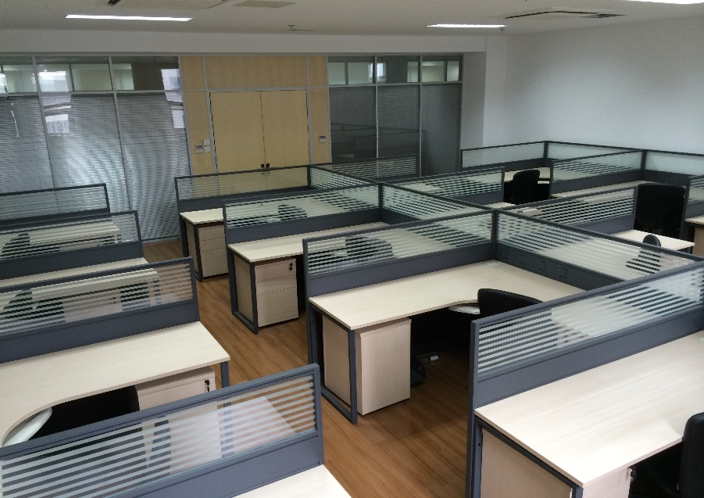
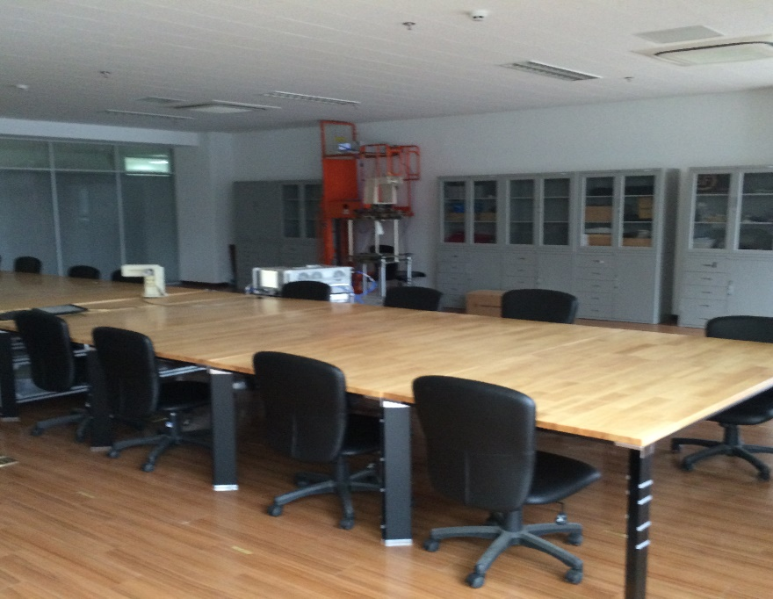
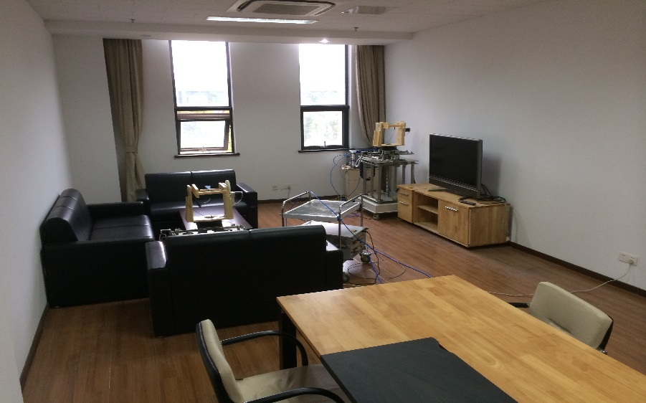
Transmission Scenarios
Conference room
Cubicle room
Living room

Slide 5
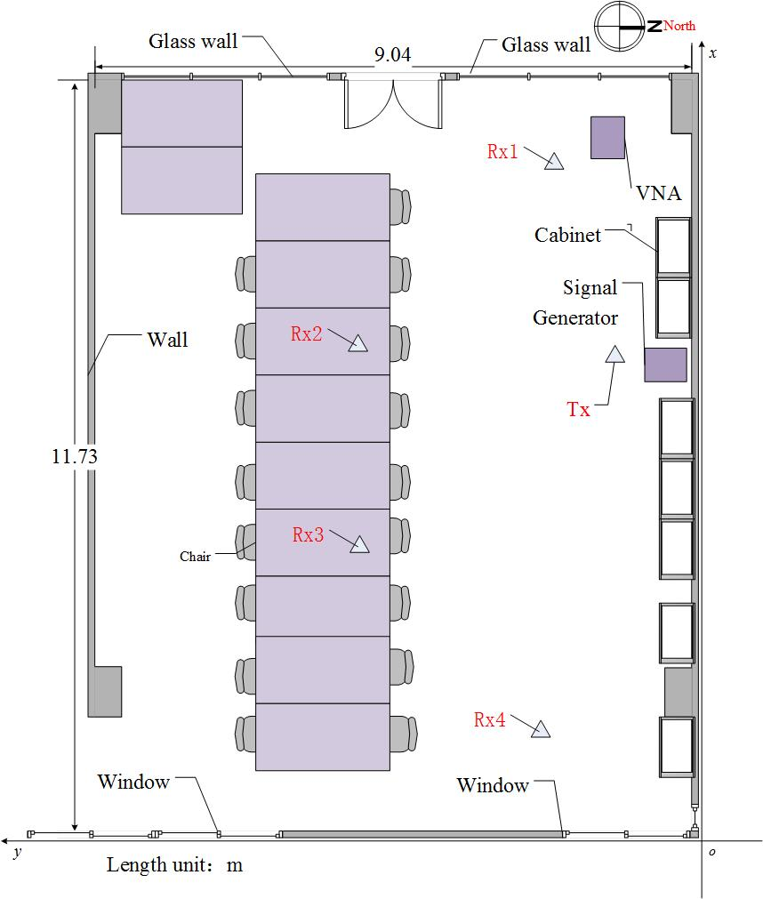
Conference Room Scenario Setup
Tx height: 1.95m
Rx height: 1.00m
Fixed Tx position and 4 Rx positions
Tx height: 10 dBm
Freq center: 44.955GHz
Sampling frequency: 660 MHz
Number of Subcarriers: 256

Slide 6
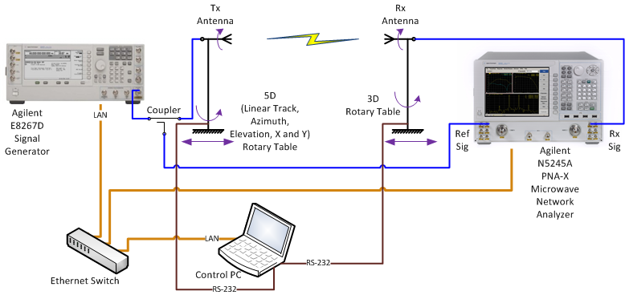
Channel Measurement Setup
A PC is used to not only control the rotary table with an RS-232 port but also control the signal generator and vector network analyzer (VNA) with LAN ports.
The signal generator transmits CW signal at each frequency, then Rx power and channel frequency response are obtained by the VNA. The positions of Tx and Rx antennas and measured data are simultaneously recorded.

Slide 7
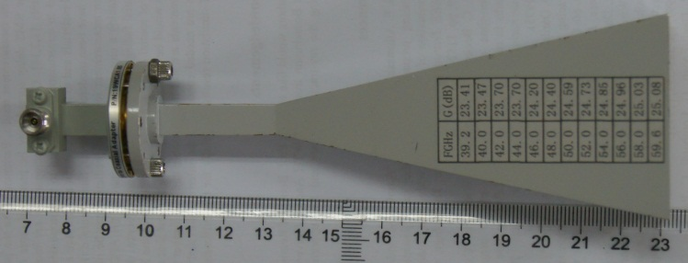
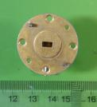
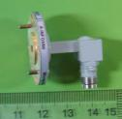
Antennas for Channel Measurement
Type I: Horn antenna with 23.7-dBi gain
H-Plane
E-Plane
Pattern (dB)
Angle (degree)
Type II: Open-ended waveguide (OEW) antenna with 6-dBi gain

Slide 8
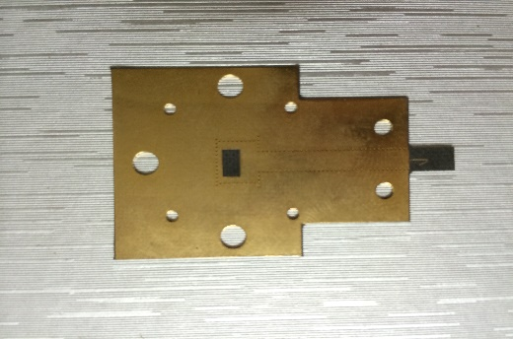
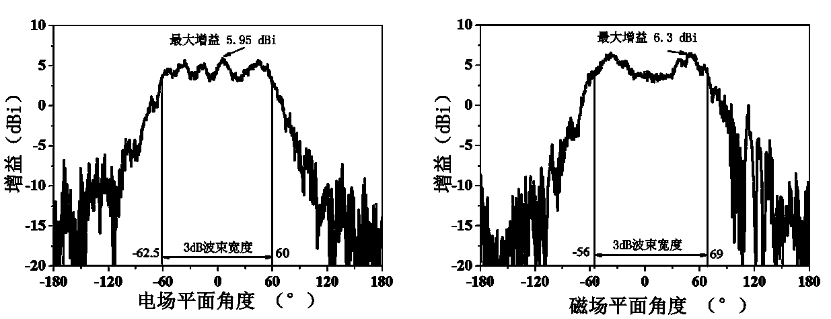
Antennas for Channel Measurement
Type Ⅲ: SIW antenna with 3-dBi gain
Three antennas are linear polarized
Maximum Gain
Maximum Gain
Gain
Gain
Gain
Angle (deg)
Angle (deg)

Slide 9
Channel Measurement Technique
Frequency domain measurement
Complex response is recorded in the frequency domain
Channel impulse response is obtained from channel frequency response using IFFT

Slide 10
Double-directional Scanning
Horn-Horn:
Tx antenna rotates at each 10 degrees, Rx antenna rotates at each 10 degrees
OEW-OEW:
Tx antenna rotates at each 60 degrees, Rx antenna rotates at each 60 degrees

Slide 11


The Channel Impulse Response Function
$$C^{\left(i\right)}$$
and are the gain and channel impulse response of the ith cluster respectively;
Amplitude, delay and angle characteristics of clusters as well as rays can be derived from massive channel measurements.
$$A^{\left(i\right)}$$

Slide 12
Power Angle Profile (PAP)

Slide 13
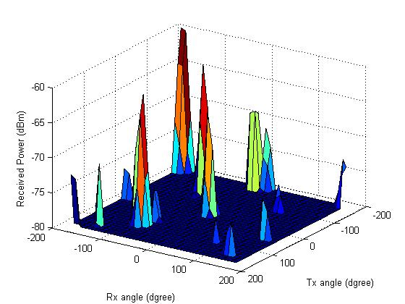
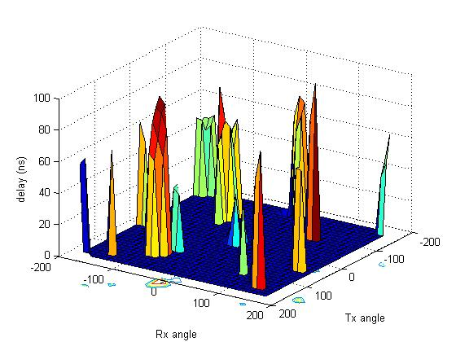
PAP at Rx 1 Position
Sub-paths whose average power 20dB less than the max path power are ignored
Power of each sub-path is the expectation of powers of 256 sub-carriers
(a) Average power of each angle
(b) Delay of each angle

Slide 14
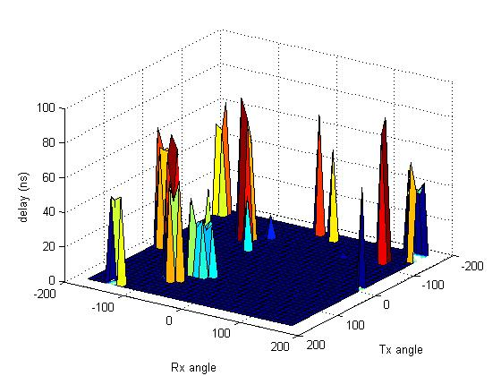
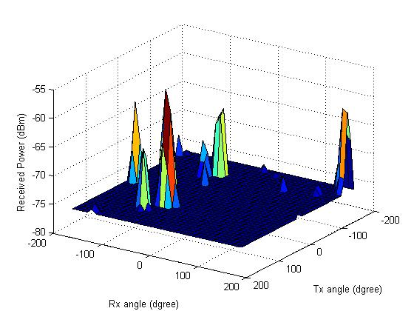
PAP at Rx2 Position
Sub-paths whose average power 20dB less than the max path power are ignored
Power of each sub-path is the expectation of powers of 256 sub-carriers
(c) Average power of each angle
(d) Delay of each angle

Slide 15
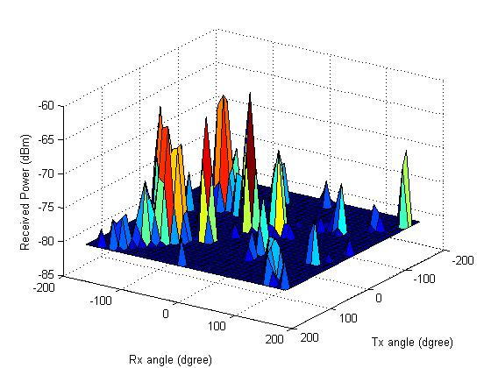
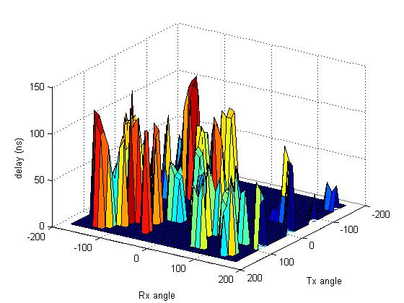
PAP at Rx 3 Position
(e) Average power of each angle
(f) Delay of each angle

Slide 16
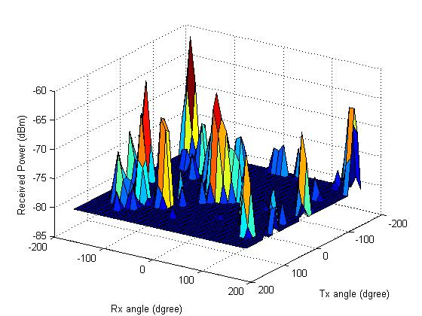
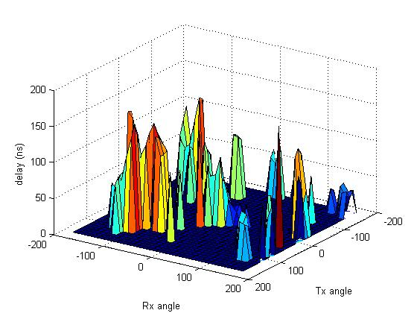
PAP at Rx 4 Position
Rx2
(g) Average power of each angle
(h) Delay of each angle

Slide 17
Discussion
Amount to 36×36 (1296) sub-channels are measured to analyze the spatial characteristics of clusters.
The left illustration shows the average power of each path, the right illustration shows the corresponding delays of all paths.
Clustering is obvious and there are about 6 or more clusters .
Cluster with larger power usually has smaller time delay.

Slide 18
Power Delay Profile (PDP)

Slide 19
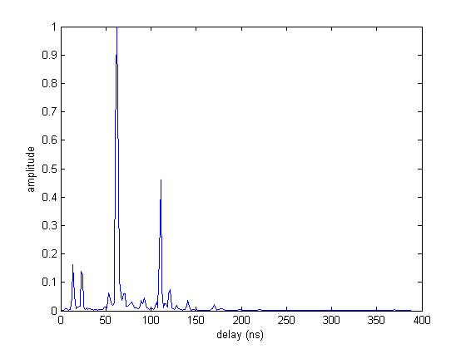
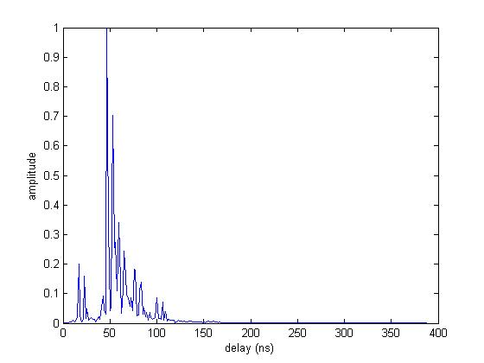
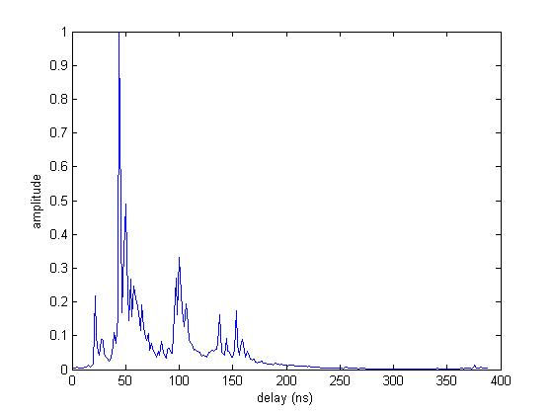
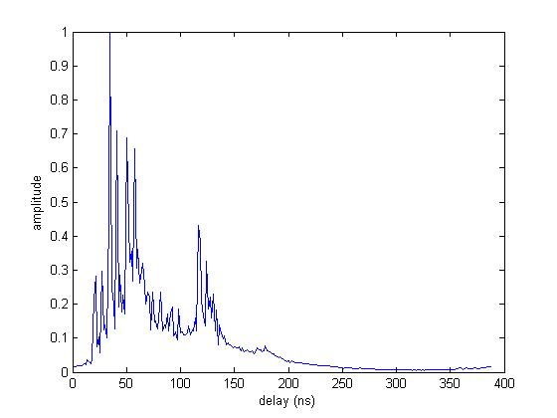
PDP of Horn-Horn
Rx1
Rx2
Rx3
Rx4

Slide 20
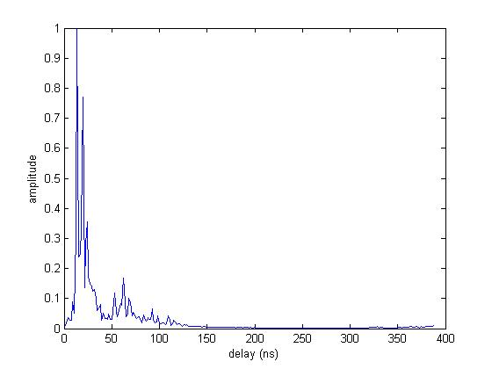
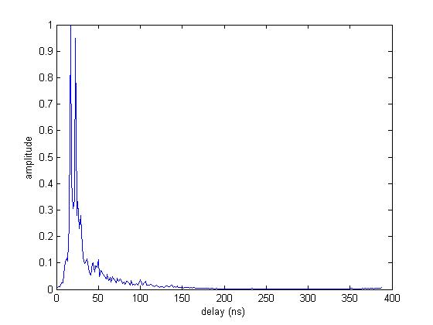
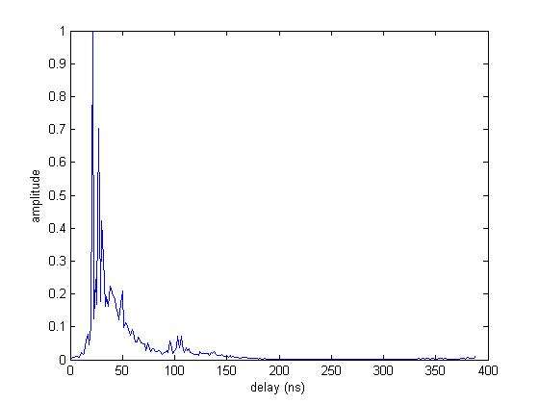
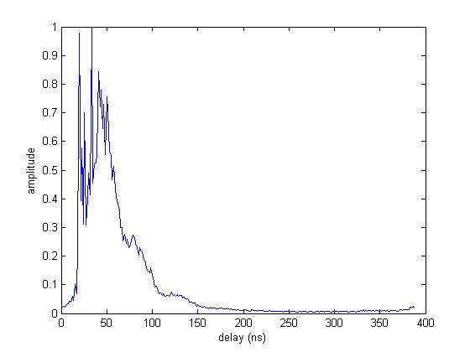
PDP of OEW-OEW
Rx1
Rx2
Rx3
Rx4

Slide 21
Discussion
There is no LoS path component in the horn scanning setup for a misalignment of TR antennas while in OEW scanning setup there is no such effect.
The first ray arrives at about 10ns as radio propagation when there is LoS component.
The LoS component is of much significant comparing the reflection and scattering components.

Slide 22
Future Work
Continue the small-scale channel measurement in other two transmission scenarios.
Extract the distribution of parameters and finish the channel models based on channel measurement.
Set up MIMO channel measurement and derive the relative correlation matrix.
Give the Matlab code of channel generation at 45 GHz band.

