Slide 1
A P2P Discovery System
Date: 2014-03-18
Authors:

Slide 2
Abstract
By using a distributed P2P system where the clients reside in in microprocessors already present in most radio nodes like Wi-Fi access points, base stations, TVs connected to Internet etc, these clients will discover other clients over the back-haul network. As a result, neighbor lists are created. Examples of how these can be used for Wi-Fi services, is discussed in this paper.
Most of these ideas can be implemented as application programs which run above the IP stack and since IEEE 802.11 group defines protocols below the IP stack, there is a minimum of changes that need to be introduced, since they are partly in place already.

Slide 3
Revised version availble from DYSPAN 2014!
Old:
arXiv:1210.3552 [pdf, other]
Large-Scale Peer-to-Peer Discovery Mechanism and Architecture for Frequency Allocation
Magnus Skjegstad, Brage Ellingsæter, Torleiv Maseng, Jon Crowcroft

Slide 4
Cognitive Radio: Dynamic Spectrum Access: 1 We need a control channel. To whom?

Slide 5
Our P2P protocol enables users to discover and communicate over the Internet with other radios that cause interference above the noise floor.
D
A
C
B
The circles indicate transmitted signal above noise floor for radios A, B, C and D. Radios C and D are more interested in knowing about radio A than radio B, even if B is geographically closer to them.
Notes:
In the example above, all nodes uses omni-directional antennas. For directional antennas, the actual antenna diagram can be included into the power and frequency algorithm once a sufficiently large number of nodes has been discovered.

Slide 6
Neighbour list:

Slide 9
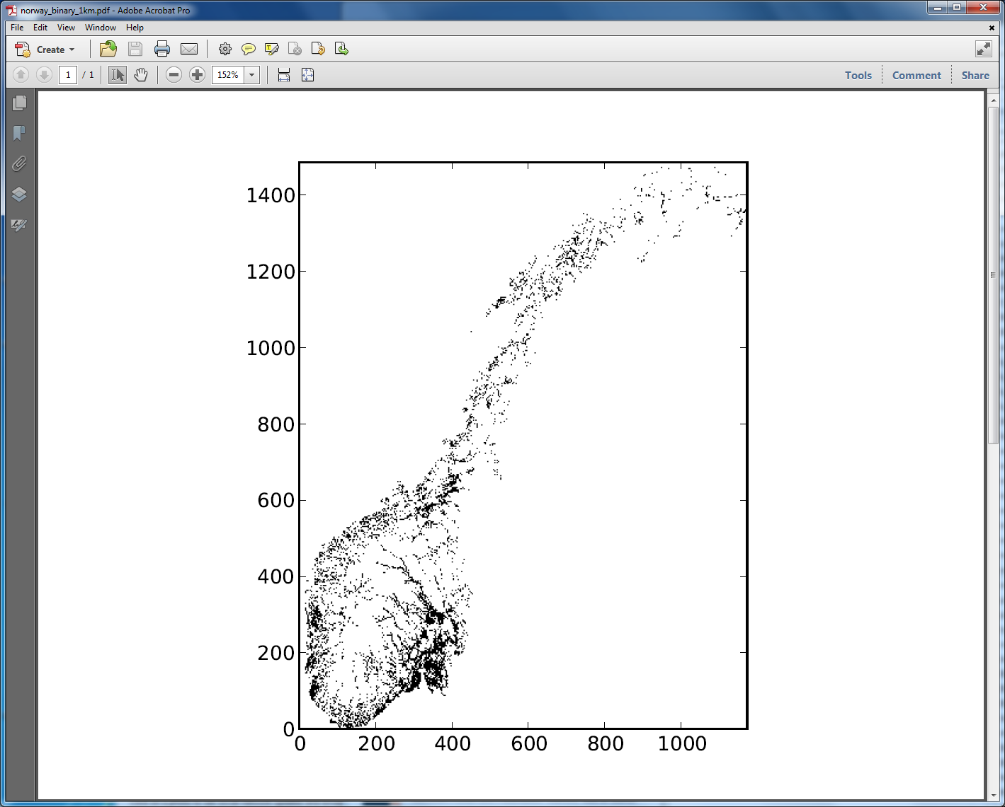

Slide 10
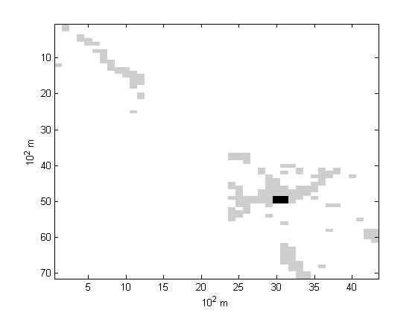

Slide 11
Discovery Agent

Slide 12
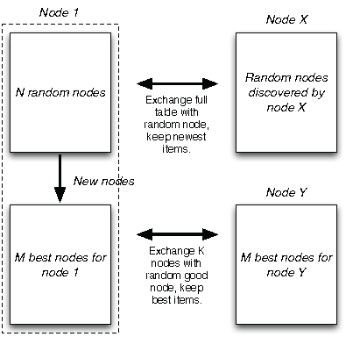
Detailed description of Discovery Agent
N
K

Slide 13
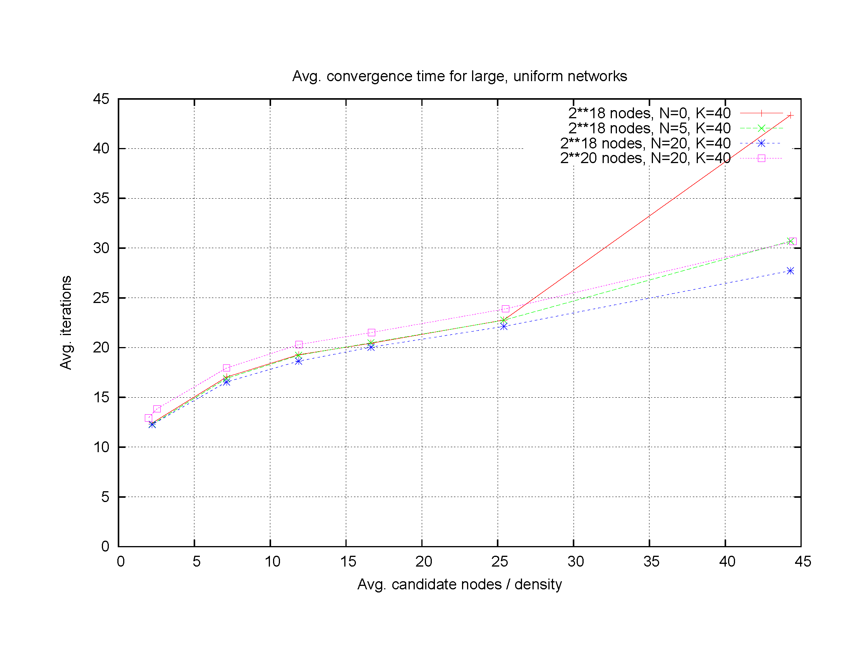
Convergence

Slide 14
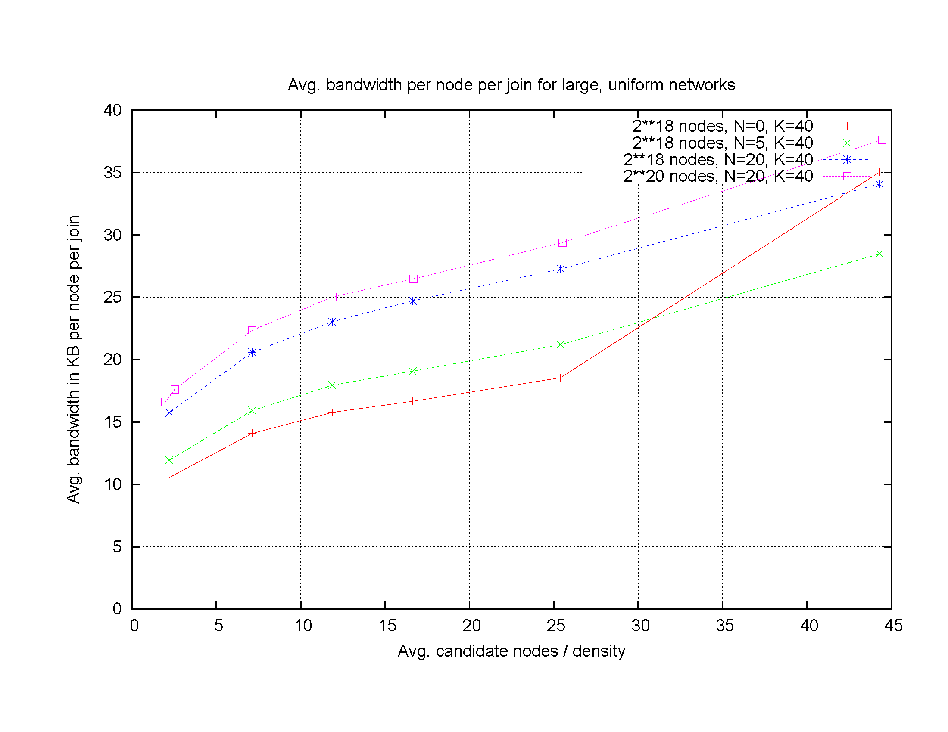
Bandwidth (kHz) per node

Slide 15
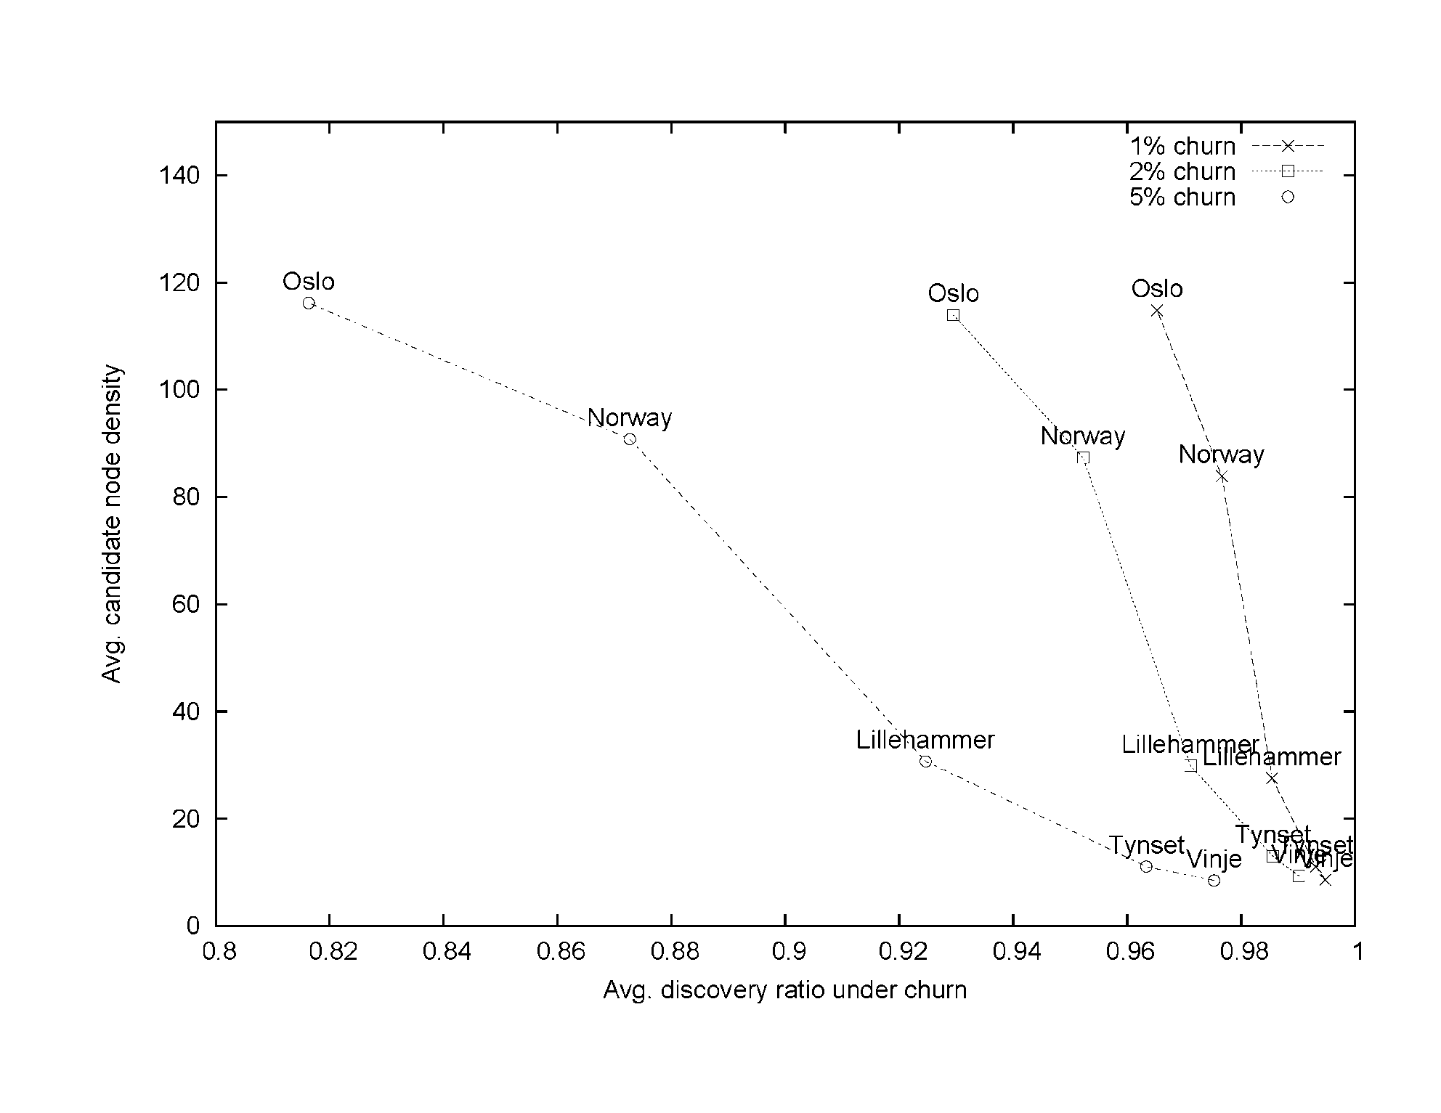
1 or 5% churn with 4 Agent Messages pr minute

Slide 16
Access Point
Client
Discovery Agent
Discovery Agent
Agent
msg.
Neighbour list
Neighbour list
Resource Allocator
Discovery
Resource Allocator
Agent msg.
Power, channel and performance metric
Power, channel and performance metric
Radio
tranceiver
Ethernet
Radio
tranceiver
Internet
IEEE 802.11
Radio

Slide 17
False agents Privacy

Slide 18
Privacy
A
B
1
X
C
D

Slide 19
Frequency allocation game in satisfaction form
Brage Ellingsæter
http://onlinelibrary.wiley.com/doi/10.1002/ett.2739/full
. arXiv:1212.0724 [pdf, other]
A Potential Game for Power and Frequency Allocation in Large-Scale Wireless Networks
Brage Ellingsæter, Magnus Skjegstad, Torleiv Maseng
Subjects: Networking and Internet Architecture (cs.NI)
2. arXiv:1210.5219 [pdf, other]
The Domino Effect in Decentralized Wireless Networks
Brage Ellingsæter, Torleiv Maseng
Comments: 6 pages, 9 figures
Subjects: Information Theory (cs.IT); Networking and Internet Architecture (cs.NI)
3. arXiv:1210.3552 [pdf, other] Revised version availble from DYSPAN 2014!
Large-Scale Peer-to-Peer Discovery Mechanism and Architecture for Frequency Allocation
Magnus Skjegstad, Brage Ellingsæter, Torleiv Maseng, Jon Crowcroft
Subjects: Networking and Internet Architecture (cs.NI)
4. arXiv:1202.3018 [pdf, other]
Using TV Receiver Information to Increase Cognitive White Space Spectrum
Brage Ellingsæter, Hemdan Bezabih, Josef Noll, Torleiv Maseng

Slide 20
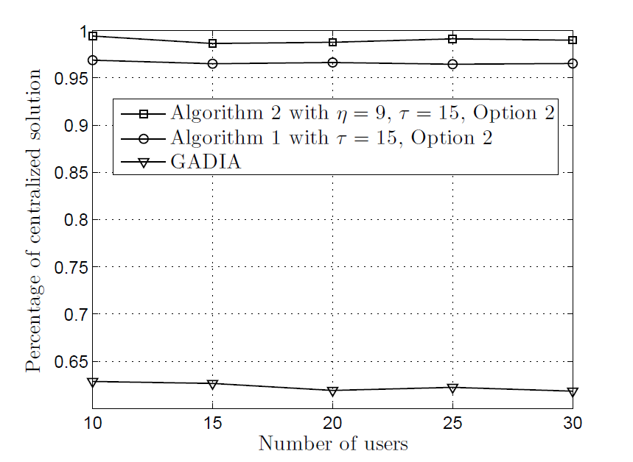
Distributed frequency allocation performs close to an ideal centralized system with perfect knowledge of the system
Algorithm 2: Considering interfering neighbour nodes quality
Algorithm 1: Considering interfering nodes
Algorithm 3: Selfish (like todays Wi-Fi systems)

Slide 21
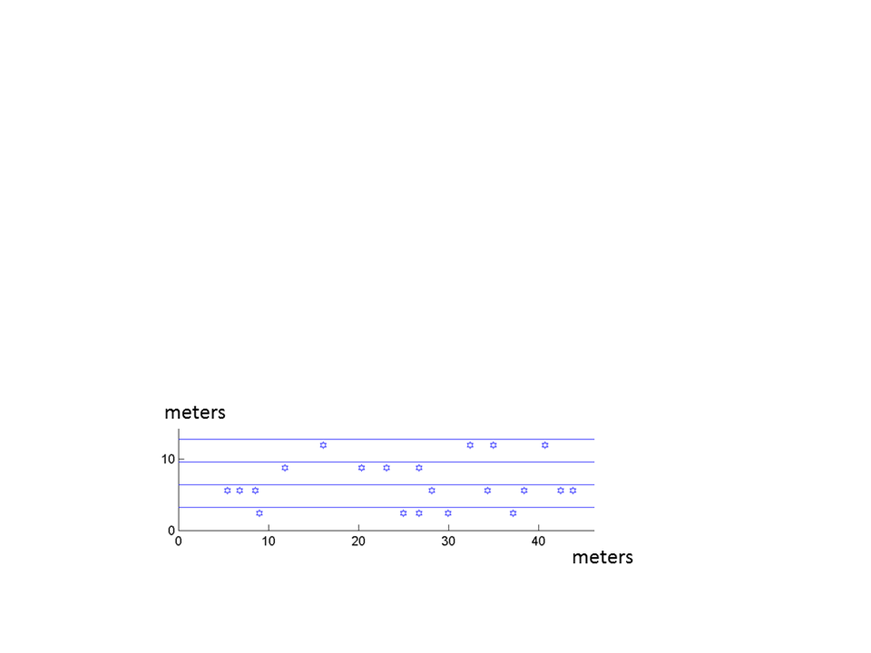
Inner roof on each floor
21 Access points (AP)/clients (STA)
18
21
3
floor
14
17
6
13
1
5
0
floor

Slide 22
Changes to the Wireless LAN Medium Access Control and Physical Layer Specifications(IEEE 802.11):
Since most of these ideas above can be implemented as application programs which run above the IP stack and since IEEE 802.11 group defines protocols below the IP stack, there is a minimum of changes that need to be introduced, since they are partly in place already. These are:
Extended Channel Switch Announcement (ECSA) Std IEEE 802.11y-2008
The transmit power of the AP can be changed in Wireless LAN Medium Access Control and Physical Layer Specifications, but not the power of the STA.

Slide 23
Advantages of a standardized decentralized system
Gradual deployment with gracefull increase in performance
Does not require initial investment in hardware infrastructure.
Enables primary users to
be deployed autonomously at low cost
locate, identify and warn secondary users
Enables secondary users to
improve local frequency coordination of shared spectrum
locate, identify and avoid primary users

Slide 24
Our Decentralized P2P Discovery System can be used for:
Dynamic Spectrum Access (considered in the following)
Handover between different systems (Wi-Fi to Wi-Fi, LTE to Wi-Fi etc)
Service Discovery (Where is a printer which I may use?)
Many small base stations

Slide 25
Use cases
For mobile operators
Better link quality to customers and low investment costs
Minimization of CAPEX/OPEX to central servers keeping databases up to date for client administration.
Autonomous sharing of frequency bands with secondary users
For TV band devices (TVBD)
A TVBD may inform other devices its existence (by Internet)
TVBDs may find other devices they should coordinate frequence and power with and exchange radio parameters
Devices without wired Internet access can be taken care of by a database or others who are, such as Wi-Fi hubs, femto cells or an operator keeping a database. Examples of devices without wired Internet access are mobile phones, TV sets, wireless microphones, wireless sensors etc.

Slide 26
Conclusion
Our research has shown that a decentralized solution is an advantageous complement to a central database.
We are looking for research partners for testing our solution on their platforms.
A decentralized system is most efficient if everybody uses it. Therefore we want to contribute towards a standard for a decentralized protocol by making our simulator and experimental prototype openly available.

