Slide 1
Possible Indoor Channel Models for HEW System Simulations
Date: 2014-03-18

Slide 2
Contents
Background
Considered channel models
  Wall and floor penetration loss
  Distant dependent loss
Numerical comparison of the different models
  Wall and floor penetration loss
  Distance dependent path loss
  Distance to trigger CCA
Summary

Slide 3
Background
In [1], a number of channel models are needed to simulate different indoors and outdoors scenarios.
Suitable channel models for outdoor deployment are presented in [2]. Different values related to penetration loss are discussed in [3], and in [4] various ways to take several walls and floors into account is discussed.
This contribution relates to [3] and [4], and discuss various available indoor channel models and in particular how penetration loss is included in these models.
The contribution relates to scenario 1 and 2 in [1].

Slide 4
Considered channel models
Winner II
COST 231
802.11n
3GPP 36.814
“Medbo”

Slide 5
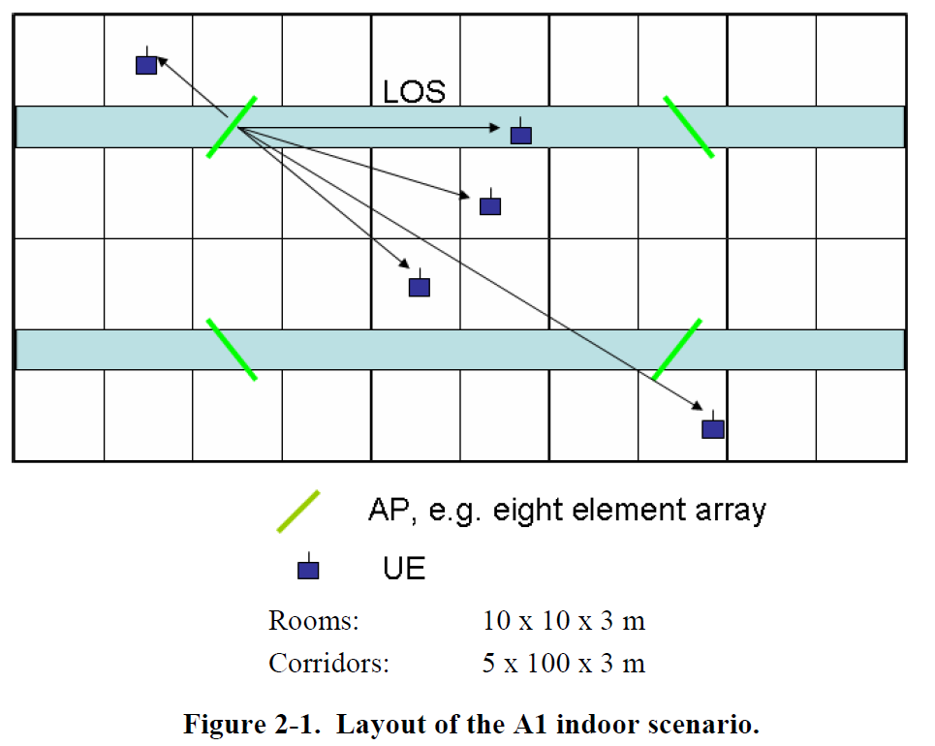
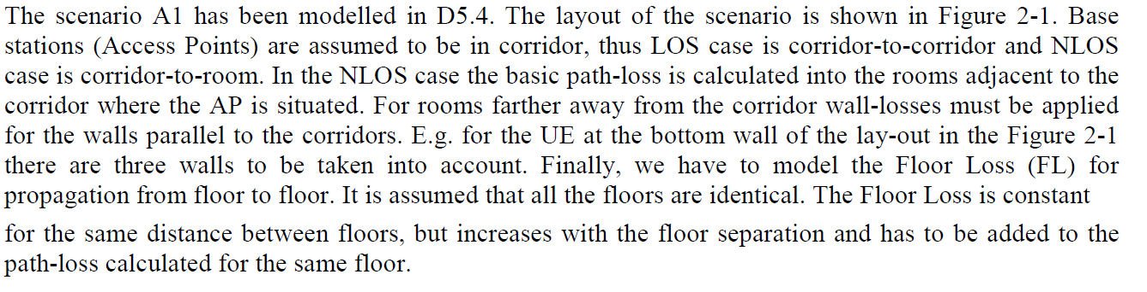
WINNER II – A1 (Indoor office/residential)

Slide 6
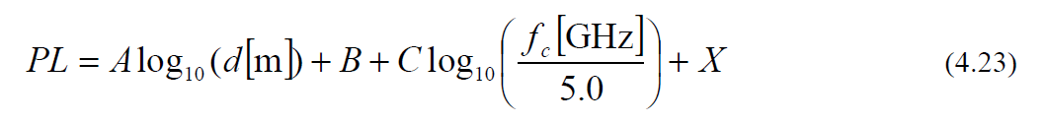
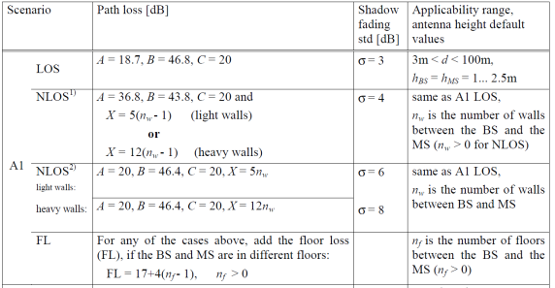

WINNER II – A1 (Indoor office/residential)

Slide 7
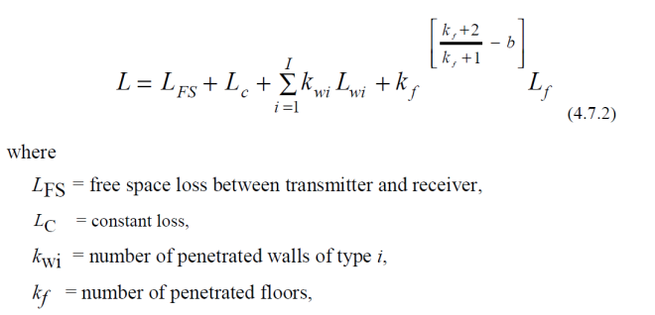
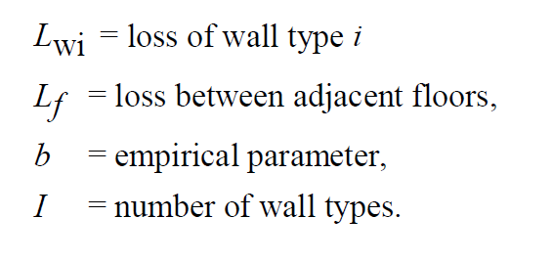
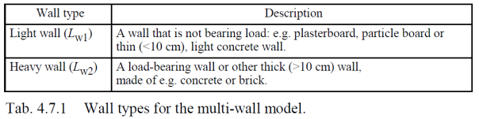
COST 231 – Multi-Wall Model

Slide 8

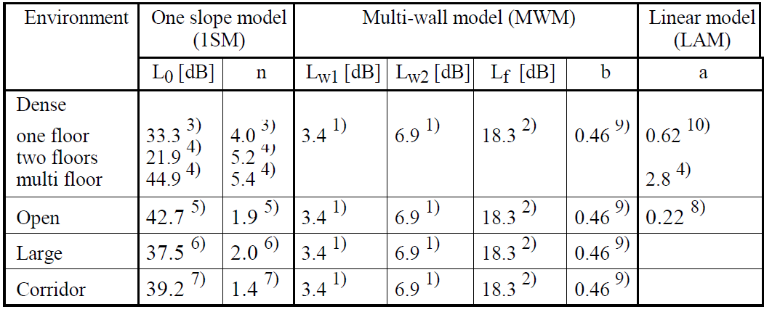
COST 231 – Linear Attenuation Model

Slide 9
IEEE 802.11-03/940r4
The path loss model that we propose consists of the free space loss L_{FS} (slope of 2) up to a breakpoint distance and slope of 3.5 after the breakpoint distance [21]. For each of the models different break-point distance d_{BP} was chosen
L(d) = L_{FS}(d) d <= d_{BP}
L(d) = L_{FS}(d_{BP}) + 35 log₁₀(d / d_{BP}) d > d_{BP} (1)
New Model | d_{BP} (m) | Slope before d_{BP} | Slope after d_{BP} | Shadow fading std. dev. (dB) before d_{BP} _{(LOS)} | Shadow fading std. dev. (dB) after d_{BP} _{(NLOS)}
A (optional) | 5 | 2 | 3.5 | 3 | 4
B | 5 | 2 | 3.5 | 3 | 4
C | 5 | 2 | 3.5 | 3 | 5
D | 10 | 2 | 3.5 | 3 | 5
E | 20 | 2 | 3.5 | 3 | 6
F | 30 | 2 | 3.5 | 3 | 6
Table I: Path loss model parameters

Slide 10
3GPP TR 36.814
Table A.2.1.1.2-8 Indoor femto Channel models (HeNB): Urban deployment (2 GHz)
PL (dB) = 38.46 + 20 log10R + 0.7d2D,indoor+ 18.3 n ((n+2)/(n+1)-0.46)
PL (dB) = 38.46 + 20 log10R + 0.7d2D,indoor+ 18.3 n ^ ((n+2)/(n+1)-0.46) + qLiw
+ q*Liw
R and d2D,indoor are in m
n is the number of penetrated floors
q is the number of walls separating apartments between UE and HeNB
Liw is the penetration loss of the wall separating apartments, which is 5dB
The term 0.7d2D,indoor takes account of penetration loss due to walls inside an apartment.
a

Slide 11
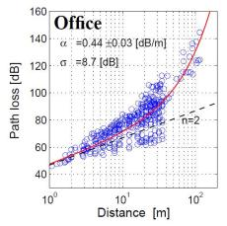
“Medbo” – same floor [9]
[dB]
Measurements
Loss [dB]
Distance [m]
[dB]
lognormal

Slide 12
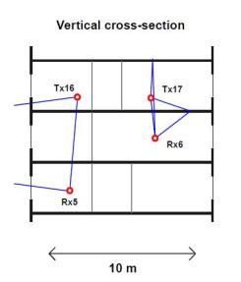
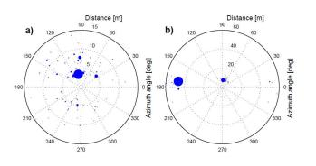
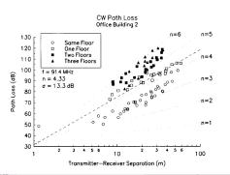
“Medbo” – different floors [12]
[dB]
lognormal

Slide 13
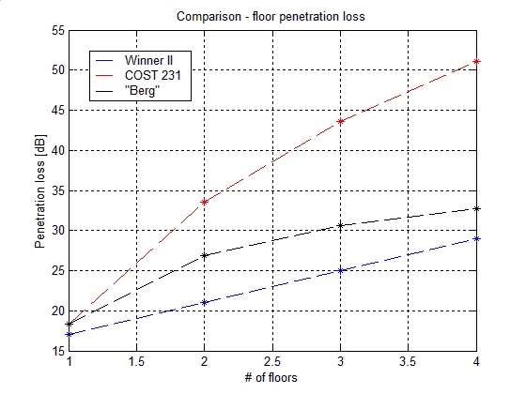
Comparison – Floor Penetration
For one floor, 18 dB seems to be rather consistent
For two floors, COST 231 has >10 dB higher penetration loss !
For three and more floors the difference is huge!
The “Berg” model can be found in [11]. It is the same as COST 231, but with b changed from 0.46 to 0.78, based on measurements

Slide 14
Comparison – “Methodology NLOS”
Winner: Slope 3.68 + walls explicitly (linear)
COST 231 LAM: FSPL + LAM, no explicit walls
COST 231 Multi-Wall: FSPL + walls explicitly (linear)
IEEE 802.11n: Slope 3.5, no explicit walls
3GPP: FSPL + LAM, no explicit walls inside apartment. (heavy walls explicitly)
“Medbo”: FSPL + LAM, no explicit walls

Slide 15
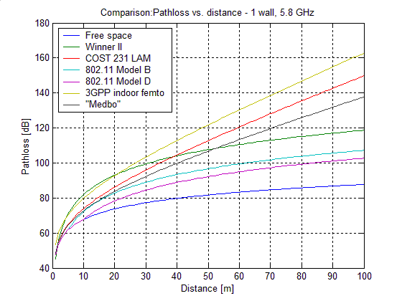
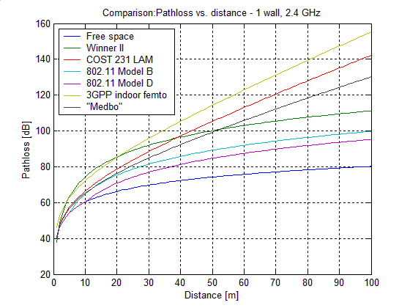
Comparison – Same floor, one wall (NLOS)

Slide 16
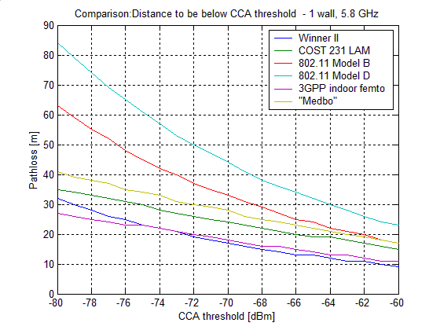
Comparison – Same floor, one wall (NLOS)
TX power: 20dBm

Slide 17
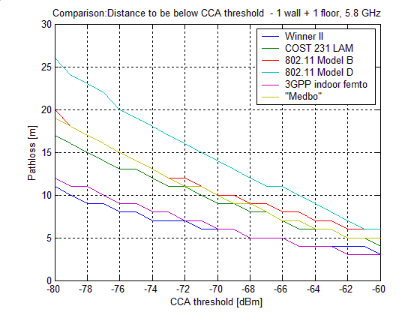
Comparison – different floors, one wall
Note: A floor penetration of 18 dB is here simulated by just reducing the TX power from 20 dBm to 2 dBm

Slide 18
Summary
802.11n channel models (in particular D) appears to give too low attenuation. Not suitable for PL estimation
For single floor – the linear attenuation model seems suitable, e.g. 3GPP HeNB
For Multi-floor penetration, n>1, COST 231 seems to give too high attenuation. Other simple alternatives exist
Overall WINNER II seems as the best model for NLOS

Slide 19
References
[1] “HEW SG simulation scenarios,” S. Merlin, et al., IEEE 802.11-13/1001r3.
[2] “Summary on HEW channel models,” J. Liu et al., IEEE 802.11-13/1135r3.
[3] “Discussions on penetration loss,” J. Liu et al., IEEE 802.11-13/1376r3.
[4] “Improved spatial reuse fesaibility–Part II ”, N. Jindal and R. Porat, IEEE 802.11-14/0083r0
[5] “TGn channel models,” V. Erceg, IEEE 802.11-03/940r4.
[6] COST 231 Final Report, Chapter 4, http://www.lx.it.pt/cost231/final_report.htm
[7] IST-4-027756 WINNER II D1.1.2 V1.2, WINNER II Channel Models, http://www.ist-winner.org/WINNER2-Deliverables/D1.1.2v1.2.pdf
[8] 3GPP TR-36-814: “Further advancements for E-UTRA physical layer aspects”
[9] “Simple and accurate path loss modeling at 5 GHz indoor environments with corridors,” J. Medbo and J.-E. Berg, Proceedings of VTC 2000.
[10] “Spatio-temporal channel characteristics at 5 GHz in a typical office environment,” J. Medbo and J.-E. Berg, Proceedings of VTC 2001.
[11] “Propagation models, cell planning and channel allocation for indoor applications of cellular systems,” C. Törnevik, et al., Proceedings of VTC 1993.
[12] “Channel models for D2D performance evaluation,” 3GPP R1-131620, Ericsson, ST-Ericsson.

Slide 20
BACKUP SLIDES

Slide 21
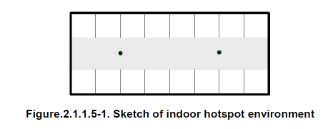
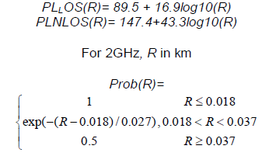
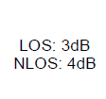
3GPP TR 36.814
Shadow fading

Slide 22
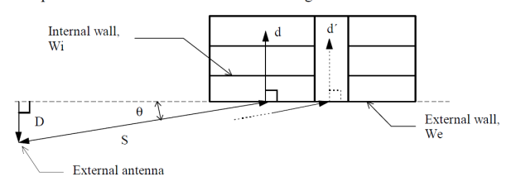
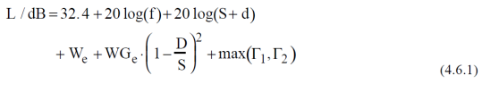
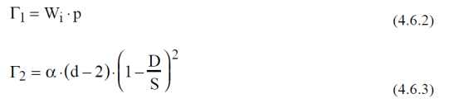
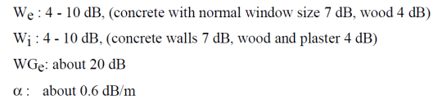
Building Penetration Loss

