Slide 1
Discussions on MCS selection for SLS calibration
Date: 2014-03-16
Authors:
Name | Affiliations | Address | Phone | Email
Tianyu Wu | MediaTek | San Jose, CA, USA |  | tianyu.wu@mediatek.com
Jianhan Liu | MediaTek | San Jose, CA, USA |  | jianhan.liu@mediatek.com
ChaoChun Wang | MediaTek | San Jose, CA, USA | +1-408-526-1899 | chaochun.wang@mediatek.com
Thomas Pare | MediaTek | San Jose, CA, USA |  | thomas.pare@mediatek.com

Slide 2
Background
System Level Simulator (SLS) is an essential tool in HEW
HEW focuses on average throughput enhancement in dense network scenarios
Simulation Scenario [1] and Evaluation Methodology [2] uses system level simulation results for comparison
Calibration and alignment are needed for System level simulator
Calibration for SLS are discussed in [3-4]
In [3-4], step by step calibration and long term SINR calibration methods are discussed. The focus is calibration on PHY abstraction.
With a calibrated PHY abstraction and statistics, different MCS selection scheme will still lead to different system performance
MCS selection schemes need to be defined for SLS calibration
This presentation is to stir further discussions on SLS alignment

Slide 3
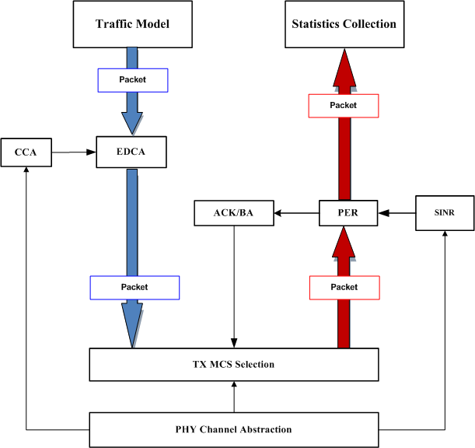
SLS Simulator
The SLS structure is illustrated in the figure
With calibrated PHY channel abstraction, calibration on TX MCS selection scheme is needed
The TX MCS can be determined from PHY abstraction and/or MAC feedback (ACK/BA)

Slide 4
Current MCS selection proposals
Three TX MCS selection schemes are introduced in IEEE Jan meetings [5]
Goodput-maximizing MCS: based on flow’s SINR statistics, find MCS that maximizes goodput=(1-PER)*rate
10% PER MCS: find highest MCS such that PER <= 10%
The above two approaches both rely on the SINR statistics to find the MCS. However, the accurate SINR statistics is very hard to obtain in practice.
No MCS adaptation applied in the above schemes and the system throughput will be low.
The above schemes are not widely implemented schemes.
Genie MCS selection: select the MCS based on instantaneous RX SINR
Always assume RX SINR known at TX
Can serve as a performance upper bound

Slide 5
Proposed MCS selection scheme
Self adaptation TX MCS selection scheme: TX select an initial MCS and adapt the MCS based on events
Detailed description for the scheme:
1. Choose simulation scenario (topology) and traffic model:
Define the simulation parameters
2. Select an initial MCS for each link
Define a rule for the initial MCS selection. As an example, Genie MCS selection can be used for the initial MCS.
3. Run the SLS and adapt the MCS based on the following events
Base on ACK/BA, adapt the TX MCS: if X out of N packets are successful, MCS+1; if Y out of M packets fail, MCS-1.
Need to identify best parameters X, N; Y, M such that throughput is maximized after network is stable.

Slide 6
Discussions
Virtue of Self adaptation TX MCS selection
Easy for implementation
Reflect the real MCS selection in WiFi systems
Adaptive to interference and environment change
Less artificial intervene when running system level simulation
Possibly higher throughput than non-adaptive schemes
Next step
Work out a set of parameters for self adaptation MCS selection scheme
Calibrate the SLS performance with the MCS selection scheme for a number of simulation scenarios

Slide 7
References
[1] “Simulation Scenarios Document Template”, Simone, Qualcomm
[2] “Evaluation Methodology”, Ron, Broadcom
[3] 11-14-0117-00-0hew-phy-abstraction-for-hew-system-level-simulation
[4] 11-14-0116-00-0hew-long-term-sinr-calibration-for-system-simulation
[5] “Improved Spatial Reuse Feasibility - Part II”, Nihar, BRCM

