Slide 1
Energy Efficiency in HEW
Date: 2014-03-17
Authors:

Slide 2
Introduction
802.11 HEW will be the standard of the 5G Wi-Fi.
It is targeting enhancements to the efficiency and performance of wireless local area networks to make them even better complements to LTE-based mobile networks.
Focus on improving real-world, rather than theoretical, spectrum efficiency and area throughput.
Aiming to improve the performance of indoor and outdoor deployments in the presence of interfering sources and dense heterogeneous networks in moderate to heavy user-loaded access points[1]
In most HEW scenarios, the energy source for each user is just a battery, users need to use power efficiently.

Slide 3
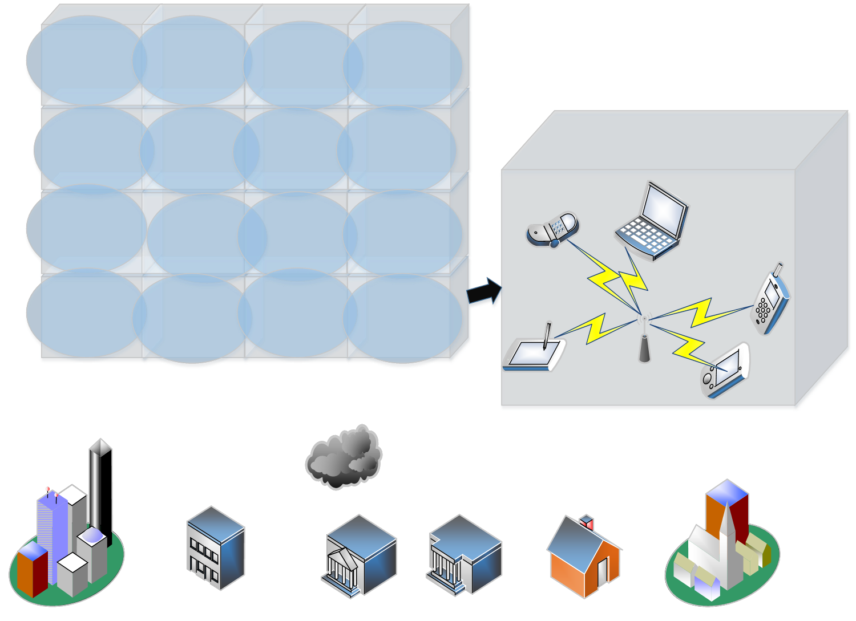

Slide 4
Motivation
Energy efficient has been paid increasing attention under the background of limited energy resource and environmental-friendly transmission behaviors, it is also useful aspect to decrease inter-cell interference
In MIMO-OFDM-based WLAN, the cross layer (PHY layer and MAC layer )power saving technique improves the power efficiency dramatically[2]

Slide 5
Dynamic Carrier Sense Ad hoc Traffic Indication Message[3]
-Mainly improve power save for doze mode
-Very light traffic case
Multiuser resource allocation for power and spectrum efficiency in OFDM system.
-E.g MAC-PHY layer multi-server-scheduling-based resource allocation algorithms[4]
Adaptive transmission power control[5]

Slide 6
The solutions above are about previous 802.11
For HEW, we can inherit and improve these method for dense deployed and strong interference scenario
- E.g adaptive transmission power control for MU-MIMO and multiuser resource allocation in beam-forming case
In a dense deployed building, one room deployed one AP. People always three or four stay together, if adaptive transmission power control and multiuser resource allocation in beam-forming can be used in this scenario:

Slide 7
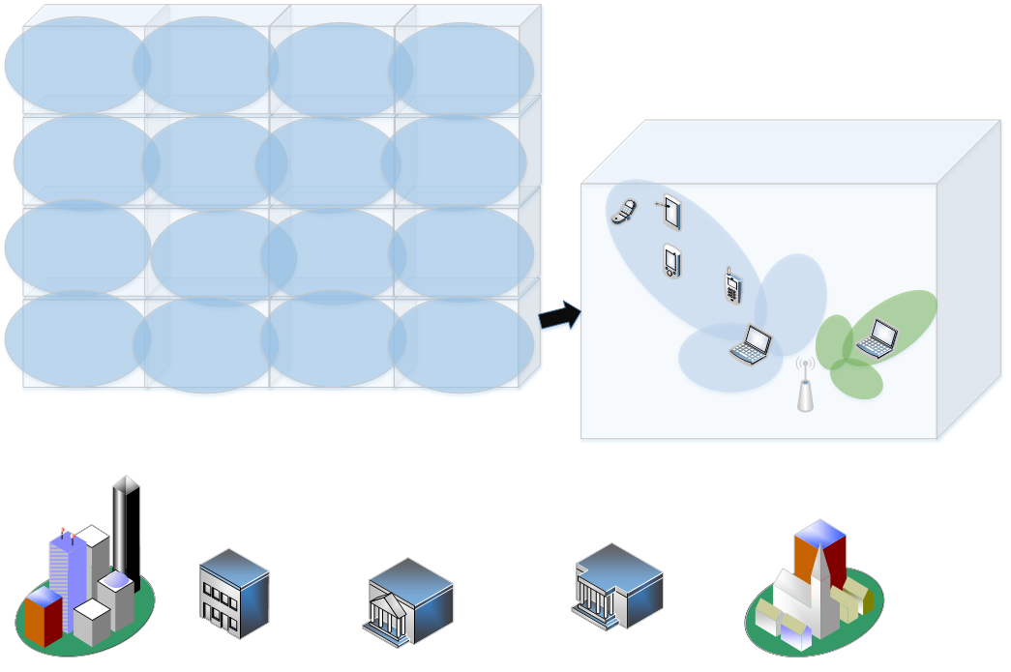

Slide 8
References
[1] doc.:IEEE 802.11-14/0214r2
[2] Il-Gu Lee, Jung-Bo Son, Eun-Young Choi, et al. “Analysis of Power Consumption and Efficient Power Saving Techniques for MIMO-OFDM-based Wireless LAN Receivers”: 2010 Fourth International Conference on Sensor Technologies and Applications pp.597-601, 2010.
[3] M.K. Miller and N.H. Vaidya, “Improving power save protocols using carrier sensing for dynamic advertisement windows,”IEEE MASS, Nov 2005.
[4] Y J (Angela) Zhang. “A Multi-Server Scheduling Framework for Resource Allocation in Wireless Multi-Carrier Networks” IEEE TRANSACTIONS ON WIRELESS COMMUNICATIONS, vol.6 No.11, pp. 3884-3891.
[5] B H Jung, H Jin, and D K Sung. “Adaptive Transmission Power Control and Rate Selection Scheme for Maximizing Energy Efficiency of IEEE 802.11 Stations” 2012 IEEE 23rd International Symposium on Personal, Indoor and Mobile Radio Communications, pp. 266-271,2012.

