Slide 1
System Level Simulations on Increased Spatial Reuse
Date: 2014-03-17
Authors:
Notes:
July 2007

Slide 2
Overviews
APs may select higher CCA levels for AP’s/STA’s carrier sensing in the BSS in several HEW contributions [1].
  Overlapping BSS may have different CCA levels.
Legacy STAs/APs have more chances to detect busy medium than STAs/APs with higher CCA level in Neighbor HEW BSSs.
  STAs/APs in neighboring non-HEW BSS may have low priority to access wireless medium.
  Fairness mechanism may be required.

Slide 3
Simulation Setup (1)
Scenario 1: Residential with only one floor using the PHY and MAC parameters/requirements defined in [1]
  20 apartment rooms (10 STAs per room), 3 random non-overlapping channels
    Positions of both AP and STAs are randomly dropped
  Simulation Time: 10 seconds
Use integrated MAC + PHY simulation
  With greater details on how the WiFi network behaves in the real world from Application layer, TCP/IP, MAC, PHY to the Channel
Notes:
Based on our experience, for a not-yet-tuned integrated simulator with a lot of network details, a 100-room simulation for 10s with multiple drops is do-able. We had done this on a single desktop!
Though our results here are preliminary, in the sense that
1, due to the bandwidth we have, we only able to finish the results with 1 drop; so if some results are not seemingly intuitive, it could be due to randomness, etc
2, I am not sure we should focus on multiple drops…Every drop we should get meaningful results
2, we encourage more companies to participate such simulation-study, so we can compare results and improve, which then can be used to validate/support future proposals that can really improve the network efficiency by validated data collected through simulation or real testbed.
3, For now, I will try to explain our results if you find anything counterintuitive, and we also do not claim that our results are 100% correct. But we do expect that around the mid-2014, we can validate our simulator in every aspect.

Slide 4
Simulation Setup (2)
Application layer
  Each STA runs a UDP client and the associated AP runs the corresponding UDP server
  UDP CBR traffic: 120 Mbps per STA to mimic the uplink full-buffer traffic
  Constant Packet Size: 1500 Bytes
  Best Effort: AC = 2 in EDCA implemented in MAC
IPv4 stack
  Static ARP: no ARP message exchange (some management frames could be easily lost in dense 802.11 network)
MAC layer
  Maximum A-MPDU size: 16x1584 bytes
  TBTT: uniform random distributed→ none of the BSS is synchronized
  Rate Adaptation: Minstrel algorithm [3], a popular rate control algorithm used in Linux wireless drivers/kernels
  11ah BSS coloring mechanism enabled for HEW BSSs
PHY layer and the Channel
  RBIR PHY abstraction [4]
  1x1 802.11 n/ac Channel B: independent fading for each packet in order to go through as many possible channel states as possible
  20MHz channel bandwidth
Notes:
The Address Resolution Protocol is a request and reply protocol that runs encapsulated by the line protocol. It is communicated within the boundaries of a single network, never routed across internetwork nodes. This property places ARP into the Link Layer of the Internet Protocol Suite,[2] while in the Open Systems Interconnection (OSI) model, it is often described as residing between Layers 2 and 3, being encapsulated by Layer 2 protocols. However, ARP was not developed in the OSI framework.
Based on our observation, it cannot be take granted that any management/control frame can be TX/RX without any problem. A failure on ARP frame exchange can easily halt the transmission of data packets, that is why we choose to use static ARP, in which we pre-calculate the ARP table for each STA/AP.

Slide 5
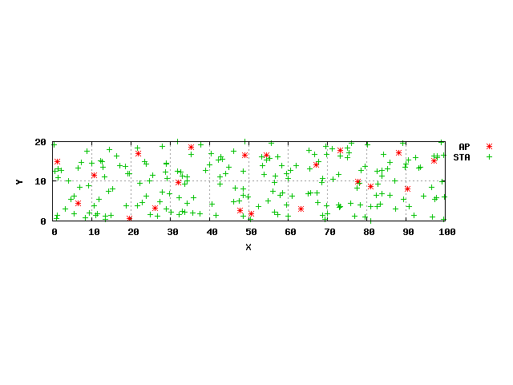
Topology and Random Channel Assignment
Doc.: IEEE 802.11-14/0372r2
BSSs with the same color are on the same frequency channel
Notes:
Here we only the x and y coordinates in a room…
Since we only have one drop, we cannot guarantee that three channels are equally used by 20 rooms…
//----for JJ’s usage---
Channel assignment map for each Ap:
2 2 0 0 1
0 0 2 2 2
0 2 0 1 1
2 0 0 2 2
Ap index-room map
19 14 7 9 2 3 1 8 11 20
12 13 15 17 16 6 4 5 18 10

Slide 6
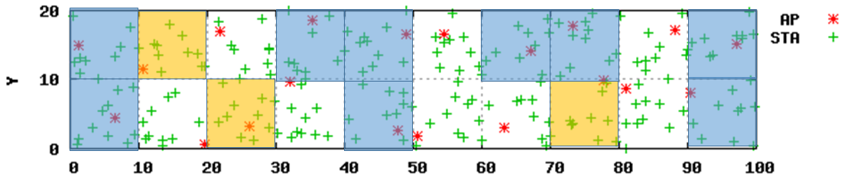
Result-1: All HEW BSS
36% gain
Notes:
Here we only the x and y coordinates in a room…
Since we only have one drop, we cannot guarantee that three channels are equally used by 20 rooms…
//----for JJ’s usage---
Channel assignment map for each Ap:
2 2 0 0 1
0 0 2 2 2
0 2 0 1 1
2 0 0 2 2
Ap index-room map
19 14 7 9 2 3 1 8 11 20
12 13 15 17 16 6 4 5 18 10

Slide 7
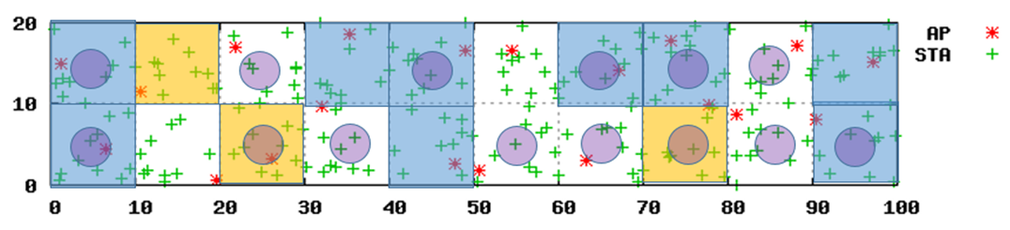
Result-2: Mixed HEW-BSS and Legacy-BSS
HEW BSS: either -82 or -62 dBm
CCA level, BSS Color
HEW BSSs using -82dBm CCA
HEW BSSs using -62dBm CCA
Legacy BSS: Fixed -82dBm CCA
level, No BSS Color
48% Drop
Notes:
Here we only the x and y coordinates in a room…
Since we only have one drop, we cannot guarantee that three channels are equally used by 20 rooms…
//----for JJ’s usage---
Channel assignment map for each Ap:
2 2 0 0 1
0 0 2 2 2
0 2 0 1 1
2 0 0 2 2
Ap index-room map
19 14 7 9 2 3 1 8 11 20
12 13 15 17 16 6 4 5 18 10

Slide 8
Conclusions
Increasing CCA level with BSS Color can improve spatial reuse in HEW BSS and boost the throughput in residential use case.
STAs/APs in legacy BSS detect more busy medium than STAs using higher CCA level.
  Legacy STAs/APs have more chances to detect busy medium than STAs/APs with higher CCA level.
Fairness mechanism is required for coexistence among STAs with different CCA levels.
Next Steps: Simulate different scenarios, using calibrated PHY&MAC SLS

Slide 9
Reference
[1] 11-14-0082-00-0hew-improved-spatial-reuse-feasibility-part-i
[2] 11-13-1001-06-0hew-simulation-scenarios-document-template
[3]http://wireless.kernel.org/en/developers/Documentation/mac80211/RateControl/minstrel
[4] 11-14-0117-00-0hew-phy-abstraction-for-hew-system-level-simulation

