Slide 1
Extended Intra-Vehicle Channel Model
Date: 20-Jan-2014
Authors:

Slide 2
Abstract
In this submission the wireless channel inside a vehicle is discussed
This submission extends [1] by both presenting results for 3 types of vehicles and by presenting results in the 5GHz band

Slide 3
Introduction
Wireless LAN is becoming an industry de-facto standard in the automotive world
The number of vehicle brands and models equipped with WLAN is constantly increasing
The leading usage for high speed WLAN in the automotive world is for infotainment
Nowadays the experience integration and sharing between the driver’s own device (e.g. cell phone) and the vehicle is on the rise
We should aim that both the driver and the passengers get a good connectivity experience comparable to the connectivity experience in the office or at home

Slide 4
WLAN Unique Scenarios in Automotive Infotainment
Traffic jams
Each WLAN equipped vehicle is an AP
In traffic jams the distance between vehicles is small and the AP density is high
The vehicular APs are typically not jointly controlled or managed
In traffic jams there is a slow movement of the vehicles
Implications:
OBSS
High interference levels
Interferers channels change at the speed the vehicles move

Slide 5
WLAN Unique Scenarios in Automotive Infotainment (Cont’d)
Communication between a static AP and a STA in a moving vehicle
The intra vehicle channel is affected by the vehicle’s surrounding
Although the direct path between the AP and the STA is mostly static, the multipath can be affected by the mobility
Implications:
Long delay spread
Doppler PDF proportional to the movement profile and speed

Slide 6
Intra-Vehicle Wireless Channel Measurement Setup
The wireless channel measurements were performed using the following equipment:
GM vehicles: compact size, SUV and a large SUV
Network analyser
4 omni-directional WiFi antennas in a 2x2 configuration
Distance between each set of 2 antennas is 10 cm
Measured frequency bands: 2.4GHz-2.5GHz, 5.150GHz-5.250GHz
Vehicle is parked in a stationary environment
In this setup there were no driver or passengers in the vehicle

Slide 7
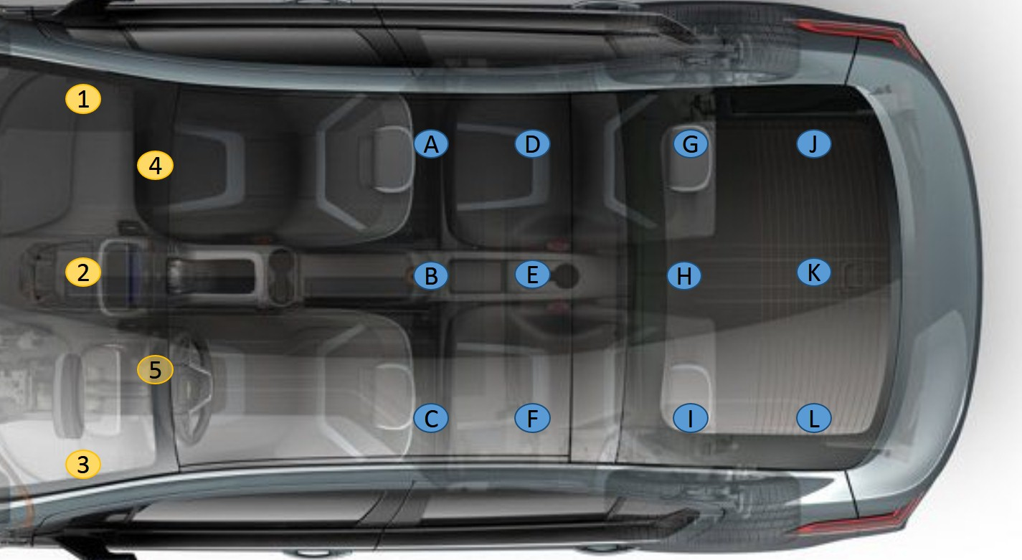
Compact Vehicle Channel Measurement Locations

Slide 8
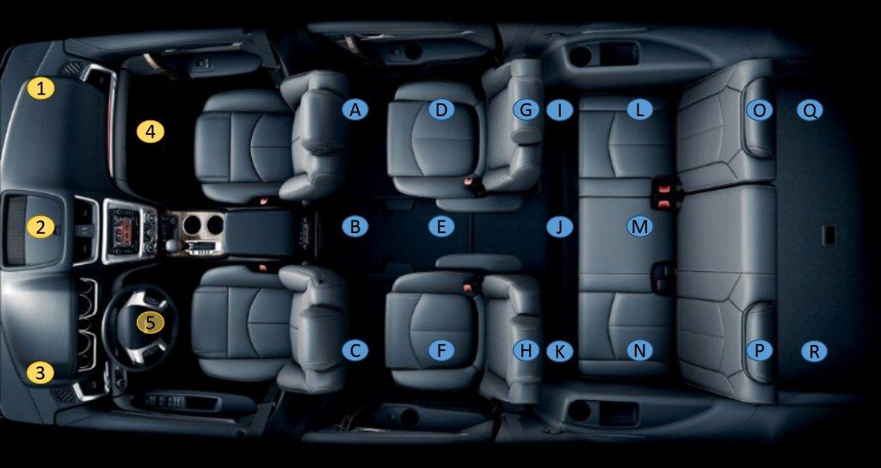
SUV Channel Measurement Locations

Slide 9
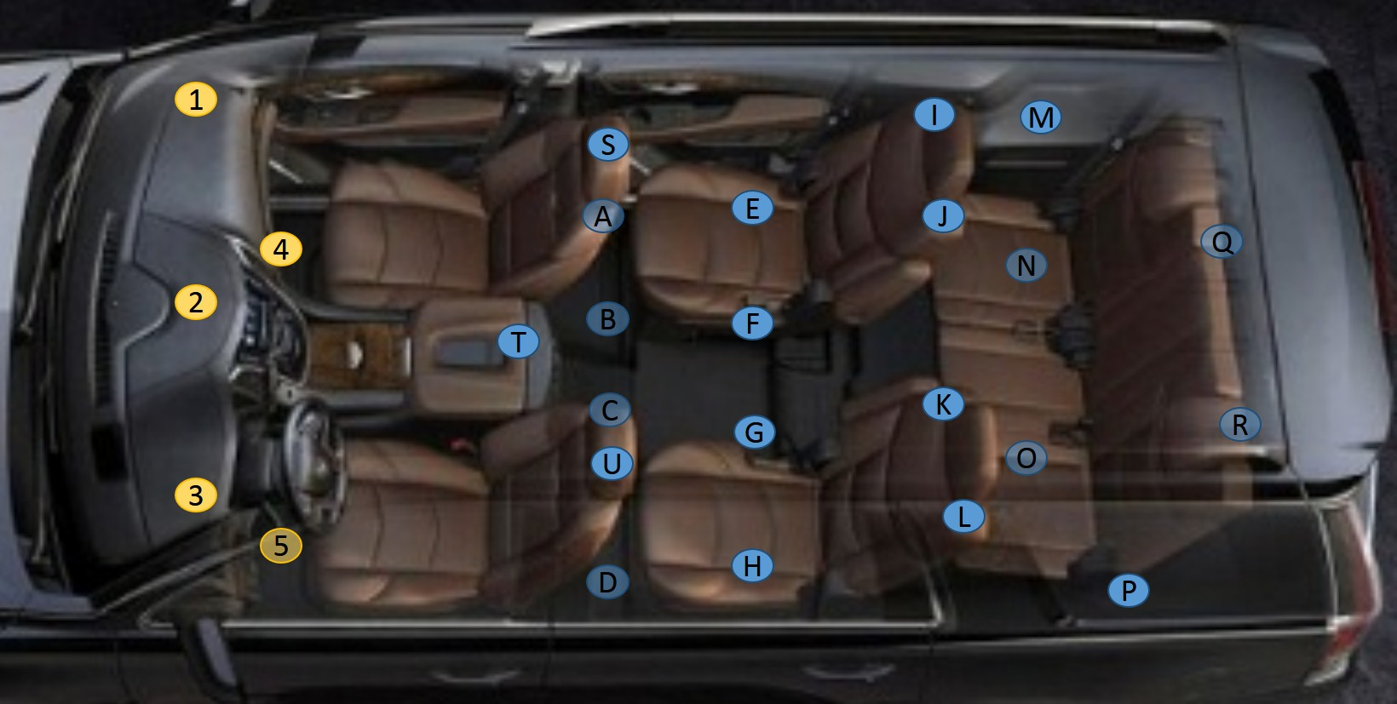
Large SUV Channel Measurement Locations

Slide 10
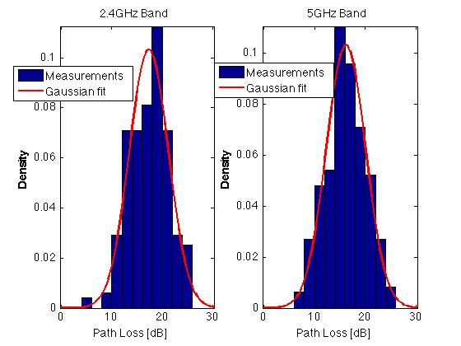
Compact Vehicle Channel Path Loss

Slide 11
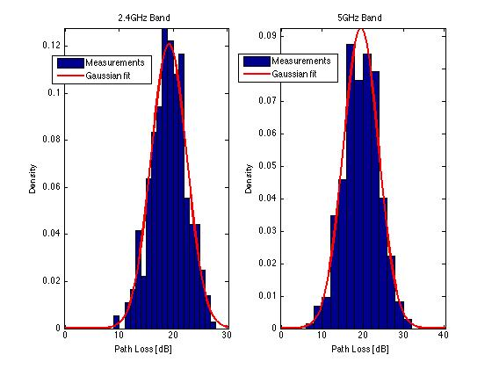
SUV Channel Path Loss

Slide 12
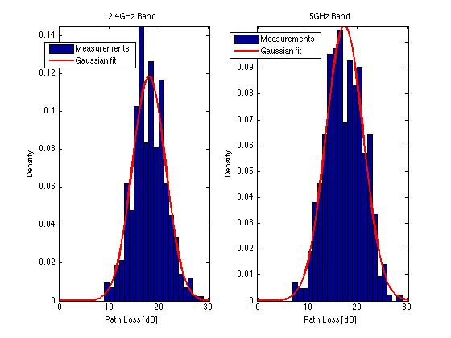
Large SUV Channel Path Loss

Slide 13
Intra-Vehicle Wireless Channel Path Loss
Measurement results fit the model: $L\left(d\right)=L_{m}\left(d\right)+s$
$L\left(d\right)$ - total path loss
$L_{m}\left(d\right)$ - mean path loss
$s$ – shadowing, log normal zero mean r.v.

Slide 14
Intra-Vehicle Wireless Channel Path Loss Log Normal Fit Summary
 |  | Compact Vehicle | SUV | Large SUV
2.4GHz | Mean path loss | 17.3dB | 19.2dB | 18.0dB
 | Shadowing variance | 14.9dB | 10.9dB | 11.3dB
5GHz | Mean path loss | 16.2dB | 19.5dB | 17.4dB
 | Shadowing variance | 15.0dB | 18.5dB | 14.0dB

Slide 15
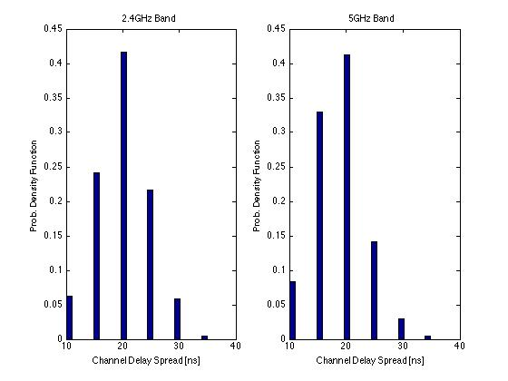
Compact Vehicle Channel Delay Spread

Slide 16
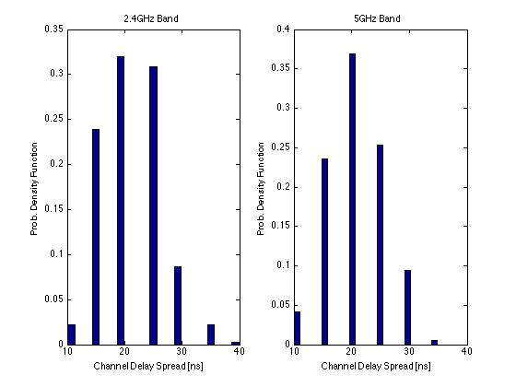
SUV Channel Delay Spread

Slide 17
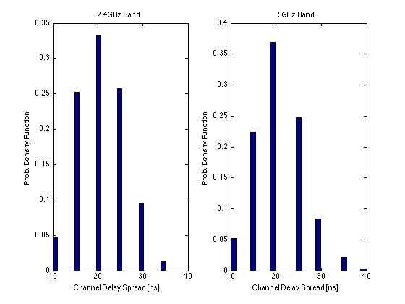
Large SUV Channel Delay Spread

Slide 18
Intra-Vehicle Wireless RMS Channel Delay Spread Summary
No clustering effect was seen
 | Compact Vehicle | SUV | Large SUV
2.4GHz | 20.5ns | 22.0ns | 21.4ns
5GHz | 19.1ns | 21.3ns | 21.5ns

Slide 19
Intra-Vehicle Wireless Channel Discussion
The RX power of an intra-vehicle WLAN system is strong relative to indoor scenarios, that is the system is not Rx power limited
The variance of the path loss shadowing in the 5GHz band is higher in large vehicles than the 2.4GHz band variance
Intra-vehicle delay spread in nomadic confined area scenarios is shorter than current WLAN indoor channel models, hence supported by current standards

Slide 20
References
[1] Intra-Vehicular Channel Model, IEEE 11-14/0088r0

