Slide 1
Utilizing Unused Resources by Allowing Simultaneous Transmissions
Date: 2014-03-17
Authors:

Slide 2
Abstract
The proposal is that HEW defines enhancements to Virtual and Physical carrier sensing to enable simultaneous transmissions
  The simultaneous transmissions improve spectral efficiency
  The enhancements require better interference coordination
The presentation describes:
  the current carrier sensing mechanisms
  unused resources
  proposes methods to utilize the unused resources

Slide 3
Current WLAN Charasteristics for Spatial Reuse
Physical and Virtual carrier sense targets that only a single STA operates at a time
The channel access is simple
The channel access is efficient especially without OBSS and without congestion

Slide 4
Current WLAN Protection Mechanisms
WLAN has protection mechanisms:
  PHY carrier sensing, Clear Channel Assessment (CCA)
    The STA senses channel idle, if the CCA assess the energy in the channel to be less than CCA threshold
  PHY carrier sensing, PPDU duration protection
    If the STA receives a preamble, the STA does not access the channel during the PPDU transmission
    When Preamble is received, but the PPDU is not received, the STA uses EIFS protection after the PPDU
  Virtual carrier sensing, NAV
    The STA shall not access the channel when the NAV is set
    NAV value is obtained from the Duration field of the MAC Header

Slide 5
Solving Hidden Terminal Problems with RTS CTS
Transmissions without RTS CTS
  TXOP initiated by data transmission sets PHY and EIFS protection around the TXOP Holder
  ACK sets the NAV also around the data receiver
Transmissions with RTS CTS
  The RTS CTS sets virtual carrier sensing (NAV protection) around the TXOP Holder and data receiver in short time
    RTS ~50µs, SIFS 16µs and CTS ~40µs
  First, RTS CTS mitigates the hidden terminal problems
  Additionally, STAs that received RTS may be reset the NAV, if they do not receive a preamble within CTS_Timeout

Slide 6
Interference Tolerance of TXOP Holder and Data Receiver
A TXOP Holder and a data receiver have difference in interference tolerance:
  The data SMCS is optimized for the link making the data receiver more vulnerable for interference than TXOP Holder, which receives ACKs and BAs transmitted with low MCS
Consequently, a TXOP Holder tolerates higher interference from simultaneous transmissions than a data receiver

Slide 7
Spatial Reuse Improvements that Relate only to PHY Carrier Sensing
Proposals to adjust the CCA threshold consider only the TXOP Holder
In the example the arrow shows the CCA threshold protection between TXOP Holder and Interferer
  The location of the TXOP holder, interferer and Data receiver define the usefulness of the Physical carrier sensing
TXOP Holder
Interferer#1
Interferer#2
Data Receiver

Slide 8
Spatial Reuse Improvements that Relate only to PHY Carrier Sensing
It is unclear how virtual carrier sensing and CCA threshold modifications fit together.
  When NAV is set, the channel is busy regardless of CCA threshold
The legacy STAs may consider the channel busy, if HEW STAs apply higher CCA threshold

Slide 9
Unused System Resources
STA considers the channel busy even if the intended receiver is capable to receive
  This STA is called as exposed terminal
HEW should provide means for an exposed terminal to transmit simultaneously whenever feasible
  The exposed terminal needs to know its and its intended recipient relationship to ongoing transmissions

Slide 10
Proposal
HEW should specify means for simultaneous transmissions scheme shall be compatible with physical and virtual carrier sensing
To maximize the network performance the interference level shall be optimized for data receiver and transmitter
  The data receiver does not tolerate additional interference
As shown in appendix simultaneous transmissions improve WLAN system performance

Slide 11
APPENDIX
Simulation Example:
Simulation of system throughput with simultaneos transmissions

Slide 12
Example simulation scenario
Scenario with 2 BSSs and full buffer DL transmission
Distance between the BSSs is varied
Two operation modes with respect to OBSS are compared:
  1. Current WLAN principle
  2. Simultaneous (Medium is always seen idle. NAV and CCA not in use)

Slide 13
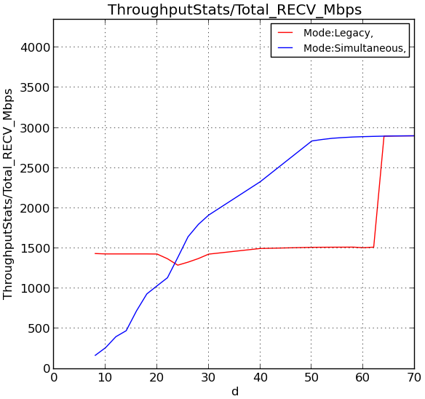
System throughput (Combined from the BSSs)
With legacy mode, the simultaneous transmissions are not allowed unless the BSSs are completely isolated.
The legacy mode works well when BSSs are very close (d < 24m) or very far (d > 65m).
In between, it would be useful to let BSSs transmit simultaneously, but it is not allowed in the legacy mode.
How to benefit from simultaneous transmissions?
d is the distance between BSSs

