Slide 1
Calibration of System Level Simulators
Date: 2014-03-17
Authors:

Slide 2
Outline
Abstract
Simulated Scenario
Results
SINR
Throughput
Number of concurrent transmissions
Reference
Conclusions
Appendix

Slide 3
Abstract
Simulation calibration verifies that simulators generate the same results on the same simulation scenario
Calibration improves simulations reliability
The presentation introduces the most important calibration metrics [2]
A new calibration metric is proposed
The presentation shows the calibration results for HEW scenario 1 [1]
Scenario 1 is simplified to add understandability to the results

Slide 4
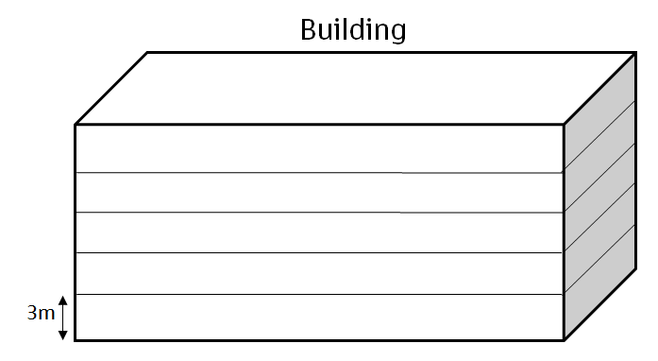
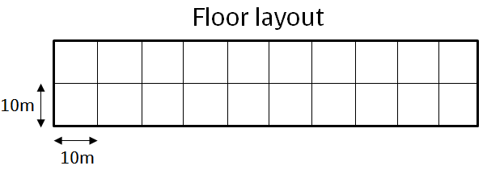
Scenario and Parameters
Same parameters as in [1]
5 floors building with 20 rooms (10x10x3) per each floor
One AP per each room, x and y randomly chosen, z=1.5
Wall loss: 12 dB
Floor loss: 17dB + 4dB per floor
TX Power: STA= 17dBm; AP= 23dBm;
Another parameters:
TGn/TGac channel model C
80 MHz bandwidth
The same primary channel
Full buffer traffic model
Static MCS: 64QAM 5/6

Slide 5
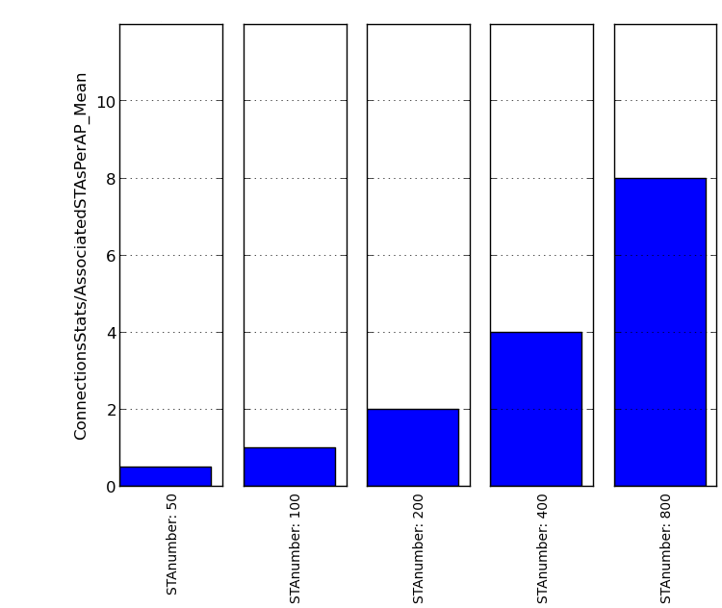
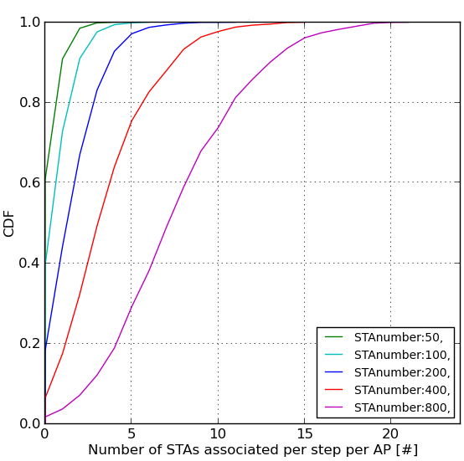
STAs Drop Parameters
Number of STAs per scenario: 50, 100, 200, 400, 800
The STAs are randomly distributed over the building
A)
Figure A shows the average amount of STAs per one AP
Figure B shows the CDF of instantaneous number of STAs per one AP
B)

Slide 6
Simulation Results
The presentation explains and shows results to following metrics:
SINR
Throughput
Number of concurrent transmissions
The results are presented for the following parameters:
FastFading: On/Off
RtsCts: On/Off
Traffic: DL/UL
Number of concurrent STAs: 50, 100, 200, 400, 800

Slide 7
SINR Statistics
SINR metric is presented in Scalar and CDF form, where scalar figures show the average numbers over the whole simulation time
The SINR samples are collected from data PPDUs and one sample presents an average SINR over one MPDU
The SINR figures show the instantaneous SINR results for simulation with Fast Fading
In the simulations without Fast Fading the instantaneous SINR is equal to the long term SINR

Slide 8
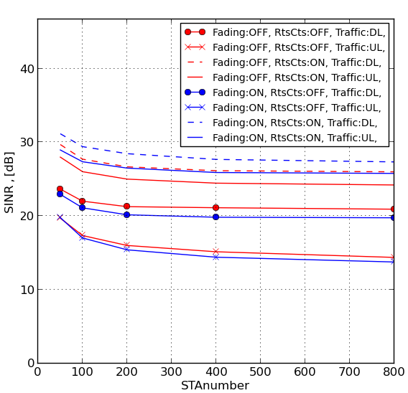
SINR
RTS CTS has big effect on SINR
The SINR in UL is probably lower due to the lower transmission power and more close-by interferers

Slide 9
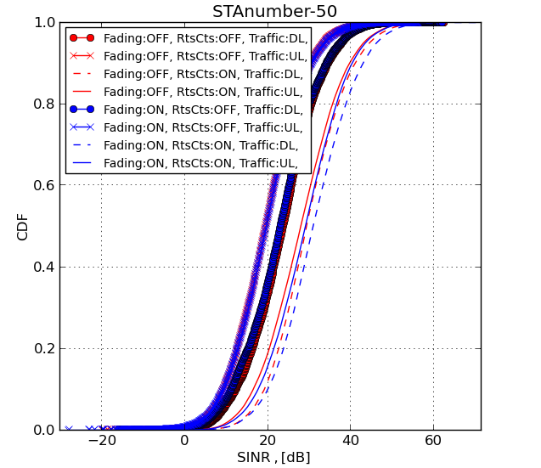
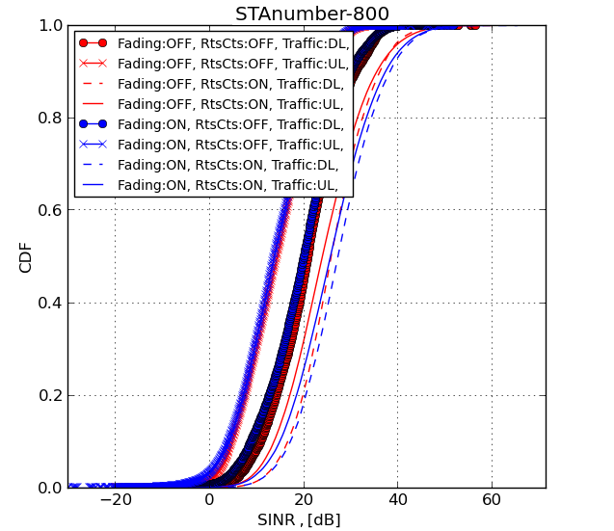
SINR
These figures show the CDF of SINR per MPDU containing user data
Left and right figures show SINR performance for 50 and 800 STAs respectively
It can be seen that the SINR difference between these figures is not big; thus SINR for other number of STAs is not showed

Slide 10
Throughput Statistics
Throughput metric is presented in scalar and CDF form, where scalar figures will show the average throughput over whole simulation time
In addition three throughput statistics are presented
Throughput per call, which shows the average throughput over a call
Total system/scenario throughput
Throughput per AP

Slide 11
Throughput Statistics
Throughput statistics show the result of multiple features operation:
Link adaptation and link performance
Channel access and offered traffic load
Link adaptation is a key to good throuhgput
Link adaptation mechanism should be discussed in IEEE
The results are created with constant MCS 64QAM 5/6
Appendix1 describes a link adaptation principle and shows results with the link adaptation

Slide 12
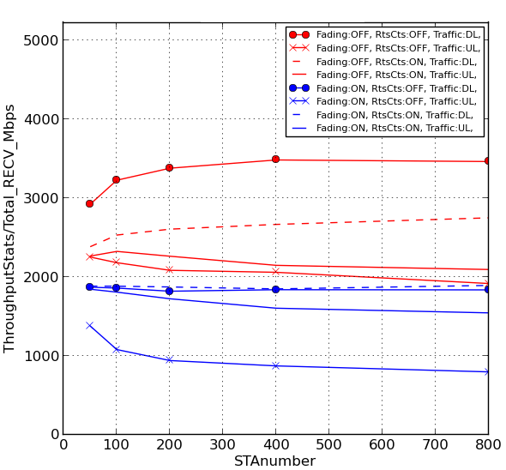
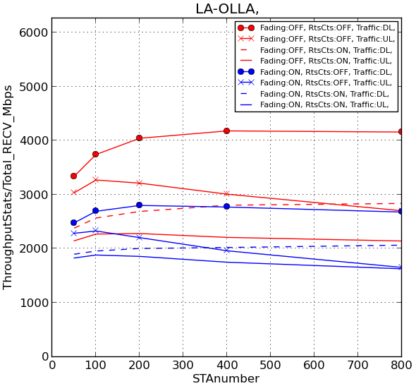
Total System/Scenario Throughput
The SINR and concurrent transmissions statistics are made for static MCS. Only throughput statistics with OLLA are provided
MCS 64QAM 5/6
With OLLA
As explained in Appendix 1

Slide 13
Throughput results
The fast fading has big impact on the throughput results
Link adaptation is required to adjust the transmissions to the interference level
The constant MCS performs poorly especially when the number of concurrent transmissions gets high
Throughput with RTS CTS is similar with or without link adaptation performance
RTS CTS reduces interference and limits the number of simultaneous transmissions in the BSS

Slide 14
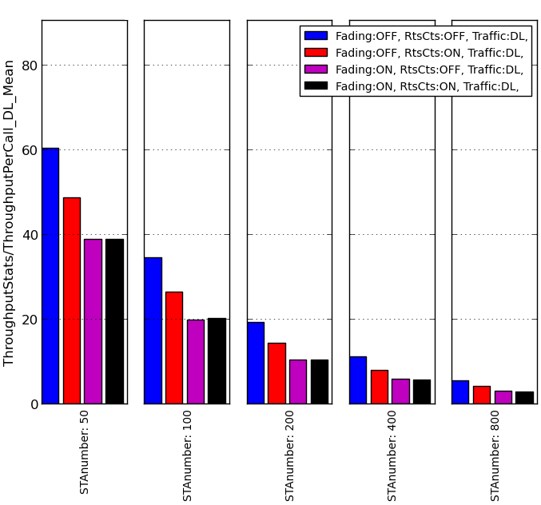
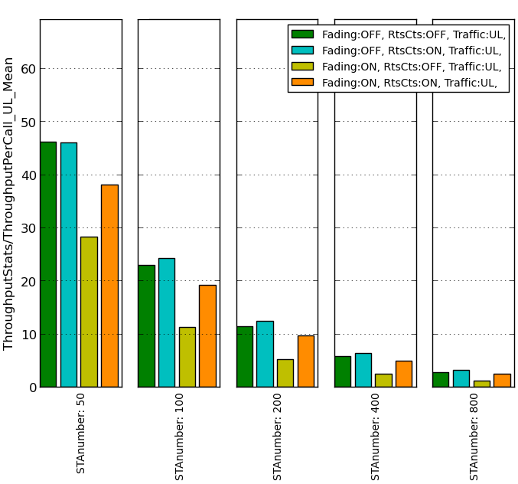
Average Throughput per Call
A)
B)
Figure in left shows DL throughput per call in Mbps
Figure in right shows UL throughput per call in Mbps
Static MCS 64QAM 5/6 in use

Slide 15
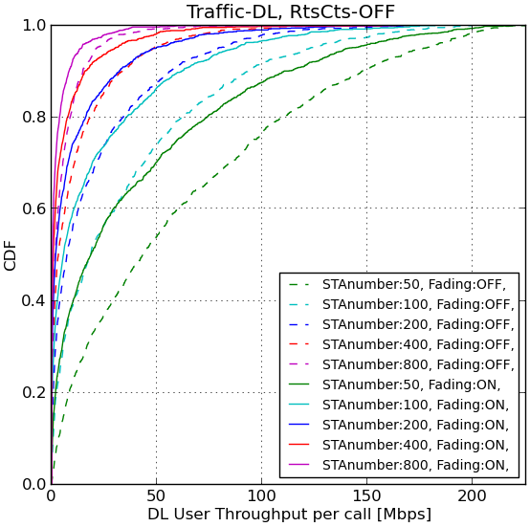
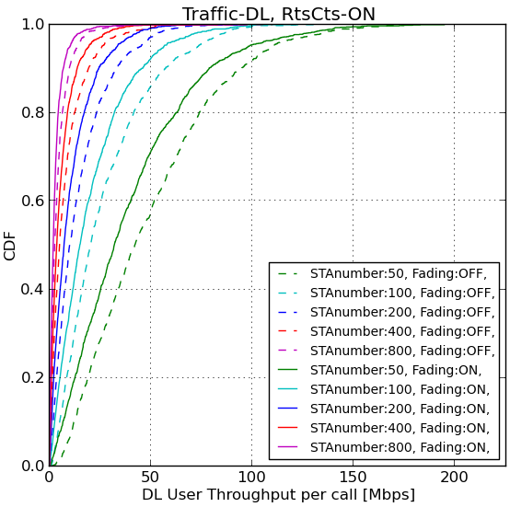
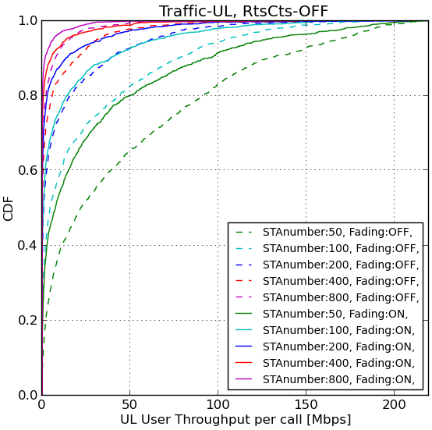
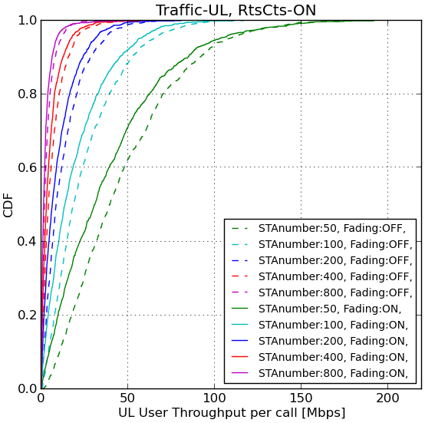
CDF of Throughput per Call
MCS 64QAM 5/6

Slide 16
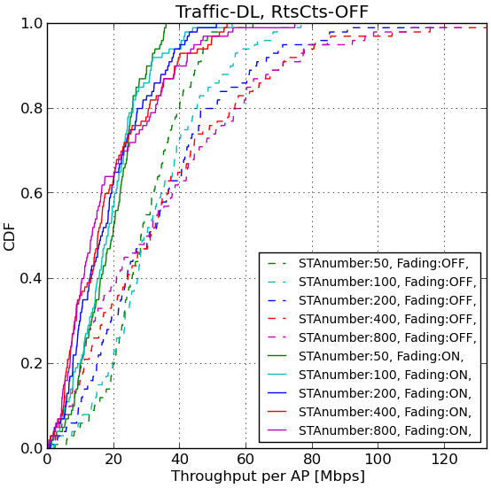
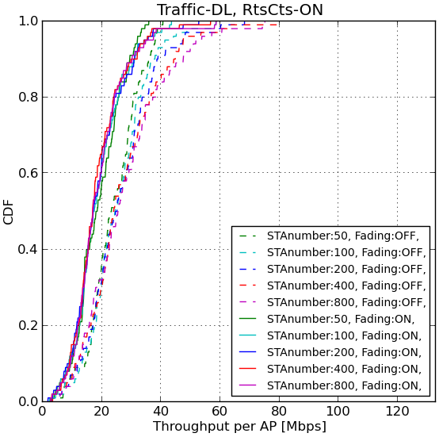
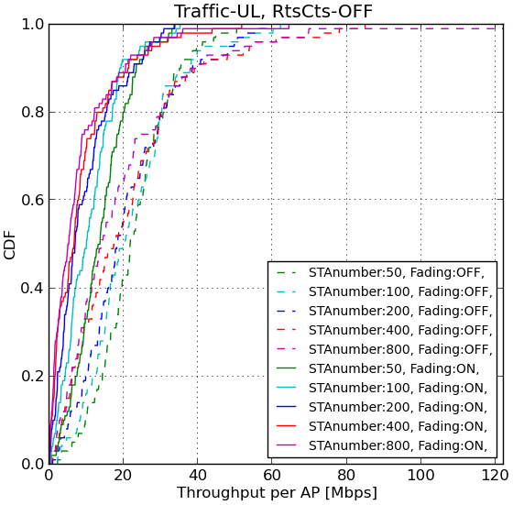
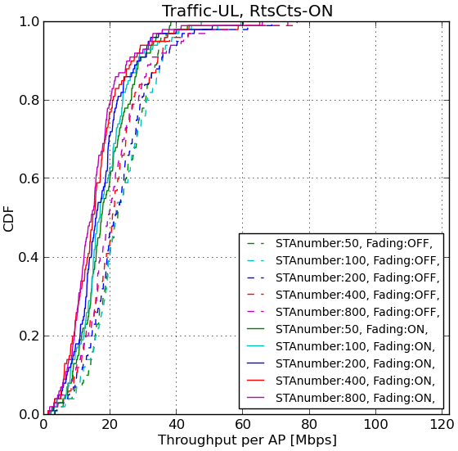
CDF of Throughput per AP
MCS 64QAM 5/6

Slide 17
Number of Concurrent Transmissions Statistics
The number of concurrent transmissions statistics shows the number of transmitting devices at the same symbol
This metric does not show the number of successful transmissions
The number of concurrent transmissions indicates the level of channel reuse
The physical and virtual carrier sensing affect to the number of simultaneous transmissions
EDCA parameters, number of competing STAs and traffic amount affect to the number of simultaneous transmissions
The number concurrent transmissions affects to the interference level

Slide 18
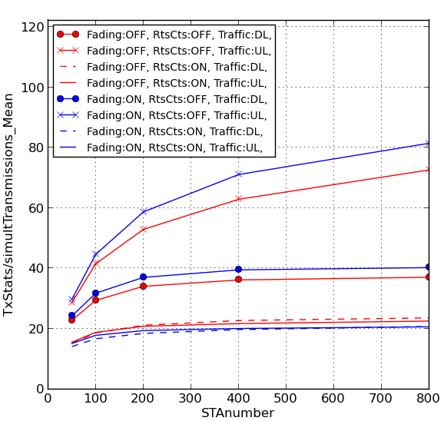
Number of Concurrent Transmissions
When RTS CTS is not used, in UL the number of simultaneously transmitting STAs increases as a function of number of STAs
RTS CTS eliminates some simultaneous transmissions and makes the number of simultaneous transmissions constant

Slide 19
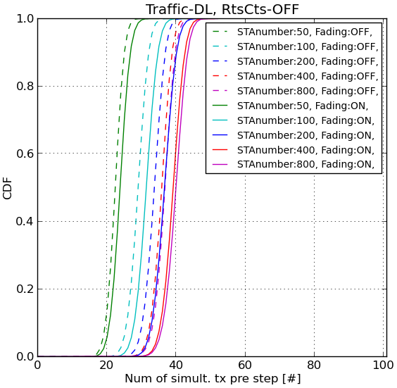
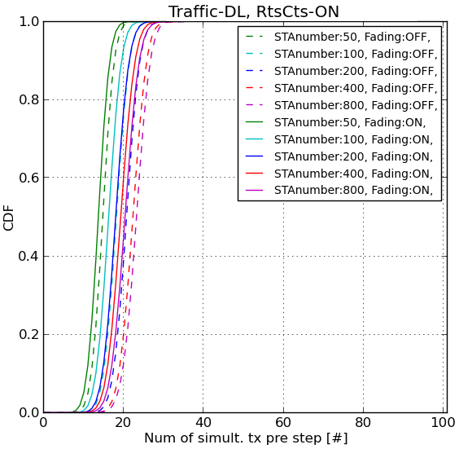
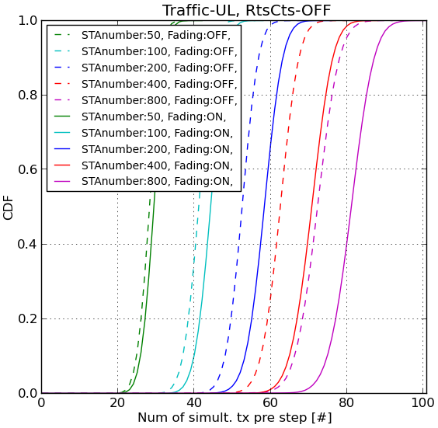
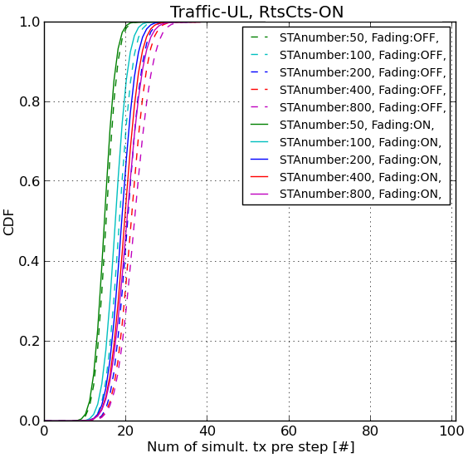
Number of Concurrent Transmissions

Slide 20
Conclusions
The presentation shows the calibration results for HEW scenario 1
Number of concurrent transmissions metric is proposed to calibration results
The metric measures channel reuse
The calibration results verify the correct operation of the system level simulator
The simulator implementation details may differ

Slide 21
References
[1] 11-13-1051-01-0hew-evaluation-methodology
[2] 11-14-0053-00-0hew-further-consideration-on-calibration of system level simulation

Slide 22
Appendix 1: Link Adaptation Algorithm
Link adaptation consists of inner-loop (ILLA) and outer-loop (OLLA) link adaptation functions
ILLA assesses the RSSI of the link and selects the best MCS based on the RSSI thresholds
OLLA counts the number of ACKs and NACKs and then tunes the MCS selected by the ILLA up or down
The target of OLLA is to select the MCS so that the MPDU failure rate is tuned to 5%
OLLA parameters were not optimized for the scenario and better performance could be gotten by doing that

Slide 23
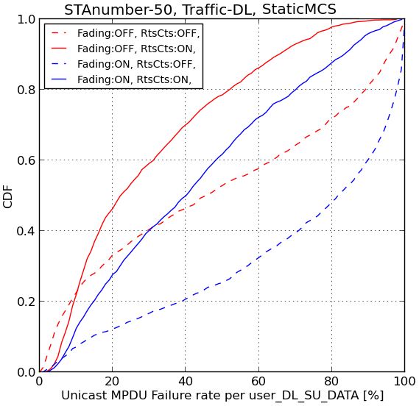
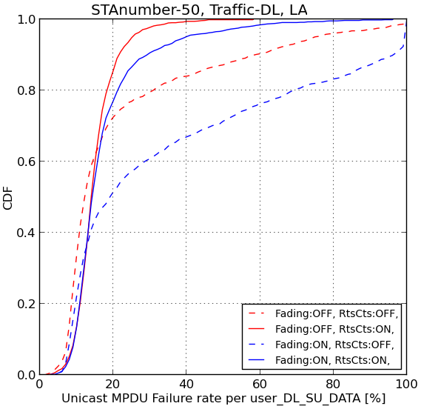
Appendix 1: Link Adaptation versus static MCS
These figures shows the MPDU failure rate per user in %
Left figure shows results for simulation with static MCS (64QAM 5/6)
Right figure shows results with OLLA
OLLA is used in all simulations presented in the next slides. In these simulations OLLA affects to the throughput results

Slide 24
Appendix 1: OLLA
Total System/Scenario Throughput

Slide 25
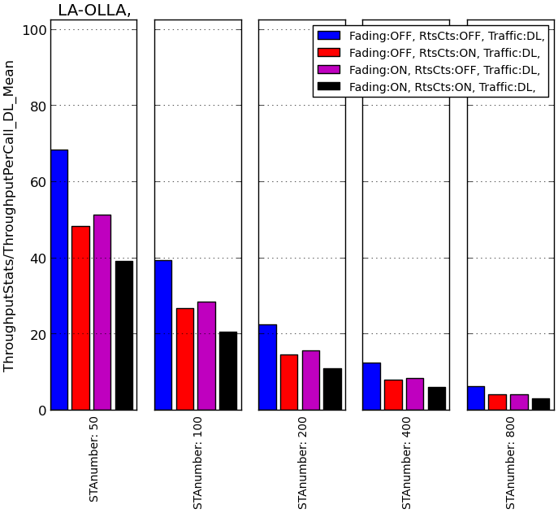
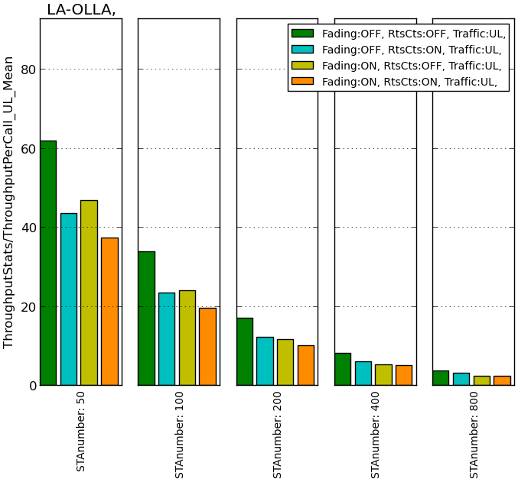
Appendix 1: OLLA
Average Throughput per Call
A)
B)
Figure in left shows DL throughput per call in Mbps
Figure in right shows UL throughput per call in Mbps

Slide 26
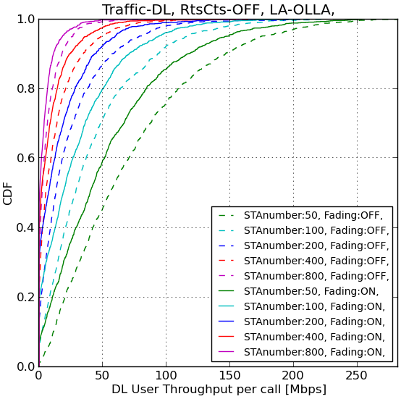
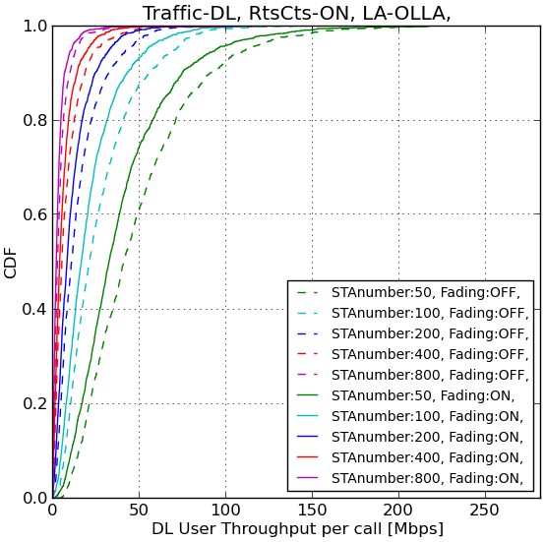
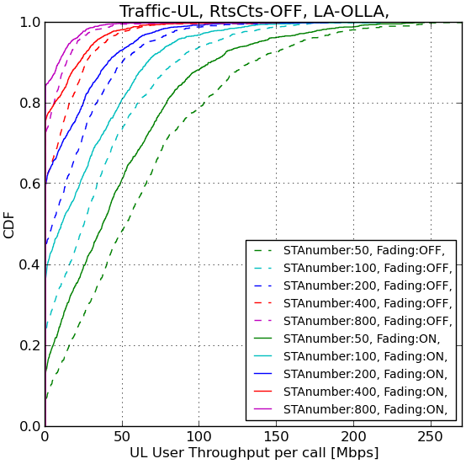
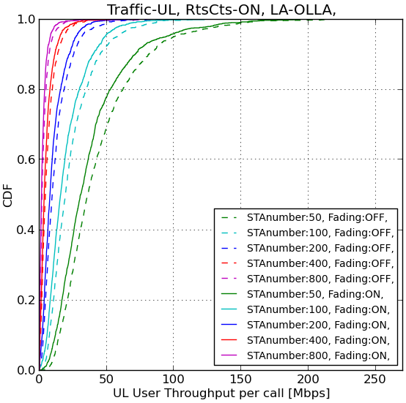
Appendix 1: OLLA
CDF of Throughput per Call

Slide 27
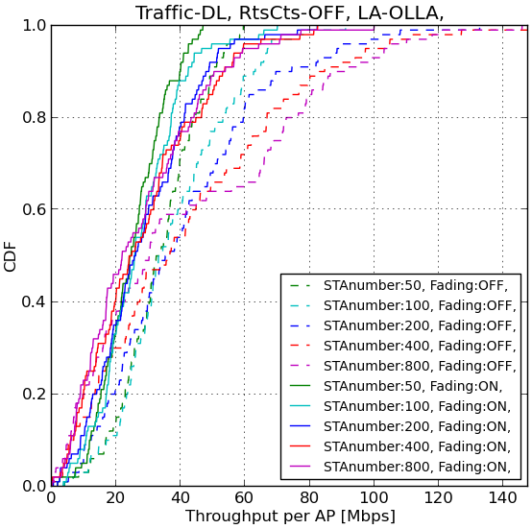
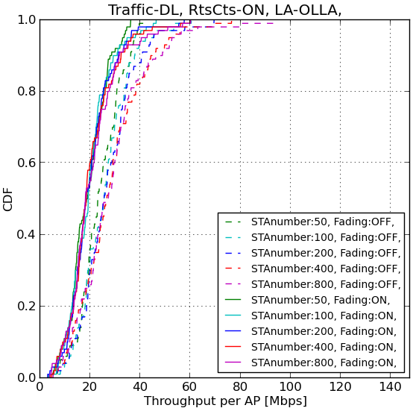
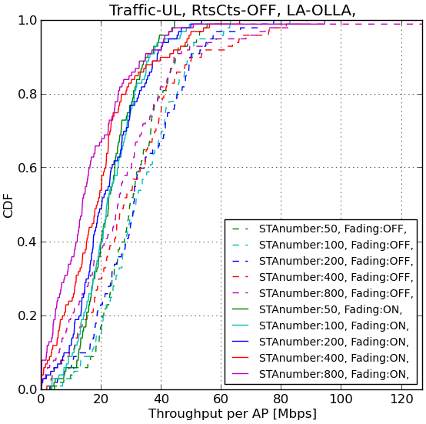
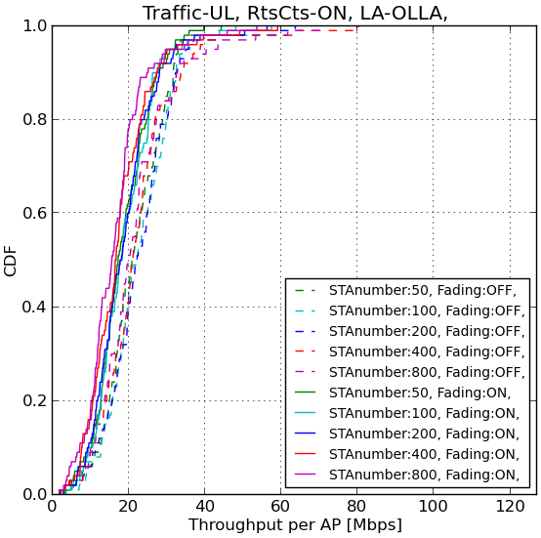
Appendix 1: OLLA
CDF of Throughput per AP

Slide 28
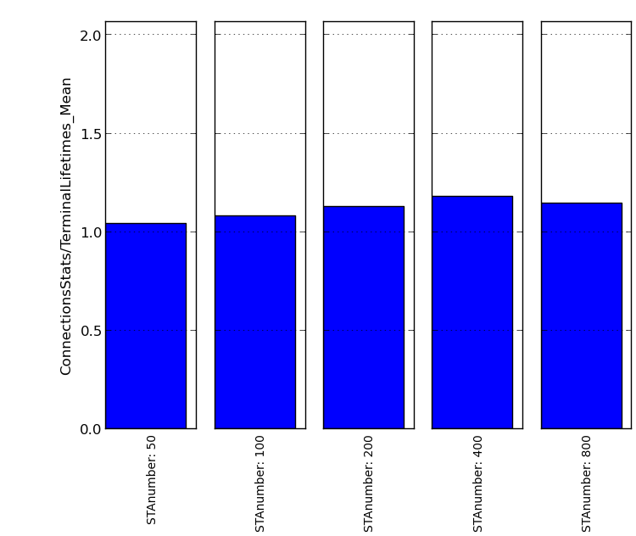
Appendix 2: Traffic Parameters
Full buffer traffic model is used in simulations
Each call creates traffic for 1 second
After 1 second the traffic generation is stopped. The STA empties its transmission buffer. When the buffer is empty the call is terminated
The figure in right hand side shows the mean STA lifetime in seconds [s]
When a STA finishes its call, another STA is created to a new random place
Separate simulations for DL and UL traffic
Interpretation of the results is much more easier in this way

Slide 29
Appendix 3: Numerical Results of One Parameter Set
 |  | SINR, dB |  |  | Throughput per Call, Mbps |  |  | Throughput per AP, Mbps |  |  | Transmissions |  | System throughput, Mbps
Simulation case | 5% | 50% | 95% | 5% | 50% | 95% | 5% | 50% | 95% | 5% | 50% | 95%
DL, FF, RtsCts, 50 | 16.7 | 30.84 | 46.15 | 3.36 | 31.86 | 98.02 | 5.85 | 18.2 | 32 | 10 | 14 | 18 | 1880.74
DL, FF, RtsCts, 100 | 15.53 | 29.1 | 43.95 | 1.34 | 14.87 | 56.38 | 6 | 17.2 | 34.8 | 13 | 17 | 21 | 1880.27
DL, FF, RtsCts, 200 | 14.74 | 28.21 | 42.78 | 0.44 | 7.06 | 33.26 | 6.4 | 17.1 | 34.95 | 14 | 18 | 23 | 1870.33
DL, FF, RtsCts, 400 | 14.06 | 27.48 | 41.79 | 0.14 | 3.5 | 19.34 | 6.45 | 16.85 | 34.8 | 15 | 20 | 24 | 1845.77
DL, FF, RtsCts, 800 | 14.09 | 27.14 | 41.34 | 0.02 | 1.74 | 10.03 | 6.5 | 16.95 | 36.1 | 16 | 21 | 25 | 1889.79
UL, FF, RtsCts, 50 | 14.45 | 28.98 | 43.46 | 1.87 | 30.75 | 102.52 | 6.65 | 17.25 | 33.3 | 11 | 15 | 19 | 1841.97
UL, FF, RtsCts, 100 | 13.21 | 27.31 | 41.83 | 0.63 | 13.5 | 55.96 | 6.65 | 16.7 | 35.25 | 14 | 18 | 22 | 1804.8
UL, FF, RtsCts, 200 | 12.39 | 26.36 | 41.21 | 0.18 | 6.26 | 30.88 | 4.8 | 15.6 | 31.7 | 15 | 19 | 24 | 1720.46
UL, FF, RtsCts, 400 | 11.76 | 25.71 | 40.69 | 0.06 | 2.9 | 17.02 | 5.05 | 14.65 | 34.4 | 15 | 20 | 25 | 1600.77
UL, FF, RtsCts, 800 | 11.8 | 25.54 | 40.57 | 0 | 1.3 | 8.76 | 4.25 | 14.2 | 32.1 | 15 | 21 | 26 | 1541.72
DL, UL – Downlink, Uplink, FF – Fading ON, RtsCts – RTS CTS applied, Fixed MCS – 64QAM 5/6
50, 100, 200, 400, 800 – number of STAs in simulation

