Slide 1
Suggestion on evaluation methodology
Date: 2014-03-17
Authors:

Slide 2
Motivation
In evaluation, we see that some users can’t support even MCS0 as shown in the next slide.
Since those users may not be able to be associated in real world, they have to be well handled in evaluation such that they do not cause impractical results.
We compare some schemes to handle those users in evaluation and propose one.

Slide 3
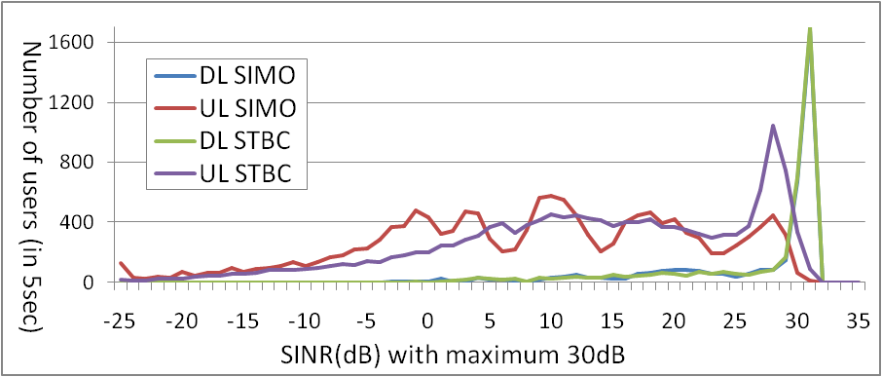
SINR in outdoor large BSS scenario
PDF of SINR distribution in 5 seconds simulation time
As shown in the above, about 30% of users in UL SIMO and 16% of users in UL STBC have SINR under MCS level 0.
MCS0
MCS8
 | Portion of users under MCS 0
DL SIMO | 0.86%
DL STBC | 0.32%
UL SIMO | 29.0%
UL STBC | 16.3%

Slide 4
Options to handle low SINR users
Temporally, we denote users with SINR under MCS0 in UL or DL as low SINR users.
Option 1: Set low SINR users to MCS0
Option 2: Consider low SINR users unassociated
Low SINR users are excluded in evaluation.
Option 3: Re-drop until zero low SINR users [4,5]
Since this is not fit with real world, we exclude this option in the following simulations.
➔ In the following slides, we see the simulation results of Option 1 and Option 2 in outdoor large BSS scenario.

Slide 5
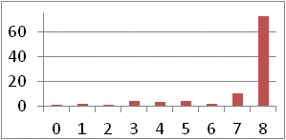
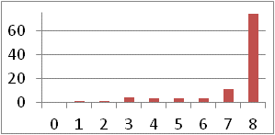
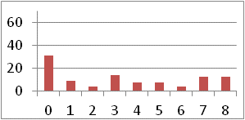
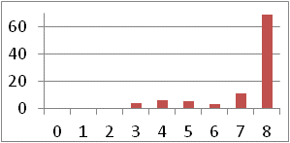
Simulation results (1x2 SIMO)
 | Option 1 | Option 2
DL Tput (Mbps) | 10.3 | 12.6
Reported DL MCS levels (%)
UL Tput (Mbps) | 10.6 | 14.4
Reported UL MCS levels (%)
Total Tput | 20.9 | 27.0
BSS idle portion¹⁾ (%) | 3.55 | 50.14
In option2, throughput is higher and BSS idle portion is also higher because many low SINR users are excluded.
¹⁾ BSS idle portion: average portion that all devices in a BSS is idle
Jinyoung Chun et.al, LG Electronics

Slide 6
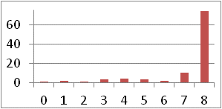
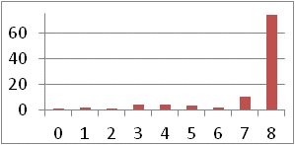
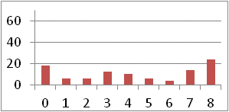
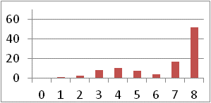
Simulation results (2x2 STBC)
 | Option 1 | Option 2
DL Tput (Mbps) | 10.3 | 11.2
Reported DL MCS levels (%)
UL Tput (Mbps) | 16.1 | 25.2
Reported UL MCS levels (%)
Total Tput | 26.4 | 36.4
* BSS idle portion (%) | 3.55 | 21.98
The tendency is similar with the previous slide.
Jinyoung Chun et.al, LG Electronics

Slide 7
Suggestion
We discussed the low SINR user handling issue for evaluation methodology
We propose to add the following text in the evaluation methodology document.
Define a user with SINR under that of MCS0 by ‘un-associated user’.
Exclude unassociated users in evaluation.
For the purpose of information, provide the percentage of unassociated users in evaluation.
Jinyoung Chun et.al, LG Electronics

Slide 8
Straw poll
March 2014
Do you support to add the text on low SINR user handling in slide 7 to evaluation methodology document?
In Favor:
Opposed:
Abstain:
Jinyoung Chun et.al, LG Electronics

Slide 9
Reference
[1] 11-13-1359-00-0hew-hew-evaluation-methodology
[2] 11-13-1001-06-0hew-simulation-scenarios-document-template
[3] 11-14-0353, “Suggestion on PHY Abstraction for Evaluation Methodology”, LG Electronics
[4] 11-14-82, “improved-spatial-reuse-feasibility-part-i”, Broadcom
[5] 11-14-83, “improved-spatial-reuse-feasibility-part-ii”, Broadcom

Slide 10
Appendix. Simulation parameters
March 2014
Simulation scenario | Outdoor Large BSS scenario
Tx/Rx power | 30/15dBm
# of users | 50
Simulation time | Initial: 2s, main: 20s, drop: 1
BW | 2.4GHz, 20MHz (64 FFT)
Data size | 1ms TXOP less fixed overhead (RTS/CTS off) Normal overhead: SIFS + ACK + 2*PLCP header - Feedback overhead: ACK frame with feedback (<1symbol = 4us)
GI | Long (0.8 us)
Antennas for AP & STA | Rank1: SIMO, STBC (interference model: AWGN)
Max # of retries | 10
DL & UL traffic | Full buffer (DL & UL ratio: based on PHY system simulation in [2])
CCA level | Preamble detection: -82dBm (both AP and STA) Energy detection: -62dBm (both AP and STA)
Channel | Time-varying
SINR margin | 0.5dB steps
PHY abstraction | MMIB [3] with extension to 256QAM ¾ (MCS8)
Jinyoung Chun et.al, LG Electronics

