Slide 1
Joint Coding and Modulation Diversity with RBD pre-coding MU-MIMO
Date: 2014-03-16
Authors:
Name | Affiliations | Address | Phone | email
Zhanji Wu | Beijing University of Post and Telecommunication (BUPT) | Xitucheng Road 10, Haidian District, Beijing, China | +86 01062281058 | wuzhanji@bupt.edu.cn
Yongtao Shi |  |  |  | shiyongtao.001@163.com
Xiang Gao |  |  |  | gaoxiangbupt@gmail.com
Yunzhou Li | Tsinghua University | Tsinghua Rd. Beijng, China | +86 01062773363 | liyunzhou@tsinghua.edu.cn
Wu Bin | Institute of Microelectronics of the Chinese Academy of Sciences (IMECAS) | Beitucheng West Road, 9,Chaoyang District, Beijing, China |  | wubin@ime.ac.cn

Slide 2
Outline
This contribution proposes an improved MIMO-OFDM scheme based on Joint Coding and Modulation Diversity (JCMD)[2] together with Regularized Block Diagonalization (RBD)[1] precoding multiuser (MU) MIMO to achieve better system performance.
For target FER=0.01, JCMD with RBD obtains 3dB gain than BICM with RBD, and JCMD with RBD obtains 1.8dB gain than JCMD with BD.

Slide 3
Introduction
Higher demand for future WLAN[3]：
Higher throughput and data rates.
Greater reliability.
increased number of mobile devices
The combination of OFDM and MIMO is still a key feature for high-throughput transmission in the next generation WLAN.
In order to enhance the system performance, we propose a JCMD scheme with RBD-Precoding MU-MIMO as the key PHY layer technology for the next-generation WLAN.

Slide 4
Pre-coding strategy
BD pre-coding
Low computational complexity.
Eliminate the interference of other users.
Ignore the noise.
Number of transmit antennas of a BS should be equal or greater than total number of all users’ receive antennas.
RBD pre-coding
Higher system performance than BD Pre-coding.
Increased computational complexity compared to BD Pre-coding.
The RBD pre-coding decreases the noise while eliminating the interference of other users.
No Tx/Rx antenna limitation[4]

Slide 5
Joint Coding and Modulation Diversity
JCMD scheme jointly optimizes the MIMO-OFDM, channel coding and modulation together, which makes full use of time, frequency and space diversity.
Rotational modulation
Q-components interleaver

Slide 6
Proposed Transmitter/Receiver Block Diagram
NOTES
The blocks drawn in dotted line are our proposed additional processing on the basis of the current 802.11 ac standard scheme.
In simulations, the spatial mapping method MU MIMO are BD/RBD precoding, respectively.

Slide 7
RBD-Precoding
Regularized Block Diagonalization (RBD) Pre-coding is a two step process. The first step is to suppress the multi-user interference ,and the second step is to optimize system performance. In the second step ,the communication between BS and users can be seen as SU-MIMO.
The matrix of precoding can be expressed as
Where,
Fa is used to suppress the multi-user interference and the noise, and then multiple-user MIMO channel is converted into a set of parallel single-user MIMO channel.
Fb is used to optimize system performance.

Slide 8
RBD-Precoding
The process of RBD Precoding can be expressed as follows:
The first step: suppress the multi-user interference
For the i-th user ,we define as the combination channel of all users except the i-th user .
The equivalent combined channel matrix of all users after the first step is equal to
where the i-th user’s effective channel is given by
the interference generated to the other users is determined by

Slide 9
RBD-Precoding
Optimization criterion:
where vector n contains the samples of a zero mean additive white Gaussian noise at the input of the receive antennas.
We try to minimize both the interference to other users, and the noise impact on the system.
We can get ,where
After the first step ,we can now apply any other previously defined SU MIMO technique on the i-th user’s equivalent channel matrix .
The second step:
Where

Slide 10
Simulation Parameters for 802.11ac MU-MIMO Scheme
Parameters | Values
User number | 2
The number of antennas at TX | 4
The number of antennas at RX per user | 2
Bandwidth | 20 MHz
Code type | BCC/LDPC
Channel model | 802.11ac channel model
MCSs | MCS4
Sub-carrier spacing | 312.5 kHz
Precoding | BD/RBD
Channel estimation | Perfect CSI

Slide 11
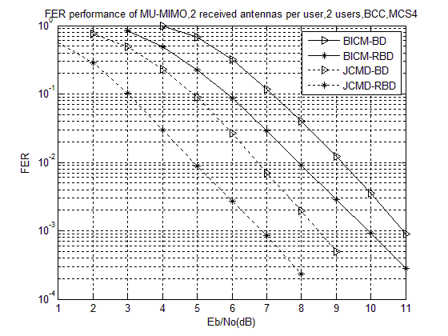
FER performance for MU-MIMO scheme in JCMD/BICM with RBD/BD Pre-coding(BCC Coding)
For FER=0.01, the corresponding Eb/No (dB) of JCMD/BICM with RBD/BD Pre-coding is :
 | RBD | BD
JCMD | 4.857 | 6.708
BICM | 7.963 | 9.132
For FER=0.01
Compare JCMD with BICM:
JCMD with RBD obtains 3.01dB gain than BICM with RBD.
JCMD with BD obtains 2.23dB gain than BICM with BD.
Compare RBD Pre-coding with BD Pre-coding :
BICM with RBD obtains 1.17dB gain than BICM with BD.
JCMD with RBD obtains 1.85dB gain than JCMD with BD.

Slide 12
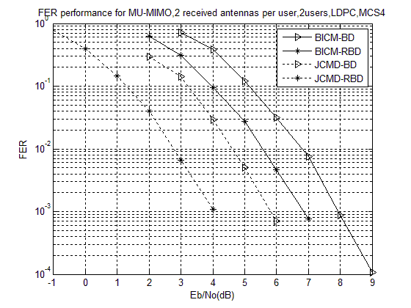
FER performance for MU-MIMO scheme in JCMD/BICM with RBD/BD Pre-coding(LDPC Coding)
For FER=0.01, the Corresponding Eb/No (dB) of JCMD/BICM with RBD/BD Pre-coding is :
 | RBD | BD
JCMD | 2.735 | 4.592
BICM | 5.531 | 6.812
For FER=0.01
Compare JCMD with BICM:
JCMD with RBD obtains 2.79dB gain than BICM with RBD.
JCMD with BD obtains 2.22dB gain than BICM with BD
Compare RBD Pre-coding with BD Pre-coding :
BICM with RBD obtains 1.28dB gain than BICM with BD
JCMD with RBD obtains 1.86dB gain than JCMD with BD

Slide 13
Summary
An improved Joint Coding and Modulation Diversity (JCMD) with Regularized Block Diagonalization (RBD) precoding multiuser (MU) MIMO is proposed.
For target FER=0.01, JCMD with RBD obtains 3dB gain than BICM with RBD，and JCMD with RBD obtains 1.8dB gain than JCMD with BD.
JCMD with RBD-precoding MU-MIMO is simple, reliable and efficient for the HEW requirement.

Slide 14
Reference
[1] R.F.H Fischer, Precoding and Signal Shaping for Digital Transmission. New York: Wiley, 2002
[2] 11-11-0336-00-00ac-joint-coding-and-modulation-diversity-to-802-11ac.ppt
[3] 11-13-1090-00-0hew-Non-linear pre-coding for next generation WLAN
[4] 3GPP TR 25.996 - Technical Specification Group Radio Access Network; Spatial channel model for Multiple Input Multiple Output (MIMO) simulations

