Slide 1
Dense Apartment Complex
Throughput Calculations
Channel Selection and DSC
Date: 2014-03
Authors:

Slide 2
Background
  This presentation looks at the Dense Apartment scenario and calculates the throughputs
  First we look at the potential overlap situation
  Then we look at channel selection schemes, random and intelligent.
  We then determine the resulting apartment sharing
  We then simulate the traffic per STA for every apartment and present the results

Slide 3
3a Dense apartment building – private access and cellular offload
Pre-Conditions
Each apartment has Wi-Fi network deployed to access internet and cloud services. In each apartment up to 3 users stream concurrently video content from the network and up to 50% of the networks are active.
At the same time each of the active Wi-Fi networks is used by 2 users for web browsing
Environment
Building with 100 apartments. One AP in each apartment of 10mx10m randomly positioned. 5 STA per AP randomly positioned in the apartment.
Applications
Cloud based applications supporting video streaming with 8k resolution.
Video throughput assumptions are: ~112Mbps per STA, delay is < 200ms, 1.0E-3 PER.
Online game
Cloud-based application as big storage
Web browsing assumptions for Social Networking are: ~20Mbps, PER 1e-3, delay<50ms
150 active video users and 100 active web browsing users in the building.
Traffic Conditions
Strong interference from unmanaged overlapping networks (neighboring apartments, and outdoor Wi-Fi network).
Multiple video display are operational simultaneously.
Interference with Zigbee, Bluetooth.
Use Case
Users watch the high quality video contents coming from the Internet or video contents stored in their PVR with VHD Display. There may be another video streams to be recorded in the Blu-ray deck.
People enjoy playing online games or local game machine with two or more people.
Other users are just accessing the Internet for email access, web browsing, etc.
Laurent Cariou (Orange)

Slide 4
Dense apartment complex - Legacy

Slide 5
Channel Selection (Channel and Overlap) vs Random

Slide 6
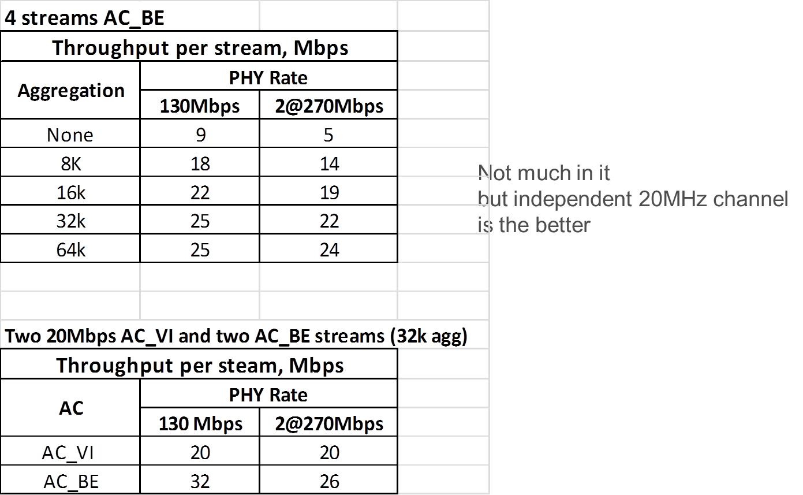
2 x 20MHz or Share 40MHz?
Does EDCA Overhead cancel out extra subcarriers?

Slide 7
Dense Apartment Complex – DSC

Slide 8
Apartment Sharing

Slide 9
Apartment Sharing - DSC
Tables show the number of apartments and the BW.

Slide 10
Traffic Simulator
Traffic Simulator has the following settings for each stream:
  EDCA settings: SIFS, AIFSN, Cwmin, Cwmax, slot time
  Stream settings: Aggregation, MSDU size, Mbps,
  PHY: PHY Data Rate, SS,
Outputs, per stream:
  Throughput: # packets in, # packets out, Mbps
  Delay: per packets, max/min
EDCA contention is fully simulated with back off and retries if packets clash
If packet gets the medium, it goes through.

Slide 11
Throughput per STA - Sharing
4 AC_BE Streams per Network
11n, 2SS.

Slide 12
Calculations
We take the number of apartments in each sharing category and the calculate the throughput per STA for the sharing.
  4 STAs per apartment, AC_BE
For example:
  10 CH Random Channel selection
    30 apartments have independent 40MH channel
    35 apartments have independent 20MHz channel
    32 apartments share a 20MHz channel with another apartment
    3 apartments share one 20MHz channel

Slide 13
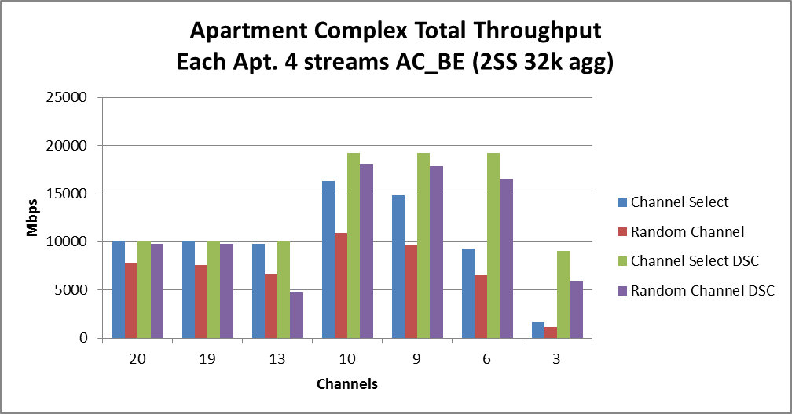
Results Total Throughput
As would be expected, Channel Selection and DSC improve the total throughput

Slide 14
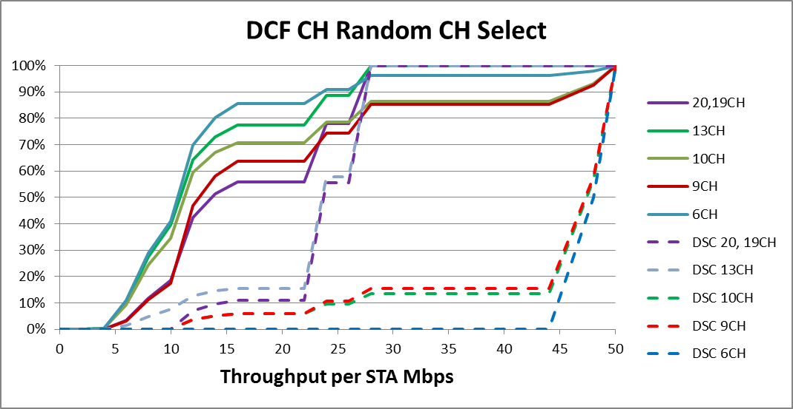
DCF for Random selection of Channels

Slide 15
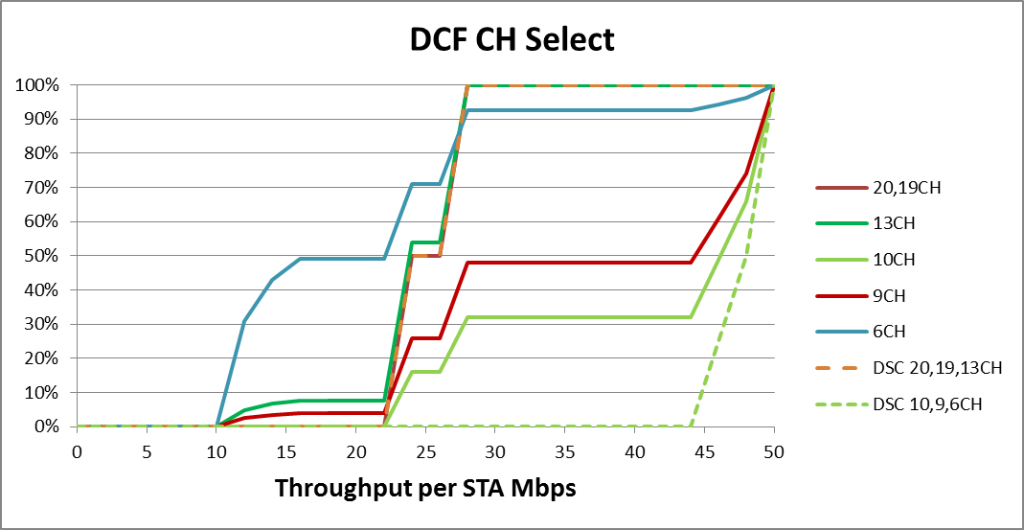
DCF for Channel Select

Slide 16
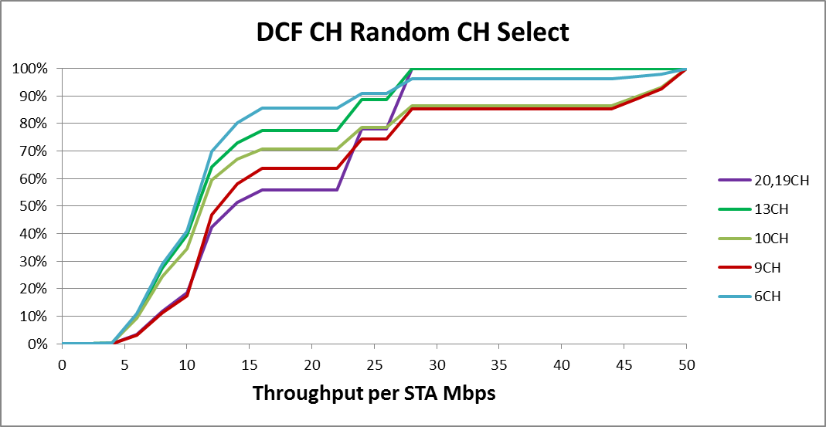
DCF for Random Channels (no DSC)

Slide 17
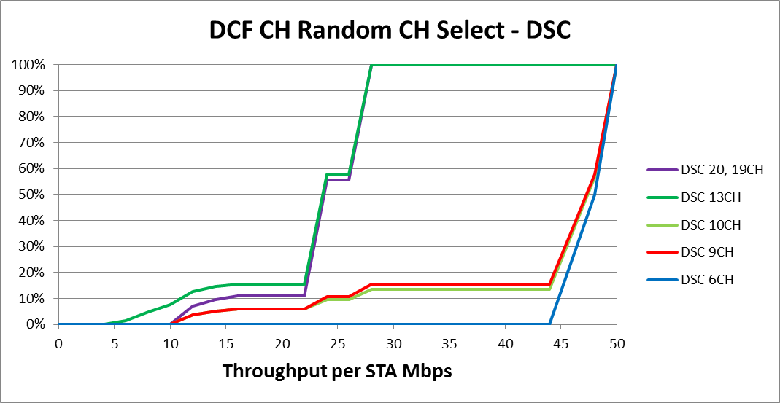
DCF for Random Channels (with DSC)

Slide 18
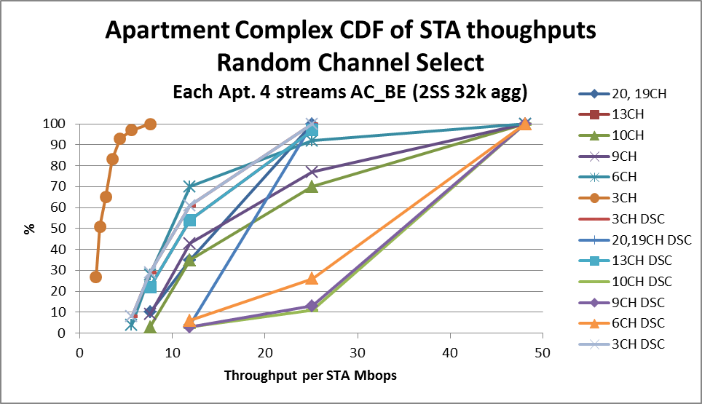
Results CDF (using average TP per STA)

Slide 19
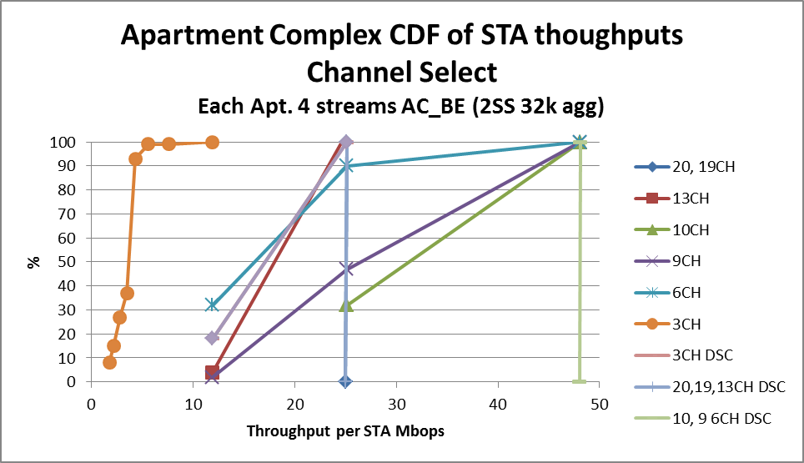
Results CDF (using average TP per STA)

Slide 20
Conclusions
When estimating the per STA throughput for the dense apartment complex, it is important to include the channel selection and the resulting apartment sharing scenario.
As expected, improvements to the throughput per STA occur with
Channel selection rather than random
DSC
“System Level Simulators” should provide similar performances for this scenario BUT need to incorporate the Channel Selection/BW use/MCS relationships.

