Slide 1
Dense Apartment Complex
Throughput Calculations
Date: 2014-03
Authors:

Slide 2
Background
  This presentation looks at the Dense Apartment scenario and calculates the throughputs
  First we look at the potential overlap situation
  Then we look at channel selection schemes, random and intelligent.
  We then determine the resulting apartment sharing
  We then simulate the traffic per STA for every apartment and present the results

Slide 3
3a Dense apartment building – private access and cellular offload
Pre-Conditions
Each apartment has Wi-Fi network deployed to access internet and cloud services. In each apartment up to 3 users stream concurrently video content from the network and up to 50% of the networks are active.
At the same time each of the active Wi-Fi networks is used by 2 users for web browsing
Environment
Building with 100 apartments. One AP in each apartment of 10mx10m randomly positioned. 5 STA per AP randomly positioned in the apartment.
Applications
Cloud based applications supporting video streaming with 8k resolution.
Video throughput assumptions are: ~112Mbps per STA, delay is < 200ms, 1.0E-3 PER.
Online game
Cloud-based application as big storage
Web browsing assumptions for Social Networking are: ~20Mbps, PER 1e-3, delay<50ms
150 active video users and 100 active web browsing users in the building.
Traffic Conditions
Strong interference from unmanaged overlapping networks (neighboring apartments, and outdoor Wi-Fi network).
Multiple video display are operational simultaneously.
Interference with Zigbee, Bluetooth.
Use Case
Users watch the high quality video contents coming from the Internet or video contents stored in their PVR with VHD Display. There may be another video streams to be recorded in the Blu-ray deck.
People enjoy playing online games or local game machine with two or more people.
Other users are just accessing the Internet for email access, web browsing, etc.
Laurent Cariou (Orange)

Slide 4
Dense apartment complex - Legacy

Slide 5
Channel Selection (Channel and Overlap) vs Random

Slide 6
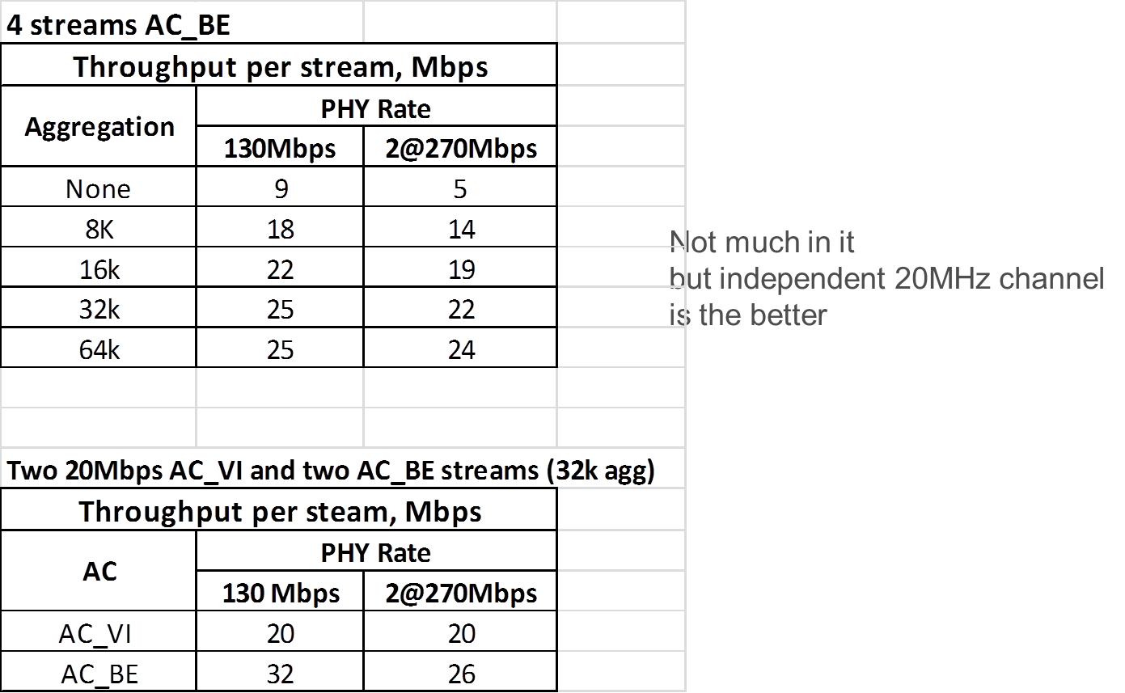
2 x 20MHz or Share 40MHz?
Does EDCA Overhead cancel out extra subcarriers?

Slide 7
Dense Apartment Complex – DSC

Slide 8
Apartment Sharing

Slide 9
Apartment Sharing - DSC
Tables show the number of apartments and the BW.

Slide 10
Throughput per STA - Sharing

Slide 11
Calculations
We take the number of apartments in each sharing category and the throughput per STA for the sharing.
  4 STAs per apartment, AC_BE
For example:
  10 CH Random Channel selection
  30 apartments have independent 40MH channel
  35 apartments have independent 20MHz channel
  32 apartments share a 20MHz channel with another apartment
  3 apartments share one 20MHz channel

Slide 12
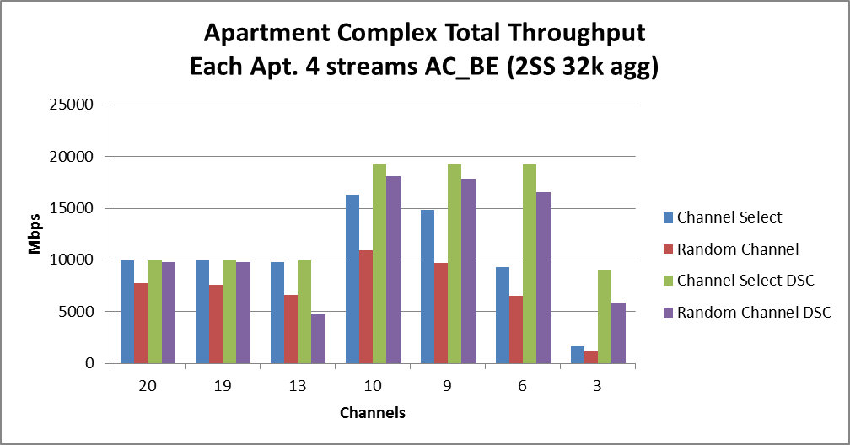
Results Total Throughput
As would be expected, Channel Selection and DSC improve the total throughput

Slide 13
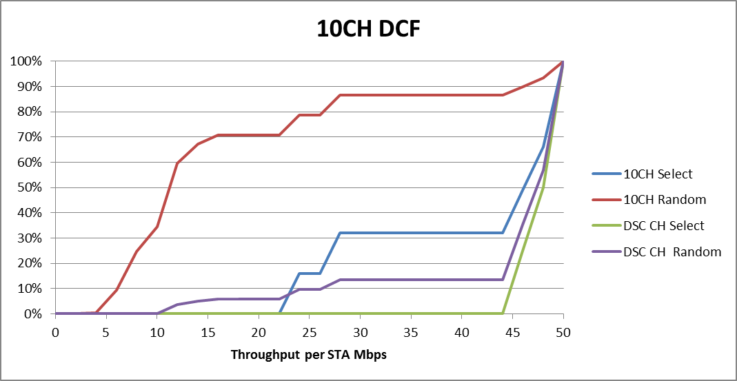
DCF for 10 Channels

Slide 14
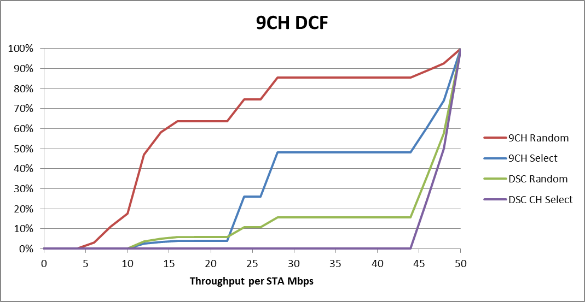
DCF for 9 Channels

Slide 15
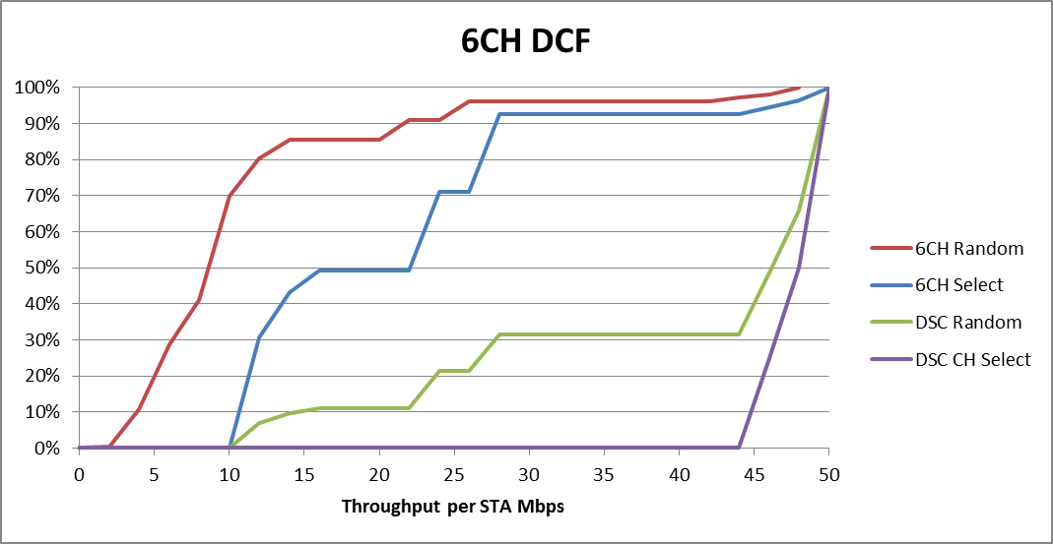
DCF for 6 Channels

Slide 16
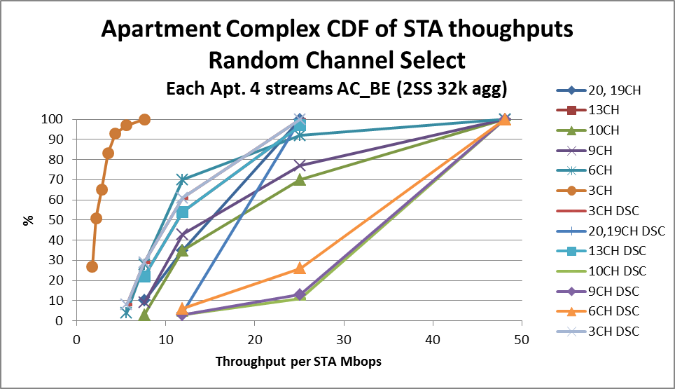
Results CDF (using average TP per STA)

Slide 17
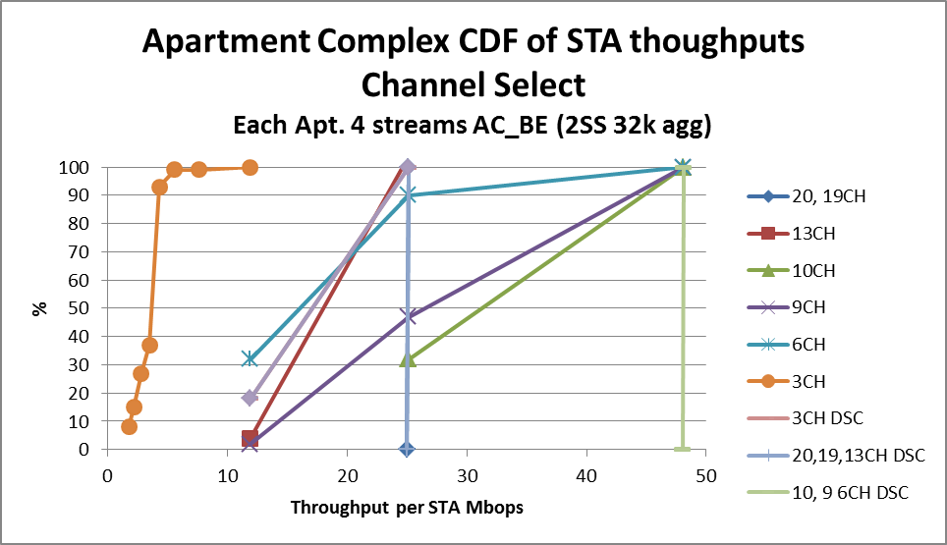
Results CDF (using average TP per STA)

Slide 18
Conclusions
When estimating the per STA throughput for the dense apartment complex, it is important to include the channel selection and the resulting apartment sharing scenario.
As expected, improvements to the throughput per STA occur with
Channel selection rather than random
DSC
Question is what do we use as the basis? Channel selection is recommended in 11aa.

