Slide 1
Introduction of Vice Chair Candidate
Jon Rosdahl
Date: 2014-03-17
Authors:

Slide 2
Abstract
Candidate information presentation

Slide 3
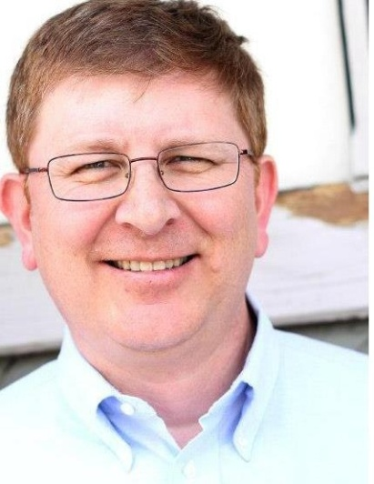
Jon Rosdahl
Candidate for IEEE 802.11 Chair

Slide 4
My Expectations
I would like to start by saying that regardless of who eventually wins the election this week, the new leadership team will need everyone’s support in order to be successful.
No one will be successful without the support of the working group as a whole.
I would hope that everyone would understand that my success does not depend on someone else’s failure.
The reason a person wins an election should be on the merits of the person being elected rather than any negative statement against an opponent.

Slide 5
IEEE Experience
21th Anniversary of participating in 802 sessions this month.
Over the course of the 21 years, I have served as
  Vice-Chair of 802.11 for 8.5 years.
  Treasurer for 6 years
  Task Group leader (TGm – Secretary/Vice Chair)
  Assisted Various Assignments – P&P, Counting, PAR etc.
Served on the IEEE-SA Standards Board and Standing Committees
  IEEE-SA Standards Board (7 years)
  NesCom (8 years); PatCom (3 years) ; ProCom (3 years)
Senior Member of the IEEE

Slide 6
Why Run?
I enjoy working with you.
I believe my experience and skill set can be utilized to make a difference in the future of IEEE 802.11
Today’s challenges are going to be solved with cooperation of the committee members; You all just need the opportunity to engage in the process;
The chairman’s job is to facilitate that opportunity.

Slide 7

My View of Committees
I view the value of a committee to be a tool to get to the goal.
If we work as a group to fulfill the requirements of the consumers in the marketplace, we, as a unified group, can produce standards that meet industry needs.

Slide 8
Officer Expectations
I believe:
  Working Group Officers serve the needs of the Working Group.
  Diligence, integrity and stability are as important as capability and execution.
  The IEEE 802.11WG members should choose officers that are able to facilitate the Working Group process in order to provide standards that fulfill the requirements of the consumers in marketplace.
  The WG Chair represents the interests of the WG, and should be inclusionary in both action and deed.

Slide 9
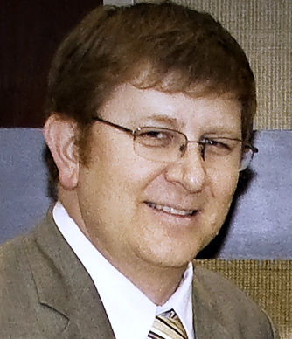
Thanks and Request for your Support
I thank you for your confidence in me over the years, and hope that I have earned your trust and confidence to elect me as your Chair.
    Jon Rosdahl

