Slide 1
PHY Calibration Results
Date: 2014-01-20
Authors:

Slide 2
Overview
Calibration flowchart from [1]
We present results on the noted items for simulation scenario 1

Slide 3
Scenario 1: Simulation Parameters
5 floor building with 2x10 apartments per floor, 10m x 10m x 3m apartments
1 AP per apartment, either centrally located (give exact coordinates) or randomly located within apartment (uniform distribution)
11nB model for PL, shadowing, and multipath:
PL: free space (f_c = 2.4e9) until breakpoint distance of 5 meters, exponent of 3.5 after breakpoint distance
Minimum path loss = 30 dB, i.e., PL = minimum of computed PL and 30 dB
Minimum computed before shadowing and wall/floor loss added
Log-normal shadowing with 4 dB std. deviation, iid for every link
Penetration losses: 12 dB floor, 17 dB wall
2.4 GHz, 20 Mhz channels, either all BSS’s on same channel or each BSS randomly picks 1 of 3 channels
TX power per antenna: 23 dBm AP, 17 dBm STA
5 dB noise figure -> effective noise floor is -96 dBm
AWGN and 11nB
For 11nB, use Shannon capacity function to compute effective SINR: log2(1+SNR)
For MIMO use MMSE receiver. Specified TX power is per antenna.

Slide 4
Description of Results
Place devices, choose random shadowing per link, compute path loss accounting for distance, walls/floors, and shadowing
Turn on specified set of devices and measured SINR’s at appropriate devices
100% DL: turn on all AP’s and measure SINR at each associated STA
0% DL: turn on 1 STA (randomly selected within BSS) and measure SINR at each respective AP
50% DL: in each BSS randomly choose to activate a DL link (to randomly selected STA) or an UL link (from randomly selected STA) and measure SINR at appropriate RX device
# WLAN channels: 1 or 3 (random selection)
Fading: 1x1 AWGN, 1x1 11nB, 2x2 11nB (all rank 2)
Traffic: 100% DL, 0% DL, 50% DL

Slide 5
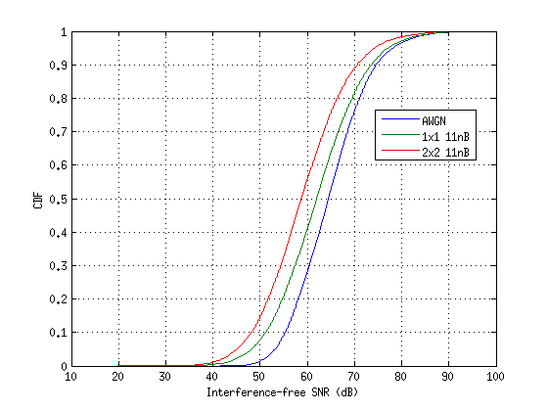
CDF of interference-free SNR
Such high SNRs may not be realistic
May want to add intra-apartment walls, or increase intra-apartment shadowing

Slide 6
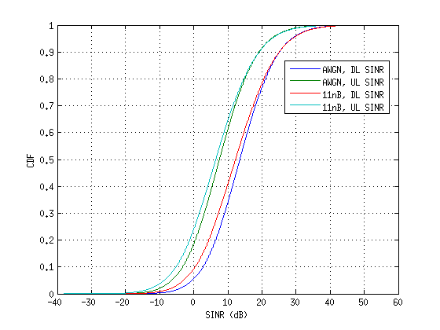
SINR CDF for 1 WLAN channel
Left plot: 100% DL or 0% DL traffic
100% DL and 0% DL have nearly identical SINR’s because UL/DL only differ in transmit power, but that is inconsequential in this scenario because interference-limited
Right plot: 50% DL/UL
UL SINR distribution is 6 dB worse than DL SINR, due to 6 dB lower TX power

Slide 7
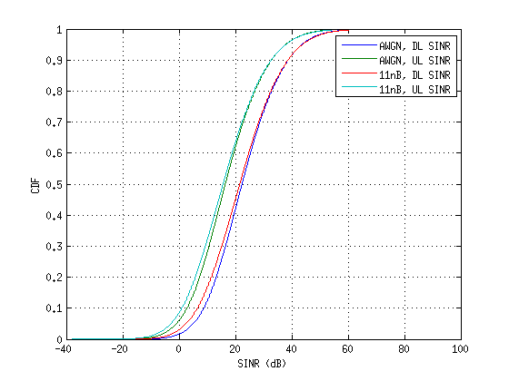
SINR CDF for 3 WLAN channels
Left plot: 100% DL or 0% DL traffic
100% DL and 0% DL have nearly identical SINR’s
Right plot: 50% DL/UL
UL SINR distribution is 6 dB worse than DL SINR

Slide 8
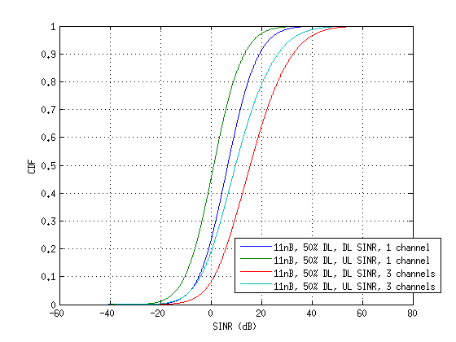
SINR CDF for 2x2 MIMO
Left plot: 100% DL
Nearly identical to 0% DL SINR’s
Right plot: 50% DL/UL
UL SINR distribution is 6 dB worse than DL SINR
All transmissions are rank 2, MMSE RX

Slide 9
Tabulated Results: 1 Channel
Scenario | 1
# channels | 1
% DL traffic | 100 | 100 | 0 | 0 | 50 |  | 50
Fading | AWGN | 11nB | AWGN | 11nB | AWGN |  | 11nB
 | Downlink | Downlink | Uplink | Uplink | Downlink | Uplink | Downlink | Uplink
1% | -8.33 | -11.32 | -8.36 | -11.44 | -6.25 | -12.43 | -9.27 | -15.35
5% | -2.51 | -5 | -2.53 | -5.08 | -0.41 | -6.36 | -2.95 | -8.6
10% | 0.46 | -1.78 | 0.43 | -1.79 | 2.7 | -3.26 | 0.4 | -5.25
50% | 11.13 | 9.79 | 11.1 | 9.82 | 13.54 | 7.56 | 12.26 | 6.49
90% | 22.43 | 22.46 | 22.44 | 22.48 | 25.12 | 19.12 | 25.09 | 19.25
95% | 26.03 | 26.37 | 26.1 | 26.34 | 28.8 | 22.8 | 29.02 | 23.05
99% | 33.51 | 34.06 | 33.35 | 33.88 | 36.22 | 30.23 | 36.67 | 30.78
Mean | 11.34 | 10.14 | 11.31 | 10.1 | 13.78 | 7.79 | 12.54 | 6.77

Slide 10
Tabulated Results: 3 channels
Scenario | 1
# channels | 3
% DL traffic | 100 | 100 | 0 | 0 | 50 |  | 50
Fading | AWGN | 11nB | AWGN | 11nB | AWGN |  | 11nB
 | Downlink | Downlink | Uplink | Uplink | Downlink | Uplink | Downlink | Uplink
1% | -3.82 | -6.59 | -4.02 | -6.61 | -1.87 | -7.91 | -4.63 | -10.2
5% | 2.85 | 0.52 | 2.83 | 0.5 | 5.07 | -0.87 | 2.58 | -2.86
10% | 6.39 | 4.28 | 6.4 | 4.23 | 8.76 | 2.77 | 6.51 | 0.98
50% | 19.72 | 18.92 | 19.71 | 18.92 | 22.36 | 16.45 | 21.58 | 15.66
90% | 35.93 | 35.92 | 35.93 | 35.95 | 38.77 | 32.83 | 38.69 | 32.69
95% | 40.91 | 41.13 | 40.91 | 41 | 43.76 | 37.91 | 43.93 | 38.1
99% | 50.66 | 51.22 | 50.5 | 50.98 | 53.23 | 47.55 | 53.85 | 48.05
Mean | 20.53 | 19.58 | 20.51 | 19.57 | 23.14 | 17.22 | 22.17 | 16.35

Slide 11
Tabulated Results: 2x2 MIMO
Scenario | 1
# channels | 1 |  |  |  | 3
% DL traffic | 100 | 0 | 50 |  | 100 | 0 | 50
Fading | 2x2 11nB
 | Downlink | Uplink | Downlink | Uplink | Downlink | Uplink | Downlink | Uplink
1% | -16.45 | -16.6 | -14.52 | -20.24 | -11.86 | -11.59 | -9.97 | -15.3
5% | -10.14 | -10.06 | -7.99 | -13.66 | -4.61 | -4.55 | -2.5 | -7.94
10% | -6.91 | -6.86 | -4.8 | -10.33 | -0.87 | -0.87 | 1.23 | -4.15
50% | 4.4 | 4.34 | 6.7 | 1.16 | 13.01 | 12.96 | 15.62 | 9.83
90% | 16.63 | 16.54 | 19.23 | 13.32 | 29.88 | 29.74 | 32.57 | 26.61
95% | 20.42 | 20.32 | 23.09 | 17.06 | 35.07 | 34.85 | 37.77 | 31.76
99% | 28.04 | 27.8 | 30.81 | 24.63 | 44.78 | 44.79 | 47.34 | 41.87
Mean | 4.68 | 4.62 | 7.01 | 1.35 | 13.81 | 13.78 | 16.33 | 10.62

Slide 12
PHY System Sim Calibration Results
PHY system simulation results for scenario 1 with previously described parameters, 100% DL, 5 STA’s per BSS
CCA threshold values: -90 dBm, -60 dBm, -30 dBm
Display CDF’s of:
Per-STA throughput
SINR of active links
Per-STA selected MCS
Per-STA airtime

Slide 13
Scenario 1, 1x1 11nB

Slide 14
Scenario 1, 2x2 11nB

Slide 15
Summary
Presented SINR calibration results for scenario 1
Based on an operationally meaningful SINR definition
Included effective SINR results with multipath and 2x2 MIMO
Presented PHY system simulation results for scenario 1
Allows for calibration of per-STA throughput

Slide 16
References
“HEW Evaluation Methodology”, IEEE 802.11-13/1359r1

