Slide 1
Multicast Considerations for HEW
Date: 18/03/2014
Authors:

Slide 3
Abstract
Discuss the unique characteristics of dense deployment scenarios receiving the same contents
In particular: Video distribution via multicast
Propose simulation scenarios to cover the multicast communication usage model that is critical to realizing the specific use cases

Slide 4
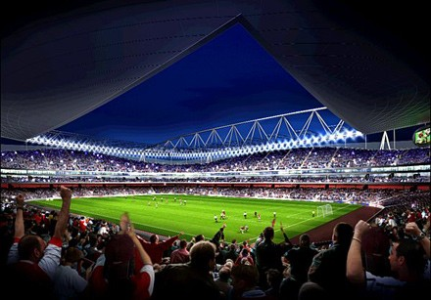
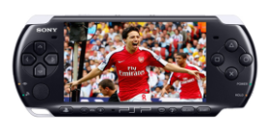
Introduction
Possible usage model in HEW
Many people in a stadium or concert arena watch the same video (e.g., stream of a football game or close-up of performer) with their phones/tablets.
An advertisement or dedicated content in an airport such as news channels with respect to each country is broadcasted only to the people who want to receive it.
Students in a classroom watch single contents of a textbook.
Technical conditions:
Dozens/hundreds of STAs within a short distance (Dense environment)
Simultaneous, single video contents distribution.
To ensure the contents are delivered with quality and low latency, high efficiency communication is essential
Thus, this usage model should be
in the target scope of HEW and
provided for in the corresponding
evaluation methodology.

Slide 5
Multicast Enhancement to Achieve the Intended HEW Usage Model
Unicast is NOT suited to distribute the same content to vast number of STAs in close proximity
Multicast is preferred in terms of the usage model and highest efficiency
11aa provides enhanced multicast, however, by itself, it may not be sufficient to cover use case envisioned by HEW
Additional multicast enhancements in HEW should be considered
For example, 11aa scheme may not provide high efficiency that HEW is targeting
Efficient multicast communication in “a highly dense environment” should be covered
Further discussions in HEW for more efficient solutions for same content distribution scenario
For example but not limited to, multicast enhancement on IEEE802.11-2012 and/or 11aa or using a new enhancement

Slide 6
Summary
To fully address the highly dense use cases such as Stadiums, Arenas, Airports, Malls, and stations, potential multicast enhancements in HEW should be explored.

Slide 7
Proposals
It is necessary to extend simulation scenarios (11-13/1001r5) to cover multicast communication usage model

Slide 8
Existing Simulation Scenario 3
Traffic model (per each BSS) - TBD
# | Source/Sink | Name | Traffic definition | Flow specific paramters | AC
Dowlink
D1 | AP/STA1 to AP/STA10 | Highly compressed video (streaming) | T2
D2 | AP/STA11 to AP/STA20 | Web browsing | T4
D3 | AP/STA21 to AP/STA30 | Local file transfer | T3
Uplink
U1 | STA1/AP to STA10/AP | Highly compressed video (streaming) – UL TCP ACKs…
U2 | STA11/AP to STA20/AP | Web browsing: – UL TCP ACKs…
U3 | STA21/AP to STA30/AP | Local file transfer | T3
The # of STAs is too small
for the usage model
TCP based streaming does not allow multicast

Slide 9
Proposed Amendment to Simulation Scenario 3
Traffic model (per each BSS) - TBD
# | Source/Sink | Name | Traffic definition | Flow specific paramters | AC
Dowlink
D1 | AP/STA1 to AP/STA10 | Highly compressed video (streaming) | T2
D2 | AP/STA11 to AP/STA20 | Web browsing | T4
D3 | AP/STA21 to AP/STA30 | Local file transfer | T3
D4 | AP/STA31 to AP/STA 70 | Multicast Video Streaming | T8
Uplink
U1 | STA1/AP to STA10/AP | Highly compressed video (streaming) – UL TCP ACKs…
U2 | STA11/AP to STA20/AP | Web browsing: – UL TCP ACKs…
U3 | STA21/AP to STA30/AP | Local file transfer | T3
U4 | STA/AP31 to STA/AP 70 | -
New source/sink and traffic for multicast streaming should be defined
There should be no data traffic from U4

Slide 10
Existing Simulation Scenario 3
None of the proposed traffic models assumes one-way traffic base on UDP/IP and does not match multicast video streaming
Traffic Model # | Traffic model name | Description | Application traffic (Forward / Backward) | Application Load (Mbps) (Forward / Backward) | A-MPDU Size (B) (Forward / Backward)
T1 | Local file transfer | FTP/TCP transfer of large file within local network | FTP file transfer / FTP TCP ack | Full buffer / 0.1 | Max A-MPDU / 64
T2 | Lightly compressed video
T3 | Internet streaming video/audio
T4 | 4k video streaming
T5 | Online game server
T6 | Management: Beacon
T7 | Managgeemnt: Probe requests

Slide 11
Proposed Amendment to Simulation Scenario 3
A new traffic model for multicast streaming should be defined
Traffic Model # | Traffic model name | Description | Application traffic (Forward / Backward) | Application Load (Mbps) (Forward / Backward) | A-MPDU Size (B) (Forward / Backward)
T1 | Local file transfer | FTP/TCP transfer of large file within local network | FTP file transfer / FTP TCP ack | Full buffer / 0.1 | Max A-MPDU / 64
T2 | Lightly compressed video
T3 | Internet streaming video/audio
T4 | 4k video streaming
T5 | Online game server
T6 | Management: Beacon
T7 | Managgeemnt: Probe requests
T8 | Multicast Video Streaming | UDP/IP transfer of compressed video streaming | UDP packet transfer/Nothing | 3-6Mbps/Nothing

Slide 12
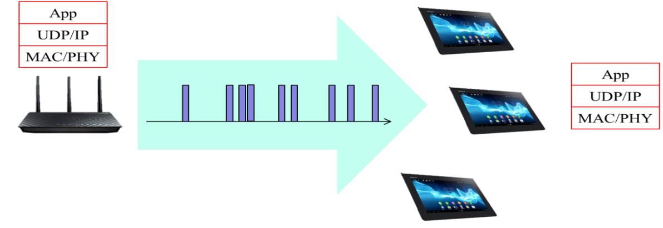
Proposal for New Traffic Model Descriptions
We define Multicast Video Streaming Traffic Model
Multicast Video Streaming is one-way video traffic from AP to STAs
The video traffic is generated from a video server, and traverses multiple hops in the internet before arriving at AP for transmission to STA.
Station layer model
AP generates video frames at application layer.
Because the traffic from AP to station has experienced network jitter,
it can be modelled the same way as the traffic model of video streaming.
The video traffic goes through UDP/IP layer and then to MAC layer.
Video traffic generation
Traffic model from AP to station: use the same steps in video streaming traffic model
Evaluation metrics
MAC throughput, latency
We assume bit rate for video streaming 6 Mbps (1080/30p AVC) and 3 Mbps (1080/30p HEVC)
multicast streaming

Slide 13
Backup

Slide 14
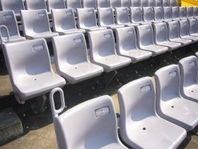
Expected number of multicast receiving STAs
Scenario 3 (Stadium use case, R=12m)
Assume there are 2.2 seats per 1m².
Assume audience of 5% seats uses multicast service.
-> about 40 STAs are expected to receive multicast video packets in each cell (BSS).
R=12m
There are about 2.2 seats/m² in typical stadium.

