Slide 1
Dynamic Sensitivity Control
Channel Selection and Legacy Sharing
Date: 2014-03
Authors:

Slide 2
Background
13/1012r4 Described Dynamic Sensitivity Control DSC and provided a throughput calculation for a hypothetical Cell Structure network.
  3005Mbps vs. 397Mbps
13/1290r2 further described DSC including a sample algorithm.
13/1487r2 described the improvements with DSC for dense apartment complex
  296% improvement for Single Apartment Complex
  412% improvement for Double Apartment Complex
This presentation shows that legacy STAs are not impeded by DSC

Slide 3

Dense apartment complex - Legacy

Slide 4
Channel Selection (Channel and Overlap) vs Random
There are two other considerations for Channel Selection

Slide 5
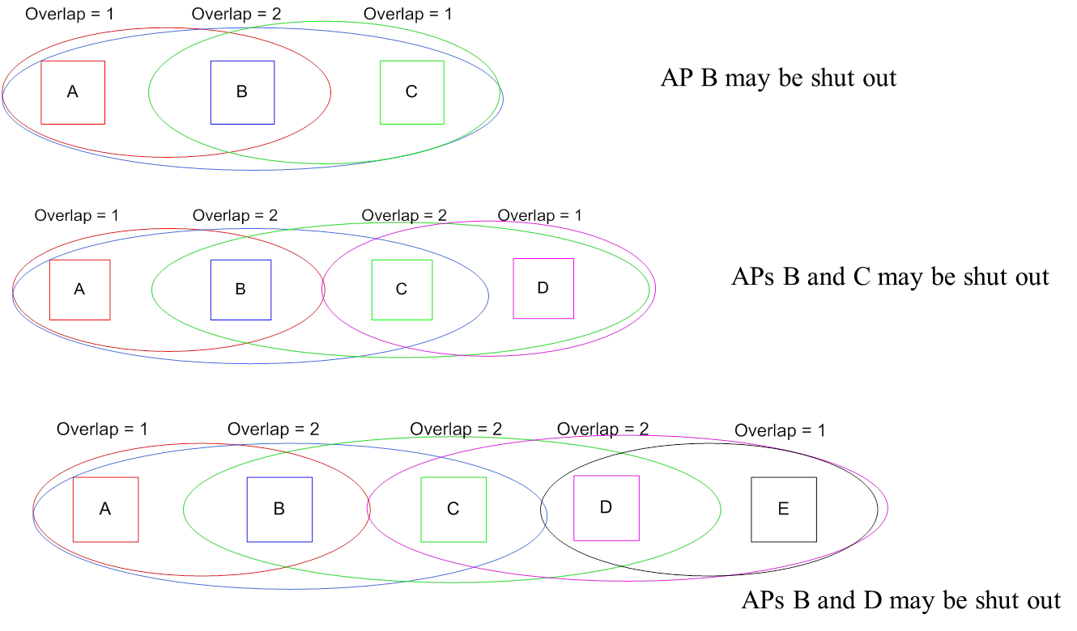
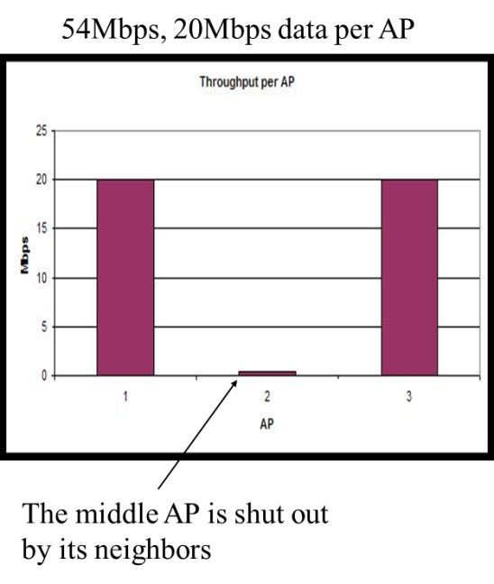
OBSS – Do overlapping networks just share? – NO
Hence, Channel selection with “Overlap” (11aa)
Neighbor AP effect: “Piggy in the middle”
An AP that has two overlapping APs that are hidden from each other, the middle AP will wait while either of its neighbors is transmitting. The two outer, hidden APs, do not wait for each other and can transmit at the same time.

Slide 6
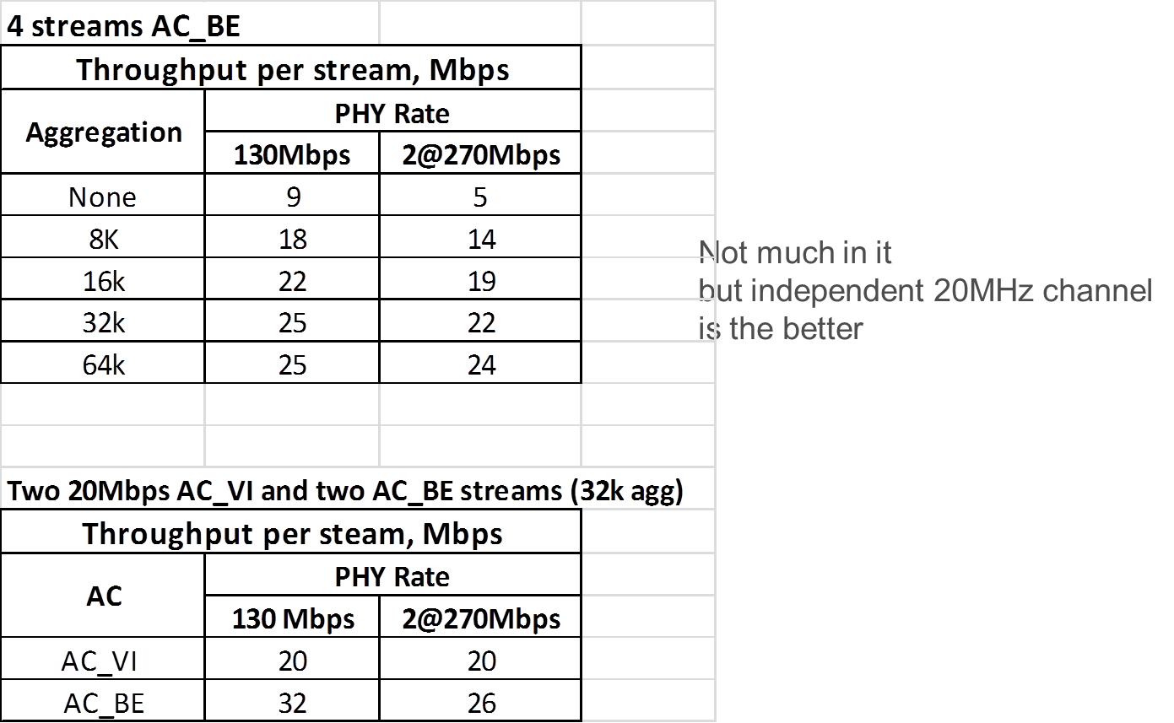
2 x 20MHz or Share 40MHz?
Does EDCA Overhead cancel out extra subcarriers?

Slide 7
Dense Apartment Complex – DSC

Slide 8
Coverage and Capacity – Cell cluster

Slide 9
“Sharing” DSC and Legacy Networks
DSC Network does not
Overlap with Legacy Network
DSC
Legacy
Legacy Network
Overlaps with DSC Network

Slide 10
DSC and Legacy STAs in apartment complex and cell cluster
DSC network sharing with a legacy network,
  DSC network does not see the legacy network
  Legacy network does see the DSC network
Legacy STAs will compete with own network STAs and with DSC STAs
DSC STAs just compete with DSC STAs
If Legacy STA wins it sends packet and completes even if DSC STA starts to transmit (DSC Margin is set to allow this)
If DSC STA starts a packet the Legacy STAs will hold off. As soon as DSC STA completes transmission all DSC and Legacy STAs will then compete for medium.
ALSO if DSC STA is transmitting when the Legacy STA completes its transmission, then the legacy STA will not hold off as CCA is now based on signal strength (i.e. -62dBm not -82dBm)

Slide 11
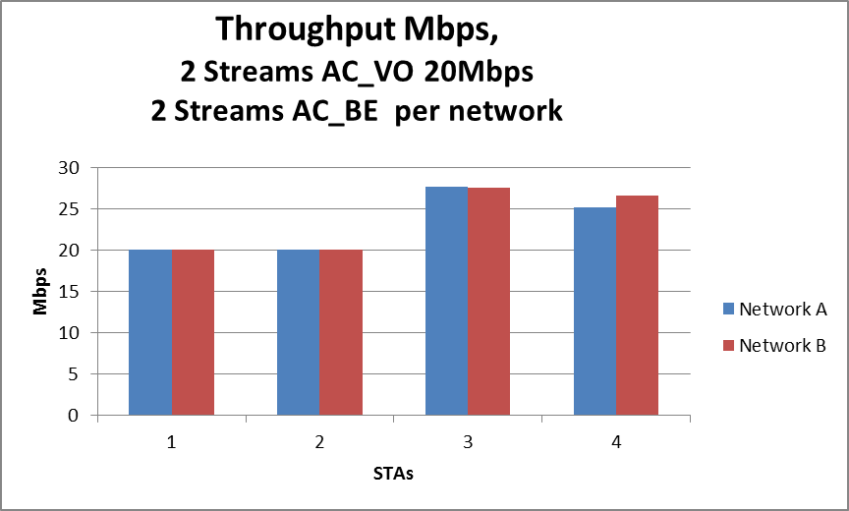
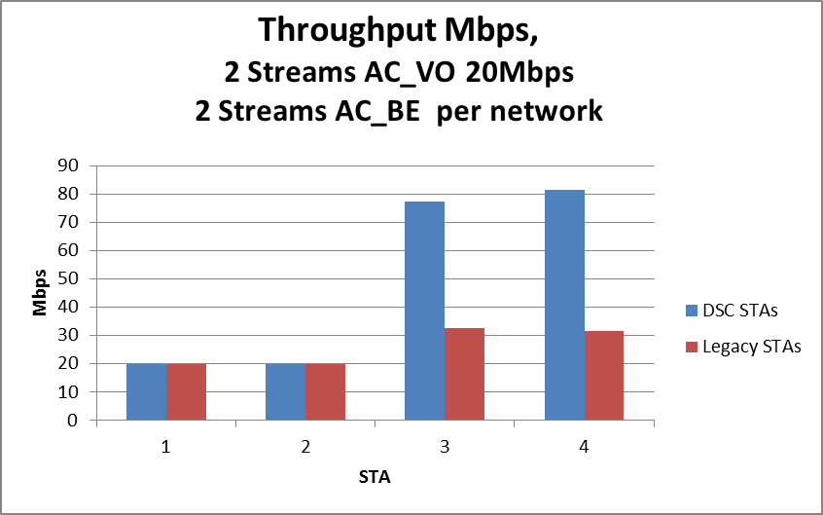
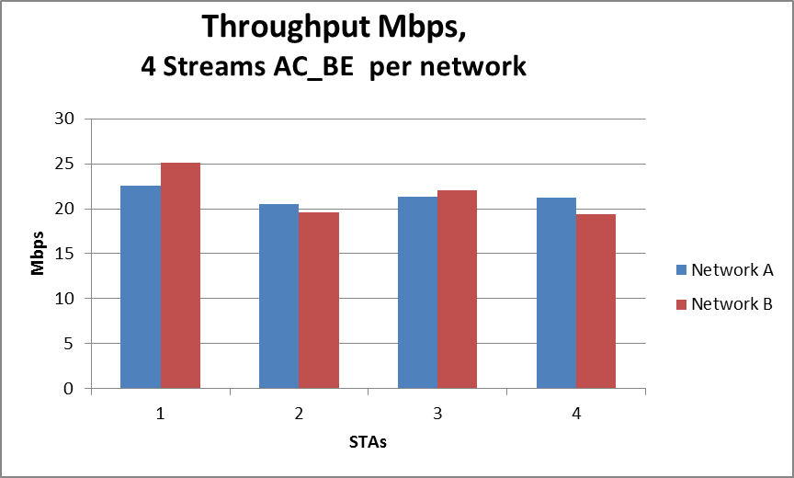
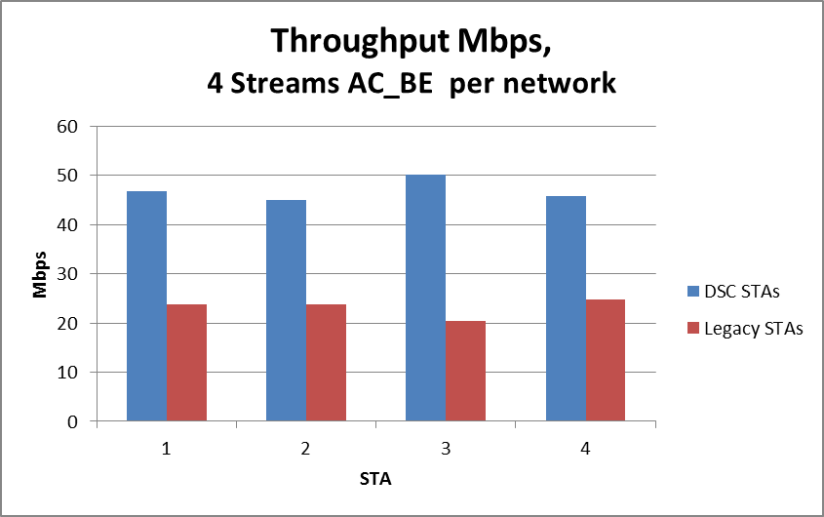
Throughput Simulations
Legacy Sharing
DSC/Legacy Sharing

Slide 12
Legacy and DSC Simulation
270Mbps 2SS 11n
Actually Legacy STAs are better off!!
DSC STAs are a lot better off
(incentive to use the feature, even by itself)

Slide 13
Conclusions/Points
DSC and Channel Selection effectively eliminates OBSS problems in dense Apartment scenario
Channel Selection with Overlap indication is required to prevent ‘piggy in the middle’ AP
  Assuming DSC is not universally used
Legacy Networks are not disadvantaged by sharing with DSC networks
In general decreasing channel BW to have independent channel is better than sharing at higher BW
  Dynamic BW as per 11ac should be effective.

