Slide 1
802.11 March 2014 Closing Reports
Date: 2014-03-21
Authors:

Slide 2
Abstract
This document is a digest of the closing reports of all 802.11 sub-groups for presentation at the March 2014 closing plenary meeting.

Slide 3
Attendance

Slide 4
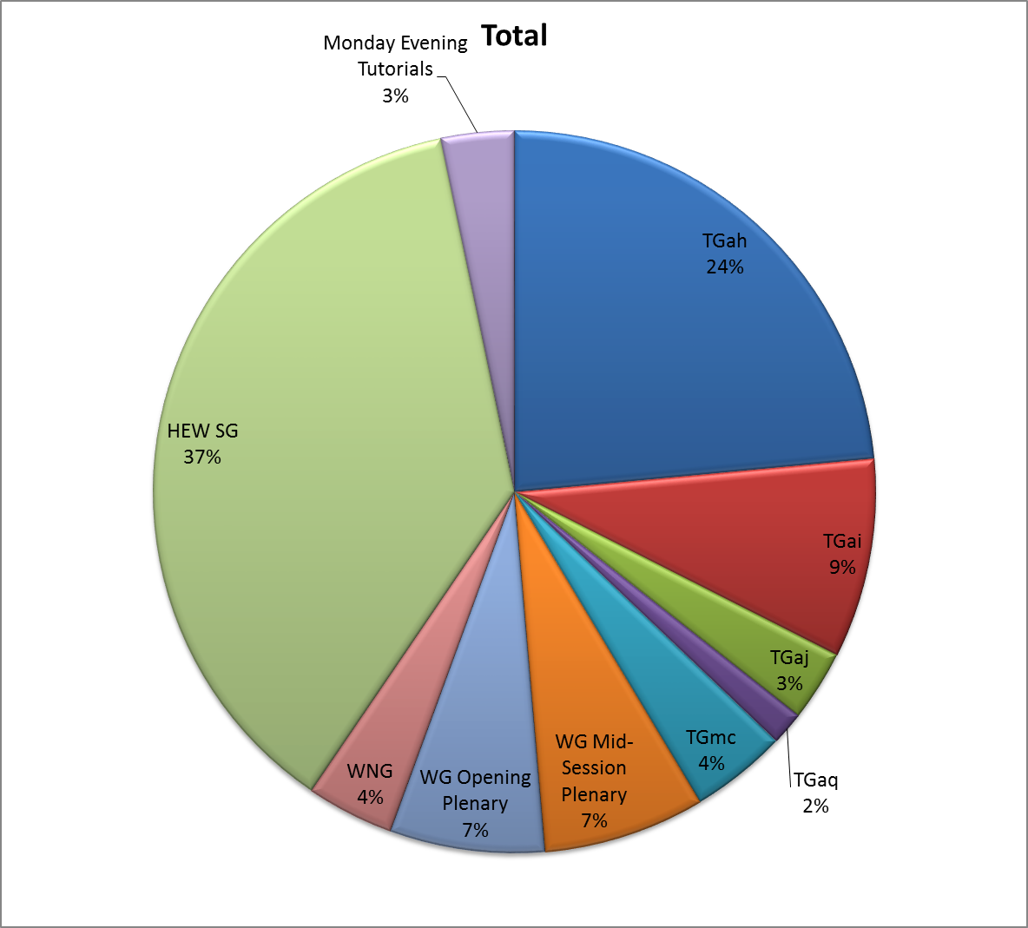
Attendance Total

Slide 5
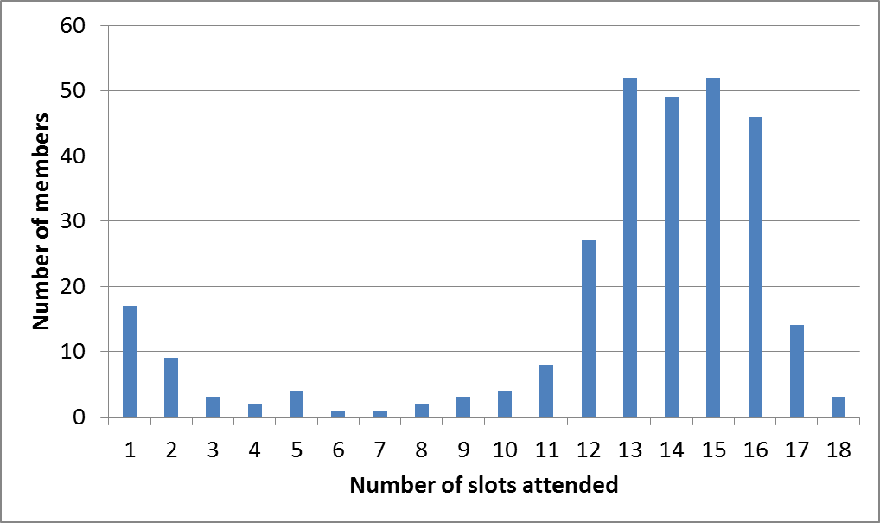
Attendance Histogram (Thu)

Slide 6
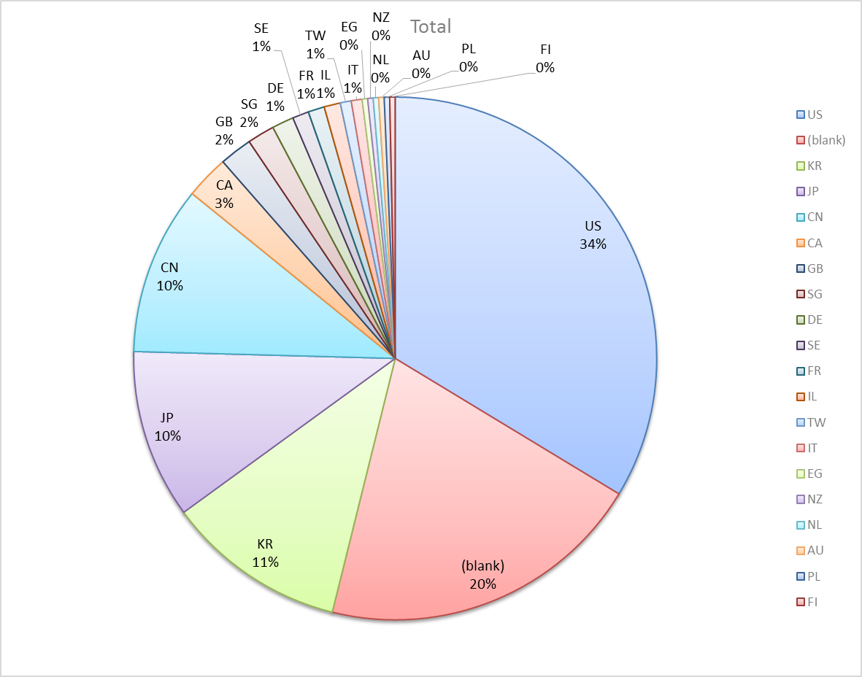
Attendance by Country

Slide 7
Type of Groups
Type of Group | Description
WG | Working Group
TG | Task Group
SG | Study Group
SC | Standing Committee

Slide 8
Groups
Type | Group | Description | Chair
WG | WG11 | The IEEE 802.11 Working Group | Bruce Kraemer
TG | MC | Maintenance (Revision C) | Dorothy Stanley
TG | AH | Operation in 900 MHz bands | Dave Halasz
TG | AI | Fast Initial Link Setup | Hiroshi Mano
TG | AJ | China Millimeter Wave (CMMW) | Xiaoming Peng
TG | AK | General Link Setup | Donald Eastlake 3rd
TG | AQ | Pre-association Discovery | Stephen McCann
SC | WNG | Wireless Next Generation | Clint Chaplin
SC | ARC | Architecture | Mark Hamilton
SC | JTC1 | ISO/IEC/JTC1/SC6 shadow committee | Andrew Myles
SC | REG | Regulatory | Richard Kennedy
SG | HEW | High Efficiency WLAN | Osama Aboul-Magd

Slide 9
Group | ClosingReportRef
WG Technical Editor | 11-14/284r2
WNG SC | 11-14/449r0
ARC SC | 11-14/437r0
JTC1 SC | 11-14/458r0
Reg SC | 11-14/431r0
TGmc | 11-14/461r0
TGah | 11-14/453r0
TGai | 11-14/450r0
TGaj | 11-14/439r0
TGak | 11-14/462r0
TGaq | 11-14/447r0
HEW SG | 11-14/457r0
802.18 Liaison | 11-14/432r0
OmniRAN Liaison | 11-14/460r0
802.24 Liaison | 11-14/459r0
802.19 Liaison | 11-14/421r0
WBA Liaison | 11-14/442r0

Slide 10
802.11 WG Editor’s Meeting (Mar ‘14)
Date: 2014-03-10
Authors:
from slide 1/6 of 11-14/284r2 by Peter Ecclesine (Cisco Systems)
Notes:
July 2007

Slide 11
Volunteer Editor Contacts
March 2014
TGmc – Adrian Stephens – adrian.p.stephens@intel.com
TGah – Yongho Seok yongho.seok@lge.com, Alfred Asterjadhi – aasterja@qti.qualcomm.com
TGai – Lee Armstrong – LRA@tiac.net, Ping FANG Ping.FANG@huawei.com
TGaj – Jiamin CHEN – jiamin.chen@mail01.huawei.com
Tgak – Donald Eastlake – d3e3e3@gmail.com
TGaq – Dan Gal – ddrgal@gmail.com
Editors Emeritus:
  TGaa – Alex Ashley – alex.ashley@hotmail.co.uk
  TGac – Robert Stacey – robert.stacey@intel.com
  TGad – Carlos Cordeiro – carlos.cordeiro@intel.com
  TGae – Henry Ptasinski – henry@LOGOUT.COM
  TGaf – Peter Ecclesine – pecclesi@cisco.com
from slide 2/6 of 11-14/284r2 by Peter Ecclesine (Cisco Systems)
Notes:
July 2007

Slide 12
802.11 Style Guide
See 11-09-1034-09-0000-wg11-style-guide.doc
  We updated 802.11 WG Style Guide based on 2012 IEEE Standards Style Manual and consistency changes in final publication of the 802.11 standard
Editor’s responsibility includes checking the 2012 IEEE Standards Style Manual when creating or updating drafts. https://development.standards.ieee.org/myproject/Public/mytools/draft/styleman.pdf
Submissions with draft text should conform to both the WG11 Style Guide and IEEE Standards Style Manual
Note that the Style Guide evolves with our practice
from slide 3/6 of 11-14/284r2 by Peter Ecclesine (Cisco Systems)

Slide 13
Editor Amendment Ordering
Amendment numbering is editorial! No need to make ballot comments on these dynamic numbers!
Data as of Mar 2014
See http://grouper.ieee.org/groups/802/11/Reports/802.11_Timelines.htm
July 2013 Editors changed the running order and will revisit in July 2014, maintaining this order in the interim
Amendment Number | Task Group | REVCOM Date
802.11-2012 Amendment 1 | TGae | Mar 2012
802.11-2012 Amendment 2 | TGaa | Jun 2012
802.11-2012 Amendment 3 | TGad | Oct 2012
802.11-2012 Amendment 4 | TGac | Dec 2013
802.11-2012 Amendment 5 | TGaf | Dec 2013
802.11REVmc | TGmc | Mar 2015
802.11-2015 Amendment 1 | TGai | Nov 2015
802.11-2015 Amendment 2 | TGah | Mar 2016
from slide 4/6 of 11-14/284r2 by Peter Ecclesine (Cisco Systems)
Notes:
July 2007

Slide 14
Draft Development Snapshot
Mar 2014
March 2014
Changes from last report shown in red.
Most current doc shaded green.
TG | Published or Draft Baseline Documents |  |  |  |  |  |  |  | Source | MDR | Style Guide | Editor | Snapshot Date
 | Published | af | mc | ai | ah | aj | ak | aq
af | Y | Y |  |  |  |  |  |  | Frame 12.0 | Yes | 2012 | Peter Ecclesine | 12-Mar
mc | N |  | 2.3 |  |  |  |  |  | Frame 10.0 | No | 2012 | Adrian Stephens | 21-Jan
ai | N | 5.0 | 1.0 | 1.3 |  |  |  |  | Frame 9.0 | No | 2012 | Lee Armstrong Ping FANG | 17-Mar
ah | N | 3.0 | 1.2 |  | 1.1 |  |  |  | Frame 11.0 | No | 2012 | Yongho Seok Alfred Asterjadhi | 19-Jan
aj | N |  |  |  |  | 0.01 |  |  | Frame 10.0 | No | 2012 | Jiamin Chen | 18-Mar
ak | N |  |  |  |  |  |  |  | Word | No | 2012 | Donald Eastlake | 12-Nov
aq | Y |  |  |  |  |  |  | 0.0 | Word | No | 2012 | Dan Gal | 12-Mar
Slide 14
from slide 5/6 of 11-14/284r2 by Peter Ecclesine (Cisco Systems)
Notes:
July 2009
July 2007
Peter Ecclesine (Cisco Systems)
Page 14

Slide 15
MIB style, Visio and Frame practices
I’m going to suggest going forward we use a single style with appropriately set tabs, and use leading Tabs to distinguish the syntax and description parts. (Adrian Stephens Feb 9, 2010)
Keep embedded figures using visio as long as possible
  Near the end of sponsor ballot, turn these all into .wmf (windows meta file) format files (you can do this from visio using “save as”). Keep separate files for the .vsd source and the .wmf file that is linked to from frame. There is likelihood we should use .emf
Frame templates for 11aa, 11ac, 11af
Text version of MIB is available (2012, ae2012, aa2012, ad2012, acD5.0, afD5.0)
from slide 6/6 of 11-14/284r2 by Peter Ecclesine (Cisco Systems)

Slide 16
Closing Report
Date: 2014-03-20
Authors:
from slide 1/3 of 11-14/449r0 by Clint Chaplin, Chair (Samsung)

Slide 17
Abstract
Closing report for WNG SC for March 2014, Beijing, China
from slide 2/3 of 11-14/449r0 by Clint Chaplin, Chair (Samsung)

Slide 18
Presentations at March 2014 meeting
  A P2P Discovery System (11-14-0399-00-0wng A P2P Discovery System.pptx) – Torleiv Maseng
Minutes
  11-14-0401-00-0wng-march-2014-wng-meeting-minutes-beijing.doc
Plans for May 2014
  1 2 hour session
from slide 3/3 of 11-14/449r0 by Clint Chaplin, Chair (Samsung)

Slide 19
ARC Closing Report
Date: 2014-03-19
Authors:
from slide 1/6 of 11-14/437r0 by Mark Hamilton, Spectralink, Corp.

Slide 20
Abstract
This document is the closing report for ARC SC,
March 2014, Beijing meeting
from slide 2/6 of 11-14/437r0 by Mark Hamilton, Spectralink, Corp.

Slide 21
Work Completed
Presentation: OmniRAN overview
  https://mentor.ieee.org/802.11/dcn/14/11-14-0398-00-0arc-wg-cooperation-for-omniran-p802-1cf.pptx
  Request for 802.11 SME review and comment
IETF/802 coordination update – Dorothy Stanley
  CAPWAP:
    New work item proposal (into IETF) for “Alternative Data Tunnel” – drafted liaison response that this appears out of scope of 802.11
    Other drafts not ready yet - will consider 802.11 comment collection process, when drafts available
  RFC4441:
    Noted rev8 available. No action needed.
  PAWS:
    Draft 8 available, 802.11 held comment collection – no comments
Update on 802 O&A D1.8
  Latest Sponsor Ballot recirc closed Mar 14, in comment resolution
  Expect next Sponsor Ballot recirc shortly after Mar meeting
from slide 3/6 of 11-14/437r0 by Mark Hamilton, Spectralink, Corp.

Slide 22
Work Completed (con’t)
IEEE 1588 mapping to 802.11
  IEEE 1588 and 802.1AS experts working together to create layered architecture, which will preserve 802.1AS mapping to 802.11.
  No further work needed now, will continue to monitor
802.1AC revision
  Task Group ballot closed Mar 14, in comment resolution
  Will continue to work with 802.1 IWG and TGak on topics in common
Architecture of APs/DS/Portals, and 802.1 concepts
  Reviewed tutorial animation submission (https://mentor.ieee.org/802.11/dcn/14/11-14-0097-00-0arc-dual-band-ap-tutorial-simulation.zip)
  Will provide comments to author, additional off-line comments encouraged
from slide 4/6 of 11-14/437r0 by Mark Hamilton, Spectralink, Corp.

Slide 23
Teleconference(s)
One expected, scheduled with 10 days notice:
  Discuss comments collected on 802 O&A recirc
  Expect week of Mar 31
Need for other telecons is possible:
  If CAPWAP drafts become available
  If 802.1AC Task Group ballot recirc starts
from slide 5/6 of 11-14/437r0 by Mark Hamilton, Spectralink, Corp.

Slide 24
May 2014 Goals
One meeting slot planned:
  Architecture topics: AP/DS/Portal
  802.1AC balloting
  802 O&A sponsor ballot
  IETF/802: RFC 4441, CAPWAP, PAWS
  IEEE 1588, if needed.
from slide 6/6 of 11-14/437r0 by Mark Hamilton, Spectralink, Corp.

Slide 25
IEEE 802 JTC1 SC closing report (Mar14)
Date: 2014-03-20
Authors:
from slide 1/7 of 11-14/458r0 by Andrew Myles, Cisco

Slide 26
Abstract
Closing report for IEEE 802 JTC1 SC
for March 2014 in Beijing
from slide 2/7 of 11-14/458r0 by Andrew Myles, Cisco

Slide 27
IEEE 802 has pushed four standards through the PSDO ratification process
IEEE 802 standard | 60 day pre-balllot | 5 month FDIS ballot | Comments resolved by IEEE
802.11 | Passed (2012) | Passed in 2012 | Liaised in Nov 2013
802.1X | Passed (2013) | Passed 21 Oct 2013 | Liaised in Jan 2014
802.1AE | Passed (2013) | Passed 21 Oct 2013 | Liaised in Jan 2014
802.3 | Passed (2013) | Passed 16 Feb 2014 | Not required
from slide 3/7 of 11-14/458r0 by Andrew Myles, Cisco

Slide 28
IEEE 802 has nine standards in the pipeline for ratification under the PSDO
IEEE 802 standard | 60 day pre-balllot | 5 month FDIS ballot | Comments resolved
802.1AB | Passed (May 2013) | Passed (18 Dec 2013) | Finished & approved (?) by 802.1 WG in Beijing
802.1AR | Passed (May 2013) | Passed (18 Dec 2013)
802.1AS | Passed (May 2013) | Passed (18 Dec 2013)
802.11aa | Passed (Feb 2013) | Passed (28 Jan 2014) | Finished in Beijing & will be approved after refinement by 802.11 WG in Hawaii
802.11ad | Passed (Feb 2013) | Passed (28 Jan 2014)
802.11ae | Passed (Feb 2013) | Passed (28 Jan 2014)
802.1AEbw | Passed (Jan 2014) |  | Finished & approved (?) by 802.1 WG in Beijing
802.1AEbn | Passed (Jan 2014)
802.22 | Closes 5 May 2014
from slide 4/7 of 11-14/458r0 by Andrew Myles, Cisco

Slide 29
The SC heard a report in Beijing of the recent SC6 meeting in Ottawa
Highlights of SC6 meeting in Ottawa included:
  Very light agenda
  No action, after discussion, on proposal to base all SC6 security on TePA from SC27 because of Snowden revelations
  No action on any TePA or UHT/EUHT proposals previously discussed in SC6
  No action, after discussion, on “WLAN optimisation” proposal
    A protocol to support network sniffing
  Discussion of “Virtual Network” proposal with subsequent request for formal comments (see motion)
    A protocol to allow sharing of AP by multiple SPs
  Efforts failed to replace next SC6 meeting (in London) with a teleconference
from slide 5/7 of 11-14/458r0 by Andrew Myles, Cisco

Slide 30
JTC1 SC will continue work in Hawaii
Refine responses for 802.11aa/ad/ae comments from FDIS ballots
Discuss and possibly respond to “WLAN optimisation” proposal
Respond to any comments on 802.22 FDIS
Respond to any new documents on SC6 server
…
Note: only Tue PM1 is planned
from slide 6/7 of 11-14/458r0 by Andrew Myles, Cisco

Slide 31
Motion
SC unanimously passed a motion approving text similar to that in 11-14-256r0, with approval for Chair to make editorial changes
  Changes were made and so a second is required
Motion:
  The IEEE 802.11 WG approves the liaison of 11-14-256r0 in relation to “WLAN Virtual Network” to ISO/IEC JTC1/SC6/WG7
  Moved: Myles
  Seconded:
from slide 7/7 of 11-14/458r0 by Andrew Myles, Cisco

Slide 32
IEEE 802.11 Regulatory SC
Beijing Closing Report
Date: 2014-03-21
Authors:
from slide 1/5 of 11-14/431r0 by Rich Kennedy, self

Slide 33
Abstract
This presentation is the closing report for the March 2014 IEEE 802.11 Regulatory Standing Committee meeting in Beijing.
from slide 2/5 of 11-14/431r0 by Rich Kennedy, self

Slide 34
Agenda
Regulatory summaries
[Potential] Action items
DSRC Coexistence
AOB
Adjourn
from slide 3/5 of 11-14/431r0 by Rich Kennedy, self

Slide 35
Accomplishments
Re-elected Rich Kennedy as Chair
Regulatory summaries
  Asia
  EU
  North America
DSRC Coexistence Tiger Team update
ECC consultation response
  Approved comments on LTE in 2300 to 2400 MHz
Other items
  Decided not to send Globalstar NPRM Comments
  Decided to wait for 3GPP work item re LTE-U
from slide 4/5 of 11-14/431r0 by Rich Kennedy, self

Slide 36
Teleconferences
Regulatory SC
  Bi-weekly on Thursdays, 12:30 to 14:00 ET
  Through May 31st
Weekly DSRC Coexistence Tiger Team
  Weekly on Fridays, 13:00 to 14:00 ET
  Through May 31st
from slide 5/5 of 11-14/431r0 by Rich Kennedy, self

Slide 37
IEEE 802.11mc Closing Report for
March 2014
Date: 2014-03-20
Authors:
from slide 1/6 of 11-14/461r0 by Dorothy Stanley (Aruba Networks)

Slide 38
Abstract
This document contains the TGmc closing report for March 2014.
from slide 2/6 of 11-14/461r0 by Dorothy Stanley (Aruba Networks)

Slide 39
Status
Continued processing comments received in LB 199 – First recirculation LB
  497 comments
  Have approved resolutions to approximately 440 comments (50 this week)
Discussed “deprecation” comments
  May 2014 meeting: Weds PM2
from slide 3/6 of 11-14/461r0 by Dorothy Stanley (Aruba Networks)

Slide 40
TGmc Plan of Record
20 July 2012 – 12 Sept 2012 – Call for Comment/Input
29-30 Aug 2012 – NesCom, SASB PAR Approval
Sept 2012 – Begin to process input
Sept 2012 – 11aa, 11ae integration
Jan – First WG Letter ballot - without 11ad
Dec 2012 – March/May 2013 – 11ad integration
Sept 2013 – Letter ballot on D2.0
Dec 2013 – May 2014 – 11ac, 11af integration – D3.0 in May 2014
July 2014 – Mandatory Draft Review
Jul - Aug 2014 – Form Sponsor Pool (45 days)
Nov 14 – Initial Sponsor Ballot
July 2015– WG/EC Final Approval
Dec 2015 – RevCom/SASB Approval – Was Sept 2015
Slide 40
from slide 4/6 of 11-14/461r0 by Dorothy Stanley (Aruba Networks)
Notes:
doc.: IEEE 802.11-10/0503r4
May 2010
Michael Montemurro, Research in Motion
Page 40

Slide 41
Teleconferences
Conference Calls 10am Eastern (2 hours)
  April 4, 11, May 2
from slide 5/6 of 11-14/461r0 by Dorothy Stanley (Aruba Networks)

Slide 42
Next Steps
Complete comment resolution of comments received from LB 199 on P802.11REVmc D2.0
from slide 6/6 of 11-14/461r0 by Dorothy Stanley (Aruba Networks)

Slide 43
IEEE 802.11ah Closing Report for
March 2014
Date: 2014-03-20
Authors:
from slide 1/5 of 11-14/453r0 by Yongho Seok (LG Electronics)

Slide 44
Activity in TGah
Letter Ballot 200 for Draft 1.0 closed November 4th
  1984 comments received
Total 823 comments (60 PHY comments and 763 MAC comments) with 43 submissions addressed in this week)
  438 (405 MAC comments, 33 PHY comments) comments unresolved after March F2F meeting
  13/1336 LB200 Comment Spreadsheet
Instructed the editor to generate Draft 1.3
from slide 2/5 of 11-14/453r0 by Yongho Seok (LG Electronics)

Slide 45
Going forward
TGah leadership election in May meeting
Work on addressing comments received during conference calls and the May meeting
Generate D2.0 in May meeting
from slide 3/5 of 11-14/453r0 by Yongho Seok (LG Electronics)

Slide 46
Teleconference
April 2, 7PM ET for 2 hour
April 9, 7PM ET for 2 hour
April 16, 7PM ET for 2 hour
April 23, 7PM ET for 2 hour
April 30, 7PM ET for 2 hour
May 7, 7PM ET for 2 hour
from slide 4/5 of 11-14/453r0 by Yongho Seok (LG Electronics)

Slide 47
TGah Timeline Update
Internal Task Group Ballot : May 2013
Initial Letter Ballot : September 2013
Initial Recirculation Letter Ballot : November 2013 September 2014
Initial Sponsor Ballot : February 2015
Initial Recirculation Sponsor Ballot : November 2015
EC Approval : January 2016
Revcom Approval : March 2016
from slide 5/5 of 11-14/453r0 by Yongho Seok (LG Electronics)

Slide 48
IEEE 802.11TGai
Closing Report
March 2014
Date: 2014-3-20
Authors:
Name | Company | Address | Phone | email
Hiroshi MANO | AlliedtelesisR&D center,K.K. | 8F TOC2 Bldg. 7-21-11 Nishi-Gotanda, Shinagawa-ku, Tokyo 141-0031 JAPAN | +81-3-5719-7630 | hmano@root-hq.com
from slide 1/12 of 11-14/450r0 by Hiroshi Mano (ATRD Root Lab)

Slide 49
Abstract
March 2014
This presentation is the closing report for the Beijing meeting of the IEEE 802.11 TGai.
from slide 2/12 of 11-14/450r0 by Hiroshi Mano (ATRD Root Lab)

Slide 50
IEEE 802.11 FILS TGai –
March 2014 Beijing meeting
Goals for the Meeting:
  Approve minutes of past meeting and teleconference
  Comment resolution of WG LB198.
  Approve all of comment resolution and move to forward WG LB.
  Approve Timeline
  Approve Teleconference schedule
  Approve Plan for May
from slide 3/12 of 11-14/450r0 by Hiroshi Mano (ATRD Root Lab)

Slide 51
Accomplishments TGai 1/2
March 2014
Approve TGai Meeting Minutes for the IEEE 802.11 Jan 2014
  11-14/204r0 January 2014 Los Angeles Session Minutes
Approve TGai teleconference meeting minutes of Los Angels to Beijing meeting.
    11-14/304r0 February-March Teleconference Minutes
from slide 4/12 of 11-14/450r0 by Hiroshi Mano (ATRD Root Lab)

Slide 52
Accomplishments TGai 2/2
March 2014
1 Adhoc and 6 regular slots were held.
1389 comments were received by WG LB198.
Complete all of comment resolution works.
Approve all of comment resolution and move to forward WG LB.
Approved Timeline
Approved Teleconference schedule
Approved Plan for May
Approved July Adhoc meeting schedule
from slide 5/12 of 11-14/450r0 by Hiroshi Mano (ATRD Root Lab)

Slide 53
Plan for May
Goals for the Meeting:
  Approve minutes of past meeting and teleconference
  Officer Election
  Comment resolution of WG LB for D2.0.
  Approve Timeline
  Approve Teleconference schedule
  Approve Plan for July
from slide 6/12 of 11-14/450r0 by Hiroshi Mano (ATRD Root Lab)

Slide 54
Time line of Tgai (no change )
  PAR Approved, Modified, or Extended 2010-12-08
  WG Letter Ballots Initial / Recirc Mar14/Sep14/Jan15
  MEC Done Nov14
  Form Sponsor Ballot Pool / Reform Mar15
  IEEE-SA Sponsor Ballots Initial / Recirc Jul15/ Sep 15
  Final 802.11 WG Approval Nov 15
  final or Conditional 802 EC Approval Nov 15
  RevCom & Standards Board Final or
  Continuous Process Approval Jan 16
  ANSI Approved N/A
from slide 7/12 of 11-14/450r0 by Hiroshi Mano (ATRD Root Lab)

Slide 55
Teleconference Schedule
March 2014
Motion:
  Approve the following schedule of weekly teleconferences.
  Tuesdays 10:00 ET 1st Apr and 6th May 2014
  Duration 1.5 Hour
  Using WEB-EX that will be provided by Task Group Chair
Approved by unanimous consent
from slide 8/12 of 11-14/450r0 by Hiroshi Mano (ATRD Root Lab)

Slide 56
LB Motion to forward WGLB
March 2014
Motion:
Having approved comment resolutions for all of the comments received during Working Group Letter Ballot 198 on TGai D1.0 as contained in document 11-13/1076r34,
  Instruct the editor to incorporate the resolutions with the D1.0 and create D2.0.
  Approve a 30 day Working Group Technical Letter Ballot asking the question “Should TGai D2.0 be forwarded to Sponsor Ballot?” .
Moved: Lee Armstrong
Seconded: PingFang
Result (6/0/0)
from slide 9/12 of 11-14/450r0 by Hiroshi Mano (ATRD Root Lab)

Slide 57
Motion: Adhoc meeting
March 2014
Motion:
Authorize TGai to hold an ad-hoc meeting on 10th to 11th July in San Diego with the preferred host being Qualcomm for the purpose of comment resolution.
Moved: Stephen McCann
Seconded:Peter Yee
Result:5,0,2
from slide 10/12 of 11-14/450r0 by Hiroshi Mano (ATRD Root Lab)

Slide 58
Reference
March 2014
Motions
  https://mentor.ieee.org/802.11/dcn/13/11-13-1186-03-00ai-tgai-motion-deck.pptx
Draft 1.4 on members area
  http://www.ieee802.org/11/private/Draft_Standards/11ai/index.html
TGai LB 198 comments for D1.0
  https://mentor.ieee.org/802.11/dcn/13/11-13-1076-34-00ai-tgai-lb-198-comments-for-d1-0.xlsx
from slide 11/12 of 11-14/450r0 by Hiroshi Mano (ATRD Root Lab)

Slide 59
Thanks to all who participated!
March 2014
謝謝!
from slide 12/12 of 11-14/450r0 by Hiroshi Mano (ATRD Root Lab)

Slide 60
IEEE 802.11aj Task Group March 2014 Closing Report
Date: 2014-03-21
Authors:
from slide 1/10 of 11-14/439r0 by Xiaoming Peng

Slide 61
Abstract
This document is the closing report for IEEE 802.11aj Task Group for the March 2014 session in Beijing China.
from slide 2/10 of 11-14/439r0 by Xiaoming Peng

Slide 62
Work Completed (1/3)
11-14/0276r1 – TGaj Call for Proposals for 45GHz
  With new modified deadline of notification of intent
11-14/011r0 - A low power demodulator prototype for SDR transceivers (40-60 GHz) – new contribution
  Specifically for OOK low power design
  11-14/018r1-PHY-Simulations-and-Methodology
  11-14/0333r0 – TGaj Editor Report
    Comment database is included in 11-14/0332 (received 151 comments)
45GHz Channel Model
  11-14/015r2 – Large Scale Characteristic of 45GHz
  11-14/0403r0 – Small Scale Characteristic of 45GHz
  SEU will generate Matlab code for the channel model of 45GHz and share more details in the coming May meeting
from slide 3/10 of 11-14/439r0 by Xiaoming Peng

Slide 63
Work Completed (2/3)
Comment Resolution for D0.01 (CC12)
    11-14/0334r2 – D0.01 comment resolution
      CIDs: 13, 59, 73, 76, 77, 79, 80, 81, 112, 117, 133, 149.
  11-14/0407r2 – comment resolution
    CID 19, 20, 21, 22, 23 (part of), 24, 25 (part of), 28, 29, 30, 31, 32, 65
  11-14/0408r1 – revised text proposal
  11-14/0389r1 – comment resolution
    CID 127 for decentralized clustering
    Text proposal will be provided in next conference call
  11-14/0390r1 – comment resolution
    CID 127 for centralized clustering
    Text proposal will be provided in next conference call
from slide 4/10 of 11-14/439r0 by Xiaoming Peng

Slide 64
Work Completed (3/3)
Comment Resolution for D0.01 (CC12)
  11-14/0391r0 – comment resolution
    CID 146
  11-14/0408r1 – revised text proposal for comment resolution
    Updated version based on the discussion and feedback
  11-14/0444r0 – comment resolution
    For CID 116
  11-14/0445r0 – revised text proposal
    For CID 116
from slide 5/10 of 11-14/439r0 by Xiaoming Peng

Slide 65
Motion 1
To approve the Call for Proposal (CFP) for 45GHz (11-14/0276r1) and issue the CFP for 45GHz
Moved by: Haiming Wang
Seconded by: Jiamin Chen
Results: Y16 N0 A0
Motion passed
from slide 6/10 of 11-14/439r0 by Xiaoming Peng (I2R)

Slide 66
Motion 2
To approve the comment resolution for the following CIDs
  CID 19-CID 22, CID 24, CID 28-32, CID 65, (from11-14/0407r3, 11-14/0408r1)
  CID 116 (from 11-14/0445r1)
  CID13, 63, 73, 76, 77, 79, 80, 81, 111,112, 113, 117, 133, and 149 (from 11-14/0334r2)
Moved by: Jiamin Chen
Seconded by: Khiam Boon Png
Results: Y10 N0 A0
Motion passed
from slide 7/10 of 11-14/439r0 by Xiaoming Peng (I2R)

Slide 67
Next Meeting for 802.11aj
China Interim Meeting for 802.11aj in May 2014 will be held from May 21 to May 22, 2014 in Beijing, China
from slide 8/10 of 11-14/439r0 by Xiaoming Peng (I2R)

Slide 68
Goals for May 2014 Meeting
Comment Resolution for CC12
New Submissions for 45GHz
from slide 9/10 of 11-14/439r0 by Xiaoming Peng (I2R)

Slide 69
Conference call times
  April 10, 2014, 9pm (ET)
    Beijing Time: April 11, 2014, 9am
  May 8, 2014, 9pm (ET)
    Beijing Time: May 9, 2014, 9am
from slide 10/10 of 11-14/439r0 by Xiaoming Peng (I2R)

Slide 70
TGak March Closing Report
Date: 2014-03-20
Authors:
Name | Address | Affiliations | Phone | Email
Donald Eastlake, 3rd | Huawei Technologies | 155 Beaver Street, Milford, MA 01757 USA | +1-508-333-2270 | d3e3e3@gmail.com
from slide 1/6 of 11-14/462r0 by Donald Eastlake, Huawei Technologies

Slide 71
Abstract
Closing Report of IEEE 802.11 Task Group AK at the IEEE 802.11 Meeting, March 2014, held in Beijing, China.
from slide 2/6 of 11-14/462r0 by Donald Eastlake, Huawei Technologies

Slide 72
TGak Closing Report
Accomplishments
  Selected Mark Hamilton to recommend to the WG as TGak Vice Chair.
  Approved a D0.01 and issued a WG Comment Call through April 25th on Draft P802.11ak_D0.01.
  Met jointly with 802.1 Thursday morning.
  Received and discussed the submissions listed on next page.
  The minutes of this TGak meeting will be in 11-14/0463 and an annotated agenda is in 11-14/0215r9.
from slide 3/6 of 11-14/462r0 by Donald Eastlake, Huawei Technologies

Slide 73
TGak Closing Report
Presentations
  11-14/0004, “Some 11ak EtherType Frame Encoding Text”, Donald Eastlake (Huawei)
  11-14/0130, “Some Subsetting and Addressing Text” , Donald Eastlake (Huawei)
  11-14/0418, “802.11ak Figures”, Philippe Klein (Broadcom)
  11-14/0429, “802.11ak infrastructure architecture thoughts”, Mark Hamilton (Spectralink)
  11-14/0454, “Some 11ak Text”, Donald Eastlake (Huawei)
from slide 4/6 of 11-14/462r0 by Donald Eastlake, Huawei Technologies

Slide 74
TGak Ad Hoc
TGak has scheduled an Ad Hoc at the end of the week before the Waikoloa Meeting:
  http://pothole.com/~dee3/kauai
  https://www.eventbrite.com/e/80211-tgak-ad-hoc-meeting-registration-10458883803
With the approval by TGak of a D0.01 and call for comments, there should be plenty of work for the Ad Hoc to do.
However, there have been very few registrations so far for the Ad Hoc. Please register as soon as you can. If there are insufficient registrations, the Ad Hoc will be cancelled.
from slide 5/6 of 11-14/462r0 by Donald Eastlake, Huawei Technologies

Slide 75
TGak Closing Report
Teleconferences
  Decided to hold 1 hour teleconferences, to be joint with 802.1Qbz, on Monday, February 10th, March 31st, April 14th, and May 5th all at 5pm Eastern US time.
May 2014 Plans
  Process comments received on D0.01 from the WG.
  Receive and discuss technical presentations.
  Produce a D0.02
  Joint meeting with ARC.
from slide 6/6 of 11-14/462r0 by Donald Eastlake, Huawei Technologies

Slide 76
TGaq Closing Report
Date: 2014-03-21
Authors:
from slide 1/3 of 11-14/447r0 by Stephen McCann, Blackberry

Slide 77
Abstract
Closing report for TGaq (Pre-Association Discovery) for March 2014, Beijing, China.
from slide 2/3 of 11-14/447r0 by Stephen McCann, Blackberry

Slide 78
Technical presentations
Architecture
    11-13-0788r5 Transaction Protocol Architecture
Protocol
    11-14-0260r2 TGaq Protocol Name
    11-13-1384r3 service-transaction-protocol
Example Message Flows
    11-14-0374r0 Two options for UPnP Printer Discovery
    11-14-0158r1 Transaction Protocol with ANDSF
Others
    11-14-0446r0 DNSSD Activities of IETF
Teleconference: 28th April 2014 , 10:00 ET
Plans for May 2014
  Call for technical proposals to create Draft 0.01
  Development of scenarios and example message flows
from slide 3/3 of 11-14/447r0 by Stephen McCann, Blackberry

Slide 79
High Efficiency WLAN (HEW) SG March 2014 Closing Report
Date: 2014-03-20
Authors:
from slide 1/6 of 11-14/457r0 by Osama Aboul-Magd (Huawei Technologies)

Slide 80
Abstract
This document is the closing report for the High Efficiency WLAN SG for the March 2014 session.
from slide 2/6 of 11-14/457r0 by Osama Aboul-Magd (Huawei Technologies)

Slide 81
Work Completed
Addressed comments related to the PAR and the CSD received from individuals and other IEEE 802 WGs. Resolution of comments is available at:
  https://mentor.ieee.org/802.11/dcn/14/11-14-0424-00-0hew-hew-sg-par-and-csd-comments-and-resolutions.pptx
Updated the PAR and the CSD documents based on received comments:
  https://mentor.ieee.org/802.11/dcn/14/11-14-0165-01-0hew-802-11-hew-sg-proposed-par.docx
  https://mentor.ieee.org/802.11/dcn/14/11-14-0169-01-0hew-ieee-802-11-hew-sg-proposed-csd.docx
Approved the new revisions of the PAR and the CSD.
Approved a motion for SG extension
The meeting agenda is available at: https://mentor.ieee.org/802.11/dcn/14/11-14-0219-04-0hew-hew-sg-march-2014-meeting-agenda.ppt
from slide 3/6 of 11-14/457r0 by Osama Aboul-Magd (Huawei Technologies)

Slide 82
May 2014 Goals
SG or TG elections
Continue the work on simulation scenarios, evaluation methodologies, channel models, and function requirements.
from slide 4/6 of 11-14/457r0 by Osama Aboul-Magd (Huawei Technologies)

Slide 83
Timeline
May 2013
  Initial meeting
July 2013
  Presentations
  SG Extension
Sept 2013
  Presentations
Nov 2013
  Presentations
  Initial PAR and 5C
  SG Extension
Jan 2014
  Presentations
  Final version of PAR and 5C
  WG Approval
March 2014
  Presentations
  EC Approval
May-June 2014
  Nescom approval
July 2014
  TG starts
We are
here
from slide 5/6 of 11-14/457r0 by Osama Aboul-Magd (Huawei Technologies)

Slide 84
Conference Call Times
Thursday April 17 10:00 – 12:00 ET
from slide 6/6 of 11-14/457r0 by Osama Aboul-Magd (Huawei Technologies)

Slide 85
RR-TAG (802.18) to 802.11 Liaison Report
Date: 2014-03-21
Authors:
from slide 1/5 of 11-14/432r0 by Rich Kennedy, self

Slide 86
Overview
This document summarizes the activities of the IEEE 802.18 Radio Regulatory Technical Advisory Group (RR-TAG) during the IEEE 802 March 2014 Plenary Meeting in Beijing.
from slide 2/5 of 11-14/432r0 by Rich Kennedy, self

Slide 87
ECC Consultation Response Approved
  The RR-TAG approved the following document which will be submitted to the EC at the closing plenary review and approval to forward to the ECC.
  ECC (14)BB comments
  11-14/0404r2 and 18-14/0017r1
from slide 3/5 of 11-14/432r0 by Rich Kennedy, self

Slide 88
ITU-R Documents Approved
The RR-TAG approved the following documents for EC review in the EC closing plenary and submission to ITU-R:
  Proposed LS to ITU-R WP 5D: Update of Section 5.6 toward Revision 12 of Recommendation ITU-R M.1457 (Meeting X+2B Notification)
  11-18/0016r0
from slide 4/5 of 11-14/432r0 by Rich Kennedy, self

Slide 89
3GPP Liaison Request Letter
The RR-TAG approved the following liaison request to 3GPP
  3GPP liaison Draft Mar18AM1
  11-14/0436r0 and 18-14/0018r0
from slide 5/5 of 11-14/432r0 by Rich Kennedy, self

Slide 90
OmniRAN EC SG Liaison Report to IEEE 802.11
Date: 2014-03-20
Authors:
from slide 1/6 of 11-14/460r0 by Max Riegel (NSN)

Slide 91
OmniRAN EC SG Liaison Report to IEEE 802 WGs
OmniRAN EC SG Chair:
Max Riegel (NSN)
2014-03-20
from slide 2/6 of 11-14/460r0

Slide 92
OmniRAN EC SG
Status and Outlook
OmniRAN PAR proposal on IEEE 802.1CF Recommended Practice: ‘Network Reference Model and Functional Description of IEEE 802 Access Network’ was approved by IEEE 802 EC on November 15th, 2013
  https://mentor.ieee.org/omniran/dcn/13/omniran-13-0096-00-ecsg-approved-par-clean.pdf
The PAR is on the NesCom agenda for approval on March 26th, 2014
  IEEE 802.1CF project starts after NesCom approval
OmniRAN EC SG was extended in November 2013 until March 2014 to take care of the PAR approval by NesCom.
OmniRAN EC SG will ask for another extension in the EC closing plenary, just for the case that NesCom asks for additional input.
  A Study Group is disbanded upon approval of the PAR by the IEEE-SA Standards Board.
from slide 3/6 of 11-14/460r0

Slide 93
OmniRAN after the approval of the P802.1CF PAR
IEEE 802.1 decided to establish an ‘OmniRAN TG’ for the P802.1CF project.
To facilitate close cooperation with the other IEEE 802 WGs, the OmniRAN TG will
  continue with the OmniRAN filespace on mentor for convenient exchange of documents with members of the other IEEE 802 WGs
  meet when appropriate at interims with the wireless working groups
  try to arrange for reciprocal attendence credits with the other IEEE 802 WGs (procedural details still to be clarified).
from slide 4/6 of 11-14/460r0

Slide 94
Envisioned activities of 802.1 OmniRAN TG until July F2F
Continue the work on the following topics:
  Wireless Access Setup
  Network Discovery and Selection
  Point-to-point links across bridged infrastructures
  SDN specification needs in P802.1CF
Meetings, teleconferences
  Teleconference (late April, date t.b.d.)
  2 full days F2F meeting in Norfolk, VA
  Teleconference (mid June, date t.b.d.)
from slide 5/6 of 11-14/460r0

Slide 95
Second Wireless SDN BoF
Thu, Mar 20th, AM1
Three presentations with discussions
  Outcome of the Wireless BoF in Jan 2014 (Roger Marks)
    https://mentor.ieee.org/omniran/dcn/14/omniran-14-0025-00-0000-outcome-of-wireless-sdn-bof-meeting-of-2014-01-23.pdf
  Software Defined Networking Supported by IEEE 802.1Q (Janos Farkas)
    http://www.ieee802.org/1/files/public/docs2014/Q-farkas-SDN-support-0314-v01.pdf
    http://www.ieee802.org/802_tutorials/2013-03/8021-IETF-tutorial-final.pdf
  SDN OmniRAN usecases (Juan Carlos Zuniga)
    https://mentor.ieee.org/omniran/dcn/14/omniran-14-0029-00-0000-sdn-based-use-cases-for-bof.pptx
Conclusions:
  Set up a dedicated mailing list for the Wireless SDN topic
  Organize for a further Wireless SDN BoF at July plenary meeting
  Establish communication with ONF
from slide 6/6 of 11-14/460r0

Slide 96
802.24
Smart Grid Technical Advisory Group
Liaison Report (January 2014)
Date: 2014-03-20
Author:
from slide 1/3 of 11-14/459r0

Slide 97
802.24 Introduction and Meeting Plan
802.24 is the Smart Grid Technical Advisory Group
Formed Nov 2012 to coordinate internal to and external to IEEE 802 in matters related to Smart Grid standards
Established meeting plan is 3 slots: PM2 on Monday, Tuesday and Wednesday
Participation from all 802 working groups is invited
  Reciprocal attendance credit is available
from slide 2/3 of 11-14/459r0 by Tim Godfrey, EPRI

Slide 98
March 2014 activities
IEEE White Paper on the applicability of IEEE 802 standards in the smart grid
  A draft was developed IEEE Editors from the TAG document.
  Further review and editing will be completed before release –
    Target May 2014
The TAG started developing an operating manual
  Including procedures for starting Task Groups. Doc 24-14-0007
Activities related to scope expansion of 802.24
  A tutorial session was hosted by 802.24 on Tuesday evening. The presentation is 24-14-0008 on Internet of Things
  New scope areas such as IoT will be assigned to Task Groups
  The TAG may adopt a new name such as “Vertical Applications”
from slide 3/3 of 11-14/459r0 by Tim Godfrey, EPRI

Slide 99
March 802.19 Liaison Report
Date: 2014-03-19
Authors:
from slide 1/7 of 11-14/421r0 by Eldad Perahia (Intel)

Slide 100
Abstract
March 802.19 liaison report
from slide 2/7 of 11-14/421r0 by Eldad Perahia (Intel)

Slide 101
802.19 March Meeting Plan
WG leadership elections
Motion to forward 802.19.1 draft to RevCom
Discussion on Future 802.19 Activities
from slide 3/7 of 11-14/421r0 by Eldad Perahia (Intel)

Slide 102
Coexistence Assurance
Ballot on 802.15.4n CA document closed on March 10
Approve: 12
Disapprove: 0
Abstain: 1
There were no comments
from slide 4/7 of 11-14/421r0 by Eldad Perahia (Intel)

Slide 103
802.19.1 Sponsor Ballot Results
 | Sponsor Ballot | Recirc #1 | Recirc #2 | Recirc #3
Draft Number | D3.06 | D4.0 | D5.0 | D5.0
Ballot Closed | 12/27/2013 | 2/7/2014 | 3/1/2014 | 3/15/2014
Ballot Group | 110 | 110 | 110 | 110
Returned Ballots | 94 | 96 | 97 | 98
Yes | 75 | 82 | 88 | 89
No with Comments | 7 | 6 | 1 | 1
No without Comments | 3 | 0 | 0 | 0
Abstain | 9 | 8 | 8 | 8
Comments Received | 102 | 20 | 0 | 0
Return Rate | 85% ≥ 75% | 87% ≥ 75% | 88% ≥ 75% | 88% ≥ 75%
Abstain Rate | 8% < 30% | 7% < 30% | 7% < 30% | 7% < 30%
Approval Rate | 91% ≥ 75% | 93% ≥ 75% | 99% ≥ 75% | 99% ≥ 75%
from slide 5/7 of 11-14/421r0 by Eldad Perahia (Intel)

Slide 104
from slide 6/7 of 11-14/421r0 by Eldad Perahia (Intel)

Slide 105
References
https://mentor.ieee.org/802.19/dcn/14/19-14-0026-00-0001-march-2014-tg-agenda.xls
https://mentor.ieee.org/802.19/dcn/14/19-14-0025-00-0000-march-2014-opening-report.ppt
https://mentor.ieee.org/802.19/dcn/14/19-14-0022-01-0000-march-2014-wg-agenda.xls
from slide 7/7 of 11-14/421r0 by Eldad Perahia (Intel)

Slide 106
WBA Liaison Ad-Hoc Closing Report
Date: 2014-03-21
Authors:
from slide 1/3 of 11-14/442r0 by Stephen McCann, Blackberry

Slide 107
Abstract
Closing report for WBA Liaison Ad-Hoc meeting for March 2014, Beijing, China
from slide 2/3 of 11-14/442r0 by Stephen McCann, Blackberry

Slide 108
Objective
To consider the liaison from the WBA (Wireless Broadband Alliance) regarding Carrier Wi-Fi (11-14-0434r0) and determine actions:
  Covering letter
  Carrier Wi-Fi Guidelines
Summary
No specific action item for IEEE 802.11 was mentioned in the Carrier Wi-Fi Guidelines document
Ask members to review this guideline document and send an email to the ad-hoc chair if any comment are found.
  e.g. discuss potential statement about amendments underway which may be relevant to Carrier Wi-Fi.
These (if any) will then be discussed during a meeting during the May 2014 meeting.
from slide 3/3 of 11-14/442r0 by Stephen McCann, Blackberry

