Slide 1
Element Fragmentation
Date: 2014-01-21
Authors:

Slide 2
Abstract
The presentation discusses on:
The format of the elements that are larger than 255 octets, i.e. HLP Wrapped Data and Public Key element, but are not ANQP or RLQP elements
The Element Fragmentation rules, how to include the large elements to the Management frames that assume 1-octet type and 1-octet length fields
The presentation is related to CID2338, CID2522, CID2630

Slide 3
Current handling of large elements
Format of the Large element:
TLV ID
TLV len
Payload
1
2
Fragmented large element:
ID of large element
EID
len
TLV ID
TLV len
Payload
1
1
EID
len
Payload
1
1
Fragment IE
EID
len
Payload
1
1

Slide 4
Issue: format of large elements
1. Current format of the Large element:
TLV ID
TLV len
Payload
1
2
The large elements are the only elements with 1 octet ID and 2 octet Length field:
- Other elements have 1 octet ID and 1 octet length fields
- ANQP elements have 2 octets ID and 2 octets Lenght fields
Recommendation is to select either 1 – 1 or 2 – 2 format
This is commented in CID2232.

Slide 5
Issue: fragmenting large elements alternative #1
ID of large element
EID
len
TLV ID
TLV len
Payload
1
1
EID
len
Payload
1
1
Fragment element ID
EID
len
Payload
1
1
The large element may be followed by zero or more Fragment elements.
The large element starts with its own ID and continues with zero or more Fragment elements
This fragmentation is possible only if length of ID field of the large element is 1 octet

Slide 6
Issue: fragmenting large elements, alternative #2
EID
len
TLV ID
TLV len
Payload
1
1
EID
len
Payload
1
1
Fragment element ID
EID
len
Payload
1
1
The large elements are within one or more Fragment elements.
This fragmentation is possible with any length of ID field, i.e. also when the length of ID field is 2 octets
The overhead of this fragmentation is the same as previous fragmentation alternative

Slide 7
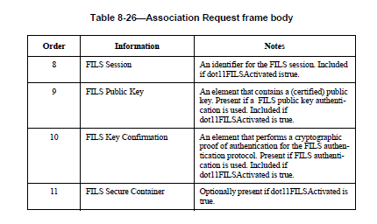
Management frame format when large element is present
Format of Association Request in current draft:
Order | Element | Information | Notes
8 | FILS Session | FILS Session
9 | FILS Key Confirmation | FILS Key Confirmation
10 | Fragment | FILS Public Key, FILS Secure Container | One or more Fragment elements
Order | Element | Information | Notes
8 | FILS Session | FILS Session
9 | FILS Public Key | FILS Public Key
10 | Fragment | FILS Public Key | Zero or more Fragment elements
11 | FILS Key Confirmation | FILS Key Confirmation
12 | FILS Secure Container | FILS Secure Container
13 | Fragment | FILS Secure Container | Zero or more Fragment elements
Association Request with fragmentation #1. Fragment element is multiple times and numerical order is not maintained
Association Request with fragmentation #2, numerical order of elements is maintained

Slide 8
Strawpoll on format of large elements
Are you favor of format 1, 2 or 3?
Format #1: Large element format of: 2 octet Type, 2 octets length field.
Format #2:Large element format of: 1 octet Type, 1 octet length field and showing remaining information in Fragment elements.
Format #3: Large element format of: 1 octet Type, 2 octets length field.
Results: Format #1:
Format #2:
Format #3:

Slide 9
Strawpoll on element fragmentation:
Are you favor of Fragmentation #1 as shown in slide 5 or Fragmentation #2 as shown in slide 6 ?
Results:
Fragmentation #1:
Fragmentation #2:

