Slide 1
Beyond 802.11ad – Ultra High Capacity and
Throughput WLAN 2nd presentation

Slide 2
Abstract
We would like to continue the discussion about creating a new Study Group to explore modifications to the IEEE 802.11ad-2012 PHY and MAC layers, so that modes of operation in the 60 GHz band (57-66 GHz) can be enabled that are capable of a maximum throughput of at least 30 Gbps as measured at the MAC data service access point (SAP), while maintaining the excellent capacity attribute of the 60GHz band.

Slide 3
Agenda
802.11ad attributes
  Small antenna footprint
  Antenna arrays at 60GHz
  Low operating SNR
  Capacity at 60GHz
Next generation (NG) 802.11ad
  High data rates usages reminder
  Methods for increasing the TPT
  Further innovation for next generation 802.11ad

Slide 4
802.11ad attributes (1)
60GHz has very small antenna footprint
  mm compared to cm
Due to the low footprint, 60GHz communication can use antenna arrays
Many advantages of using antenna array in 60GHz
  Increases link margin
  Increases directivity
  Implementation wise: higher efficiency when trying to get high EIRP numbers

Slide 5
802.11ad attributes (2)
802.11ad high rate is a result of using high BW (1.76 GHz)
The operating SNR for 4.6Gbps is lower than 14 dB

Slide 6
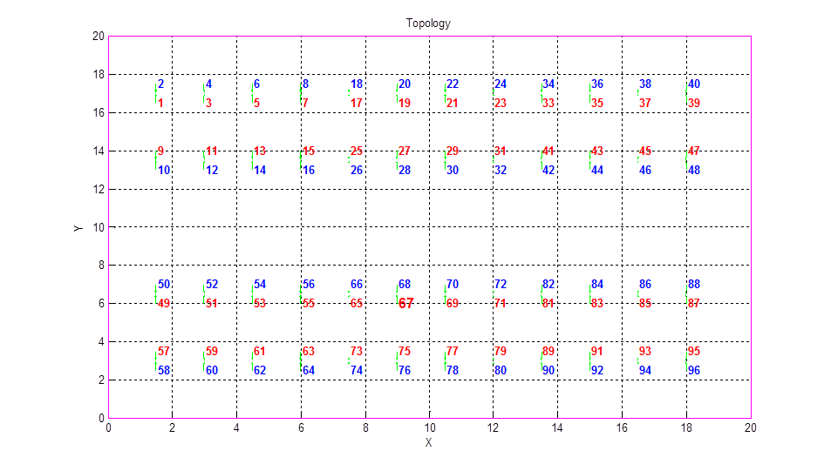
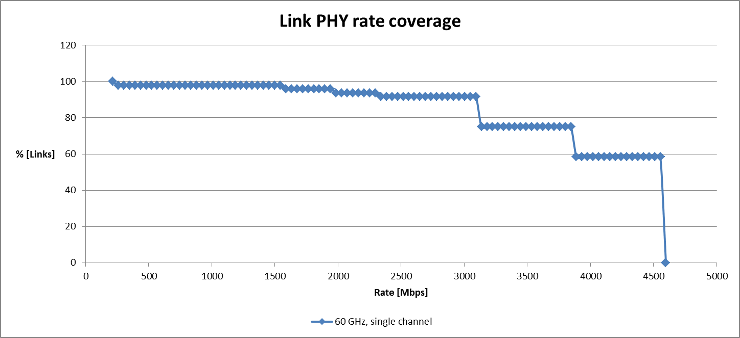
802.11ad attributes: capacity (3)
Directivity and low operating SNR are fantastic attributes to increase capacity
60GHz can significantly increase network capacity
  Directivity in many situations dramatically reduces or eliminates OBSS interference
  Low operating SNR means better resilience to interference
  We have shown amazing numbers of spatial reuse
Simulation from 11-13 408r2
48 pairs
Hall size 20x20x2.5 meters

Slide 7
Next Generation 802.11ad

Slide 8
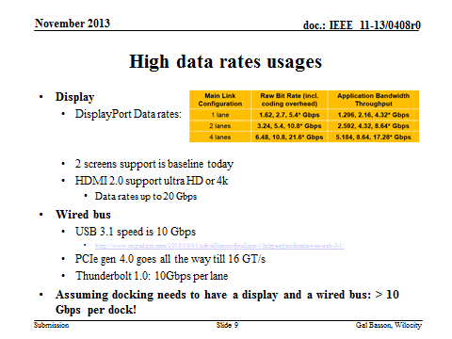

Slide 9
Methods for increasing the TPT
Channel bonding [1]
  We have suggested 2 additional BW
    Double channel-5.28GHz
    Quadruple channel-10.56GHz
    We have shown technology feasibility of such an analog FE today.
      Marinating low power
MIMO [1]
  “Traditional MIMO”
  “Spatial orthogonal MIMO”
    For receiver simplification
  Shown channel measurement
    11-13 408r2

Slide 10
Example: rate table

Slide 11
Protocol overheads at high rates
802.11ad NG can introduce rates as high as 100Gbps
802.11ad introduced VERY low PHY overheads and low latency protocol
  3 uSec SIFS
  PHY preambles including header <2usec
Questions:
  Will these parameters affect such high data rates?
  What can be done in 802.11ad NG to accommodate this?

Slide 12
Protocol overheads at high rates
The architecture assumes transmissions will have to be stored on chip due to transmission retry.
On chip memory will grow bigger 5 years from now

Slide 13
Possible additions to 802.11ad NG: ToF (1)
TOF-Time of Flight
Applications
  Proximity based (like security)
  Location based (together with DOA/DOD)
802.11ad already employs high sampling rate
This enables high timing accuracy (10s of psec)
802.11ad NG will employ higher sampling rate, hence better timing accuracy
Mechanisms can be added to improve TOF measurement

Slide 14
Possible additions to 802.11ad NG: ToF (2)
802.11v uses 10nsec timing resolution
  About 3 meters
  802.11ad NG can reduce the resolution to 10s of cm’s
To increase accuracy, some of the ideas that can be considered include:
Round Trip Time (RTT) with timestamp
  Assuming no clock sync
  Define a new Tx→Rx transaction
    Clock drift to limit transaction time (<20us)
    Timestamp exchange capability at PHY/MAC level
PHY support for TOF
  Signaling through the PHY header

Slide 15
Possible additions to 802.11ad NG: backhaul support
There is a lot of industry interest in backhaul communication using 60 GHz
  ISM band
  Small antenna footprint
  Phased array
  Commodity Si is available (Price is lower)
Usages are targeting up to 1Km range
Need to explore the requirements and accommodate through 802.11ad NG

Slide 16
Summary
802.11ad-based products are shipping in the market today; more are expected to come in the near future
Increasing demand for capacity and new applications are driving the desire to enhance 11ad to support these needs
Technical feasibility to enhance 11ad with MIMO and channel bonding have been widely demonstrated
Suggest that 802.11 start a new SG on next generation 11ad

Slide 17
Straw polls
Would you agree to form a new 802.11 SG on this topic at the May/14 802.11 meeting?

Slide 18
References
https://mentor.ieee.org/802.11/dcn/13/11-13-1408-01-0wng-beyond-802-11ad-ultra-high-capacity-and-tpt-wlan.pptx

Slide 19
Backup

Slide 20
MIMO at 60 GHz: can we simplify?
Reminder: 4.6 Gbps can be achieved at 13 dB SNR
Can we create “spatial orthogonal
streams”
  A diagonal channel matrix on the receiver
    60 GHz require 10 dB SNR for decoding 3Gbps
    Training should be done via BF mechanism
    Sector sweep and BRP
  Low cost/complexity receiver
    lower digital complexity

Slide 21
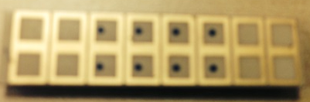
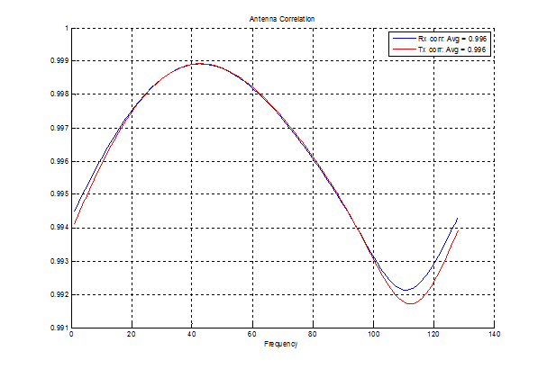
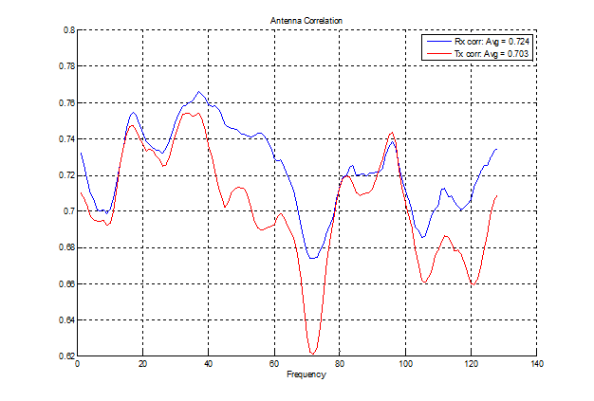
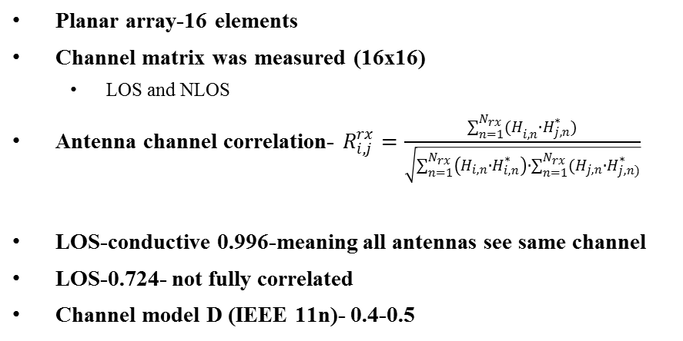
MIMO Channel measurement at 60GHz
LOS-planar array
Planar array-16 elements
Channel matrix was measured (16x16)
  LOS and NLOS
Antenna channel correlation- $R_{i,j}^{rx}=\frac{\sum_{n=1}^{N_{rx}}{{(H}_{i,n}∙H_{j,n}^{∗})}}{\sqrt{\sum_{n=1}^{N_{rx}}{\left(H_{i,n}∙H_{i,n}^{∗}\right)}∙\sum_{n=1}^{N_{rx}}{(H_{j,n}∙H_{j,n)}^{∗}}}}$
LOS-conductive 0.996-meaning all antennas see same channel
LOS-0.724- not fully correlated
Channel model D (IEEE 11n)- 0.4-0.5

