Slide 1
The New Public Phone Service -Non Contact Ultra High Speed Contents Download
Date: 2014/01/21
Authors:
Name | Affiliations | Address | Phone | email
Masashi Shimizu | NTT Corporation | Hikarinooka 1-1, Yokosuka 239-0847 Japan | +81-46-859-3339 | shimizu.masashi@lab.ntt.co.jp
Ken Hiraga | NTT Corporation | Hikarinooka 1-1, Yokosuka 239-0847 Japan | +81-46-859-3339 | hiraga.ken@lab.ntt.co.jp
Kazumitsu Sakamoto | NTT Corporation | Hikarinooka 1-1, Yokosuka 239-0847 Japan | +81-46-859-3339 | sakamoto.kazumitsu@lab.ntt.co.jp
Tomohiro Seki | NTT Corporation | Hikarinooka 1-1, Yokosuka 239-0847 Japan | +81-46-859-3339 | seki.tomohiro@lab.ntt.co.jp
Toshimitsu Tsubaki | NTT Corporation | Hikarinooka 1-1, Yokosuka 239-0847 Japan | +81-46-859-3339 | tsubaki.toshimitsu@lab.ntt.co.jp
Hideki Toshinaga | NTT Corporation | Hikarinooka 1-1, Yokosuka 239-0847 Japan | +81-46-859-3339 | toshinaga.hideki@lab.ntt.co.jp
Tadao Nakagawa | NTT Corporation | Hikarinooka 1-1, Yokosuka 239-0847 Japan | +81-46-859-3339 | nakagawa.tadao@lab.ntt.co.jp

Slide 2
Abstract
This contribution will present the non-contact ultra high speed transmission service over 60-GHz band. With this contribution, it is considered that the 60-GHz band will be useful in non-contact file download kiosk system with up to 24 G bit/s and with over 100 G bit/s using MIMO.
Purpose: Input for discussion on utilizing MIMO over line-of-sight channel for download kiosk application in “beyond ad”.

Slide 3
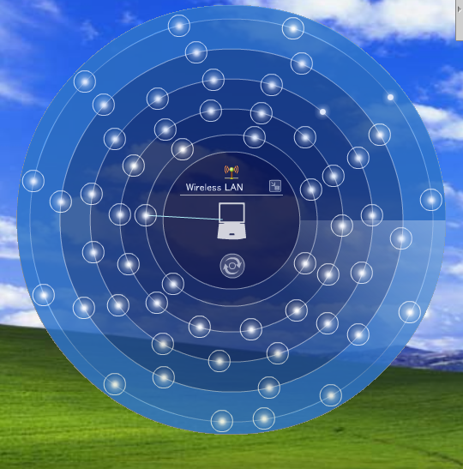
Real WLAN Speed Measurements
9:00 AM at Tokyo Station
LTE Tethering 802.11g
Real Speed was estimated as 2.1Mbps

Slide 4







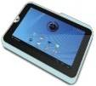
High Speed Data Download Service
NTT must provide carrier grade services.
P-to-P is mandate to keep high transmission rate.
Crowd server
4K Images
Book
Music
Data size is growing up
Movie
Big Data
Photo and Cam
Game
Optical NW
High speed
High Speed
Data rate was defined by the number of users.
Point-to-Point
LTE/3G, WiFi, WiMAX, etc
Reliable communication
(guaranteed quantity)
Point-to-Multipoint

Slide 5









Service roadmap
・At first, Solution for contents provider will launch at 2015.
・Services will expand to public space application.
・Finally we will these services contain anywhere.
Contents Provider
Step３
57,000,000
Subscriber
Platform
Step ２
（Convenience Store:48,000、Station:9300
Public Phone 210,000)
Crowd Server
Cash Files
Any Where!!
NW
Stations
Convenience Stores
Step１
Contents Provider
(Rental Video)
Stations
Public phone
Gas station
Convenience Store
Cash Files
Public
Space
Rental Video
Contents Provider
Cash Files

Slide 6
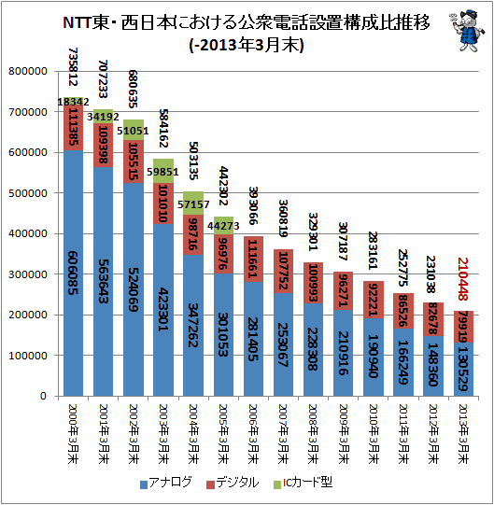
Number of Public Phone
2000~2013
FY 1999
FY 2000
FY 2001
FY 2002
FY 2003
FY 2004
FY 2005
FY 2006
FY 2007
FY 2008
FY 2009
FY 2010
FY 2011
FY 2012
Analog
Digital
Digital (IC-card payment)

Slide 7










Our Target Usage Models
We focus on the usage of millimeter wave communications with ultra short range communication (non contact).
Not only ultra high speed. The Total Contact Time must be less than 1 Second.
【 Rapid Download / Upload】
Public use
Local use
Audio and Video equipment
⇔ mobile terminal
Content Holder
Authentication
Throughput :
> 2Gbps
Throughput :
> 2Gbps
movie
Range :
< 5cm
Home GW
Range :
< 5cm
Kiosk

Slide 8
    Standard Comparison
Our target system concept is similar to TransferJet.
  But data rate is less than 1 Gbps.
Near field Communication
New standard
Throughput (Bps)
10G
Target
802.11ad
1G
TrasferJet Consortium
Promoters (9 Companies)
Sony Corporation
Toshiba Corporation
etc.
Adopters(36 Companies)
NTT Docomo, INC.
KDDI Corporation
etc.
Transfer Jet
100M
～
～
～
ISO14443
～
ISO15693
10cm
1m
10m
Communication Range

Slide 9
Standard Specifications
 | Frequency band | Modulation | Range | Beamforming | IP | Topology | DRM
TransferJet | 4.5 GHz | UWB 560Mbps (max) | < 5cm | Not Required | Not support | P to P | Support ( CPRM etc.)
IEEE 802.11ad | 60 GHz | 1.115Gbps（SC, BPSK） Option: 6.756Gbps（OFDM, 64QAM） | In room gaming,…5m Rapid sync-n-go file transfer…8m Projection to TV or projection in conf. room…8m | Mandatory | Support | AP-based BSS (Basic Service Set) PBSS (Personal BSS)…P to P | Support over IP (DTCP-IP)
Target | 60 GHz | >2Gbps OFDM or SC+FDE | < 5cm | Not Required | Support | P to P | Support

Slide 10
Discussion
  We need a fast link establishment. (about 100 msec or less)
WiGig: Association/Authentication
About 1 sec
Target time
100 msec or less
SD: File System Mount
About 3 sec
Data transmission

Slide 11
Surveillance of Waiting Time for Web Site Response
How long can you wait a response on the web site without stress ?
(%)
 | Average | Men | Women | Age 20’s | Age 30’s | Age40’s
3Sec | 17.0 （17.0） | 20.9 | 12.2 | 22.8 | 14.0 | 14.9
5Sec | 23.8 （40.8） | 25.5 | 21.7 | 18.9 | 23.8 | 29.7
8Sec | 7.5 （48.3） | 5.0 | 10.6 | 7.1 | 7.6 | 7.9
10Sec | 25.0 （73.3） | 25.9 | 23.9 | 26.8 | 27.9 | 17.8
15Sec | 13.3 （86.6） | 11.8 | 15.0 | 12.6 | 11.0 | 17.8
30Sec | 8.0 （94.6） | 7.3 | 8.9 | 6.3 | 10.5 | 5.9
More than 30Sec | 5.5 （100） | 3.6 | 7.8 | 5.5 | 5.2 | 5.9
http://www.citizen.co.jp/research/index.html

Slide 12
Download Time Comparison
Contents | File size | Download time (Sec)
 |  | First Step | Second Step | Transfer Jet | 802.11ac (Draft)
 |  | Read Speed 2 Gbit/s | Read Speed 4 Gbit/s | Real Speed 375 Mbit/s | Read Speed 530 Mbit/s
Book | １ MByte | 0.004 | 0.002 | 0.021 | 0.015
Comic | 30 MByte | 0.12 | 0.06 | 0.64 | 0.45
Magazine | 300 MByte | 1.2 | 0.6 | 6.4 | 4.5
CD | 700 MByte | 2.8 | 1.4 | 14.9 | 10.6
Movie (1hour) | 1.8 GByte | 7.2 | 3.6 | 38.4 | 27.2
Movie (2hour) | 3.6 GByte | 14.4 | 7.2 | 76.8 | 54.3

Slide 13
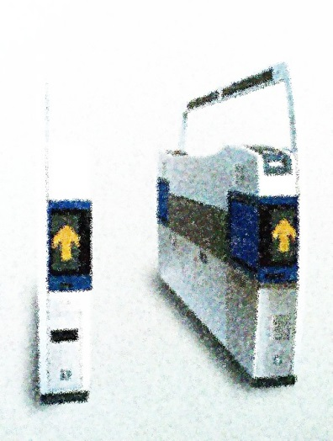

Realization of “Real touch-and-get”
Maximum file sizes allowed in 0.5-sec download
“Real touch-and-get” within 0.5 sec
download with toll-gate
100
Blu-ray Disc
10
1 DVD
File size [GBytes]
<0.5-sec download
1-hr Video
(MPEG2)
1
1 CD
1 Magazine
4 newspapers
100Gbit/s
0.1
2
4
10
40
100
400
1000
Video: Busy toll-gates in the train station
e.g., “http://youtu.be/_r5rjvjquzY”
Transmission rate [Gbit/s]
  With 100 Gbit/s, data sizes of up to a DVD (4.7 GBytes) are downloaded within 0.5 sec.

Slide 14
Transmission rates over 60-GHz band
Rate | Download time for DVD data (4.7 GBytes) | Modulation | No. of frequency channels | MIMO
4.5 Gbit/s | 8.4 sec | 16QAM | 1 | - (SISO)
6.8 Gbit/s | 5.5 sec | 64QAM | 1
27 Gbit/s | 1.4 sec | 64QAM | 4
100 Gbit/s | 0.4 sec | 16QAM | 2 | 16x16
 |  | 64QAM | 1
100 Gbit/s rates are attainable using MIMO
Short-Range MIMO (SR-MIMO)
IEEE802.11ad OFDM PHY
MCS#17: 2.1 Gbit/s (QPSK, Code rate=3/4)
MCS#21: 4.5 G bit/s(16QAM,Code rate=13/16)
MCS#24: 6.8 G bit/s (64QAM,Code rate=13/16)
TX
RX
#1
#1
#2
#2
Line-of-sight
environment
・
・
・
・
・
・
#M
#M

Slide 15
100 Gbit/s performance estimation
Electromagnetic simulation model of transmission channel [1]
OFDM transmission simulation
Parameter | Value
Frequency channel | Ch2 (f_{c}=60.48 GHz), Ch3 (f_{c}=62.64 GHz)
No. of branches | 16 x 16
Transmission distance | D = 10 mm
Element spacing | d = 4.1 mm = 0.82 λ₀ (Optimized for this transmission distance)
MIMO detection | Zero Forcing (ZF)
No. of data subcarriers | 336
Subcarrier spacing | 5.15625 MHz
Modulation | QPSK, 16QAM, 64QAM
23mm
Rx array
Tx array
Microstrip antenna
d
d= 4.1 mm
Frequency channels
D = 10 mm
Ch1
Ch2
Ch3
Ch4
57 GHz
60.48
62.64
66 GHz

Slide 16
100 Gbit/s performance estimation
Simulated bit error rate (BER)
Transmission rates with each modulation
16 x 16 MIMO
Modulation | No. of frequency channels | Transmission rate
QPSK | 1 | 33 Gbit/s
 | 2 | 67 Gbit/s
16QAM | 1 | 72 Gbit/s
 | 2 | 144 Gbit/s
64QAM | 1 | 108 Gbit/s
 | 2 | 216 Gbit/s
Frequency channels in 60-GHz band
Ch1
Ch2
Ch3
Ch4
60.48
62.64
[GHz]
  Over 100 Gbit/s is attainable with 16x16 MIMO using small (23 mm x 23 mm) antenna arrays that can be installed on portable devices.

Slide 17
Capacity enhancement with SR-MIMO
With short-range MIMO transmission, channel capacity is almost in proportion to the number of MIMO branches.
Further capacity is expected.
25x25 MIMO
284 bit/s/Hz
16x16 MIMO
193bit/s/Hz
9x9 MIMO
115 bit/s/Hz
Calculation conditions
Transmission distance: D=1 mm
Element spacing: d = 2.5 mm

Slide 18
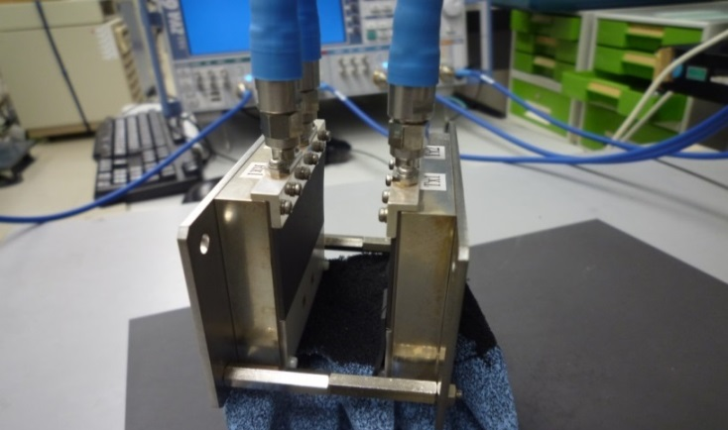
SR-MIMO Channel Measurement
(with 25-GHz scale model)
Measurement setups
Frequency:
24.0GHz - 26.0GHz (The scale model of 2-ch bonding of 60-GHz; Its relative bandwidth is the same as that in 60-GHz.)
Element spacing:
d = 0.500 λ₀, 0.750 λ₀, 1.000 λ₀, 1.125 λ₀, 1.250 λ₀, 1.500 λ₀
(λ₀ is the wavelength, 12.0mm)
Transmission distance:
D = 2.00 λ₀
Antenna element:
Square microstrip antenna (Gain = 5.5 dBi, Beamwidth 74.8°at 25.0 GHz)
Tx array
Rx array
2.0 λ₀
Tx#1
Rx#1
d
Tx#2
Rx#2
Rx array
Tx array
Notes:
Short-range MIMO channel was measured using network analyzer.
Frequency was 25-GHz band as the scale model of 60-GHz band.
Bandwidth is 8 percent, as the scale model of two frequency channels of 802.11ad band.
smoothing 6 %
averaging 128 times

Slide 19
SR-MIMO Channel Measurement
(with 25-GHz scale model)
Modem simulation using the measured SR-MIMO channel shown in the previous page clarified the BER of the short-range MIMO.
Simulation setups
Modulation：OFDM（QPSK，16QAM，64QAM）
Subcarrier spacing：2.13MHz
No. of subcarriers：355
Center frequency: 24.6 GHz (Ch1) and 25.4 GHz (Ch2)
SNR required for BER < 10⁻³
BER curve (d = 1.000 λ₀)
Optimum element spacing is d = 1.000 λ₀
Notes:
Scale model of
QPSK: 2.1 Gbit/s * 2channels * 2branches = 8.4 Gbit/s
16QAM: 4.5 Gbit/s * 2channels * 2branches = 18 Gbit/s
64 QAM: 6.8 Gbit/s * 2channels * 2branches = 27.2 Gbit/s
Actual bitrate
QPSK: 2.1 Gbit/s * 2channels * 2branches *25/60 = 3.5Gbit/s

Slide 20
Summary of 100 G bit/s over 60-GHz band using short-range MIMO
Channel capacities of over 100 Gbit/s are attainable using MIMO at 60-GHz band
With 100 Gbit/s, data sizes of up to a DVD (4.7 GBytes) are downloaded within 0.5 sec.
  → “Real touch-and-get” will be realized.

Slide 21
References
[1]Hiraga, K.; Seki, T.; Nishimori, K.; Nishikawa, K.; Uehara, K., "Ultra-high-speed transmission over millimeter-wave using microstrip antenna array," Radio and Wireless Symposium (RWS), 2010 IEEE , vol., no., pp.673,676, 10-14 Jan. 2010.

Slide 22
Backup

Slide 23
Regulation will be Changed
EIRP
  47dB antenna with 10mW output power. Low gain antenna was not assumed. It will be changed keeping same EIRP.
Channel Bonding
  Now, channel band width was less than 2.15GHz. It is not arrowed Channel bonding. It will be changed.
Certifications formulation
  More easy process to have certification

Slide 24
Public kiosks with downloadable movies, such as at an airport, are a great way.
to make movies available to users with portable devices
• At multi-gigabit download speeds, a user can download an uncompressed, HD movie in one minute, or on the way to an airport gate before boarding.
• The kiosk can support multiple simultaneous transfers, which means even less time waiting in line.

Slide 25
Concept of short-range MIMO (SR-MIMO)
(a) General MIMO
(b) SR-MIMO
TX
RX
TX
RX
#1
#1
#1
#1
#2
#2
#2
#2
Multipath-rich
environment
Line-of-sight
environment
・
・
・
・
・
・
・
・
・
・
・
・
#M
#M
#M
#M
Low spatial correlation is achieved without multipath propagation
because path length differences is exploited

Slide 26
Further advantage of SR-MIMO
We have clarified that the channel capacity obtained by zero forcing (ZF) at the receiver which does not use beam forming at the transmitter and channel state feedback is almost the same as that using eigenmode transmission when the element spacing is optimized.[1]
Hence transceiver’s transmission signal processing cost for MIMO detection will be reduced compared with eigenmode transmission.

Slide 27
SR-MIMO Channel Measurement
(with 25-GHz scale model)
Measured frequency response (d = 1.000 λ₀)
Ch1
Ch2
Ch1
Ch2

Slide 28
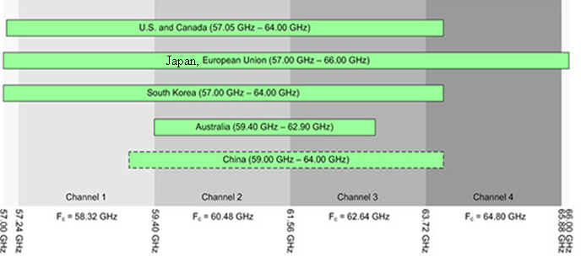
Frequency of scale model measurement
Actual 60-GHz band
2-ch bonding
Scale model
at 25-GHz band
24.561GHz
25.0GHz
25.439GHz

