Slide 1
Consideration on System Level Simulation
Date: 2014-01-20
Authors:

Slide 2
Introduction
In simulation scenarios document [1], we defined five simulation scenarios to enable verification of the proposed HEW technologies performance in different environment
In outdoor large BSS hotspot scenario, followings are expected
  Channel variation and longer inter-cite distance (ICD) than other scenarios
    Possibility of degraded system throughput from selecting low MCSs
  Relatively higher AP transmit power than other scenarios
    Possibility of turning off multi-BSSs Tx opportunity
In this contribution, we provide preliminary evaluation results based on [1] and some consideration points to evaluate this scenario

Slide 3
Parameters on simulation scenario
Other default parameters: [1]
Simulation scenario (Channel model) | Scenario-4 (UMi), Indoor user portion: 0%
Environment description | 19 hexagonal grid with ICD = 130m (Wrap around off)
STAs type | 2.4GHz, 50 STAs in a BSS
BW | 20MHz (64 FFT)
Data size | 1ms TXOP less fixed overhead Overhead (RTS/CTS off): SIFS + ACK + 2*PLCP header Overhead (RTS/CTS on): 3*SIFS + RTS + CTS + ACK + 4*PLCP header
GI | Long (0.8 us)
APs location | Place APs on the center of each BSS with 0 standard deviation (fixed) AP height: 10m, STA height: 1.5m [2]
AP & STA TX power | (AP, STA) = Case-1(30dBm, 15dBm), Case-2(23dBm, 15dBm), Case-3(15dBm, 15dBm)
Noise figure | 7dB for both DL and UL
Antennas for AP & STA | 2 by 2 with STBC for both links (1-stream)
Max # of retries | 10
DL & UL traffic | Full buffer (DL & UL ratio: based on PHY system simulation in [3])

Slide 4
Evaluation methodology:
PHY system simulation [3]
Simulation assumptions
  Time aligned TXOPs among BSSs
  Link adaptation
    MCS selection based on estimated SNR of the last frame, and modified by ACK statistics [1]
    No transmission mode selection
  A subset of MAC features
    CCA level
      Preamble detection: -82dBm (both AP and STA)
      Energy detection: -62dBm (both AP and STA)
    RTS/CTS on/off (Used for CCA comparison. No actual Tx)
    Fixed amount of overhead (assuming MCS0 simply)
      Without RTS/CTS: 29 symbols
      With RTS/CTS: 69 symbols
  PHY abstraction: MMIB [4] with extension to 256QAM ¾ (MCS8)

Slide 5
Multi-BSSs idle/busy decision to TX
Idle/busy state based on CCA
  Check interfering signal power from all BSSs to exceed CCA threshold value
  Any BSS which exceeds the threshold is set to busy state to TX
Procedure with RTS/CTS
  Simulation assumption: Each TXOP contains one data packet (RTS/CTS + Data + ACK)
  In a TXOP, any BSS which hears interfering signal from neighbor BSSs to exceed CCA threshold value in either DL or UL link is set to busy state to TX

Slide 6
Performance results – RTS/CTS off
Tx power (dBm) (AP, STA) | DL Tput (Mbps) | DL packet loss (%) | MCS portion (%) (MCS0, MCS8) | UL Tput (Mbps) | UL packet loss (%) | MCS portion (%) (MCS0, MCS8) | DL:UL Tx ratio (%) | Total Tput (Mbps) | Total packet loss (%) | BSS idle portion (%) *
Case-1 | 4.5 | 1.5 | (45, 41) | 5.72 | 3.52 | (53, 16) | 20:80 | 10.22 | 3.02 | 5.62
Case-2 | 3.92 | 2.29 | (56, 21) | 5.94 | 1.8 | (57, 13) | 32:68 | 9.86 | 1.97 | 0.74
Case-3 | 2.57 | 3.0 | (64, 14) | 6.53 | 0.975 | (59, 10) | 32:68 | 9.1 | 1.6 | 0.2
*: Average portion that all devices in a BSS is idle
Observation
Higher UL Tx portion makes higher UL Tput than DL
BSS idle portion is very low
  System gets high Tx opportunity not critically depending on AP power variation
  But, low MCSs (especially MCS0) are used as more than a half of portion (difficult of getting high throughput)
  => Total system throughput can be limited by the used MCS distribution
  : Necessity of some clear channel protection

Slide 7
MCS distribution – RTS/CTS off
<Used MCSs in DL>
<Used MCSs in UL>
MCS0 is a dominant MCS to be used in the simulation
  Including very low estimated SINR condition (assuming no minimum MCS requirement)

Slide 8
Performance results – RTS/CTS on
Tx power (dBm) (AP, STA) | DL Tput (Mbps) | DL packet loss (%) | MCS portion (%) (MCS0, MCS8) | UL Tput (Mbps) | UL packet loss (%) | MCS portion (%) (MCS0, MCS8) | DL:UL Tx ratio (%) | Total Tput (Mbps) | Total packet loss (%) | BSS idle portion (%)
Case-1 | 7.5 | 0.48 | (13, 82) | 4.81 | 1.97 | (28, 56) | 50:50 | 12.31 | 1.17 | 68.23
Case-2 | 11.2 | 1.19 | (17, 71) | 7.94 | 2.08 | (28, 52) | 50:50 | 19.14 | 1.61 | 42.02
Case-3 | 9.46 | 1.67 | (23, 59) | 10.1 | 1.61 | (20, 63) | 50:50 | 19.56 | 1.64 | 41.76
Observation
Higher MCS portion becomes larger than that without RTS/CTS
  - Total system Tput is enhanced (about 20 ~ 95%), even in significant BSS idle condition
As AP Tx power is getting down,
  Both DL and UL Tput increase (some cross point exists in DL case)
  High BSS idle situation is getting relaxed
  Strong AP power could turn off other BSS Tx opportunity
  : Necessity of AP power alleviation

Slide 9
MCS distribution – RTS/CTS on
<Used MCSs in DL>
<Used MCSs in UL>
MCS8 is a dominant MCS to be used in the simulation
  Because of reliable Tx condition by RTS/CTS protection
  Possibility of using more increased MCS (FFS)

Slide 10
Summary
Consideration points from our system simulation results on scenario-4
  Point-1: MCS distribution
    Higher MCSs are used, more increased system throughput is expected
    In multi-BSS environment, using channel protection like RTS/CTS can make those condition more guaranteed (currently we have ‘RTS/CTS threshold [TBD]’ in [1])
  Point-2: AP power alleviation
    High AP power in a BSS can turn-off other BSS’s Tx opportunity
    From the system performance point of view, some AP power calibration may be considerable (e.g. from 30dBm to 23dBm or less)
Next steps
  Checking on some modification in the simulation scenario document, if needed
  More verifying the results and finding out calibration points of other simulation scenarios

Slide 11
Reference
[1] 13/1001r5, “Simulation Scenarios Document Template”, Simone Merlin (Qualcomm)
[2] 13/1383, “System Level Simulation Parameters”, Wookbong Lee (LG Electronics)
[3] 13/1051r1, “Evaluation Methodology ”, Ron Porat (Broadcom)
[4] 13/1059, “PHY Abstraction for HEW Evaluation Methodology, Dongguk Lim (LG Electronics)

Slide 12
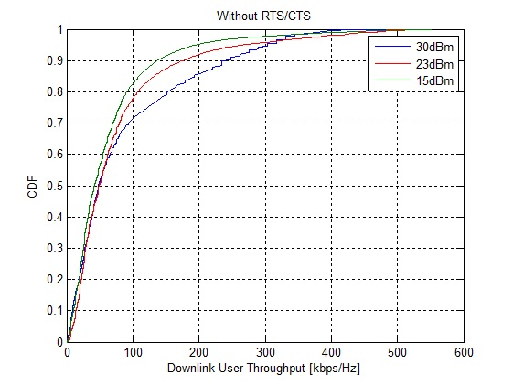
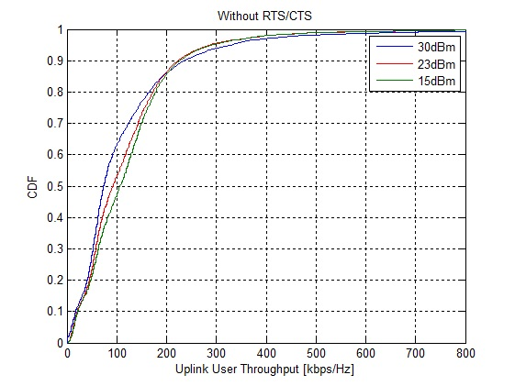
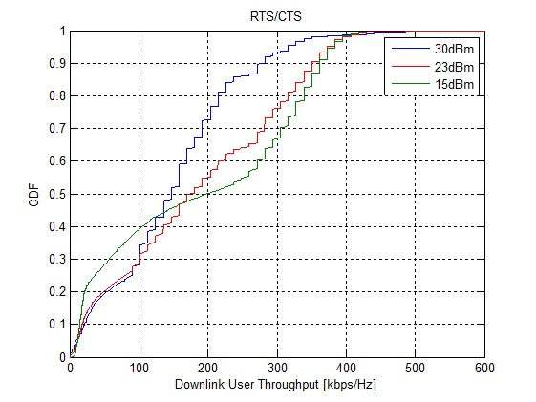
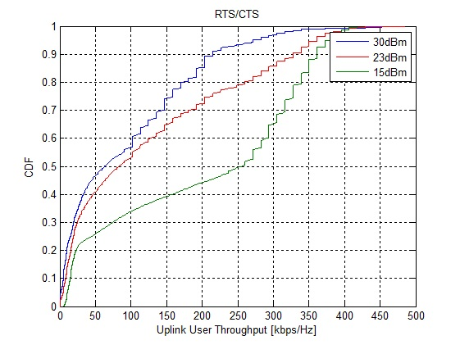
Appendix: User throughput distribution

