Slide 1
Comments on 802.11 HEW Draft
PAR & 5C Document
Date: 2014-01-20
Authors:

Slide 2
Abstract
This document provides some comments on the 802.11 HEW Draft PAR & 5C Document based on 13/1410r3.

Slide 3
Commented Topics
Quantified throughput improvement
Power Efficiency
Bands and Backward Compatibility
Use of the term "User Experience”

Slide 4
Quantified throughput improvement

Slide 5
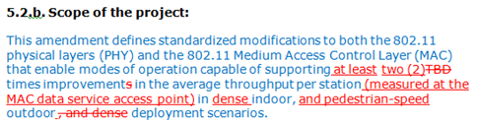
Comment on Throughput Improvement
Current text in 13/1410r3 reads
Next, let us consider what one possible solution to 2x improvement in throughput might look like?

Slide 6
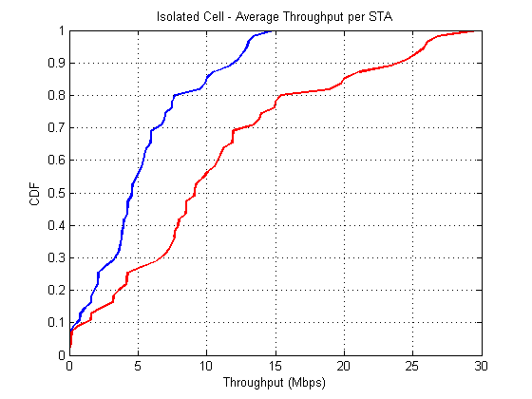
What would 2x Improvement in Average Throughput per STA mean?
Large improvements for users in with large throughputs
2x Improvement
Also see Josiam et.al, 13/1401
“Outdoor System Level Assessment for HEW SG”
5 %ile throughput still close to zero
Might still not fully address the consensus of providing an improved user experience to all STAs.

Slide 7
How to capture the improvement of overall throughput
- especially the 5percentile figure
Desirable shape for STA Throughput CDF, i.e. smaller variance in the throughput figures.
(Curve is for illustration purposes only)
Improvement in 5 %ile throughput (at the expense of 95%ile throughput)

Slide 8
Possible PAR Language to capture throughput improvement
Propose to modify text in the Project scope to capture “fairness”
Proposed text for Project Scope:
… enable modes of operation capable of supporting at least two (2) times improvement in the average throughput per station (measured at the MAC data service access point) in dense indoor, and pedestrian-speed outdoor deployment scenarios, while improving throughput fairness
Proposed text for Explanatory notes.
One way to quantify fairness objectively could be to add the following text:
“the 5 percentile user throughput to be no smaller than y% of the average throughput in the network”

Slide 9
Power Efficiency

Slide 10
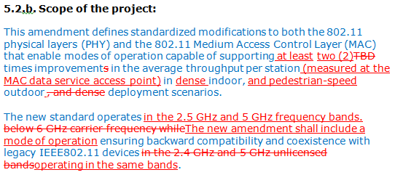
Comment on Power Efficiency
Current text for Proposed Scope in 13/1410r3 does not address power efficiency at all
Power efficiency is becoming an increasingly important metric in the design and specification of wireless systems.
Propose to include language in the PAR scope to capture power efficiency.

Slide 11
Suggestions for Language for Power Efficiency (Scope Section)
The following text is proposed for inclusion in the Scope Section (as an increment to the text in 13/1410r3)
… enable modes of operation capable of supporting at least two (2) times improvement in the average throughput per station (measured at the MAC data service access point) in dense indoor, and pedestrian-speed outdoor deployment scenarios, while improving throughput fairness and power efficiency.

Slide 12
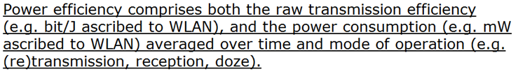
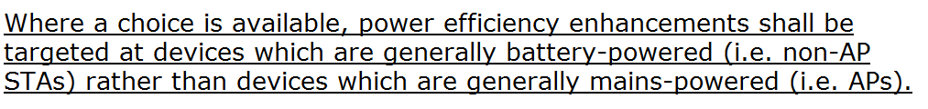
Suggestions for Language for Power Efficiency (Explanatory Notes Section)
The following text is proposed for inclusion in the Explanatory Notes Section (increment to 13/1410r3) to emphasize looking beyond PHY transmission alone
To emphasize client efficiency, we propose adding:

Slide 13
Bands and
Backward compatibility

Slide 14

Comment on Backward Compatibility
The current suggestion in 13/1410r3 on BC reads:
Comment: Above text discourages solutions that are able to provide backward compatibility in more than one mode. Further, it limits the operation to 2.4 and 5 GHz only.

Slide 15
Suggested Text for Backward Compatibility
We propose to amend the text in 13/1410r3 as follows:
The new standard operates in the 2.5 GHz and 5 GHz below 6 GHz carrier frequency bands. The new amendment shall include a mode of operation ensuring address backward compatibility and coexistence with legacy IEEE802.11 devices operating in the same bands.

Slide 16
User Experience

Slide 17
Straw poll:
Does the group agree to modify the current PAR language on the bands of operation as follows?
In the scope:
The new standard operates below 6 GHz carrier frequency.
In the explanatory notes:
The group will focus primarily on 2.4 and 5GHz.
Results:
In Favor: 49; Opposed: 42; Abstain: 37

Slide 18
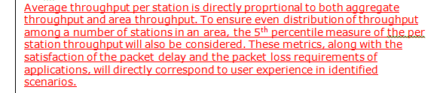
Comment on the use of the term
“User Experience” (1 of 2)
There are two occurrences of the term “User Experience” in the PAR section of the current draft (13/1410r3) .
In the Explanatory Notes (Section 8.1), the current text reads:

Slide 19
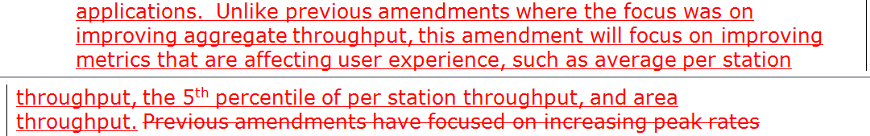
Comment on the use of the term
“User Experience” (2 of 2)
The text in the “Need for the Project” (Section 5.5) reads:
Comment: The use of the term in both instance, appears to be an attempt to define the term “User Experience”. However, on both instances it can be said that the explanation is different, if not contradictory.

Slide 20
Comment Resolution Proposal
Well understood, clearly defined and explicitly measurable metrics like packet delay, 5%ile throughput etc. are already used in the Scope, Purpose and explanatory notes sections. By adding language containing “user experience”, what additional aspects/dimensions are we trying to capture?
Avoid including terms in the PAR for which we have no clear definition. Recommend proceeding as follows:
Option 1: Make an attempt to define the term unambiguously in the explanatory notes.
Option 2: Consider removing these terms form the PAR section of the document (use of these term in the 5 Criteria section seems to be OK)

Slide 21
Thank you!

