Slide 1
Intra-Vehicle Channel Model
Date: 20-Jan-2014
Authors:

Slide 2
Abstract
In this submission the wireless channel inside a vehicle is discussed.

Slide 3
Introduction
Wireless LAN is becoming a leading standard in vehicular communications
  Many vehicle models today have a built in WLAN communication
    WLAN is present in virtually every consumer electronic device
    Vehicle manufacturers adapt the vehicles to the changes in consumer electronics
    WLAN is used in intra-vehicle infotainment systems
    WLAN can also be used for vehicular sensor linking
The number of vehicle models equipped with WLAN is constantly increasing

Slide 4
WLAN in the Vehicle – Channel Perspective
The vehicular environment posts some unique challenges for WLAN systems aiming at providing top performance
WLAN can be used in three vehicular scenarios:
  Intra-vehicle communication – mainly for infotainment
  Inter-vehicle communication such as multimedia, mesh networking
  Vehicle to infrastructure
In this submission the intra-vehicle 2.4GHz wireless channel will be discussed
Notes:
WLAN channel models were created for indoor applications
Antenna correlation matrices - ????????

Slide 5
Intra-Vehicle Wireless Channel Measurements Setup
The wireless channel measurements were performed using the following equipment:
  GM SUV vehicle
  Agilent PNA N5242A network analyser
  4 omni-directional WiFi antennas in a 2x2 configuration
In this setup there was no driver / passengers in the vehicle

Slide 6
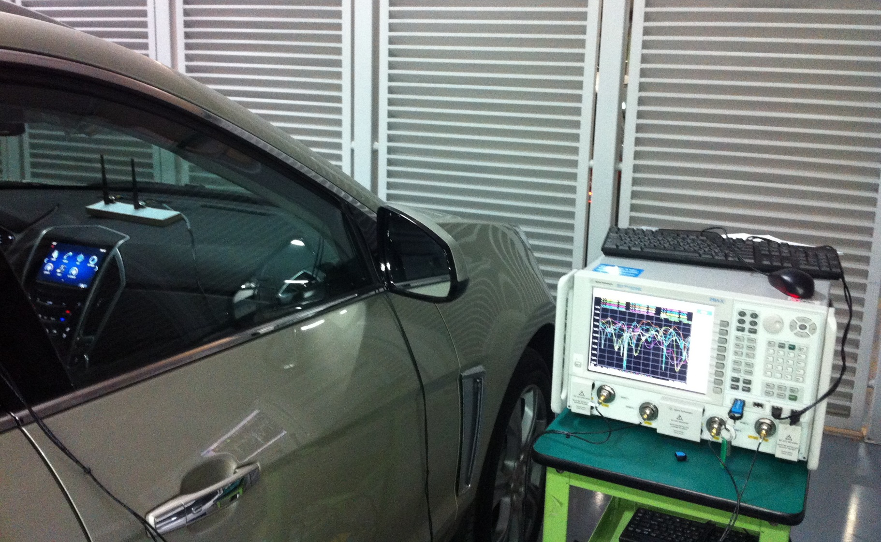
Intra-Vehicle Wireless Channel Measurements Setup

Slide 7
Intra-Vehicle Wireless Channel Measurements Locations
Front of the vehicle |  | Rear of the vehicle
1, 2, 3 | Dashboard height | A, B, C, D | Rear passenger head height
4, 5, 6, 7 | Kick Panels (Low behind dashboard) | E, F, G, H | Rear passenger seat height
 |  | I, J, K, L | Rear passenger foot height
 |  | M, N, O, P | Trunk floor height
All possible rear-front combinations were measured (112 measurements)

Slide 8
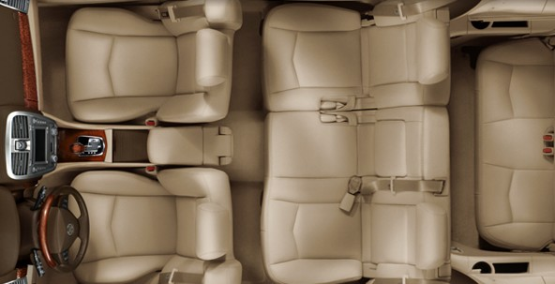
Intra-Vehicle Wireless Channel Measurements Locations
1
4
I
E
A
M
O
J
B
5
F
Trunk
2
6
K
G
C
N
P
3
L
H
D
7

Slide 9
Intra-Vehicle Wireless Channel Path Loss

Slide 10
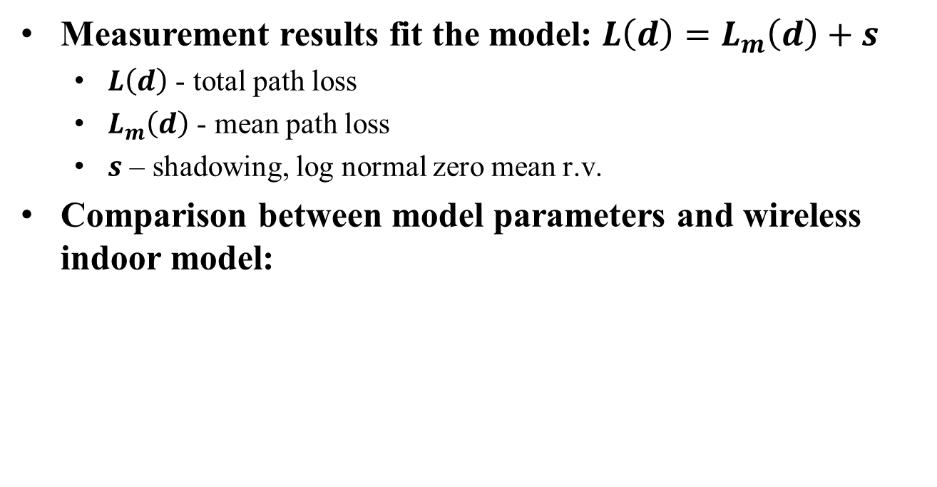
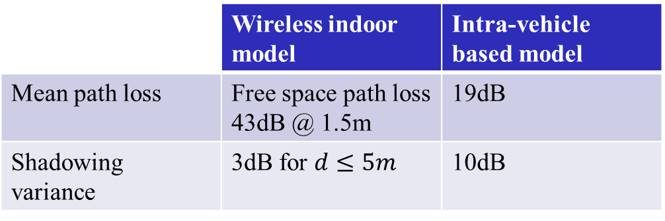
Intra-Vehicle Wireless Channel Path Loss
Measurement results fit the model: $L\left(d\right)=L_{m}\left(d\right)+s$
  $L\left(d\right)$ - total path loss
  $L_{m}\left(d\right)$ - mean path loss
  $s$ – shadowing, log normal zero mean r.v.
Comparison between model parameters and wireless indoor model:
 | Wireless indoor model | Intra-vehicle based model
Mean path loss | Free space path loss 43dB @ 1.5m | 19dB
Shadowing variance | 3dB for $d≤5m$ | 10dB

Slide 11
Intra-Vehicle Wireless Channel Delay Spread

Slide 12
Intra-Vehicle Wireless Channel Path Loss
RMS channel delay spread: 22ns
No clustering effect was seen
 | Wireless indoor model | Intra-vehicle based model
RMS channel delay spread | 40ns – 600ns for one cluster | 22ns

Slide 13
Intra-Vehicle MIMO Channel Matrix Condition Number and Rank
All of the measured 2x2 MIMO channel matrices have a rank of 2
The channel matrix’s condition number varies significantly between bands and within bands.
  Based on the measurements the condition number varies between 0dB to 30dB

Slide 14
Intra-Vehicle Wireless Channel Matrix Condition Number and Rank

Slide 15
Intra-Vehicle Wireless Channel
Discussion
The RX power of an intra-vehicle WLAN system is strong relative to indoor scenarios
  Initial measurements of inter-vehicle interference suggest RX SNR of about 30dB
The intra-vehicle channel delay spread is very short, thus it is possible to shorten the CP and gain efficiency
It is theoretically possible to achieve full 2x2 MIMO, however due to large changes in the streams’ power it is hard to implement practically. Addressing this issue, especially in a non Rx power limited environment can increase performance.

