Slide 1
Improved Spatial Reuse Feasibility – Part II
Date: 2014-01-20
Authors:

Slide 2
Introduction
In 802.11-14/0082r0 (“Improved Spatial Reuse Feasibility – Part I”) we provided initial PHY system simulation results
In this follow-up presentation, we provide further detail on two topics:
Summation of wall and floor losses
MCS selection

Slide 3
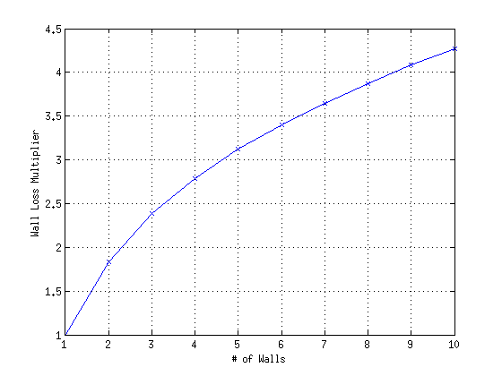
Summation of Wall & Floor Losses
Literature suggests that summation of losses is sub-linear [1][2]
From COST 231, loss from N floors is N^((N+2)/(N+1)-0.46) * K, where K is the floor loss
Important to note that wall/floor loss factors are not measured physical wall losses, but instead are coefficients chosen to fit measurement data

Slide 4
Summation of Wall & Floor Losses (2)
Compare 2 different methods:
Sub-linear summation of wall losses, sub-linear summation of floor losses, linear summation of total wall and total floor
Sub-linear summation of all losses, with 14.5 dB per wall and floor
Method requires single coefficient for wall and floor loss
If wall=floor loss, L₁ > L₂
Method 1 used in earlier presentation (802.11-14/0082r0)

Slide 5
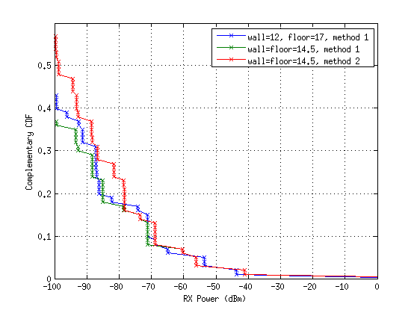
RX Power CDF
CDF of RX power at middle AP (center of middle floor) from other AP’s, assuming 23 dBm TX power
# of AP’s above -90 significantly larger for method 2 compared to method 1

Slide 6
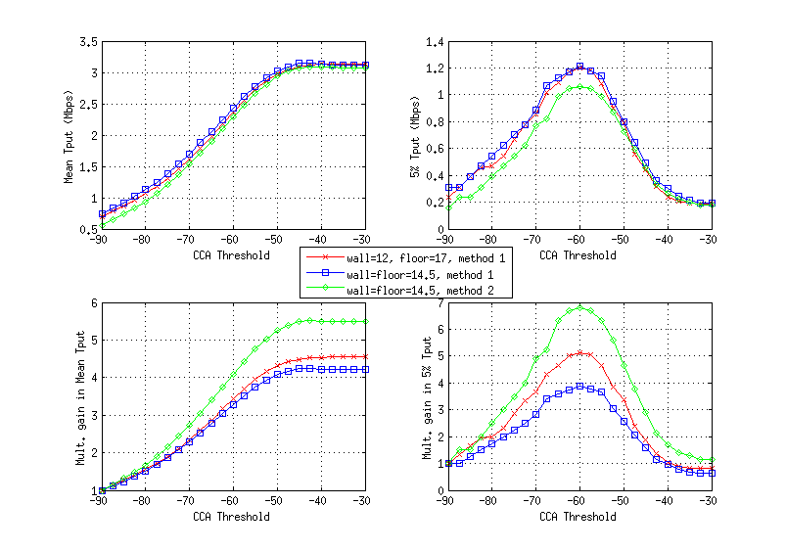
Penetration Loss Summation - Results
50/50 DL/UL traffic, random AP, 1 channel
Smaller penetration loss for method 2 leads to higher interference, and lower absolute throughput
Throughput difference is particularly large with -90 dBm threshold, due to the large difference in # of nodes seen above -90 dBm
Smaller throughput difference when CCA threshold is higher
Large throughput difference with -90 dBm threshold leads to large difference in multiplicative gain

Slide 7
Proposal
For scenario 1, we feel that wall and floor losses are similar, and so we feel method 2 (sub-linear summation of all losses) is appropriate
Scenario 2 (enterprise, wireless office) currently only has a single floor (with 8 x 64 STA’s) and 7 dB cubicle wall loss. We feel this scenario should be extended to multi-floor, in which case floor and wall (cubicle) losses will be quite different and thus method 1 is needed

Slide 8
MCS Selection (from Part I)
Required SNR per MCS defined by Shannon capacity with 7 dB gap (4 dB from BCC, 3 dB implementation loss):
Genie MCS: find highest MCS supportable based on per-TX event SINR
Fixed MCS: MCS for a flow is the MCS supportable with SNR = (interference-free SNR –margin)
With genie MCS, a flow can have a different MCS for different TX events. Throughput is the rate averaged across all TX events.
With fixed MCS, a flow has the same MCS for every TX event (within a drop). Throughput is defined as the goodput = TX rate of assigned MCS X success probability of assigned MCS
MCS | 0 | 1 | 2 | 3 | 4 | 5 | 6 | 7 | 8 | 9
SNR (dB) | 3.2 | 7.0 | 9.6 | 11.8 | 15.5 | 18.8 | 20.4 | 21.9 | 25.0 | 27.0

Slide 9
Alternative MCS Selection Schemes
Genie MCS is overly optimistic because it presumes knowledge of the instantaneous SINR.
Choosing MCS based on interference-free SNR is overly pessimistic and not sufficiently adaptive
Objective is to find an MCS selection scheme that is simple yet realistic
Consider two SINR statistics based MCS selection schemes:
Goodput-maximizing MCS: based on flow’s SINR statistics, find MCS that maximizes goodput=(1-PER)*rate
10% PER MCS: find highest MCS such that PER <= 10%
For both schemes, a particular flow uses a single MCS for all TX events within a drop

Slide 10
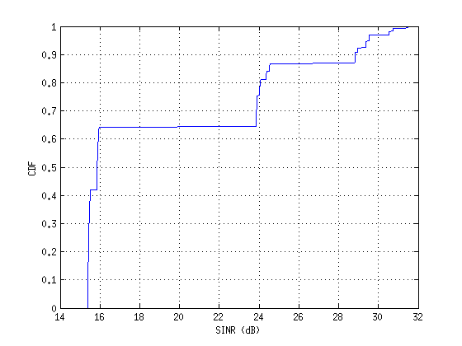
MCS Selection Example
Consider single AP->STA flow, for network with -55 dBm interference threhsold
Link was active in 625 out of 1000 TX events
SINR distribution during those 625 TX events shown below right
PER and goodput per MCS (assuming cliff wall PER curves):
Selected MCS and average rate of different methods:
MCS | 0 | 1 | 2 | 3 | 4 | 5 | 6 | 7 | 8
Rate (Mbps) | 6.5 | 13.0 | 19.5 | 26.0 | 39.0 | 52.0 | 58.5 | 65.0 | 78.0
PER | 0.00 | 0.00 | 0.00 | 0.00 | 0.30 | 0.64 | 0.64 | 0.64 | 0.87
Goodput | 6.5 | 13 | 19.5 | 26 | 27.3 | 18.6 | 20.8 | 23.2 | 10.4
Method | MCS | Avg. Rate
Genie | various | 46.1
Goodput-max | 4 | 27.3
SNR-based | 8 | 10.4
10% PER | 3 | 26

Slide 11
MCS Selection Warmup Period
Goodput-max and 10%PER methods require knowledge of SINR and/or PER per MCS statistics to determine MCS
Statistics can be based on:
All TX events in a drop
Warmup period: first X TX events (per flow) in a drop, e.g., with X = 50

Slide 12
Comparison of MCS Selection Schemes
Random AP placement, 1 channel, 100% DL traffic
Compare following schemes:
Genie MCS
Fixed MCS based on interference-free SNR with 6 dB margin
Always selects MCS8 due to very high interference-free SNR
Goodput-max MCS
Based on all TX events
Based on 50 event warmup period
10% PER MCS
Based on all TX events
Based on 50 event warmup period

Slide 13
Comparison of MCS Selection Schemes (2)

Slide 14
Observations
Ordering in terms of absolute throughput and multiplicative gain:
Genie > goodput-max > 10% PER > Int-free SNR
All schemes give same baseline (-90 dBm threshold) results
All active links operate at MCS8
SNR-based MCS selection performs very poorly in terms of mean and 5% tput with high CCA threshold
Compared to goodput-max MCS, 10% PER MCS gives reasonable mean throughput but significantly lower 5% tput with high CCA
No noticeable difference between goodput-max MCS using warmup versus using all TX events
See same behavior for other combinations of central/random AP, 1 vs. 3 channels, DL vs DL/UL traffic

Slide 15
Proposal
Use goodput-maximizing MCS as baseline MCS selection method
Achieves the desired balance of simplicity and realism

Slide 16
References
[1] “Digital mobile radio towards future generation systems, final report,” COST Action 231, European Communities, EUR 18957, Tech. Rep., 1999.
[2] Zyoud et. al., Comparison of Empirical Indoor Propagation methodls for 4G Wireless Networks at 2.6 GHz, Int. Conf. on Control, Engineering, & Information Technology

