Slide 1
Improved Spatial Reuse Feasibility – Part I
Date: 2014-01-20
Authors:

Slide 2
Background
During 11ac we investigated the appropriate value for CCA levels in secondary channels [1]. The value ended up at the mid point between aggressive (high) value close to ED level and a conservative (low) value close to the primary channel level [-62,-72,-82].
In this contribution we take a step back and investigate the optimal CCA value for the primary channel that maximizes the average throughput for dense deployments. In particular we use a PHY system simulation to examine the average and 5 percentile throughput in scenario 1 of [2].
The underlying mode of operation uses the concept of BSS color introduced in 11ah:
Each BSS has a different color (TBD bits) that enables STA to know (with high probability) whether the transmission is within their BSS or not after decoding the SIG field.
Transmissions within the BSS are deferred to at the lowest possible level in order to on one hand side provide the lowest sensitivity and on the other hand side prevent intra-BSS multiple unsynchronized transmissions (which are bound to be unsuccessful)
Transmissions that are perceived to belong to an OBSS (different color) are deferred to based on the CCA value (in 11ah 3 values of CCA levels exist).
With that type of operation, the CCA level functions as a simple OBSS spatial reuse factor – high value leads to high spatial reuse, large number of concurrent transmissions, potentially high average throughput in dense environment but also reduced average

Slide 3
Cont. - Outline
SINR per link.
Low value leads to low spatial reuse, sometime referred to noise limited operation but also high SINR per link. This is the mode of operation for 802.11 systems today as the current value of -82dBm in the spec is based on what was perceived in 11a as the practical detection threshold. The actual detection threshold is lower and we have used -90dBm in the simulations as the minimum investigated value.
The tradeoff between many links operating at medium SINR and few links operating at high SINR needs to be studied in many environments (those defined for HEW in [2] but also others less dense), several low and high MIMO configurations and include all PHY/MAC techniques to verify that gains in one case are not losses in another.
In all, we believe substantial amount of simulations will be required to ascertain the gains/losses in all device configurations / deployment scenarios and a fast simulation is critical.
Part I of this contribution explains in detail (sufficient for other companies to replicate results) the PHY system simulation we use, the performance metrics and proceeds to provide few simulation results.
Part II of this contribution adds research into several parameters, channels and configurations and provides more insight.

Slide 4
High-Level Description of Simulation
Drop: place AP’s and STA’s, according to scenario (and any specified spatial distributions)
TX event: determine set of active TX nodes and RX SINR based on that set
For a single drop, run many TX events and compute a per-flow throughput
Flow is either uplink from a STA or downlink to a STA. Total # of flows = 2 * # STA’s
Perform above across many drops to get averaging across spatial distribution

Slide 5
Further Details of Drop Procedure
Drop AP’s and STA’s according to scenario (random and/or deterministic placement)
Ensure that every STA <-> associated AP link can sustain MCS0 (or another predetermined MCS) in both directions. If not, re-drop STA.
Channel for every link in network determined by distance-based PL, shadowing, wall/floor loss, and multipath model
Independent shadowing for every TX-RX link
Deterministic values for wall & floor loss
Total penetration loss = f(# of walls traversed)* wall_loss + f(# floors traversed) * floor_loss
F() is a sub-linear function detailed later in slides
# of walls traversed = # traversed in x direction + # traversed in y direction, so diagonally opposite apartments are separated by 2 walls
Once drop has been made, for link between every pair of devices in the building have:
PL value, with PL value accounting for shadowing and penetration losses
Multipath channel
No time variation of channels, i.e., for each drop the channels are all completely fixed

Slide 6
Further Details of TX Event
Initialize visited BSS set as empty.
Randomly select an un-visited BSS
Identify potential TX/RX pair in selected BSS: Randomly determine downlink/uplink according to downlink probability, and randomly select one of STA’s in selected BSS
Check interference level from already activated TX’s at potential TX device
Sum power in linear domain across interferers and tones, and average (in linear domain) across RX antennas to get aggregate interference
If interference <= threshold, activate link and add potential TX to set of already activated TX’s
If interference > threshold, do not activate.
Continue above until every BSS has been tried once.
Once complete, the set of active TX nodes in the current TX event has been determined.
For each TX event, visit BSS’s in a random order -> thereby leading to possibly different active TX set for each TX event

Slide 7
SINR Computation
Determine per-RX effective SINR based on active TX set:
Per-tone SINR computed by linearly summing power over interferers:
where S_{k} is signal power on tone k and I_{l,k} is the power from the l-th interferer (out of L) on tone k, with S_{k} and I_{l,k} both capturing RX filtering, PL, shadowing, multipath, and TX power for all STA to STA pairs.
Effective SINR computed by averaging per-tone Shannon capacity, and then inverting capacity formula

Slide 8
MCS Selection
Required SNR per MCS defined by Shannon capacity with 7 dB gap (4 dB from BCC, 3 dB implementation loss):
MCS selection. The current EM document [3] discusses two options
Fixed MCS: MCS for a flow is the MCS supportable with SNR = interference-free SNR –margin
Genie MCS: find highest MCS supportable based on per-TX event SINR
In part I we focus on genie MCS and in part II we explore several MCS adaptation
schemes
With genie MCS, a flow can have a different MCS for different TX events. Throughput is the rate averaged across all TX events.
With fixed MCS, a flow has the same MCS for every TX event (within a drop). Throughput is defined as the goodput = rate of assigned MCS times fraction of TX events where the SINR was higher than the minimum required for that MCS.
MCS | 0 | 1 | 2 | 3 | 4 | 5 | 6 | 7 | 8 | 9
SNR (dB) | 3.2 | 7.0 | 9.6 | 11.8 | 15.5 | 18.8 | 20.4 | 21.9 | 25.0 | 27.0

Slide 9
Performance Metrics
Each drop yields one throughput value per flow, e.g., single drop in scenario 1 (100 apartment) yields 200 throughput values (100 downlink & 100 uplink)
Sufficient # of TX events should be run so that each of the per-flow throughput values has reasonably converged
Throughput values concatenated across drops, from which following metrics are computed:
Mean throughput
5% throughput
Throughput is long-term averaged, so accounts for percentage of time each flow is active
Example: 10 drops with 2000 TX events per drop
For each drop there are 100 DL throughputs & 100 UL throughputs
Concatenate all 1000 DL throughputs and 1000 UL throughputs, and compute mean DL and UL, and 5% DL and 5% UL

Slide 10
Simulation Parameters
5 floor building with 2x10 apartments per floor, 10m x 10m x 3m apartments
5 STA’s per apartment, randomly located
AWGN for baseline and 11nB model for PL, shadowing, and multipath:
PL: free space until breakpoint distance of 5 meters, exponent of 3.5 after breakpoint distance
4 dB shadow fading std. deviation
Penetration losses: 12 dB floor, 17 dB wall. Total loss based on the formula below (details in part II)
2.4 GHz, 20 MHz channels, either all BSS’s on same channel or each BSS randomly picks 1 out of 3 channels (no adjacent channel leakage)
Traffic: full buffer, 100% DL, 50% DL
Antennas: N_{AP} = 2 (CDD), N_{STA} = 1. For 2x1 scenario, 2RX uses MRC → one spatial stream only
TX power per antenna: 23 dBm AP, 17 dBm STA
5 dB noise figure
Genie MCS
CCA levels are varied from -90dBm to -30dBm. (-90dBm assumed lowest detection threshold)

Slide 11
Baseline Performance
CCA threshold set a -90dBm
Because of small apartment size and high TX power, single TX shuts down large # of neighboring apartments when the lowest value of CCA is used
For AWGN without shadowing, interior AP transmission shuts down (heard at power > -90 dBm) 30 apartments
Airtime per apartment for AWGN with no shadowing: interior (48 apartments) 5.5%, non-corner edge (44 apartments) 8.5%, corner (8 apartments) 15%
Shadowing and multipath lead to spread in airtime per apartment
Highest MCS (8) achieved whenever on-air, because small apartment size leads to very strong signal (above -40 dBm) and low CCA threshold ensures very low interference
RX power by STA (in absence of shadowing or multipath) in corner of apartment is -36 dBm for center AP, and -47 dBm for AP in opposite corner, but only -71 dBm is needed for MCS8

Slide 12
Baseline Results
Results for 100% DL, center AP
Plots of throughput CDF and airtime (per STA) CDF
Channel | Drops/TX events | Mean Tput (Mbps) | 5% Tput (Mbps) | Avg # Links Active
AWGN, no shadow | 1/10000 | 1.20 | 0.8 | 7.7
AWGN, 4 dB shadow | 10/10000 | 1.24 | 0.76 | 8.0
2x1 11nB, 4 dB shadow | 10/10000 | 1.16 | 0.69 | 7.5

Slide 13
AWGN, 4 dB shadow, center AP, 1 channel, 100% DL
If CCA threshold increased to -60 dBm, can still maintain MCS8 for almost all links while increasing airtime per STA by 4X
Because signal RX power is >> than required for MCS8
With threshold > -60 dBm, interference begins leading to lower MCS’s.
Mean throughput continues to increase as threshold goes > -60 dBm, but 5% throughput begins to drop
CCA Threshold | Avg per-STA airtime (%) | Avg rate of active link (Mbps)
-90 | 1.6 | 78
-85 | 2.0 | 78
-80 | 2.5 | 78
-75 | 2.9 | 78
-70 | 3.7 | 78
-65 | 4.9 | 77
-60 | 6.5 | 76
-55 | 7.6 | 71
-50 | 9.1 | 62

Slide 14
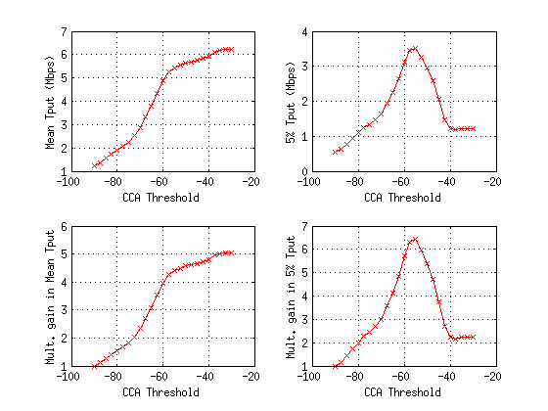
AWGN, 4 dB shadow, center AP, 1 channel, 100% DL (2)
> 4X gain in terms of mean and 5% throughput with -60 dBm threshold

Slide 15
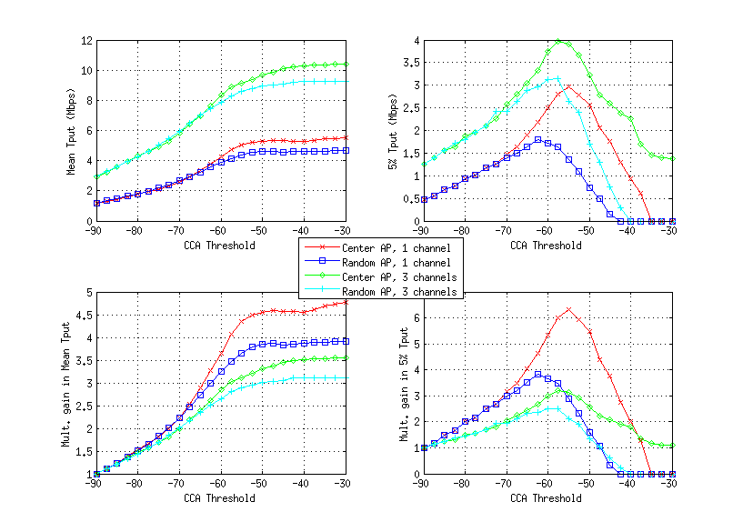
2x1 11nB, 4 dB shadow, 100% DL traffic
Center vs. randomly located AP
With random AP get weaker signal links and more random interference – some links are badly positioned for aggressive spatial reuse
Mean throughputs are very similar, and 5% throughput very similar until reasonably high threshold reached
1 vs. 3 channels
Larger throughput for 3 channels vs. 1 channel, although gains are about 2X
Performance vs. CCA threshold shows same trends as 1 channel
See > 2X gain in terms
of mean and 5% Tput
at optimum point for all 4
scenarios

Slide 16
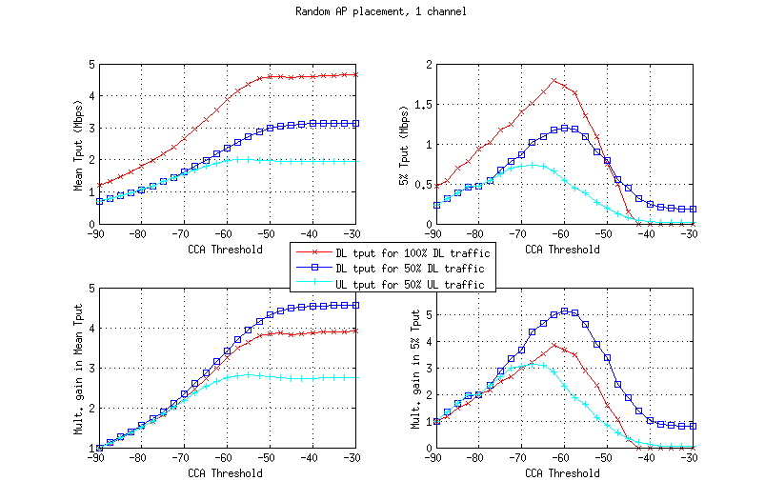
2x1 11nB, 4 dB shadow, 100% DL vs. 50% DL traffic
With mix of UL/DL traffic, UL Tput lower than DL due to lower power
Effect only shows up when CCA threshold high enough to enable meaningful interference
Gains for UL traffic smaller than for DL traffic, but still very large

Slide 17
Conclusions
Ran simulation with different CCA thresholds, and ploted performance metrics vs. CCA threshold
Increasing threshold leads to more spatial reuse and more interference -> increased airtime per STA, at expense of increased interference (decreased SINR)
Baseline: -90 dBm threshold
We observe >2X gain in mean throughput and 2X gain in 5% throughput (UL and DL traffic) by increasing threshold to the range [-70,-60] dBm
Because apartments are so small, desired signal is very strong (~ -40 dBm) and thus highest MCS can be achieved even with -70 dBm interference
The focus of this work was not on latency but we also note that latency is reduced with higher CCA since STA are not locked out of the channel for long periods of time when they here many neighbors

Slide 18
References
[1] 11-11-0061-00-00ac-cca-threshold-levels
[2] Simulation scenario working document 11-13/1001r5
[3] 11-13-1359-00-0hew-HEW-Evaluation-Methodology

Slide 19
Backup – Complete Results DL/UL 50/50

