Slide 1
PMK Caching for FILS
Date: 2014-01-15
Authors:

Slide 2
Abstract
This slide deck describes an enhancement for faster authentication of non-initial FILS connections using PMK caching.

Slide 3

FILS Use Case– Tokyo Train Station

Slide 4
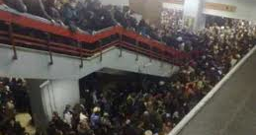
What About When They Start Moving?

Slide 5

Can Subsequent Link Setup be Fast(er)?

Slide 6
PMK Caching with FILS
The I in FILS is initial
The result of the Fast Initial Link Setup is a PMKSA
  PMKSA represents authenticated state, including a key (the PMK)
  PMKSA can be reused to enable Fast Subsequent Link Setup
Many 802.11 deployments use a switch/controller
  MAC on AP is split, non-real time portion resides on controller
    802.1X authenticator is non-real time part of MAC
    Makes sense to put FILS functionality on controller as well
  A multitude of APs can be part of a single controller
  A STA can quickly roam among the multitude of APs, reusing the same PMKSA– PMK Caching

Slide 7
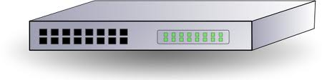
PMK Caching
Subsequent FILS exchanges
only go to controller
ISP
PMK
SA
First FILS exchange goes back to ISP

Slide 8
PMK Caching with FILS
PMKSA can be created by public or shared key FILS
Once created, a PMKSA is cached
  Many PMKSAs can be cached at once
  PMKSAs are identified by a PMKID
  PMKSAs can be deleted at any time by either STA or AP
  Should make PMKSAs created by FILS be somewhat short lived
STA and AP agree on PMKSA during Auth exchange
  STA includes (list of) PMKID(s)
  AP selects (one of) the PMKID(s)
FILS “shared key” exchange (but not ERP)
  PMK from cached PMKSA is used to authenticate FILS exchange
  PFS is supported!

Slide 9
References
11-14/0052r*-- PMK Caching with FILS

