Slide 1
Further Considerations on
Calibration of System Level Simulation
Date: 2014-01
Authors:
Name | Affiliations | Address | Phone | Email
Zhang Jiayin | Huawei Technologies Co., Ltd | No. 2222, Xin Jinqiao Rd. Pudong, Shanghai, China |  | zhangjiayin@huawei.com
Luo Jun |  | No. 2222, Xin Jinqiao Rd. Pudong, Shanghai, China
Ma Chixiang |  | No. 2222, Xin Jinqiao Rd. Pudong, Shanghai, China
Kong xueli |  | F1-17, Bantian Huawei Base, Shenzhen, China
Pang Jiyong |  | No. 2222, Xin Jinqiao Rd. Pudong, Shanghai, China
Edward Au |  | Kanata, ON
Yakun Sun | Marvell Semiconductor | 5488 Marvell Ln, Santa clara, CA 95054
Hongyuan Zhang

Slide 2
Abstract
Further considerations on the calibration of an integrated system level simulation are presented

Slide 3
Background (1/2)
Three types of simulation methodologies are presented in [1], including PER Simulation, PHY System simulation and MAC System simulation.
An Integrated System Level Simulation, which can take into account both PHY and MAC features for performance evaluation, is proposed in [2]. There are also a number of presentations, e.g., [3], that details a step-by-step calibration.

Slide 4
Background (2/2)
In this presentation, we aim at providing further consideration on the following topics:
  Select an appropriate scenario for calibration
  Recommend metric and methodology for
    long term SNR/SINR calibration
    Instantaneous SNR/SINR calibration
    PHY SLS calibration
    Integrated SLS calibration

Slide 5
Why Calibration?
To validate the modeling methodology of all building blocks of a system level simulator.
To provide a common baseline for all companies to develop their simulators and align their system simulation results.

Slide 6
Calibration Scenario Selection
The scenario should be
  able to test all building blocks;
  clearly defined;
  run efficiently.
Since the simulation scenarios for HEW [4] are yet to be finalized, a simple and fixed deployment can be considered.
  e.g. 11ac OBSS enterprise scenario [5] or one of the simulation scenarios currently discussed.

Slide 7
Step 1: Long Term SNR/SINR Calibration
Metric:
  CDF of long term SNR/SINR of each potential communication link
Method:
  Signal power: received signal power from the transmitting node to the receiving node within a BSS.
  Interference power: the sum of average effective received power from all interfering BSS (all BSSes other than the BSS of target STA/AP).
    Average effective received power: total received power at the target node averaged by the total number of AP and STA in one interfering BSS assuming all these nodes in this interfering BSS are transmitting.

Slide 8
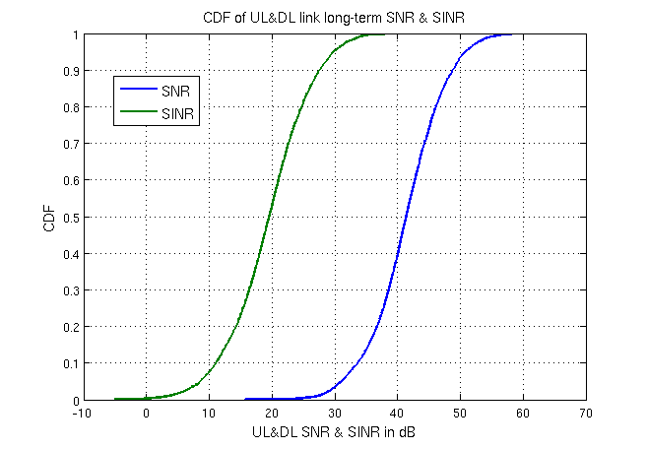
Step 1: Long Term SNR/SINR Calibration
Illustrative example by considering 11ac OBSS enterprise scenario [5]

Slide 9
Step 2: Instantaneous SNR/SINR Calibration
Metric:
  CDF of instantaneous SNR/SINR of each potential communication link
Method:
  Signal power: received signal power from the transmitting STA to the receiving STA within a BSS.
  Interference power: sum of all interfering STAs/APs based on PHY system simulation.
Simple MAC assumption can be assumed, such as CCA-only mechanism mentioned in [1].

Slide 10
Step 3: PHY SLS Calibration
Metric:
  Area throughput/throughput per BSS and CDF of per STA throughput
Method:
  Full buffer traffic is assumed;
  Simple MAC mechanism, which is the same as Step 2, should be used;
  PHY abstraction should be used;
  PHY features, such as MIMO scheme, need to be clarified.

Slide 11
Step 4: Integrated SLS Calibration
Metric:
  The same as Step 3, i.e., area throughput/throughput per BSS and CDF of per STA throughput.
Method:
  The same as Step 3 except a more detailed MAC mechanism, e.g., CSMA/CA, should be included.
Remarks:
  Additional calibration of the baseline for each scenario is required, which can be merged with step 4.

Slide 12
Further Consideration on SLS Calibration
Several interim calibration can be carried on in parallel if necessary:
  Traffic model;
  Small-scale fading channel;
  PHY abstraction.
Network deployment of HEW simulation scenarios can also be calibrated prior to baseline calibrations.

Slide 13
Summary
A step by step calibration is recommended for system level simulation, including long term /instantaneous SNR/SINR calibration, PHY SLS calibration and integrated SLS calibration.

Slide 14
Reference
[1] 11-13-1051-01-0hew-evaluation-methodology
[2] 11-14-0059-00-0hew-Integrated-System-Level-Simualtion
[3] 11-13-1392-00-0hew-methodology-of-calibrating-system-simulation-results
[4] 11-13-1001-05-0hew-simulation-scenarios-document-template
[5] 11-09-0451-16-00ac-tgac-functional-requirements-and-evaluation-methodology

Slide 15
Appendix:
Parameters for Calibration in Step 1
Parameter | Value
Central frequency | 5.57GHz
Bandwidth | 20MHz
Transmission power | AP: 15dBm STA: 15dBm
Antenna configuration | Antenna type: omni-directional antenna Antenna gain: 0dB AP antenna number:1 STA antenna number: 1
Implementation loss | 0dB
Noise floor | -174 dBm/Hz
Noise figure | AP: 10dB STA: 10dB
Channel model | 802.11 TGac channel model D (LOS/NLOS) Shadow fading std. dev. (dB): 3 (before d_{BP}); 5 (after d_{BP}) d_{BP}: 10m
Notes:
Appendix: parameters for calibration step 2

