Slide 1
E-Education Analysis
HEW SG
Date: 2014-01
Authors:

Slide 2
Background
This presentation looks at the E-Education HEW Use Case.
See also:
Use Case Dense Apartments 13/1487r2
  “Single” apartment complex 2.4 to 2.96 improvement in throughput per apartment (using DSC and Channel; Selection)
  “Double” apartment complex 3.3 to 4.12 improvement in throughput per apartment (using DSC and Channel; Selection)
Airport Capacity 13/1489r4
  Can be satisfied by existing technology
E-Education 14/0045
  Improvement of 2.28 in throughput per classroom using DSC
Pico Cell 14/0048
    Improvement of 7.58 in in capacity using DSC in cell cluster pattern (see 13/1290)
    “Street” Pico cell can be satisfied with existing technology
DSC is explained in 13/1012 and 13/1290

Slide 3
Objective
To look at the prime HEW Use Cases and see what is theoretically possible using known techniques.
Then to determine if there is a “gap” that can lead to a requirement for HEW.

Slide 4


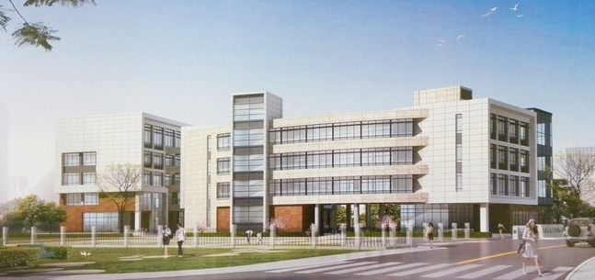
1e e-Education
Scenario Characteristics:
  Dense STAs (40~60 STAs) in one classroom with one AP
  20~30 classrooms in one typical school building (3~6 floors)
  Thus, nearby 1,000 STAs with 20~30 APs within a building space.
Typical education applications:
  Video streaming among teacher and students;
  Teachers/Students demonstrate theirs desktop to others;
  File transfer and sharing;
  4+ subgroup in one classroom with multicasting traffic for screen sharing or video;
  Throughput assumption: longtime/stable throughput in one classroom >= 20 Mbps
Challenges and Issues:
  Fast Connection: Very long STAs registering time (1~5 minutes) delay the start of a class;
  Interference Control and Delay Optimization:
    Annoying lag in screen sharing, video streaming and command response (sometimes it is longer than 20 seconds)
    Very low bandwidth for e-homework submission in the same period.
Laurent Cariou (Orange)

Slide 5
1e e-Education
Pre-Conditions
WLAN is deployed in a each classroom of a campus in order to provide communication tools for e-Education.
Environment
Dense STAs (40~60 STAs) in one classroom with one AP. 20~30 classrooms in one typical school building (3~6 floors).
Nearby 1,000 STAs with 20~30 APs within a building space.
Applications
Video streaming among teacher and students;
Teachers/Students demonstrate theirs desktop to others;
File transfer and sharing;
4+ subgroup in one classroom with multicasting traffic for screen sharing or video;
Throughput assumption: longtime/stable throughput in one classroom >= 20 Mbps
Traffic Conditions
Interference between APs in different classrooms belonging to the same managed ESS due to high density deployment.
interference with peer-to-peer networks within each classroom.
Use Case
e-Education starts in multiple classrooms simultaneously.
Teacher/students demonstrated their desktop to others, video or screens are shared.
Laurent Cariou (Orange)

Slide 6
Classroom
Say 30 x 30ft
40 desks

Slide 7
Channels
Ref:Wikipedia

Slide 8
Building Complex example – one side
Assumed 3dB wall loss
10dB Floor loss
Use of directivity on antennas could assist

Slide 9
Building Complex Example – Other side
Note: Without DSC blocked rooms doubles.

Slide 10
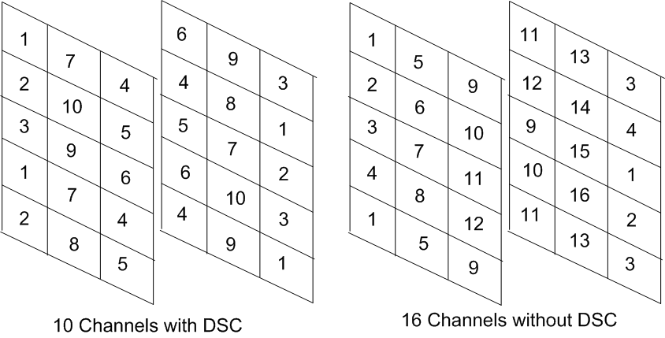
Channel Selection
As situation is controlled, AP channels can be preset
Example is extreme for 36 classrooms, worse case layout

Slide 11
11ac Rates
Assuming 2SS for the STA, and using SU MIMO
With DSC 10 Channels (40MHz)
Without DSC 20 Channels (20MHz)
Signal strength within each class is >-45dBm hence can use 256 QAM 5/6
  11ac PHY Rate for 40MHz, 2SS is 400Mbps (10 Channels)
    Max Throughput 344Mbps (131k agg)
    Say 240Mbps throughput*
  11ac PHY Rate for 20MHz, 2SS is 173Mbps (3/4 rate, 5/6 is excluded)
    Max Throughput 150Mbps (65k agg – 131k exceeds length)
    Say 105Mbps throughput*
Improvement is 2.28 Downlink could use MU-MIMO?
*Assuming EDCA Overhead.

Slide 12
What is Use Case Requirement?
Unclear what the Use Case requirement is.
  20 Mbps?
Downlink would be multicast?
With DSC ~240Mbps per class (6Mbps per pupil)
Without DSC ~ 105Mbps per class (2.6Mbps per pupil)
Not sure what the ‘gap’ is, but hopefully this quick analysis will help determine it.

Slide 13
Discussion
Isolation between classrooms could be improved by antenna directivity
With 11ac SU-MIMO, DSC provides 240Mbps per classroom throughput
Without DSC SU-MIMO provides ~105Mbps per classroom throughput
Improvement of x2.28 per classroom.
“Fast” connection – is this satisfied with 11ai?
Interference/OBSS greatly improved by DSC and also by antenna positioning.

Slide 14
Conclusions
My personal opinion is that 11ac provides sufficient data throughput and efficiency and not easy to see any need for improvement.
The basic need is for higher channel re-use so that the higher BWs can be used.
Channel re-use can be improved with DSC but also by not using omni-directional antennas.
  Corner antennas, such as used in cellular for example.
  Easy to do if a ‘managed’ network.

