Slide 1
PHY abstraction in system level simulation for HEW study
Date: 2014-01-20
Authors:

Slide 2
Outline
Effective SNR Mapping and parameter fitting results
Fitting result sensitivity to bandwidth
Parameterise PER over PDU length
Frequency-domain modelling of interference
Temporal-domain modelling of interference

Slide 3
Effective SNR Mapping
Mapping a vector (SNR) to a scalar; four candidate methods
EESM
RBIR
RBIR-BICM
MMIB
Share a similar processing flow
The function is in the form:
Map per sub-carrier SNR to a bit rate equivalence
Take average over the per-subcarrier bit rate equivalence
Map the averaged bit rate equivalence back to an effective SNR
All methods need fitting for α and β
For different MCS, FEC type and fading channel scenario
Parameters need to be calibrated by fitting the simulated PER curves

Slide 4
Selection of Mapping function
 | EESM | RBIR/RBIR-BICM | MMIB
Function for Φ | Closed-form | Tabulated | Closed-form; but not available for 256QAM
Function for Φ⁻¹ | Closed-form | Tabulated | Tabulated; but not available for 256QAM
Curve fitting | Large search range for (α, β) | Limited search range for (α, β) | Limited search range for (α, β) Extra curve fitting for function Φ
For the complexity issue, MMIB will not be evaluated in this presentation

Slide 5
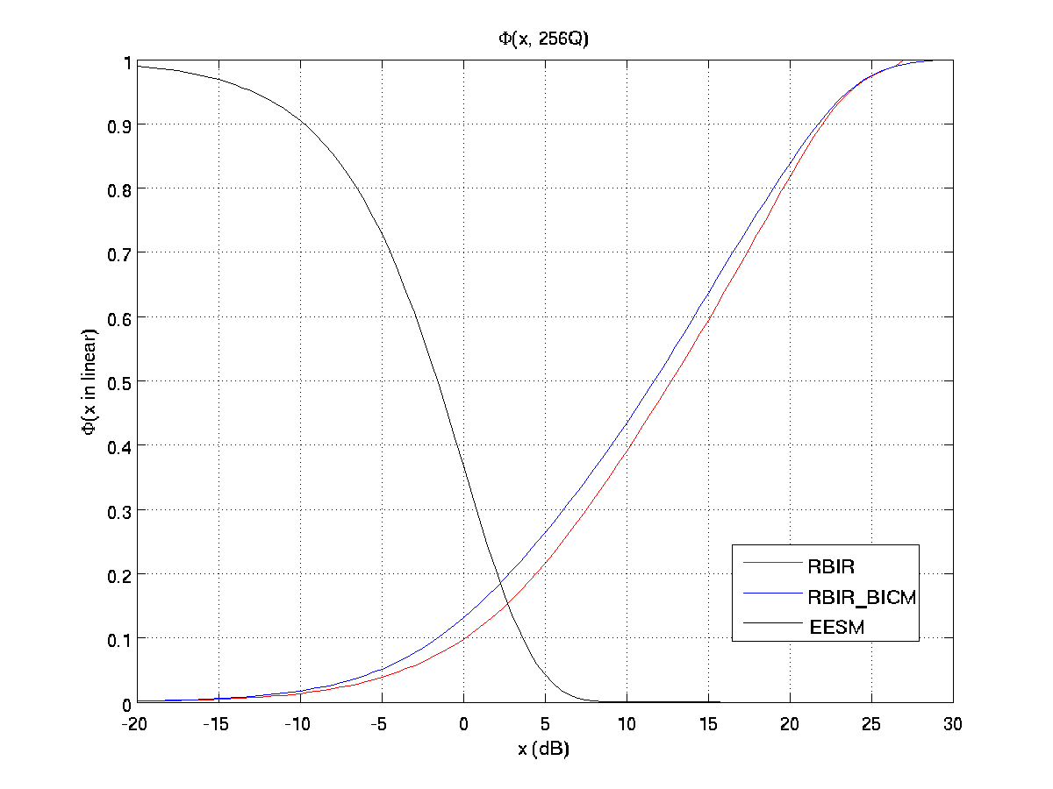
Function Φ (normalised by bit per symbol)

Slide 6
Simulation conditions/assumptions
PPDU configuration
VHT 40 MHz frame BCC FEC with single spatial stream
MCS 0-9
PDU length 1K bytes
Channel condition
Static frequency-selective channel type (B and D)
Receiver assumption
Ideal channel estimation
Single tap equalisation
Floating point Viterbi decoder

Slide 7
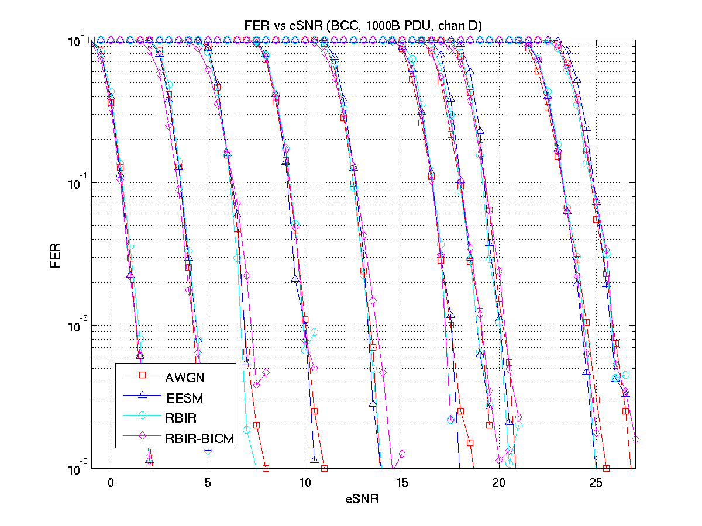
BCC fitting results (Chan D)

Slide 8
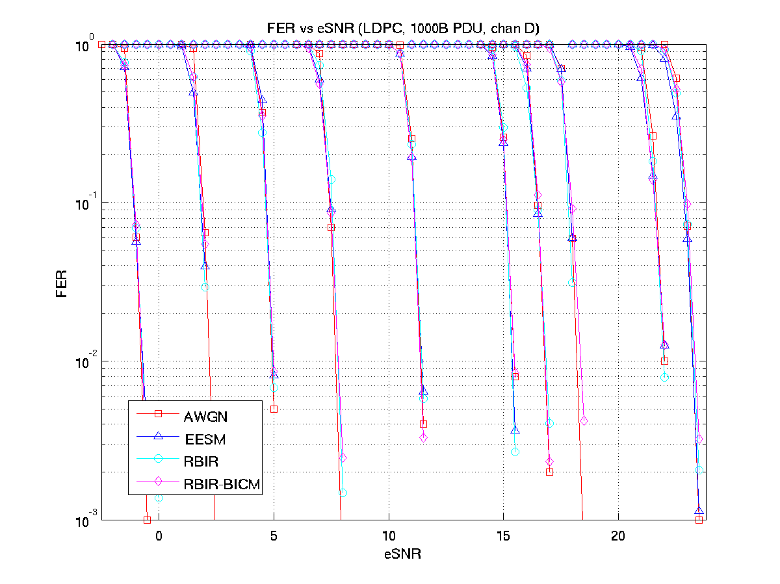
LDPC fitting results (Chan D)

Slide 9
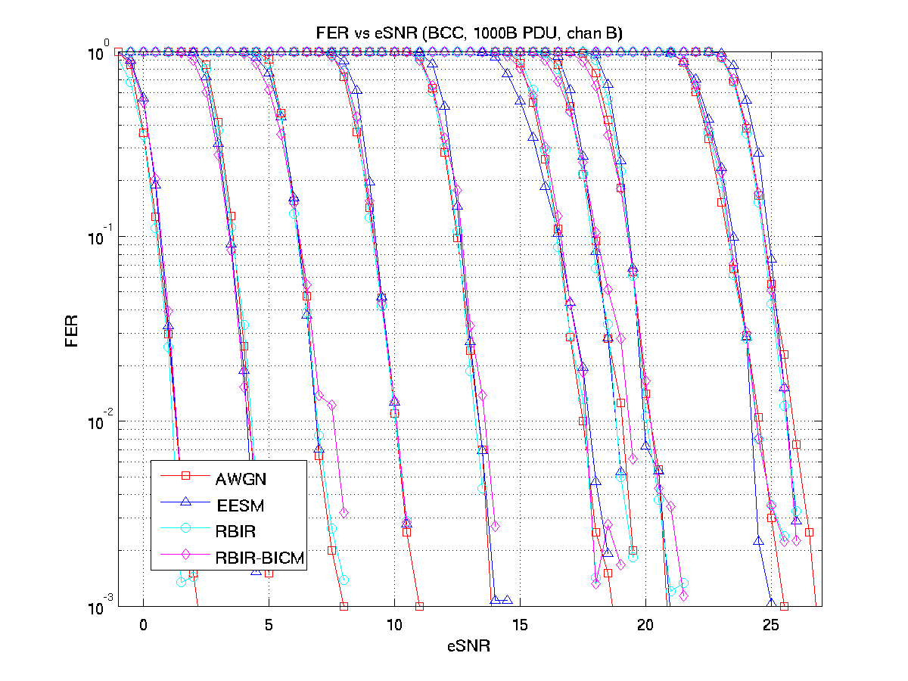
BCC fitting results (Chan B)

Slide 10
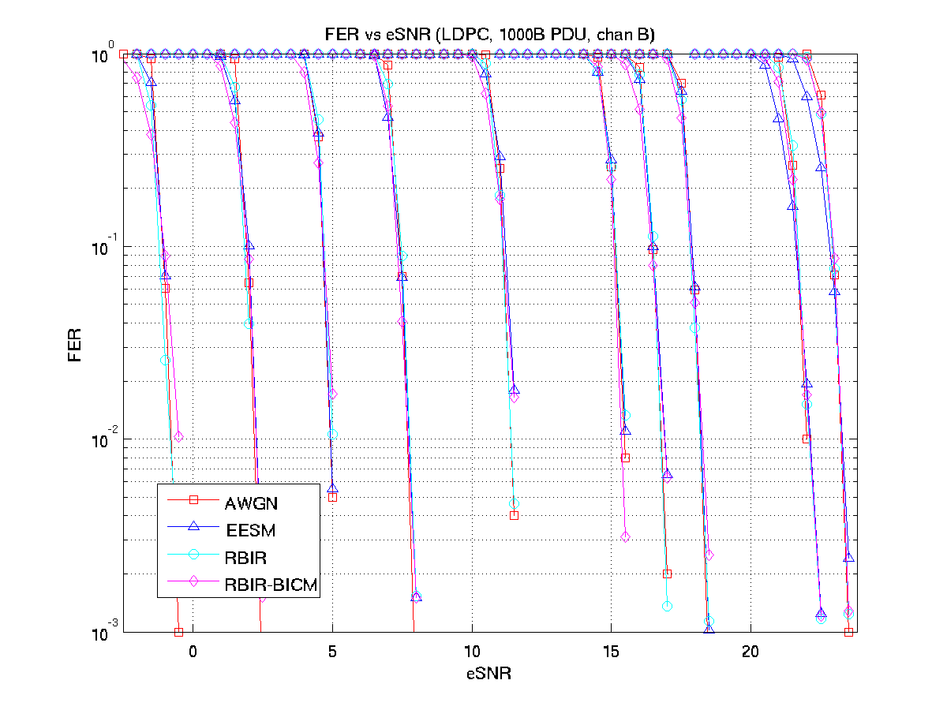
LDPC fitting results (Chan B)

Slide 11
Sensitivity to bandwidth
Fitting results obtained on 40 MHz are tested on 20 and 80 MHz cases
For 80 MHz, BCC has small but noticeable mismatch; LDPC has no significant mismatch
For 20 MHz, BCC has noticeable mismatch; LDPC has small mismatch for some MCSs

Slide 12
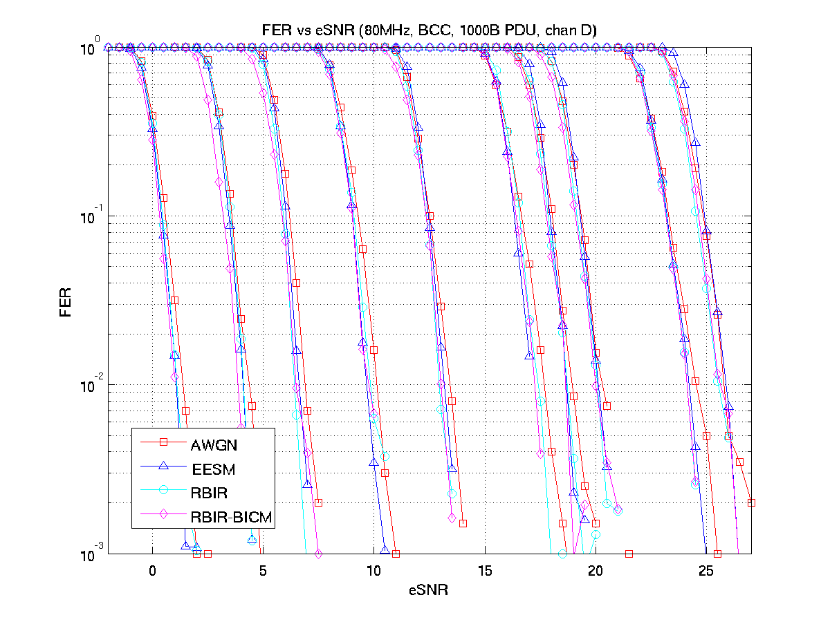
80 MHz Bandwidth (BCC Chan D)

Slide 13
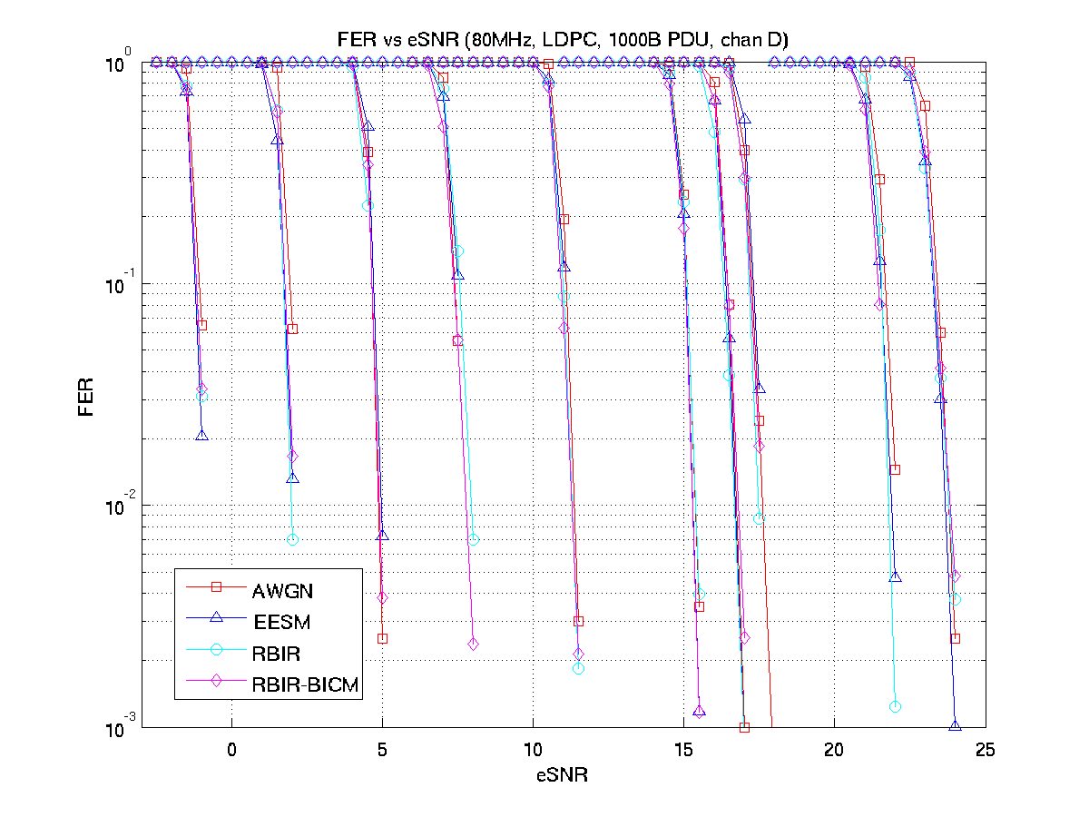
80 MHz Bandwidth (LDPC Chan D)

Slide 14
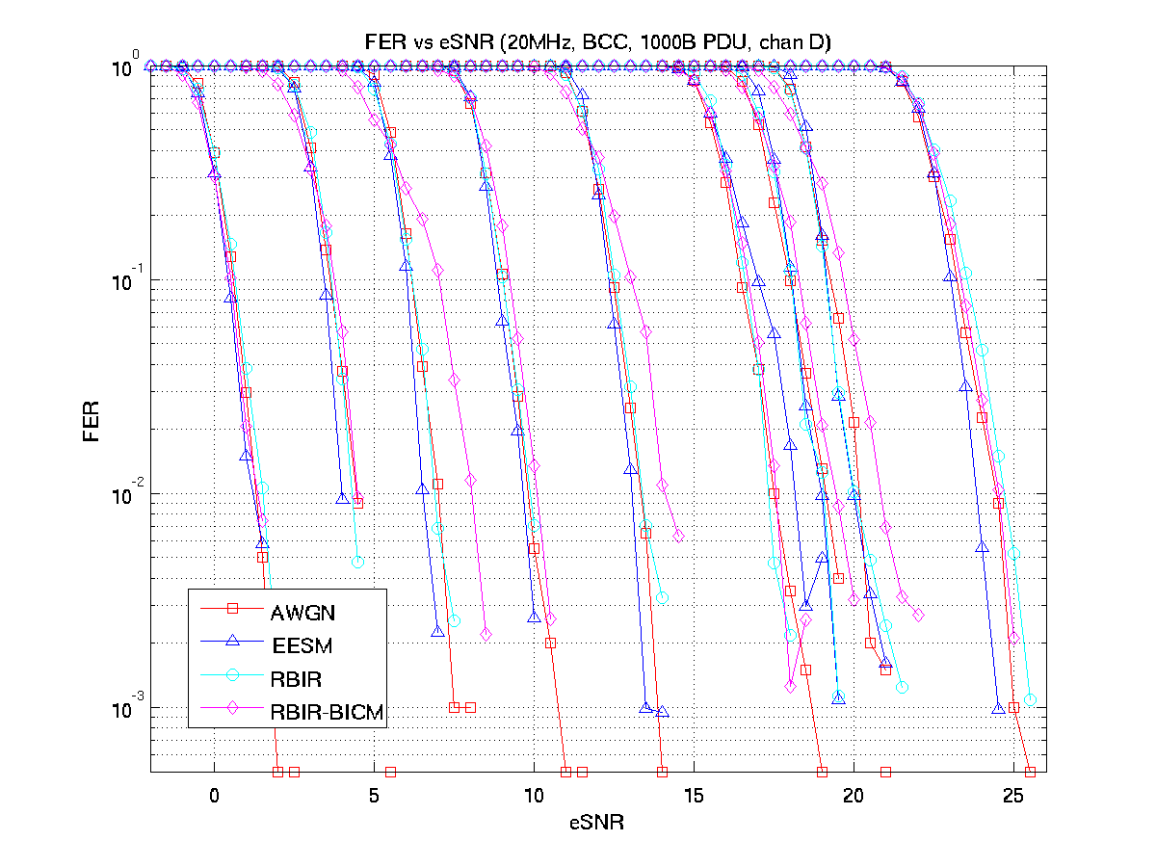
20 MHz Bandwidth (BCC Chan D)

Slide 15
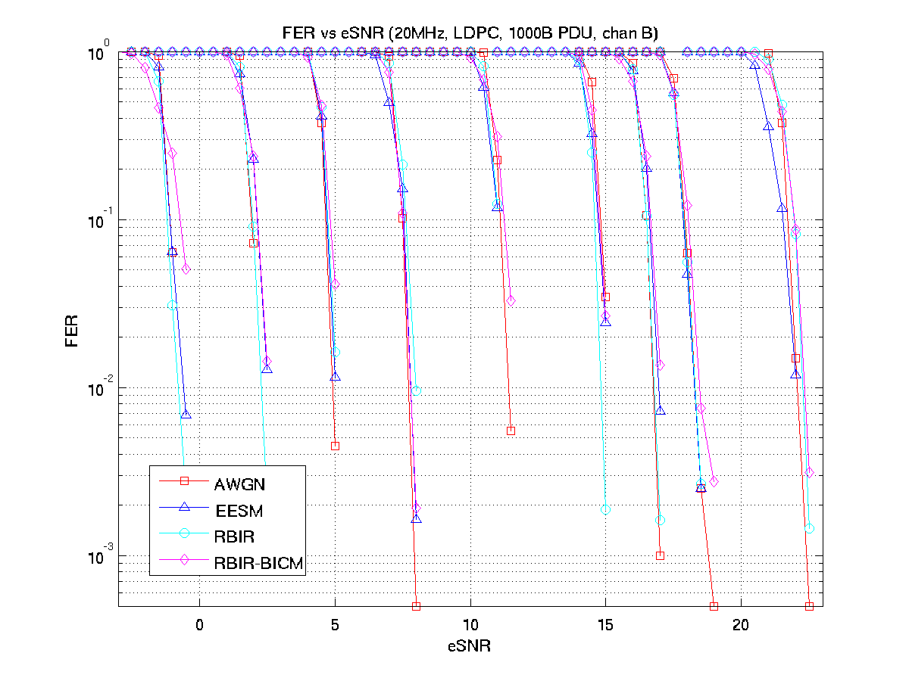
20 MHz Bandwidth (LDPC Chan D)

Slide 16
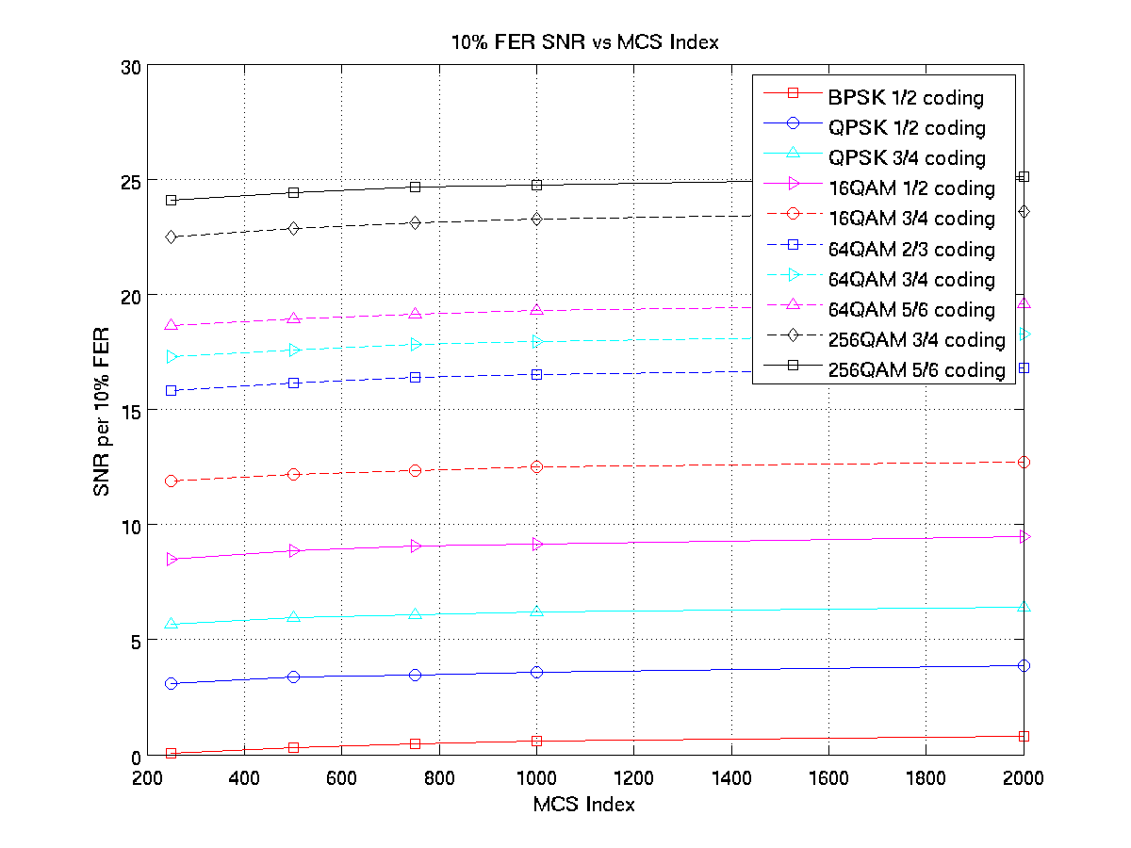
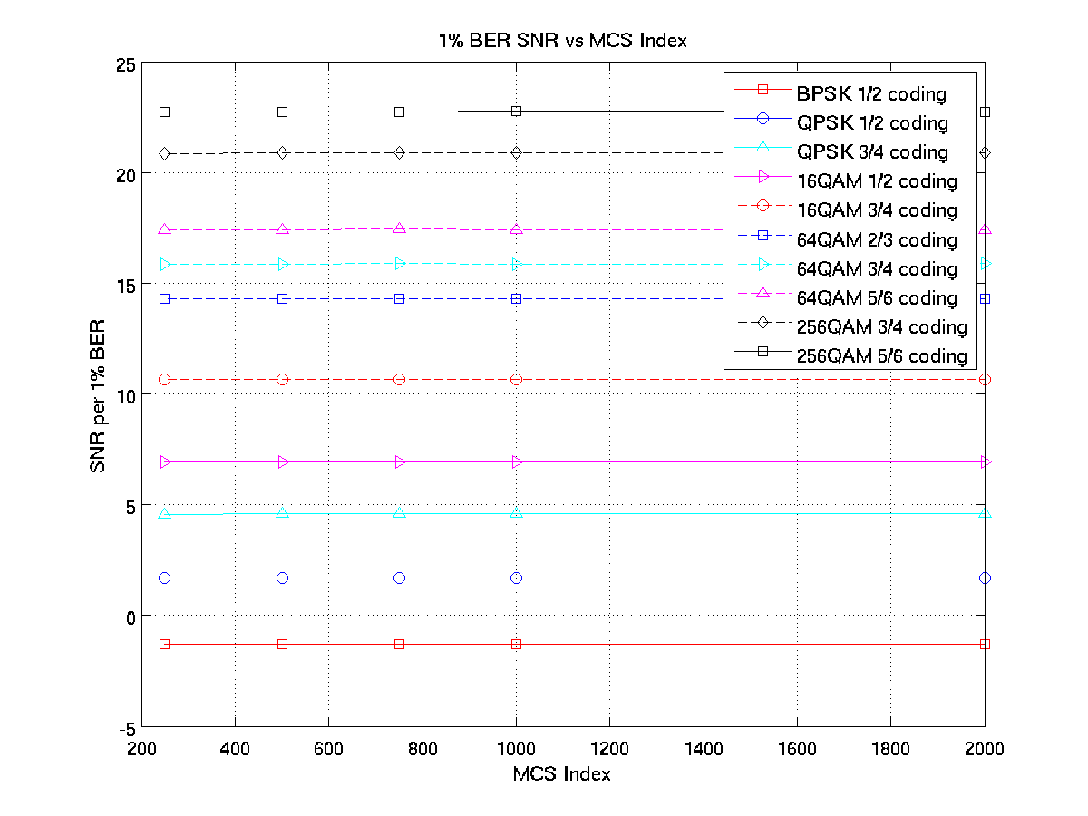
Impact of PDU length
For the same MCS, FER varies depending on PDU length; but BER does not

Slide 17
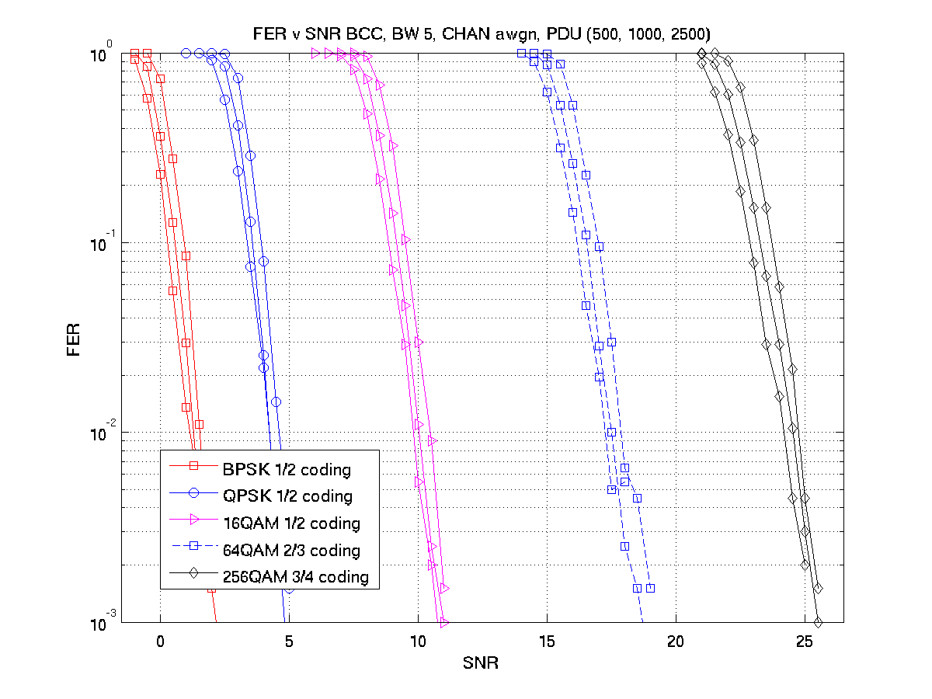
Parameterize FER on PDU length (1)
Alt. 1. Tabulate PER on MCS, PDU length
Need to store a set of curves and interpolate for other length

Slide 18
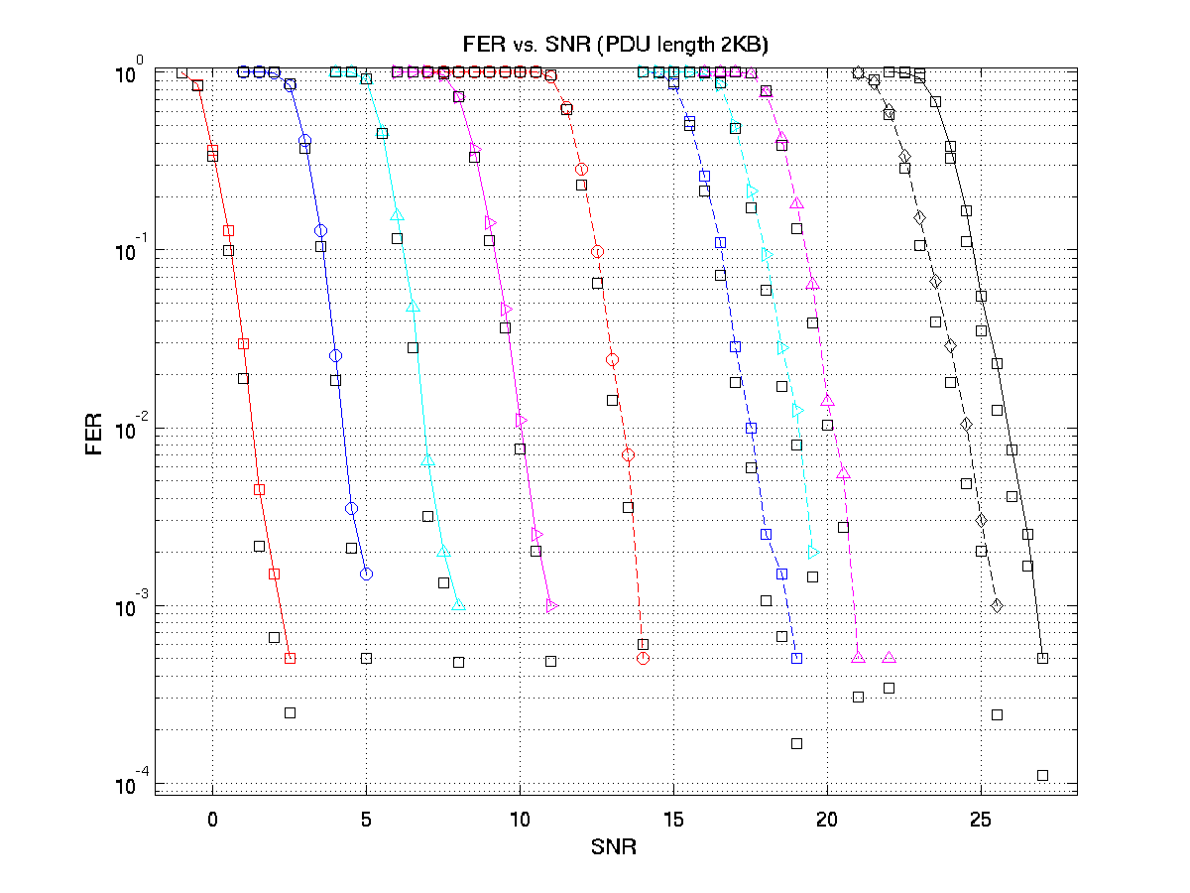
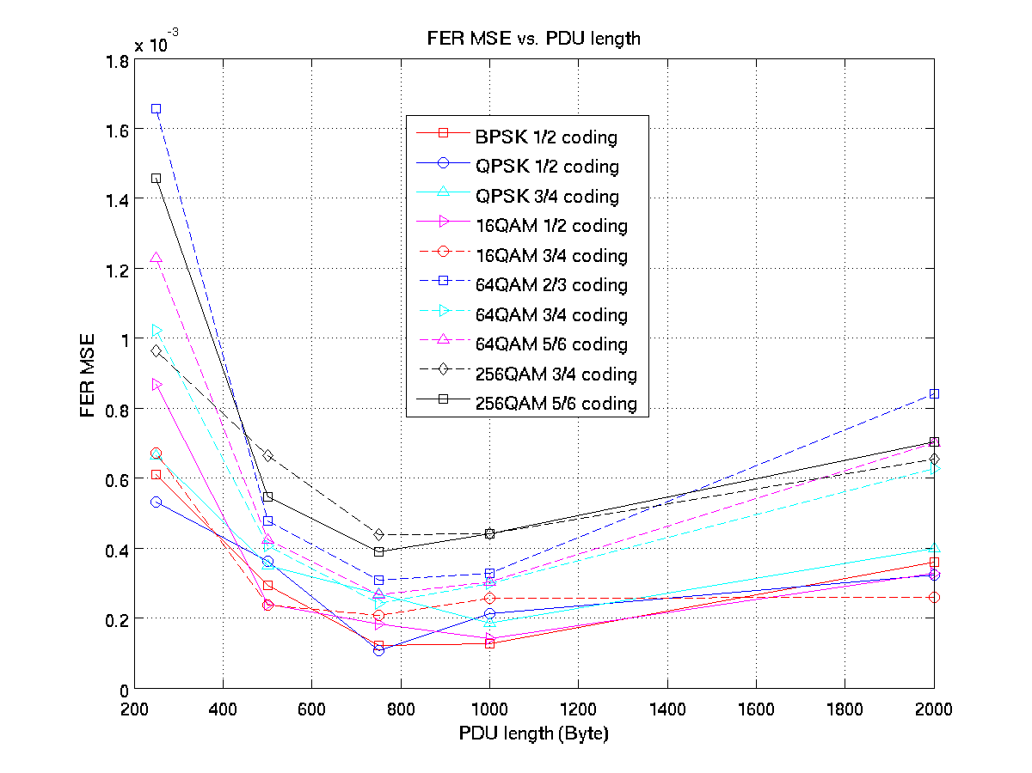
Parameterize FER on PDU length (2)
Alt. 2. Map BER to FER using a model function
Map SNR to BER(Pe) based on 1000B PDU
FER ~ 1-(1- Pe)L/D, fitting D per MCS

Slide 19
Interference modelling – frequency selectivity
In general, the interference is frequency selective;
However, modelling frequency selectivity interference in system level simulator is expensive
Frequency selectivity modelling involves CIR generation and FFT processing;
There may exist multiple interferers
For lower power interference, may not be significantly different from a white-noise interference modelling
With respect to average power, the null subcarrier is deeper than the peak subcarrier in the interference spectrum
With same power, instant white-noise has greater dynamic range than interference signal

Slide 20
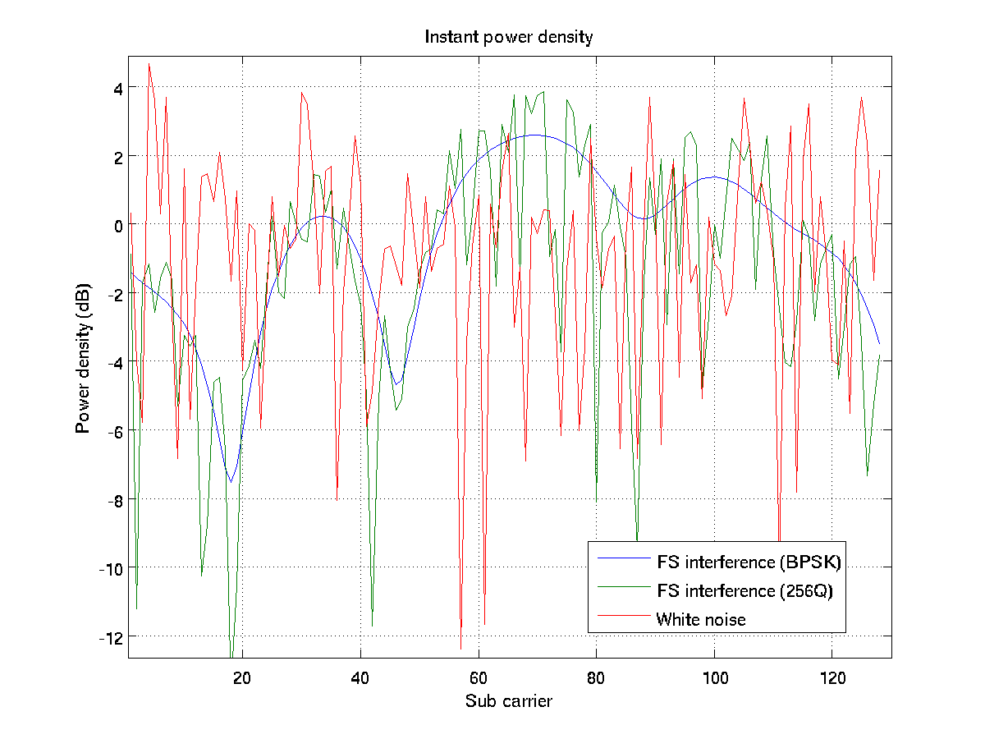
Instant interference power density
The interference power density peak matters more than the null

Slide 21
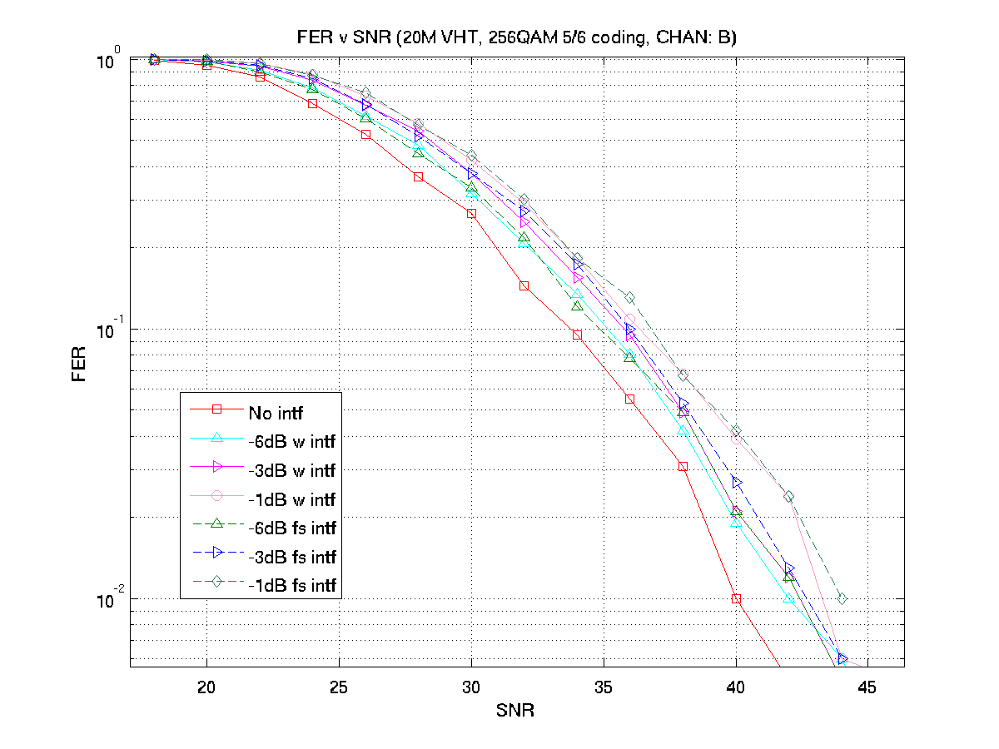
Compare interference models
Interference power is defined w.r.t. to noise power

Slide 22
Interference modelling – temporal dynamics
In OBSS, the interfering signal may not be aligned with intended signal in time;
interfering signal may appear at any time with respect to the intended signal
Assessing the packet reception once either at the preamble and the end of the frame is pessimistic
Due to aggregation, some MPDUs may be correctly received
Accurately modelling the temporal dynamic interference is costly
A good balance is to assess the reception for each MPDU duration in an A-MPDU

Slide 23
Summary
Effective SNR Mapping
All methods discussed give similar accuracy, RBIR/RBIR-BICM have advantage of small search space
Parameters in the mapping function are not sensitive for 40 and 80 MHz bandwidths but for 20 MHz bandwidth
Parameterise PER over PDU length
Fitted BER vs. FER mapping function can avoid storing too many FER tables
Frequency-domain modelling of interference
For lower power interference, white-noise model is sufficient
Temporal-domain modelling of interference
Multiple check point in a frame
Time resolution up to MPDU duration

Slide 24
Reference
[1] “PHY Abstraction for System Simulation”, IEEE 802.11-04/0174
[2] “PHY Abstraction for HEW Evaluation Methodology”, IEEE 802.11-13/1059r0
[3] “PHY Abstraction for HEW System Level Simulation”, IEEE 802.11-13/1131r0
[4] “PHY Abstraction for HEW System Level Simulation”, IEEE 802.11-13/1390r0

Slide 25
Thank you!

