Slide 1
A low power demodulator prototype for SDR transceivers (40-60 GHz)
Date: 2014-01-07
Authors:
Jingjie Feng, ZJU

Slide 2
Abstract
This contribution proposes a low power, 40-60 GHz, oscillator-less self-demodulator for short-range software-deﬁned transceivers.
Jingjie Feng, ZJU

Slide 3
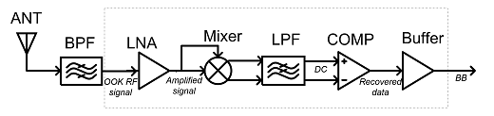
A low power demodulator prototype (1)
Architecture of the oscillator-less OOK self-demodulated receiver
0.18µm SiGe BiCMOS technology.
Able to demodulate Gbps data signal (carrier 40-60GHz).
Minimum sensitivity of -43dBm.
12mW power consumption.
1.5V supply.
Jingjie Feng, ZJU

Slide 4
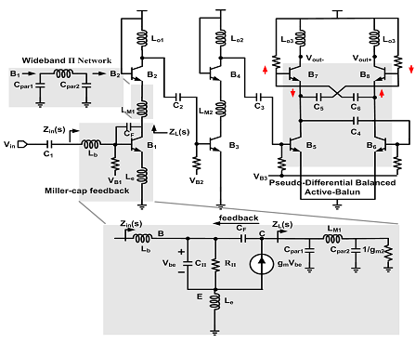
A low power demodulator prototype (2)
Low power implementation (1)
  a three-stage single-input differential-output LNA.
The schematic of LNA
Jingjie Feng, ZJU

Slide 5
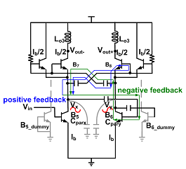
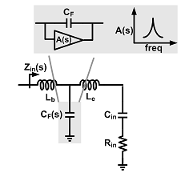
A low power demodulator prototype (3)
Low power implementation (2)
  miller-capacitor feedback effect with embedded active-balun
Miller-capacitor feedback input-matching network
Active-balun proposed in this work
Jingjie Feng, ZJU

Slide 6
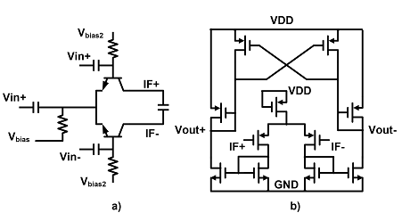
A low power demodulator prototype (4)
Low power implementation (3)
  removing the power consuming and wide-band voltage-controlled oscillator (VCO).
The topology of the BiCMOS mixer embedded with low pass ﬁlter.
Jingjie Feng, ZJU

Slide 7
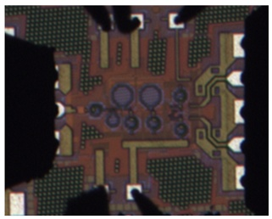
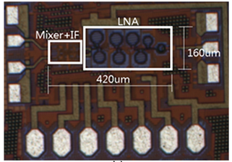
A low power demodulator prototype (5)
Chip area: 0.07 mm².
Die Photo of LNA
Die Photo of demodulator
Jingjie Feng, ZJU

Slide 8
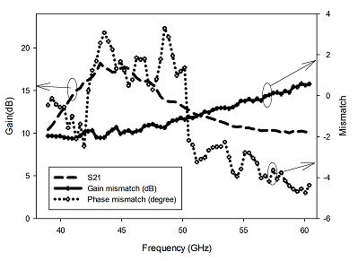
Results (1)
Measured S-parameter and Mismatches of Gain and Phase between the LNA Differential Output, Vout+ and Vout-
Jingjie Feng, ZJU

Slide 9
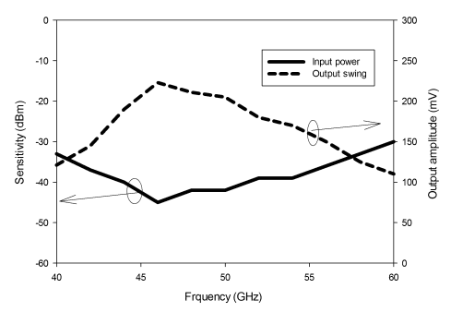
Results (2)
The receiver’s Input Sensitivity and Output Swing of IF Ampliﬁer Output
Jingjie Feng, ZJU

Slide 10
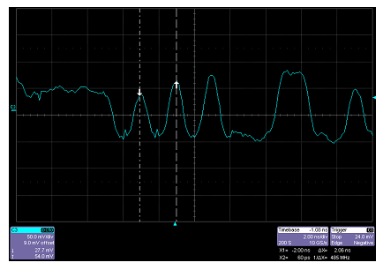
Results (3)
Transient Output from a 1Gps Pseudo Random Data
Jingjie Feng, ZJU

Slide 11
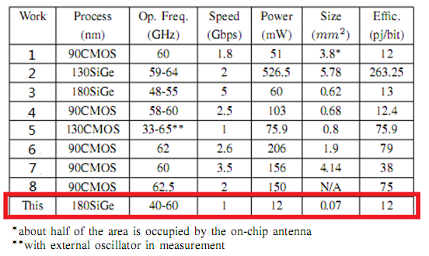
Results (4)
A 12mW, 40-60 GHz, 0.18 µm BiCMOS demodulator in this proposed work
The performances of this proposed work with other receivers.
Jingjie Feng, ZJU

Slide 12
Conclusion
Design challenge lies in demodulator for chip-scale, millimeter wave range communications.
Oscillator-less demodulator is proposed to achieve low power consumption without considerable impact on the sensitivity of the system.
The proposed demodulator is able to work up to Gbps from 40GHz to 60GHz with a typical sensitivity of -43dBm.
The proposed demodulator only consumes 12mW from a 1.5V supply.
Jingjie Feng, ZJU

Slide 13
Reference
Kai Kang, Fujiang Lin, Duy-Dong Pham, et al.,“A 60-GHz OOK Receiver With an On-Chip Antenna in 90 nm CMOS,” IEEE J. Solid-State Circuits, vol.45, no.9, pp.1720-1731, Sept. 2010.
S. K. Reynolds, B. A. Floyd, U. R. Pfeiffer, et al, “A silicon 60-GHz receiver and transmitter chipset for broadband communications,” IEEE J. Solid-State Circuits, vol. 41, no. 12, pp. 2820-2831, Dec. 2006.
W.-H. Chen, S. Joo, S. Sayilir, et al.,“A 6-Gb/s wireless inter-chip data link using 43-GHz transceivers and bond-wire antennas,” IEEE J. Solid-State Circuits, vol. 44, no. 10, pp. 2711-2721, Oct. 2009.
Jri Lee, Yenlin Huang, Yentso Chen, et al., “A Low-Power Fully Integrated 60GHz Transceiver System with OOK Modulation and On-Board Antenna Assembly,” ISSCC Dig. Tech. Papers, pp. 316-317, Feb. 2009.
J. H. Tsai, and T. W. Huang,“35-65-GHz CMOS broadband modulator and demodulator with sub-harmonic pumping for MMW wireless gigabit applications,” IEEE Trans. Microwave Theory and Techniques, vol. 55, no.10, pp. 2075-2085, 2007.
M. Tanomura, Y. Hamada, and S. Kishimoto, et al., “TX and RX front-ends for 60GHz band in 90nm standard bulk CMOS,” ISSCC Dig. Tech. Papers, pp. 558-635, Feb. 2008.
H. Wang, M. H. Hung, Y. C. Yeh, and J. Lee, “A 60-GHz FSK transceiver with automatically-calibrated demodulator in 90-nm CMOS,” IEEE Symposium on VLSI Circuits, pp. 1397-1400, Jun. 2010.
E. Juntunen, M. C. H. Leung, F. Barale, et. al,“A 60-GHz 38-pJ/bit 3.5-Gb/s 90-nm CMOS OOK digital radio,” IEEE Trans. Microwave Theory and Techniques, vol. 58, no.2, pp. 348-355, 2010.
Jingjie Feng, ZJU

