Slide 1
802.11 Supplementary Plenary Information - January 2014
Date: 2014- January -10
Authors:
Name
Company
Address
Phone
email
Bruce Kraemer
Marvell
5488 Marvell Lane,
Santa Clara, CA, 95054
+1 (321) 751-3958
bkraemer@
marvell
.com
Abstract: Additional Information on topics for 802.11 Plenary meeting – January 2014
being held in Los Angeles, California, US
Notes:
November 2011

Slide 2
Monday
Notes:
November 2011

Slide 3
IEEE LOA Database – January 12, 2014
Monday Agenda Item 3.2.1
http://standards.ieee.org/db/patents/pat802_11.html
0 entries with 2014 submission dates
Request for LOAs - 9 sent

Slide 4
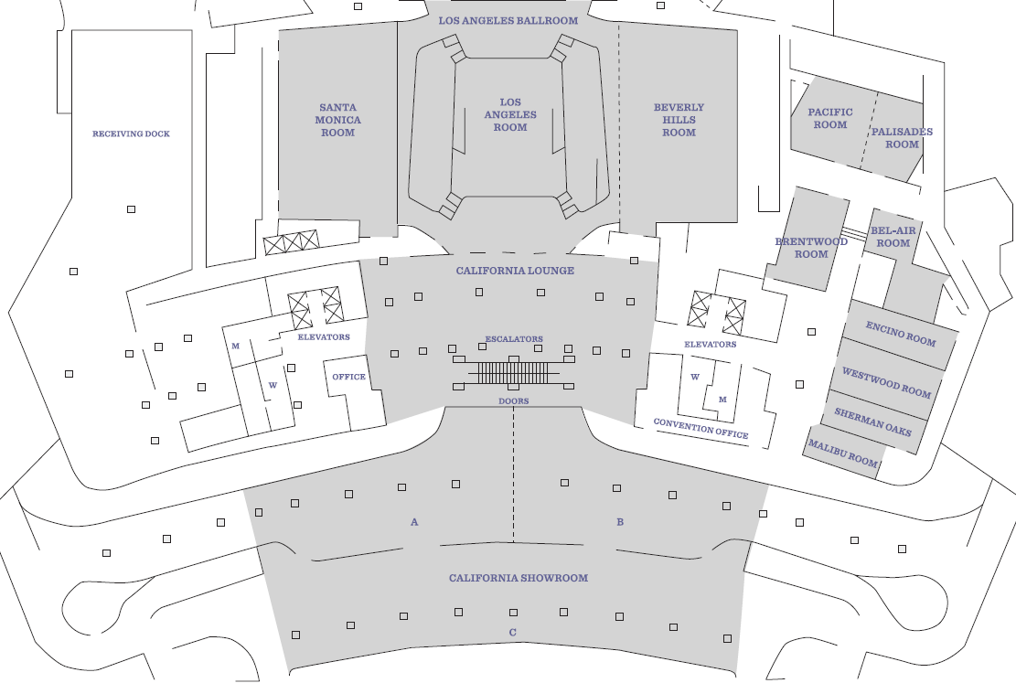
California Level – NO 802 Meetings
Monday Agenda Item 4.1.3
Down 2

Slide 5
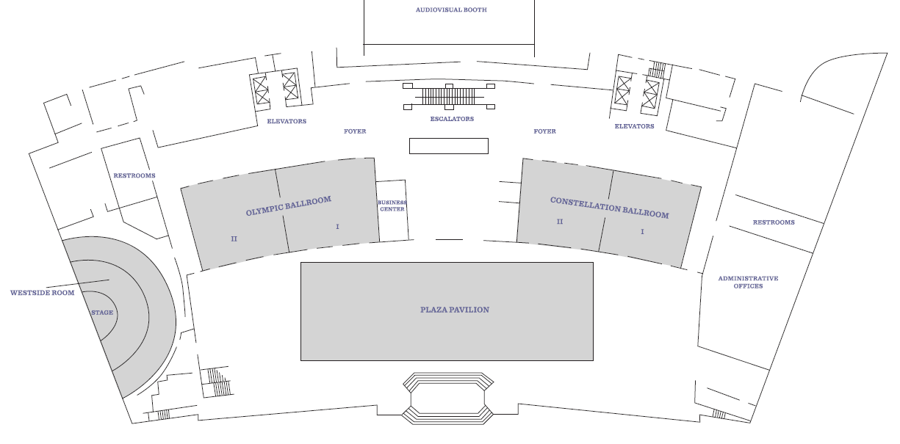
Plaza Level Meeting Areas
Monday Agenda Item 4.1.3
Down 1
Constellation 1+2
Westside

Slide 6
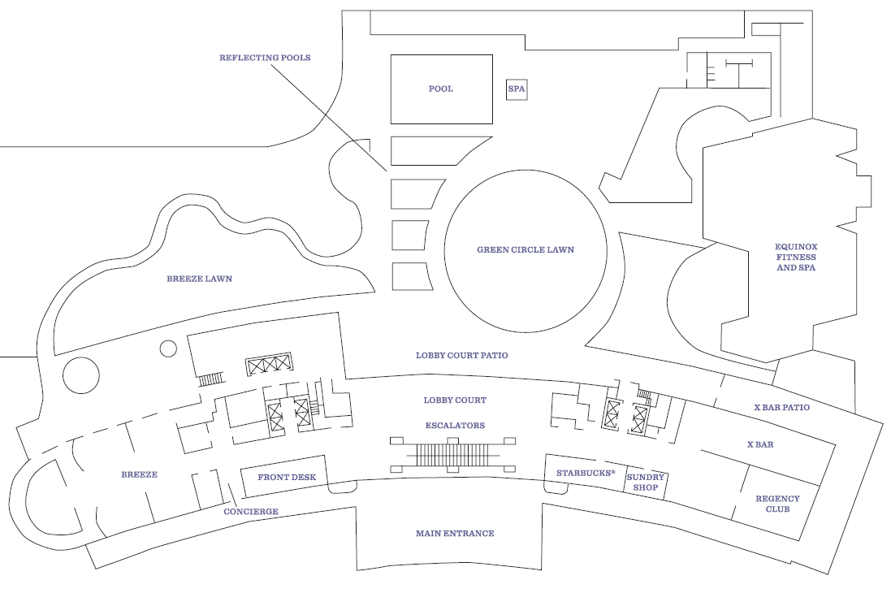
Lobby Level – no 802 meetings on this level
Monday Agenda Item 4.1.3
Mezzanine access

Slide 7
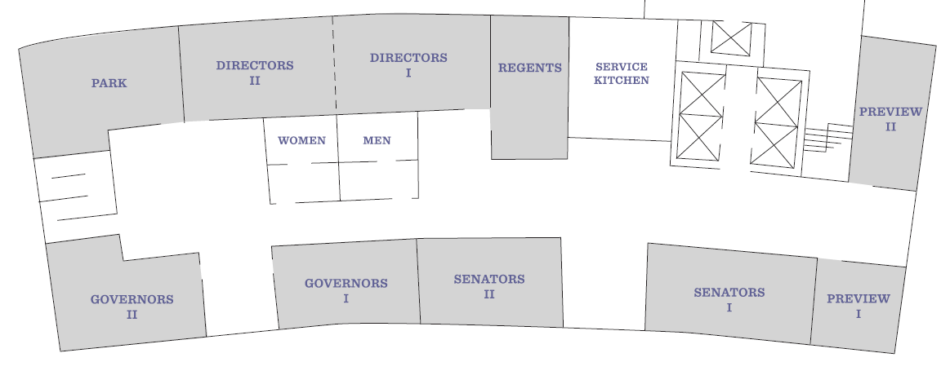
Mezzanine Level Meeting Areas
Monday Agenda Item 4.1.3
Up 1

Slide 8
Joint Meetings
Monday Agenda Item 4.1.4
Internal:
none
External:
AK and 802.1 Thursday am1 (8am – 10am) Constellation 2

Slide 9
March 2014 PARS
Monday Agenda Item 4.1.5
802.22 - Revision, PAR in preparation

Slide 10
Group Room assignments
Monday Agenda Item 4.1.6
WG | Level | Room
1 |  | Olympic 2, Preview 1, Governors 2
16 |  | Suite 3 Room 510
18 |  | Suite 2 Room 505
19 | Mezzanine | Senators 1
21 |  | Suite 1 Room 503
22 |  | Suite 4 Room 512
24 | Mezzanine | Directors 1+2
OMNIRAN | Mezzanine | Directors 1+2
Notes:
November 2011

Slide 11
Group Room assignments
Monday Agenda Item 4.1.6
WG | Level | Room
802.11 Monday Plenary | Plaza | Constellation 1 +2
802.11 Wednesday Plenary | Plaza | Constellation 1 +2
802.11 Friday Plenary | Plaza | Westside
MC
AC
AF
Editors
AH
AI
AJ
AK
AQ
REG
WNG
JTC1
HEW
ARC
http://802world.org/attendee
or IMAT
Notes:
November 2011

Slide 12
WG Agendas
Monday Agenda Item 4.1.6
18: Agenda 18-13-0121 r2
Opening Report 18-
19: Agenda 19-14-0005 r0
Opening Report 19-
21: Agenda 21-13-0231 r0
Opening Report 21-
22: Agenda 22-14-0011 r0
Opening Report 22-
24: Agenda 24-13-0048 r0
Opening Report 24-
OmniRAN Agenda omniran-14
Opening Report omniran-14-0001 r0

Slide 13
802.18 topics – Timeslots to be assigned
Monday Agenda Item 4.1.6
PRELIMINARY DRAFT REVISION OF RECOMMENDATION M.2003 - Multiple Gigabit Wireless Systems in frequencies around 60 GHz (18-13/123r0)
PRELININARY DRAFT REVISION OF REPORT ITU-R M.2227 - Multiple gigabit wireless systems in frequencies around 60 GHz (18-13/124r0)
FREQUENCY ARRANGEMENTS FOR PUBLIC PROTECTION AND DISASTER REFLIEF RADIOCOMMUNICATION SYSTEMS IN UHF BAND IN ACCORDANCE WITH RESOLUTION 646 (Rev. WRC-12) (18-13/125r0)
RADIO INTERFACE STANDARDS FOR USE BY PUBLIC PROTECTION AND DISASTER RELIEF OPERATIONS IN SOME PARTS OF THE UHF BAND IN ACCORDANCE WITH RESOLUTION 646 (Rev. WRC-12) (18-13-126r0)
FCC-13-157A1_Expanding_Access_Mobile_Wireless_Services_On_Board_Aircraft (18-13/128r0)

Slide 14
March 16-24, 2014 Beijing, China
Monday Agenda Item 4.1.7
IEEE 802 Plenary Session
Hotel Registration OPEN
Early: Before Feb 14
Meeting Registration OPEN
Early: Before Feb 7
http://www.ieee802.org/11/Meetings/Meeting_Plan.html

Slide 15
Los Angeles Meeting Registration (~412)
Monday Agenda Item 4.1.8
802.1
802.3
802.11 247
802.15
802.16
802.18
802.19
802.21
802.22
802.24
None
XX
Staff, Guests, Students, ??

Slide 16
Current Membership Status - January
Monday Agenda Item 4.1.8
Status | Number
Aspirant | 121
Potential Voter | 27
Voter | 330
Definitions:
Aspirant: a member who has attended 1 qualifying meeting
Potential Voter: a member who has attended 2 qualifying meetings and will become a voter at the start of the next plenary they attend
Data as of 2012-11-06

Slide 17
IEEE Staff on site
Monday Agenda Item 4.1.9
None

Slide 18
FOOD & BEVERAGE SERVICE
Monday Agenda Item 4.1.10
FOOD & BEVERAGE SERVICE Continental Breakfast 7:15 AM to 8:30 AM Plaza Pavilion
Morning Coffee/Tea 9:30 AM to 10:30 AM Olympic & Constellation Foyers
Buffett Lunch Service 12:00 PM to 1:30 PM Plaza Pavilion
Afternoon Coffee/Tea/Snacks 3:00 PM to 4:00 PM Olympic & Constellation Foyers

Slide 19
Social LA Live Lucky Strike Bowling Alley - 1st bus leaves at 5:45pm 5 busses rotating between Hyatt & Alley Wear your name badge to the social You will be given a Lucky Strike wrist band Obtain guest badges by Wednesday noon
Monday Agenda Item 4.1.10

Slide 20
Social Details
Monday Agenda Item 4.1.10
SHUTTLE BUS STARTS @ 5:45 PM
• Busses will be boarded In Front of Hyatt on the Avenue of
the Stars
• Busses will depart as filled until 6:45 PM
• Busses will drop off attendees near the Staples Center
approximately 1 block from the bowling alley - a short walk
to Lucky Strike is required.
RETURN SHUTTLE STARTS @ 7:45 PM
• Board at LA Live Drop Off Location
• Last Drop Off at Hotel @ 9:45 PM
NAME BADGE & WRISTBAND
• Name Badges & Wristbands Required for Entry
• Wristbands provided at Shuttle Bus
• Guest Badges at Registration Desk until 3:00 PM
Wednesday
BOWLING SHOES
• Complimentary Shoe rental is included.
INFORMATION WEBSITES
• LA LIVE – http://www.lalive.com
• LUCKYSTRIKE BOWLING -
http://www.bowlluckystrike.com/locations/california/losangeles

Slide 21
Open Positions
AH Chair
Dave Halasz has left
Thanks for getting the project this far!
Yongho Seok is chairing this meeting
Nominated for Chair position
Any other nominees?
Officer changes and election options will be discussed in AH pm1

Slide 22
Open Positions
Regulatory Chair
Richard Kennedy has left
Thanks for leading this effort and AF
Jim Lansford is chairing this meeting
No nominees at the moment for Chair position
Any nominees?

Slide 23
SDN Bof on Thursday - 8am- Park
Monday Agenda Item 4.1.11
At the 12 November IEEE 802 tutorial on Wireless SDN, I agreed to organize a follow-up "Birds of a Feather" meeting during the Los Angeles interim. I have arranged for this on Thursday AM1 (8-10 am), in the Park Room. The agenda will include discussion arising from the tutorial, including technical topics as well as ideas on next steps. Formal document contributions are not required but are welcome, following the IEEE 802.16 submission process (using the file code "Gcon").

Slide 24
Publication & Awards 802.11ac publication expected before end of 2013 802.11af publication expected February 2014 Award distribution for both AC and AF planned for May 2014 (Hawaii)
Monday Agenda Item 4.1.11

Slide 25
Wednesday/Friday Plenary Topics
Monday Agenda Item 4.1.12
Webex experiment Adrian Stephens
Rules change to accommodate submissions from past members – Adrian
LTE in unlicensed band –
May ad hoc in Kauai – Donald Eastlake
802.11ac drafts and accessibility - Adrian

Slide 26
802.1 Architecture Document
Monday Agenda Item 4.1.13
Recirculation sponsor ballot just closed
ARC discussion topic Wednesday am1

Slide 27
802.11 Topics for March 2013 EC
Monday Agenda Item 4.1.15
Begin Sponsor Ballot? none
Submit to RevCom? none
New project PAR to NesCom? HEW
PAR Extension ? none
Revision PAR? none
Study Group start up? Depends upon results of WNG meeting
Study Group extension? HEW (11-13-1100)
Press Release?
Officer changes

Slide 28
March Tutorials
Monday, July 15, 2013
Monday Agenda Item 4.1.16
http://ieee802.org/Tutorials.shtml
Monday, March 17, 2014

Slide 29
Notable ExCom or SA Activities
Monday, July 15, 2013
Monday Agenda Item 4.1.17
802 operations manual changes Modification of 5Cs approved in November

Slide 30
Wednesday
Notes:
November 2011

Slide 31
Wednesday Plenary Topics
Wednesday Agenda Item 2.3 New Items - Group 5
Webex experiment Adrian Stephens
Accommodating submissions from past members – Adrian
LTE in unlicensed band – Bruce
May ad hoc in Kauai – Donald Eastlake
802.11ac drafts and accessibility – Adrian
Draft submission guidelines: MS and Apple - Adrian

Slide 32
FOOD & BEVERAGE SERVICE
Wednesday Agenda Item 2.7
FOOD & BEVERAGE SERVICE Continental Breakfast 7:15 AM to 8:30 AM Plaza Pavilion
Morning Coffee/Tea 9:30 AM to 10:30 AM Olympic & Constellation Foyers
Buffett Lunch Service 12:00 PM to 1:30 PM Plaza Pavilion
Afternoon Coffee/Tea/Snacks 3:00 PM to 4:00 PM Olympic & Constellation Foyers

Slide 33
SDN Bof on Thursday - 8am- Park
Wednesday Agenda Item 2.7
At the 12 November IEEE 802 tutorial on Wireless SDN, I agreed to organize a follow-up "Birds of a Feather" meeting during the Los Angeles interim. I have arranged for this on Thursday AM1 (8-10 am), in the Park Room. The agenda will include discussion arising from the tutorial, including technical topics as well as ideas on next steps. Formal document contributions are not required but are welcome, following the IEEE 802.16 submission process (using the file code "Gcon").

Slide 34
Social LA Live Lucky Strike Bowling Alley - 1st bus leaves at 6:30pm Wear your name badge to the social You will be given a Lucky Strike wrist band on bus Obtain guest badges by Wednesday noon
Wednesday Agenda Item 2.7
802 Wireless Interim Meeting, Los Angeles

Slide 35
Social Details
Wednesday Agenda Item 2.7
SHUTTLE BUS STARTS @ 5:45 PM
• Busses will be boarded In Front of Hyatt on the Avenue of the Stars
• Busses will depart as filled until 6:45 PM
• Busses will drop off attendees near the Staples Center approximately 1 block from the bowling alley - a short walk to Lucky Strike is required.
RETURN SHUTTLE STARTS @ 7:45 PM
• Board at LA Live Drop Off Location
• Last Drop Off at Hotel @ 9:45 PM
NAME BADGE & WRISTBAND
• Name Badges & Wristbands Required for Entry
• Wristbands provided at Shuttle Bus
• Guest Badges at Registration Desk until 3:00 PM Wednesday
BOWLING SHOES
• Complimentary Shoe rental is included.
INFORMATION WEBSITES
• LA LIVE – http://www.lalive.com
• LUCKYSTRIKE BOWLING - http://www.bowlluckystrike.com/locations/california/losangeles

Slide 36
Wednesday/Friday Plenary Topics
Wednesday Agenda Item 4.2
Webex experiment Adrian Stephens

Slide 37
WG Officer Election Process Session of March 16-21, 2014
Wednesday Agenda Item 4.3
802.11 Opening Plenary on Monday March 17
Announcement of Candidate slate
Final call for Nominations and close of nominations
802.11 Mid-week Plenary on Wednesday March 19
Process will be scheduled to occupy ~ 1/2 hour
Candidate speeches Elections on Wednesday
Down selection votes if needed
Confirmation by EC on Friday March 21
Officially instated to office after close of EC business Friday

Slide 38
Current 802 Rules
Wednesday Agenda Item 4.3
IEEE PROJECT 802
LAN / MAN STANDARDS COMMITTEE (LMSC)
WORKING GROUP (WG)
POLICIES AND PROCEDURES (P&P)
As approved 15-Nov-2013
Last edited 18-Nov-2013

Slide 39
6.2 Election of Officers
Current 802 P&P
A WG may elect a new Chair or Vice Chair at any plenary session, subject to confirmation by the IEEE802 LMSC Sponsor
All WG elections become effective at the end of the plenary session where the election occurs. A plenary session is as defined in the LMSC OM, 4.1[refs4]. Prior to the end of that plenary session, persons that have been elected during the session are considered „Acting‟. Persons who are succeeding someone that currently holds the position do not acquire any rights for that position until the close of the plenary session.

Slide 40
Chair Responsibilities – Part 1
6.5.1. Chair
The main responsibility of the WG Chair is to enable the WG to operate in an orderly fashion, produce a draft standard, recommended practice, or guide, or to revise an existing document.
The Chair or Chair’s designee shall have the following responsibilities.
a) To lead the activity according to all of the relevant policies and procedures
b) To be objective
c) To entertain motions, but not make motions
d) To not bias discussions
e) To delegate necessary functions as needed
f) To ensure that all parties have the opportunity to express their views
g) To set goals and deadlines and endeavor to adhere to them
h) To be knowledgeable in IEEE standards processes and parliamentary procedures and ensure that the processes and procedures are followed
i) To seek consensus as a means of resolving issues
j) To prioritize work to best serve the group and the goals
k) To ensure compliance with the IEEE-SA Intellectual Property Policies, including but not limited to the IEEE-SA Patent Policy and Copyright Policy.
l) To fulfill any financial reporting requirements of the IEEE, in the absence of a Treasurer.
m)To participate as needed in meetings of the Sponsor to represent the WG and, in the case of a “Directed Position”, vote the will of the WG in accordance with the Directed Position Procedure (See 6.2 of the LMSC OM [refs4])

Slide 41
Chair Responsibilities – Part 2
6.5.1. Chair
n) To call meetings and issue a notice for each meeting at least 30 calendar days prior to the meeting
o) To ensure agendas are published at least 14 calendar days before a meeting
p) To ensure important requested documents are issued to members of the WG, the Sponsor, and liaison groups.
q) To ensure a membership roster is created and maintained
r) To ensure participant attendance is recorded at each meeting
s) To be responsible for the management and distribution of working group documentation in compliance with IEEE-SA guidelines, including but not limited to guidelines with regard to posting and distribution of drafts and approved IEEE standards.
t) To ensure lists of unresolved issues, action items, and assignments are maintained
u) To maintain liaison with other organizations at the direction of the Sponsor or at the discretion of the WG Chair with the approval of the Sponsor
v) To ensure that any financial operations of the WG comply with the requirements of clause 14 of these P&P
w) To establish WG rules beyond the WG rules set down by the Sponsor. These rules must be written and all WG members must be aware of them
x) To assign / unassign subtasks and task leaders (e.g., secretary, subgroup chair, etc.)
y) To determine if the WG is dominated by an organization and, if so, treat that organizations‟ vote as one (with the approval of the Sponsor)
z) To manage balloting of projects
aa) To decide which matters are procedural and which matters are technical
bb) To decide procedural matters or defer them to a vote by the WG
cc) To place issues to a vote by WG members
dd) To preside over WG meetings and activities of the WG according to all of the relevant policies and procedures

Slide 42
802.11 Operations Manual
IEEE 802.11™ Wireless Local Area Networks (WLANs)
Operations Manual
www.ieee802.org/11
Date:

Slide 43
WG Officer Election Process - Part 1
3.4 Working Group Officer Election Process
The election of the IEEE 802.11 WG Officers (Chair and Vice-Chairs) is held in March of each even-numbered year. The nominations for the election shall be made at the WG Opening Plenary meeting. The WG Chair shall designate one of the WG Vice-Chairs as an Acting Chair Pro Tem if the WG Chair is running for re-election. If not running for re-election, the WG Chair shall conduct the election process. This election process shall be used for each WG officer election.
Each candidate shall be given a short time (nominally, two minutes) for an introductory statement of acceptance that should nominally contain the candidate’s:
Summary of qualifications
Commitment to participate and accept duties and responsibilities
Vision for the WG.

Slide 44
WG Officer Election Process – Part 2
The floor shall be opened for discussion (nominally for five-ten minutes total).
The Acting Chair should limit the duration of comments and promote open participation, both pros and cons. If only one candidate is nominated, the Acting Chair may choose to sharply limit the debate.
The discussion shall be repeated, with the WG Chair leading the process for the nomination(s) of the WG Vice-Chair(s).
At the Mid-Plenary meeting, the WG Officers shall conduct the election, count the votes, and notify the WG of the results.
Voting tokens shall be used to cast valid votes during the session.
In order to be elected, any candidate must receive a simple majority (over 50%) of the votes cast in the election for the respective position.
Should no candidate receive a majority in the election, a runoff election shall be held at the WG Closing Plenary meeting. The process shall be similar to the initial election, except that:
New nominations shall not be permitted.
In the runoff election, the nominated candidate having received the fewest votes in the previous election round shall not be an eligible candidate (in case a tie prevents this possibility, all the nominated candidates shall remain eligible).

Slide 45
Wednesday Agenda Item 5.1
Room Changes
Remove time slots for
Add time slots for
Notes:
November 2011

Slide 46
Wednesday Agenda Item 5.2
Revised Agenda Graphic
If needed

Slide 47
Wednesday Agenda Item 5.3
Mid-week Officer Changes
Additions
AH Chair:
Regulatory Chair:

Slide 48
WG11 Task & Study Group Officers – January 2014
Cat | Group | Chair | Vice Chair | Technical Editor | Secretary
WG | WG11 | Bruce Kraemer | Jon Rosdahl Adrian Stephens | Adrian Stephens Peter Ecclesine | Stephen McCann
TG | MC | Dorothy Stanley | Mark Hamilton, Jon Rosdahl | Adrian Stephens | Jon Rosdahl
TG | AC | Osama Aboul-Magd | Menzo Wentink, Joonsuk Kim | Robert Stacey | David Yang
TG | AF | Richard Kennedy | Peter Ecclesine, Zhou Lan | Peter Ecclesine | Zhou Lan
TG | AH | Dave Halasz | Yongho SEOK | Yongho SEOK | Li Chia CHOO
TG | AI | Hiroshi Mano | Marc Emmelmann, | Lee Armstrong Ping Fang | Hitoshi Morioka
TG | AJ | Xiaoming PENG | Eldad Perahia, Haiming WANG | Jiamin CHEN | HAO Peng
TG | AK | Donald Eastlake | NYRQ | Donald Eastlake Norm Finn | ZHUANG Yan
TG | AQ | Stephen McCann | Yunsong YANG | Dan Gal | Dapeng Liu
SC | WNG | Clint Chaplin | Jim Lansford
SC | ARC | Mark Hamilton | Joe Levy
SC | JTC1 | Andrew Myles
SC | REG | Richard Kennedy
SG | HEW | Osama Aboul-Magd |  |  | Yasuhiko Inoue
NYRQ = Not yet required, nominations are not open
OPEN = Candidate Nominations are open
NEW

Slide 49
TG/SG/SC Officer Election Process Week of May 11-16, 2014
Wednesday Agenda Item 5.5
Announcement of Candidate slate at opening plenary Monday May 12
Elections Monday, Tuesday, Wednesday before mid-week plenary
Confirmation on Wednesday mid-week plenary
Candidate introductions
Officially instated to office

Slide 50
LTE-U Moving LTE into 5GHz
Wednesday Agenda Item 5.6
Document (RP-131635) submitted to the 3GPP plenary meeting proposes to deploy LTE as Supplemental Downlink (SDL) in 5725-5850 MHz in USA, with the PCell (Primary Cell) always operating on a carrier in a licensed band.
Work Item Proposal (RP-131680) proposes to use the new band for SDL usage.
There’s also a Study Item proposal (RP-131788) to study the modifications necessary to the LTE radio.
These documents can be downloaded from the 3GPP FTP site.
Expect future discussion in 802.11 in HEW, Regulatory, Plenary

Slide 51
Friday

Slide 52
Wednesday Agenda Item 2.07
Officer Changes
Departures
Additions

Slide 53
IEEE LOA Database – January 09, 2014
Friday Agenda Item 2.08
http://standards.ieee.org/db/patents/pat802_11.html
xx entries with 2014 submission dates
Request for LOAs - status

Slide 54
IEEE Store Contents - January 2014
Friday Agenda Item 2.09
http://www.techstreet.com/ieeegate.html
http://standards.ieee.org/about/get/802/802.11.html
Amendment | Draft in TechStreet Jan 09 | Draft in Members Area | Publication in Get 802 January
AF | D6.0 $250 pdf | 6.0
AC | D7.0 $250 pdf | 7.0
AD-2012 | $360 print |  | P
AE-2012 | $105 print |  | P
AA-2012 | $180 print |  | P
802.11 -2012 | $540 print |  | P
802.11REVmc | D2.0 $500 pdf | 2.0
b, k, i, n, p, y, r, w, u, v, z, s | $100 - $305
802.11-2007
Notes:
November 2011

Slide 55
802 drafts to ISO/IEC JTC1/SC6
Friday Agenda Item 2.10
Task Group | After Vancouver | After Geneva | Afterr Dallas
802.11ac | D5.0 | D6.0 | D7.0
802.11af |  | D5.0 | D6.0
mc resolutions |  |  | doc 123r5
Notes:
November 2011

Slide 56
Future Venues - 2014
Friday Agenda Item 6.3
2014
# 143 January 19-24, 2014 -Hyatt Century Plaza, Los Angeles, CA, US
#143.5 January 8-9, 2014 - Sanya, China
# 144 March 16-21, 2014 – Beijing, China
# 145 May 11-16, 2014 ----Hilton Waikoloa, Big Island, HI
#145.5 May 21-22, 2014 - China
# 146 July 13-18, 2014 - Manchester Grand Hyatt, San Diego, CA, US
# 147 September 14-19, 2014----Hilton Athens, Greece
#147.5 September 24-25, 2014 - China
# 148 November 2-7, 2014 Hyatt Regency San Antonio, TX, US
Notes:
November 2011

Slide 57
Future Venues
Friday Agenda Item 6.3
For Year 2014 |  | Session | Type
January | Hyatt Century , Los Angeles, CA, US | 143 | Interim
January | Howard Johnson, Sanya, China | 143.5 | China Interim
March 16-21 | China World Hotel, Beijing, China | 144 | Plenary
May 11-16 | Hilton Waikoloa Village, HI, USA | 145 | Interim*
May 21-22 | China (TBD) | 145.5 | China Interim
July 13-18 | Manchester Grand Hyatt San Diego, CA, USA | 146 | Plenary
September 14-19 | Hilton Athens, Greece (TBC) | 147 | Interim*
September 23-27 | China (TBD) | 147.5 | China Interim
November 2-7 | Hyatt Regency San Antonio, San Antonio, TX, USA | 148 | Plenary
For Year 2015 |  | Session | Type
January 18-23 | Hyatt Regency Atlanta, Atlanta, GA, USA | 149 | Interim*
March | Barcelona, Spain (TBC) | 150 | Plenary
May | TBD - Possibly Hyatt Regency Vancouver | 151 | Interim*
July | Hilton Waikoloa Village, Hawaii, USA | 152 | Plenary
September | Kobe, Japan | 153 | Interim*
November | Hyatt Regency, Dallas, TX, USA | 154 | Plenary

Slide 58
