Slide 1
IEEE 802.11TGai Closing Report
Date: 2013-11-15
Authors:
Name | Company | Address | Phone | email
Hiroshi MANO | AlliedtelesisR&D center,K.K. | 8F TOC2 Bldg. 7-21-11 Nishi-Gotanda, Shinagawa-ku, Tokyo 141-0031 JAPAN | +81-3-5719-7630 | hmano@root-hq.com

Slide 2
Abstract
This presentation is the closing report for the Dallas meeting of the IEEE 802.11 TGai.

Slide 3
IEEE 802.11 FILS TGai – Nov 2013 Dallas
Goals for the Meeting:
Approve minutes of past meeting and teleconference
Comment resolution of WG LB.
Approve Timeline
Approve Teleconference schedule
Approve Plan for Jan

Slide 4
Accomplishments TGai 1/2
Approve TGai Meeting Minutes for the IEEE 802.11 Sep 2013 :
13-1244r1 Sep Nanjing Session Minutes
https://mentor.ieee.org/802.11/dcn/13/11-13-1244-01-00ai-september-2013-nanjing-session-minutes.doc
Approve TGai teleconference meeting minutes of Nanjing to Dallas meeting.
13-1251r6 Oct-Nov Teleconference Minutes
https://mentor.ieee.org/802.11/dcn/13/11-13-1251-06-00ai-october-november-teleconference-minutes.doc

Slide 5
Accomplishments TGai 2/2
9 regular slots were held.
1389 comments were received by WG LB198.
Total of 479 resolutions were solved.
Total of 677 approved comment resolutions.
417 editorial open
295 technical open
Approved Timeline
Approved Teleconference schedule
Approved Adhoc meeting schedule
Approved Plan for Jan

Slide 6
Motion Adhoc meeting
Motion:
Authorize TGai to hold an ad-hoc meeting on 19th Jan at the same venue of Los Angeles Interim 2014 for the purpose of comment resolution.
Moved:Lei
Seconded:Jarkko
Result: 5-0 -3

Slide 7
Plan for Jan
Goals for the Meeting:
Approve minutes of past meeting and teleconference
Comment resolution of WG LB.
Approve to forward the draft to WG
Approve Timeline
Approve Teleconference schedule
Approve Plan for March

Slide 8
Time line of TGai
PAR Approved, Modified, or Extended 2010-12-08
WG Letter Ballots Initial / Recirc Jan14/Jul14
Form Sponsor Ballot Pool / Reform Nov14
MEC Done Nov14
IEEE-SA Sponsor Ballots Initial / Recirc Jan15/ Mar 15
Final 802.11 WG Approval Jul 15
final or Conditional 802 EC Approval Jul 15
RevCom & Standards Board Final or Continuous Process Approval Nov 15
ANSI Approved N/A

Slide 9
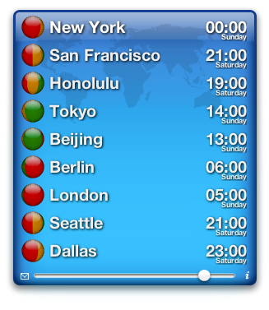
Teleconference Schedule
Motion:
Approve the following schedule of weekly teleconferences.
Tuesdays 00:00 ET(23:59.99…. on Monday) 3rd,10th,17th Dec and 8th Jan 2014
Duration 1Hour
Using WEB-EX that will be provided by Task Group Chair
Approved by unanimous consent

Slide 10
Reference
Motions
https://mentor.ieee.org/802.11/dcn/13/11-13-1186-01-00ai-tgai-motion-deck.pptx
Draft 1.1 on members area
http://www.ieee802.org/11/private/Draft_Standards/11ai/index.html
TGai LB 198 comments for D1.0
https://mentor.ieee.org/802.11/dcn/13/11-13-1076-03-00ai-tgai-lb-198-comments-for-d1-0.xlsx

Slide 11
Thanks to all who participated!

