Slide 1
The use of 802.11 Timing Measurement with P802.1ASbt in the context of P802.11ak
Date: 2013-11-14
Authors:

Slide 2
Abstract
This is the 802.11 upload of the 802.1 document
Asbt-kbstanton-TimingMeasurements-status-1113-v02.pptx.

Slide 3

The use of 802.11 Timing Measurement with P802.1ASbt in the context of P802.11ak
Kevin B. Stanton
Intel Corporation
November 2013

Slide 4
Questions
What about the new dot11 Timing Measurement?
How does P802.11ak affect gPTP?

Slide 5
The new dot11 Timing Measurement
IEEE Std. 802.1AS™-2011 specifies the use of Timing Measurement
  Which is published in IEEE Std. 802.11™-2012
“
”
P802.11mc is adding Fine Timing Measurement
  It’s nearly the same as Timing Measurement
    Increased timestamp resolution (10ns→100ps)
    Public Action Frame → Private Action Frame
    Other changes expected
  Expected to be published in 2015
A change to P802.1ASbt is not recommended at this time

Slide 6
Residence Time of a Station-Bridge
P802.11ak introduces WLAN Stations that Bridge
Residence Time of a WLAN Station-Bridge is large
  FOLLOWUP information for message n sent in message n+1
  With fixed Sync Interval, Residence Time ≥ sync interval
Implications to P802.1ASbt, if we do nothing:
  Introduces small lag in time propagation through Station Bridge
  And this grows linearly with # of Station-Bridge
    += Sync Interval * # of Station-Bridges
Approaches
  Bi-modal sync interval (“burst-of-two”)
  Increased sync rate
  Live with the lag
    Probably fine for Stations, less fine for long chains of Station-Bridges

Slide 7
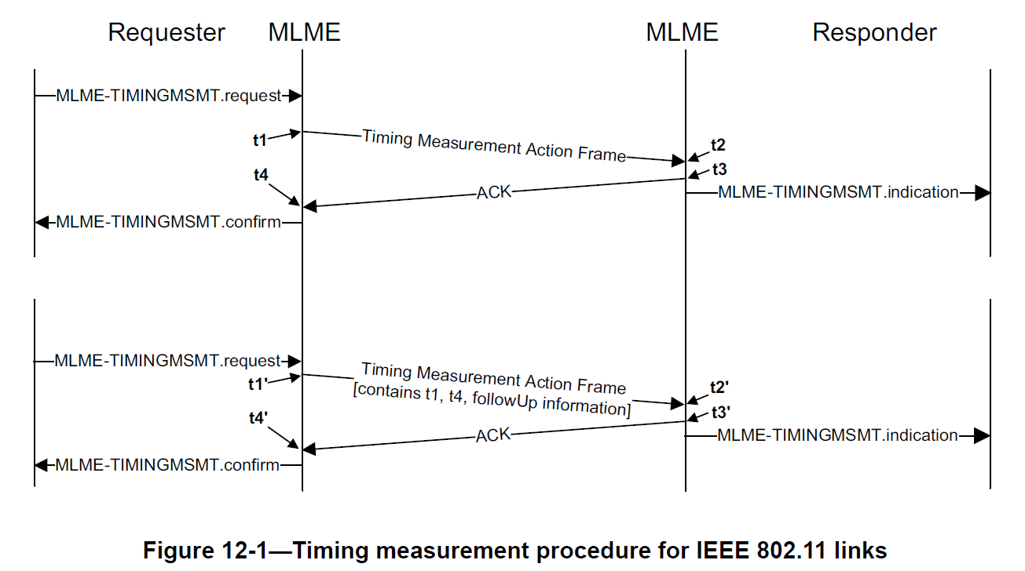
IEEE Std. 802.11™-2012 Timing Measurement

Slide 8
BACKUP

