Slide 1
ARC Closing Report
Date: 2013-11-14
Authors:

Slide 2
Abstract
This document is the closing report for ARC SC,
November 2013, Dallas meeting

Slide 3
Work Completed
Ad Hoc Monday: Collected comments on 802 O&A D1.7
  Sponsor Ballot recirc, closed Nov 12
    http://www.ieee802.org/11/private/Draft_Standards/802architecture/802-rev-D1-7.pdf
  802.11 comments:
    https://mentor.ieee.org/802.11/dcn/13/11-13-1368-01-0arc-cc10-comments-on-802-o-a-d1-7.xlsx
  Results: 142,8,7 (out of 174 voters; 90% returned; 94% yes; 134 comments) Comments are here: https://mentor.ieee.org/802-ec/dcn/13/ec-13-0067-00-00EC-802-sb2-comments.ods
Elected Vice Chair:
  Joseph Levy (InterDigital) – Thank you, and congratulations, Joe!

Slide 4
Work Completed (con’t)
IETF/802 coordination update – Dorothy Stanley
  RFC4441:
    Reviewed rev5, which has 802.11’s comments included
    http://tools.ietf.org/html/draft-iab-rfc4441rev-05
    Editorial comments only
  CAPWAP:
    Draft not ready yet
    Will hold 802.11 Comment Collection ballot, when draft available
    Possibly need teleconference to collect comments, or at Jan F2F
  PAWS:
    Behind CAPWAP, coming soon
802.1AC revision
  Reminder of 802.11 material in this document, not written by 802.11:
  http://www.ieee802.org/1/files/public/docs2013/acrev-nfinn-new-802-11-text-0813-v02.pdf

Slide 5
Work Completed (con’t)
IEEE 1588 mapping to 802.11
  Work not started yet, expected to be in a couple months
Architecture of APs/DS/Portals, and 802.1 concepts
  One submissions this week: https://mentor.ieee.org/802.11/dcn/13/11-13-1436-00-0arc-alternative-dual-band-ap-reference-model-graphic.pptx
  Working on Reference Model diagram updates (next slides)

Slide 6
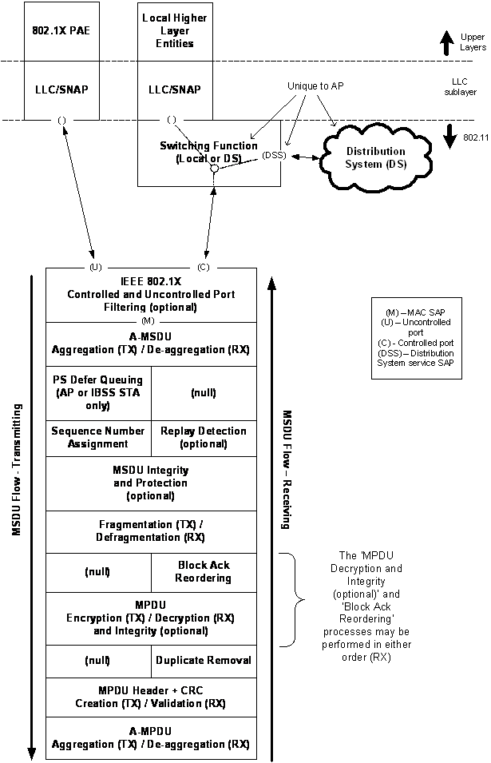
MAC
Reference
Model

Slide 7
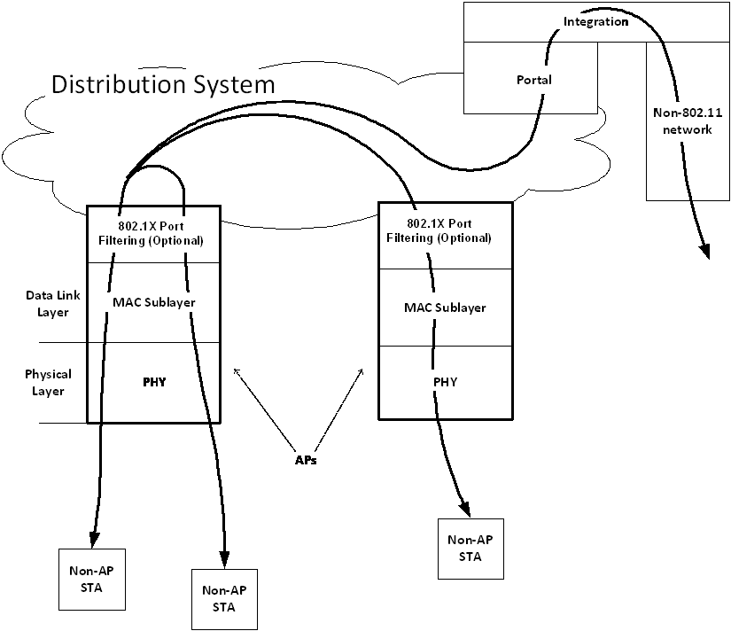
Infrastructure
Reference
Model

Slide 8
Teleconference(s)
One possible, scheduled with 10 days notice:
  Discuss comments collected on CAPWAP draft
  Timing depends on CAPWAP comment collection timing
  Discussion might be during Jan F2F instead

Slide 9
November 2013 Goals
One meeting slot planned:
  Continue discussion on MAC reference model, and Infrastructure reference model
  802.1AC subclause 12.2 discussion
  802 O&A sponsor ballot
  IETF/802: RFC 4441, CAPWAP, PAWS
  IEEE 1588, if started.

