Slide 1
ARC Closing Report
Date: 2013-11-14
Authors:

Slide 2
Abstract
This document is the closing report for ARC SC,
November 2013, Dallas meeting

Slide 3
Work Completed
Ad Hoc Monday: Collected comments on 802 O&A D1.7
Sponsor Ballot recirc, closed Nov 12
http://www.ieee802.org/11/private/Draft_Standards/802architecture/802-rev-D1-7.pdf
802.11 comments:
https://mentor.ieee.org/802.11/dcn/13/11-13-1368-01-0arc-cc10-comments-on-802-o-a-d1-7.xlsx
Results not posted yet
Elected Vice Chair:
Joseph Levy (InterDigital) – Thank you, and congratulations, Joe!

Slide 4
Work Completed (con’t)
IETF/802 coordination update – Dorothy Stanley
RFC4441:
Reviewed rev5, which has 802.11’s comments included
http://tools.ietf.org/html/draft-iab-rfc4441rev-05
Editorial comments only
CAPWAP:
Draft not ready yet
Will hold 802.11 Comment Collection ballot, when draft available
Possibly need teleconference to collect comments, or at Jan F2F
PAWS:
Behind CAPWAP, coming soon
802.1AC revision
Reminder of 802.11 material in this document, not written by 802.11:
http://www.ieee802.org/1/files/public/docs2013/acrev-nfinn-new-802-11-text-0813-v02.pdf

Slide 5
Work Completed (con’t)
IEEE 1588 mapping to 802.11
Work not started yet, expected to be in a couple months
Architecture of APs/DS/Portals, and 802.1 concepts
One submissions this week: https://mentor.ieee.org/802.11/dcn/13/11-13-1436-00-0arc-alternative-dual-band-ap-reference-model-graphic.pptx
Working on Reference Model diagram updates (next slides)

Slide 6
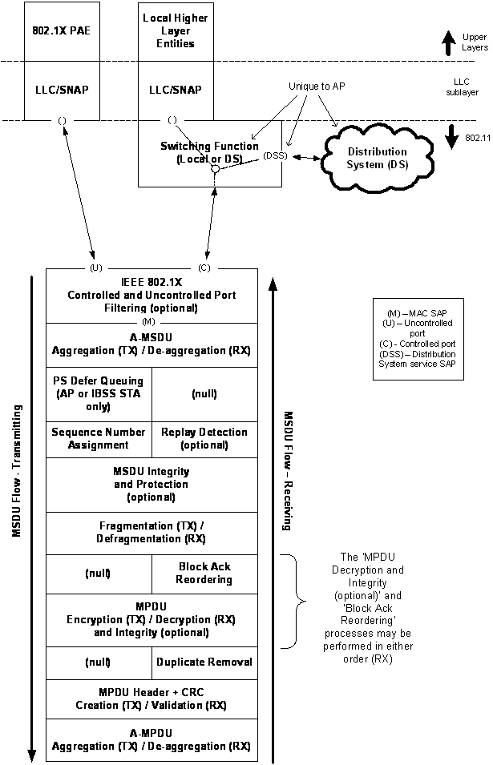
MAC
Reference
Model

Slide 7
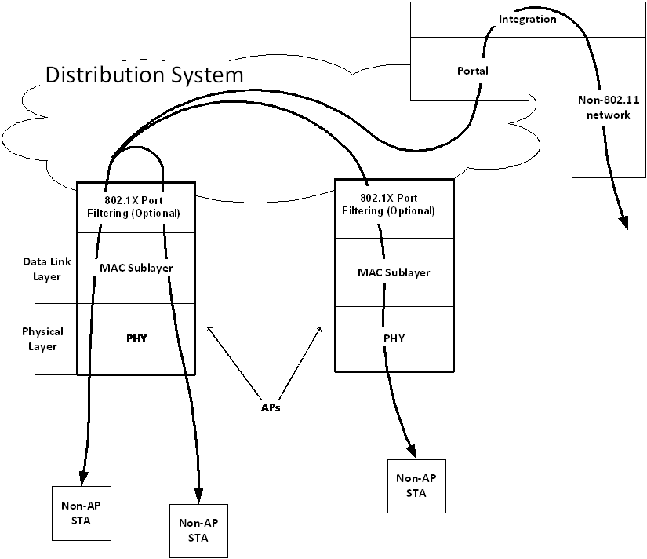
Infrastructure
Reference
Model

Slide 8
Teleconference(s)
One possible, scheduled with 10 days notice:
Discuss comments collected on CAPWAP draft
Timing depends on CAPWAP comment collection timing
Discussion might be during Jan F2F instead

Slide 9
November 2013 Goals
One meeting slot planned:
Continue discussion on MAC reference model, and Infrastructure reference model
802.1AC subclause 12.2 discussion
802 O&A sponsor ballot
IETF/802: RFC 4441, CAPWAP, PAWS
IEEE 1588, if started.

