Slide 1

802.11 Privacy
Date: 2013-11-14
Authors:

Slide 2
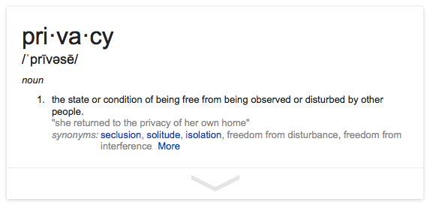
Privacy

Slide 3
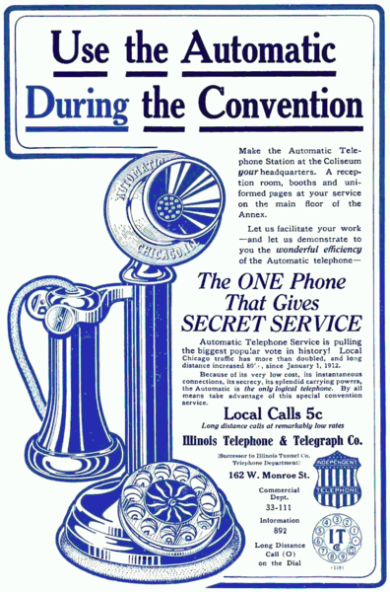
Communication privacy is not a new issue.
Privacy was an important selling point for dial based phones (1912) since they did not require an operator.
http://en.wikipedia.org/wiki/Privacy

Slide 4
Wi-Fi Privacy Concerns
Seattle Police Deactivate Wi-Fi Spy Grid After Privacy Outcry (Nov 2013)
  A DHS and Seattle police network collecting location information
CreepyDOL WiFi surveillance project debuts at Blackhat/DEFCON (Aug 2013)
  DIY surveillance with low-cost Wi-Fi based sensors that capture MAC addresses
Wi-Fi Trashcans Now Silently Tracking Your Smartphone Data (Aug 2013)
  ... the company boasted that the cans, which included LCD advertising screens, "provide an unparalleled insight into the past behavior of unique devices"—and hence of the people who carry them around
"Technopanic" mounts over Google's Wi-Fi Privacy violations (Mar 2013)
  A DHS and Seattle police network collecting location information

Slide 5
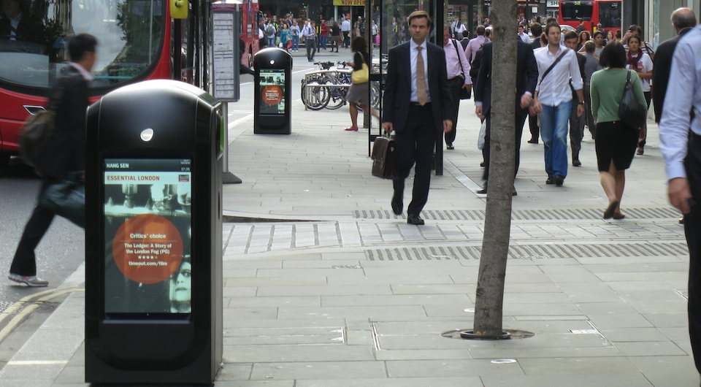
But wait – Wi-Fi “location” is also a service!
Location-based Wi-Fi services can add immediate value to Wi-Fi deployments (Oct 2013)
  “Knowing where someone is can be important because you are then in a better position to do something for or with them.”
In-Location Alliance (Nov 2013)
  “There are countless uses for accurate indoor positioning ...”
Renew - Wi-Fi based market information (Nov 2013)
  The Renew Network extends to over three million professionals in the City of London everyday. Our units have been strategically placed to achieve optimum viewing time, enabling our clients to receive a constant and continuous space to accommodate commercial campaigns.

Slide 6
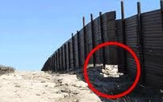


Risk Analysis and Privacy
Risk = Vulnerability x Threat x Cost
  Vulnerability:
  is the probability of success of an attack for a particular threat category. The “value” of vulnerability in the risk equation can vary depending on the type of attacker, for example a government may have more resources to be successful than a single hacker.
  Threat:
  is the likelihood of an adverse event. It is based on a particular threat category (hacker, paparazzi, disgruntled employee, government agency).
  Cost:
  is the impact of an attack against the vulnerability by the particular threat. Breaking into an online banking account typically has a higher cost than a denial of service attack against a single user.

Slide 7
Privacy versus other Security Services in 802.11
Privacy protection is provided by encryption and authentication
  But this just protects the disclosure “data”
  Good security (e.g. RSN) is a first step and is not the subject of this analysis and is assumed as a starting point
Privacy of identity and location must consider other information in 802.11 frames that can be used to track a device
  Like the MAC address

Slide 8
Where are the privacy vulnerabilities?
MAC Addresses are unique per device
  Enable detailed tracking by passive capture
  MAC addresses may be used in IPv6 addresses and carried beyond the WLAN and will directly identify the connecting device
SSIDs are sometimes unique
  Enable tracking when used in probe requests and indicate a devices commonly used APs
  The profile of multiple SSIDs used in probing are a good fingerprint of a users identity
802.11u is unprotected and may indicate user interests
Others?

Slide 9
Privacy Threats
Source of Threats:
  Hackers, private investigators, stalkers, paparazzi
  Marketing firms and retail outlets
  Police, Government Agencies
Non-threats:
  Marketing firms and retail outlets (with user approval)
  Personal home automation (of home user)
  ... Etc.
It is very important to identify ways to enable tracking when it is a “service”, but prevent unauthorized tracking

Slide 10
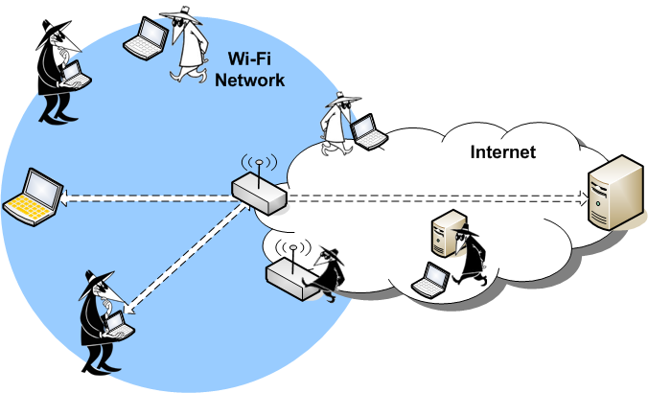
Attack Vectors for 802.11 Communications
The location and capabilities of an attacker in the network is a useful way to categorize vulnerabilities.

Slide 11
Passive Scanning and Monitor APs
The primary scenarios to consider that are “threat” and not “services” are passive monitoring and APs used for monitoring

Slide 12
Possible Technical Solutions
Ephemeral MAC Addresses
  use local addresses that change occasionally
Limit active scanning
Capability bits to indicate “willingness to be tracked”
Others?

Slide 13
Ephemeral MAC Addresses
Virtual STAs could be defined that allow a device to have a different MAC address for each BSSID
What happens to DHCP allocation and routing tables?
  Rapid changes are a problem, occasional changes are enough to prevent correlation of a device to a human
Not easy to change with an active association
  But could only change on new connections
Roaming and fast handoff might be impacted
  But MAC addresses could remain the same for roaming and only change when not actively associated
While there are issues with Ephemeral MAC Addresses to solve, it appears viable to define procedures for MAC address privacy!

Slide 14
Straw Poll
Would this group support the definition of privacy mechanisms for IEEE 802.11?
  yes:
  no:
  abstain:

