Slide 1
Argos | Practical Massive-MIMO
Date: 2013-11-12
Authors:

Slide 2
Abstract
We present a practical architecture for massive-MIMO and show early results from a real-world prototype. We suggest a small modification to 802.11ac to enable implicit channel sounding, which is critical for the practicality of massive-MIMO.

Slide 3
Massive-MIMO Benefits
Huge improvements in spectral capacity
Reduced inter-AP interference
Reduced STA power
Increased range

Slide 4
Scalability Challenges
Acquire CSI
  M pilots, then M•K feedback
Calculate Weights
  O(M•K²), non-parallelizable, centralized data
Apply Linear Precoding
  O(M•K), then O(M) data transport

Slide 5
Argos’ Solutions
Acquire CSI
  New reciprocal calibration method
Calculate Weights
  Novel distributed beamforming method
Apply Linear Precoding
  Carefully designed scalable architecture
O(M•K) → O(K)
O(M•K²) → O(K)*
O(M•K) → O(K) *

Slide 6
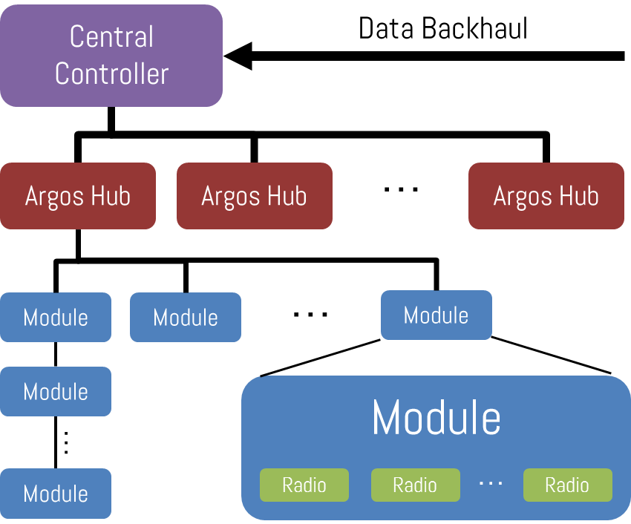
Argos Architecture
Notes:
Modular
Daisy-chainable
1 or more radios
Hierarchal
Increases Reliability
Constrains Latency
Cost-effective
Replace figure w/ paper veresion?
Need a lot more here – present central controller, explain hub, etc.
Scalable in 4 directions:
# of Radios per Module
# of Modules per Chain
# of ports per Hub
# of Hubs (and levels)
Reliable
Branches can fail without affecting other branches
Central hubs can be easily made redundant
Accommodates linear pre-coding
Add samples together at every junction

Slide 7
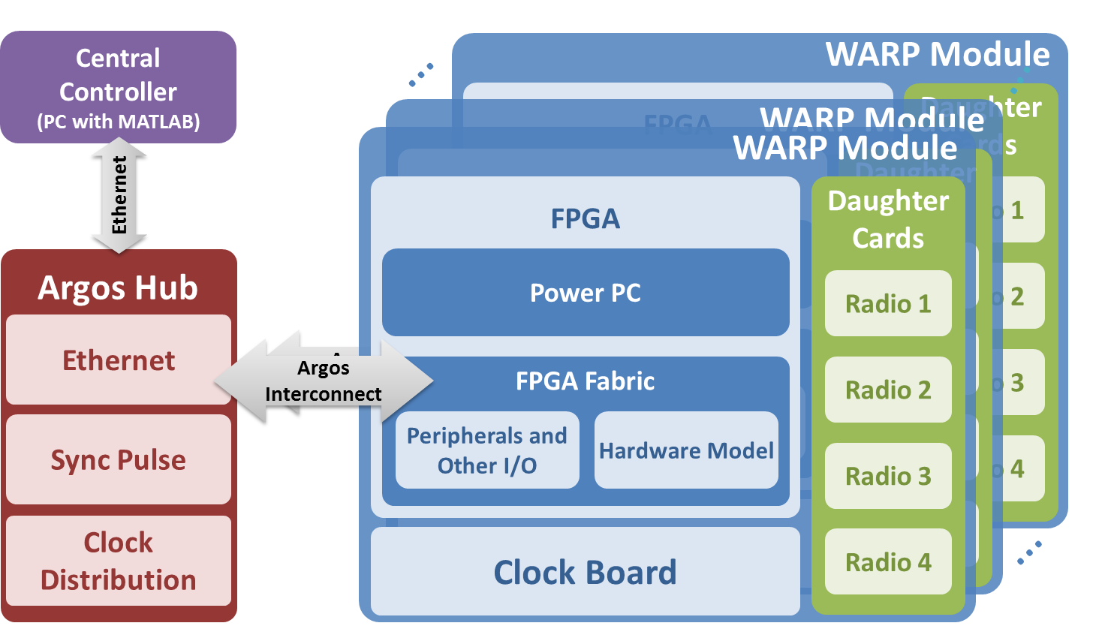
Argos Implementation

Slide 8
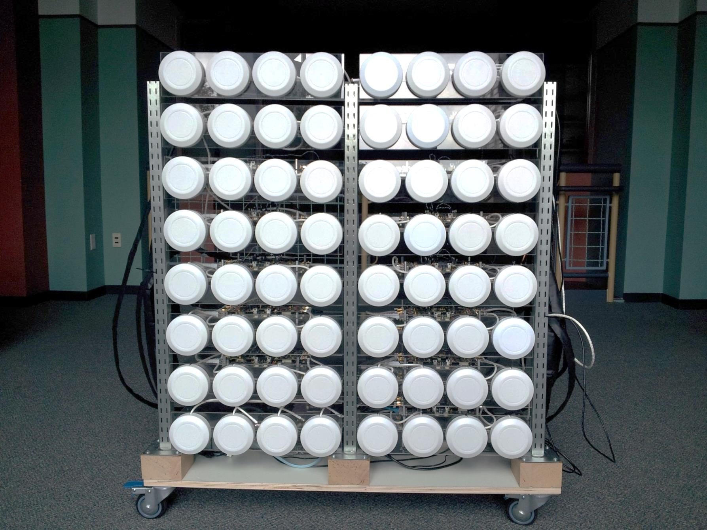
Notes:
Mention greek creature here.

Slide 9
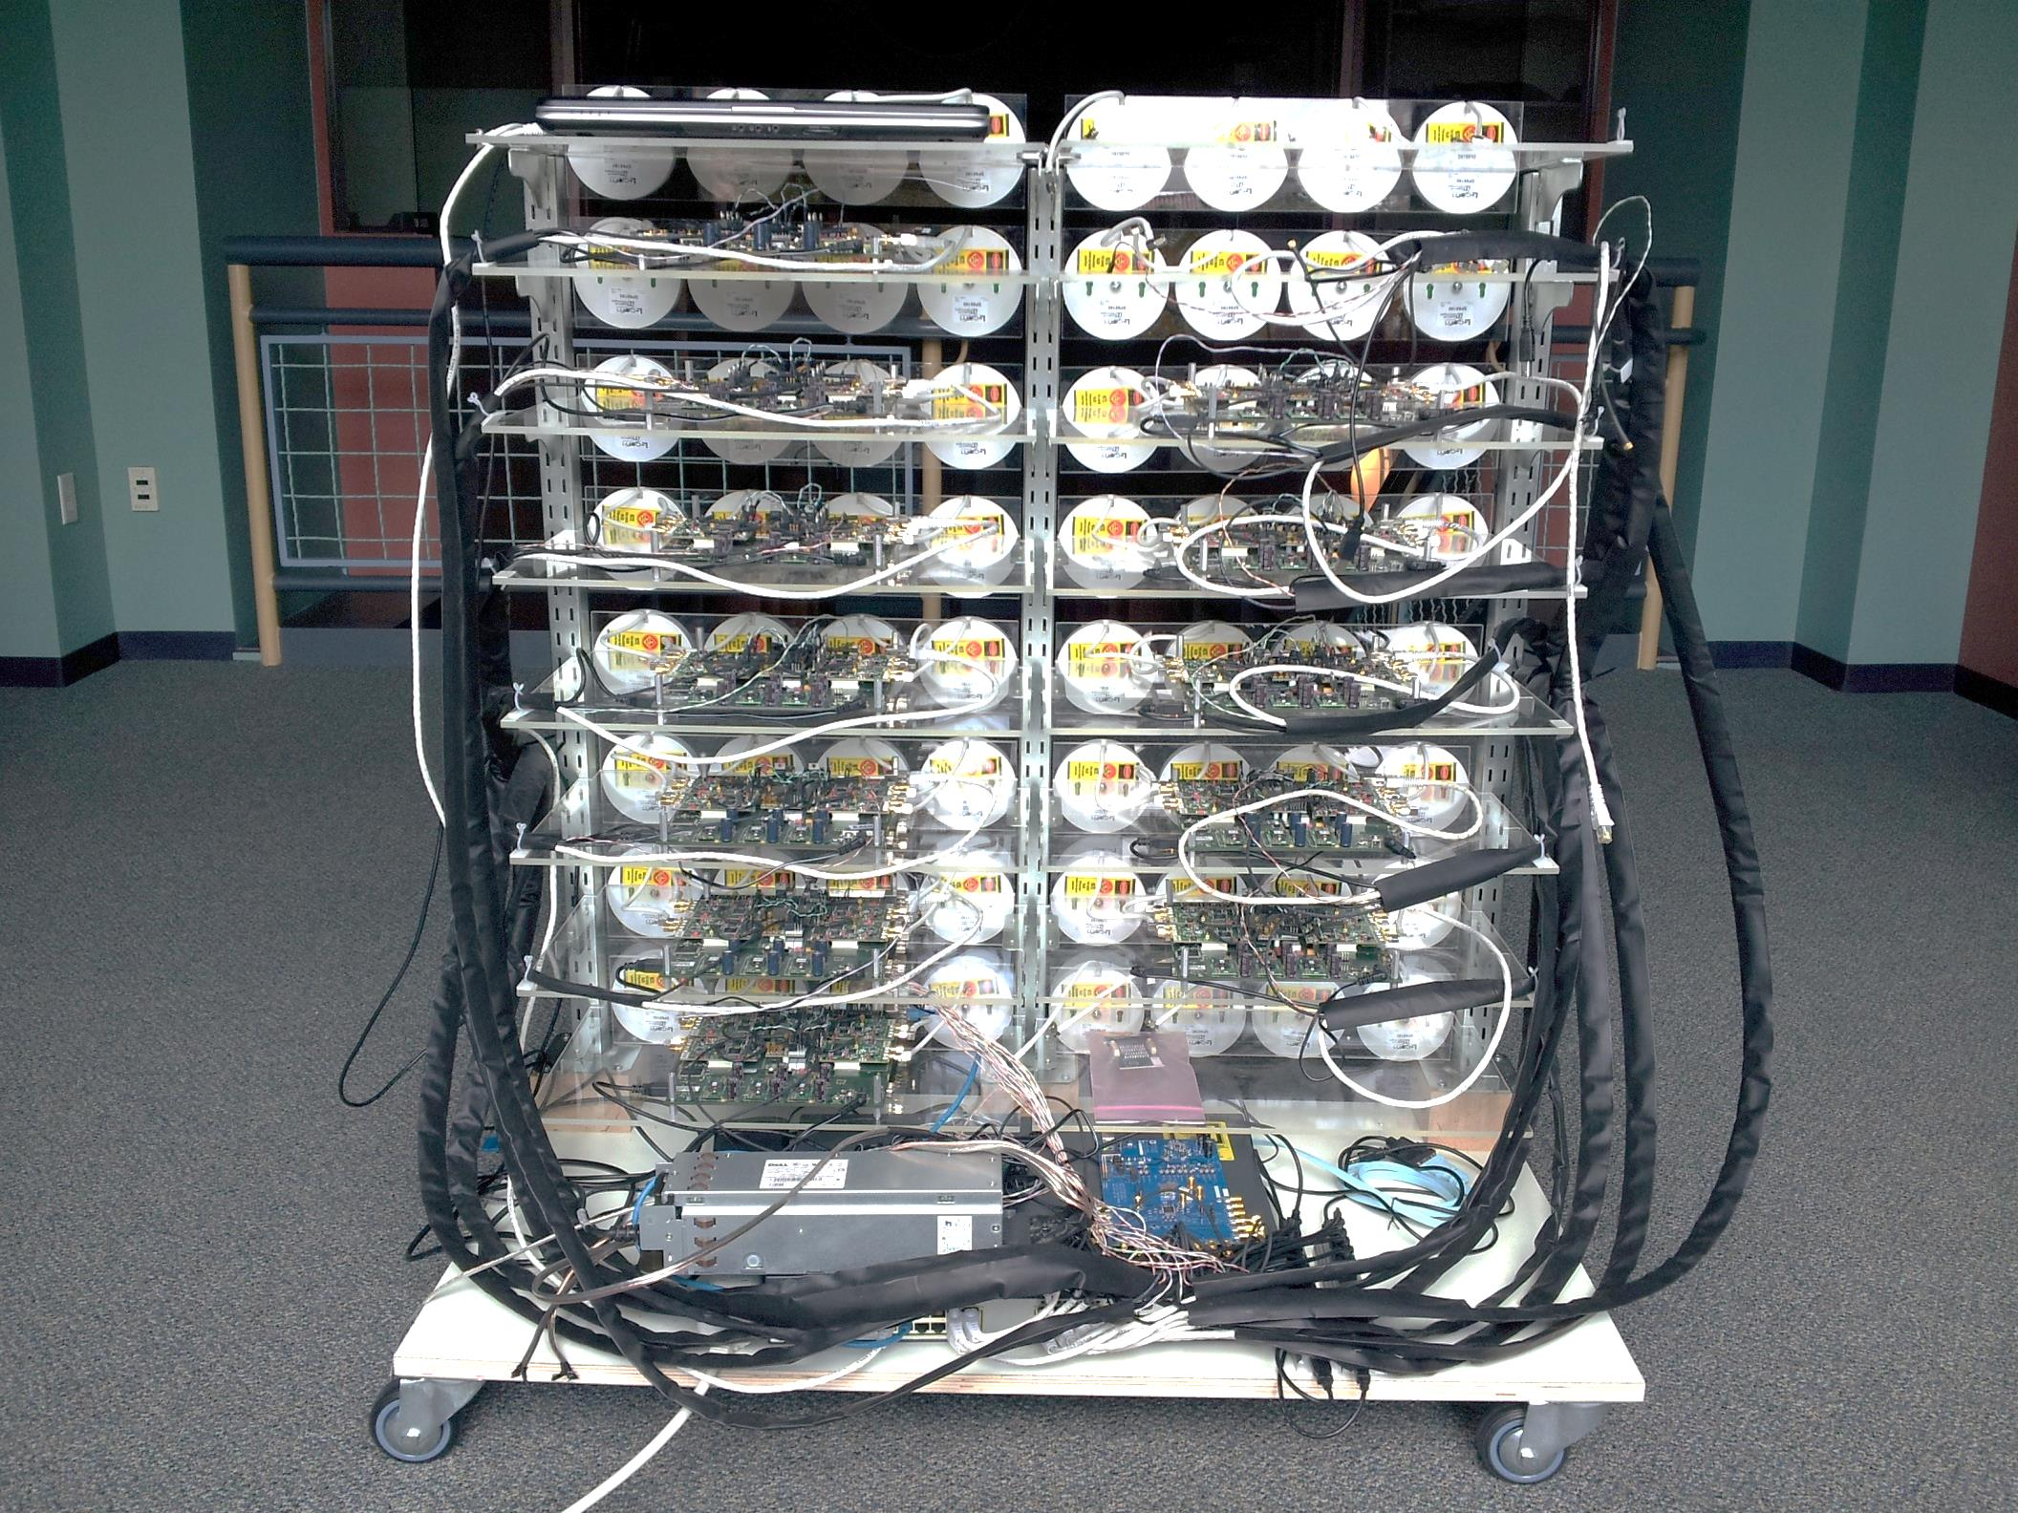
Central Controller
WARP Modules
Argos Interconnects
Sync
Distribution
Clock Distribution
Argos Hub
Ethernet Switch
Notes:
WARP platform, 64 antennas, 15 receivers.
AD9523
While we have primarily focused on techniques that target very large-scale operation, it is important to note that this platform is not just for very-large scale. It supports any linear precoding technique (as well as even non-linear, but more overhead).
This is actually important for real-world use, as we’ve seen that depending on the channel, number of users, and hardware capacity, it is optimal to dynamically switch between precoding techniques.
Very flexible and configurable platform.

Slide 10
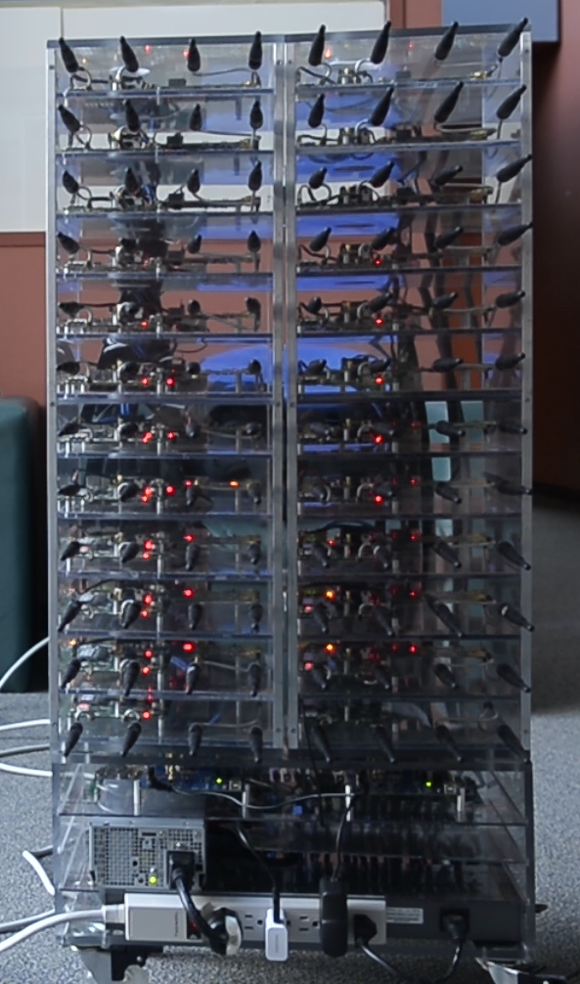
Ref: [3]

Slide 11


Slide 12


ArgosHub
Notes:
Custom Clock Board
48 Port GbE Switch
Supports up to 36 connections, which is 3 towers, or 144 boards.

Slide 13
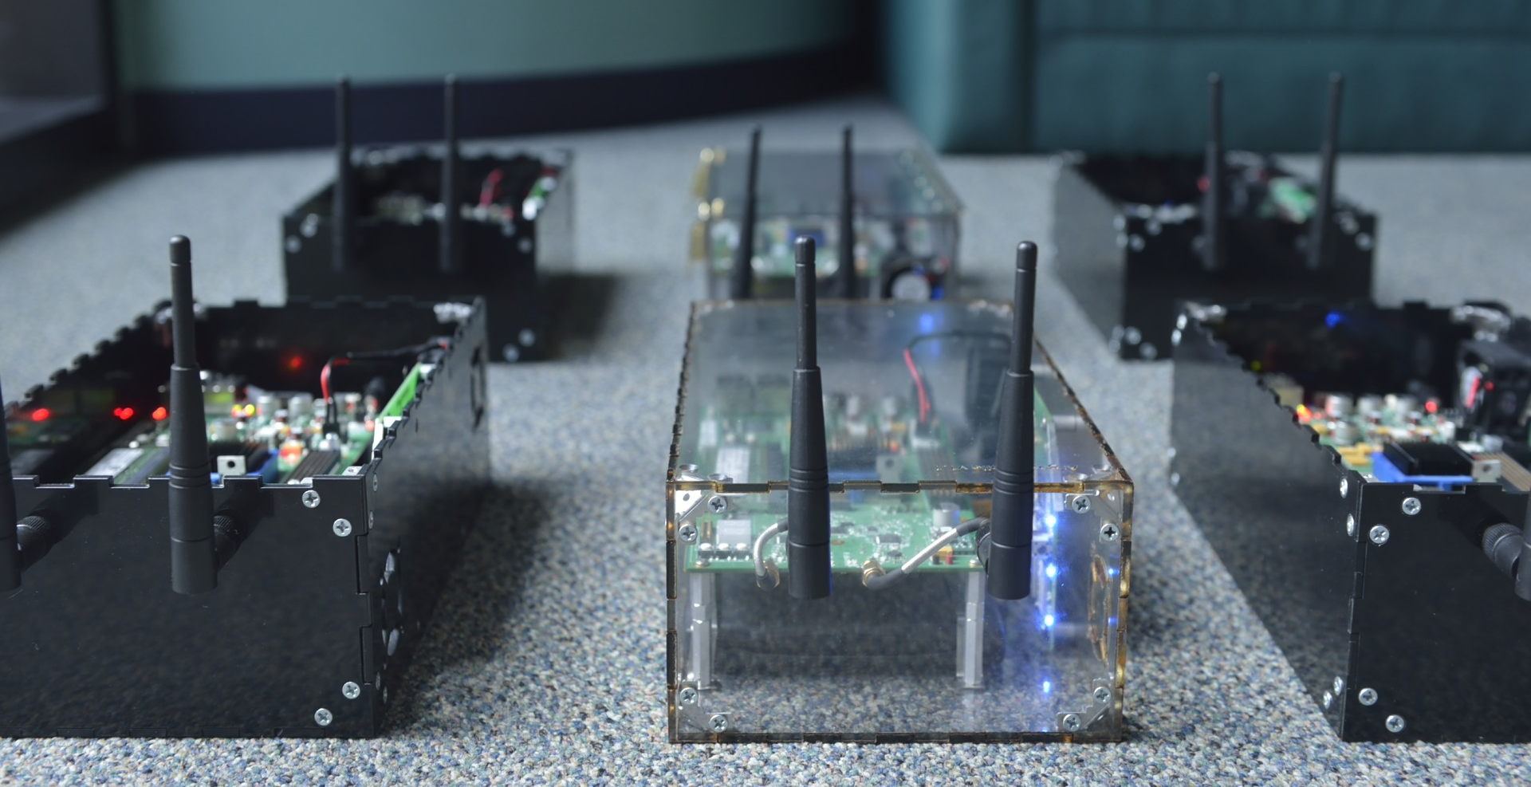
ArgosMobile
Notes:
Easy to produce
Completely autonomous
Battery-powered – 3h battery life
Subtle, but important feature – wireless bridge is critical for rapid prototyping, experimentation, debugging etc. (also, at Rice we have it setup so that we can access our mobiles anywhere on campus)

Slide 14

Results Without Considering Overhead
CE
Comp
Transmit

Slide 15
Linear Gains as # AP Antennas Increases
Capacity vs. AP Antennas with 15 STAs
Ref: [1]
Notes:
Total power is scaled with 1/M!!!
Overhead of CE and calculation not included – ultra stable channel, ZF not feasible for high mobility. Better performance with more antennas.
Performance gap peaks for ZF depending on K, but conjugate
5.7x and 12.7x vs. 3x and 6.7x
Emphasize local conj uses same power.

Slide 16
Linear Gains as # of STAs Increases
Capacity vs. # of STAs, 64 AP antennas
Notes:
Note initial capacity loss due to interference

Slide 17
Scaling # of STAs with 16 AP Antennas
Capacity vs. # of STAs, 16 AP antennas

Slide 18

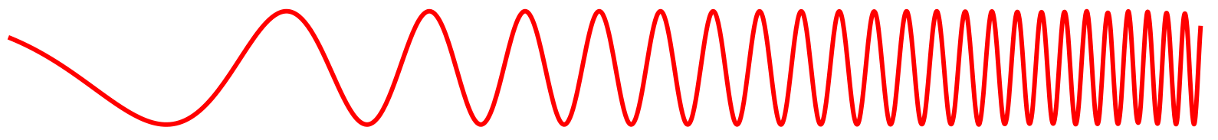
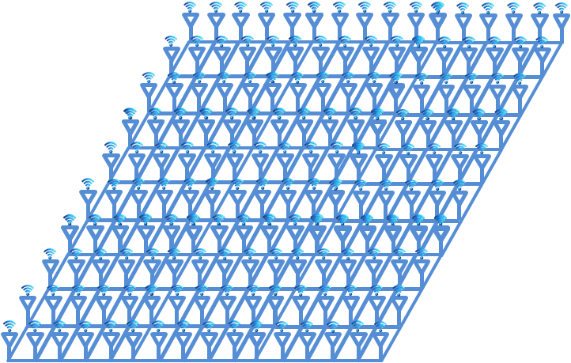
Zero-forcing vs. Conjugate
More Antennas or Higher Mobility
Faster Processing
Adaptive
Precoding
Zero-forcing
Conjugate
1 GHz
10 GHz
Ref: [2]

Slide 19
Massive-MIMO in 802.11
CSMA
Expensive
Large Form-Factor
TDD
Low Mobility
High Frequency (5.8 GHz)

Slide 20
Current 802.11ac Sounding
<<
Tx
NDPA
NDP
Data
CSI
ack
Rx A
CSI
ack
Rx B
CSI
ack
Rx C
Transmission Procedure
Select transmission group (NDPA)
Send channel sounding training sequence (NDP)
Receive channel state feedback (CSI) from each receiver serially
Construct steering weights and transmit data
Acknowledge transmission

Slide 21
Modified Implicit Sounding
Tx
NDPA
Data
NDP
ack
Rx A
NDP
ack
Rx B
NDP
ack
Rx C
Transmission Procedure
Select transmission group (NDPA)
Group serially transmits implicit sounding training sequence (NDP)
Construct steering weights and transmit data
Acknowledge transmission

Slide 22
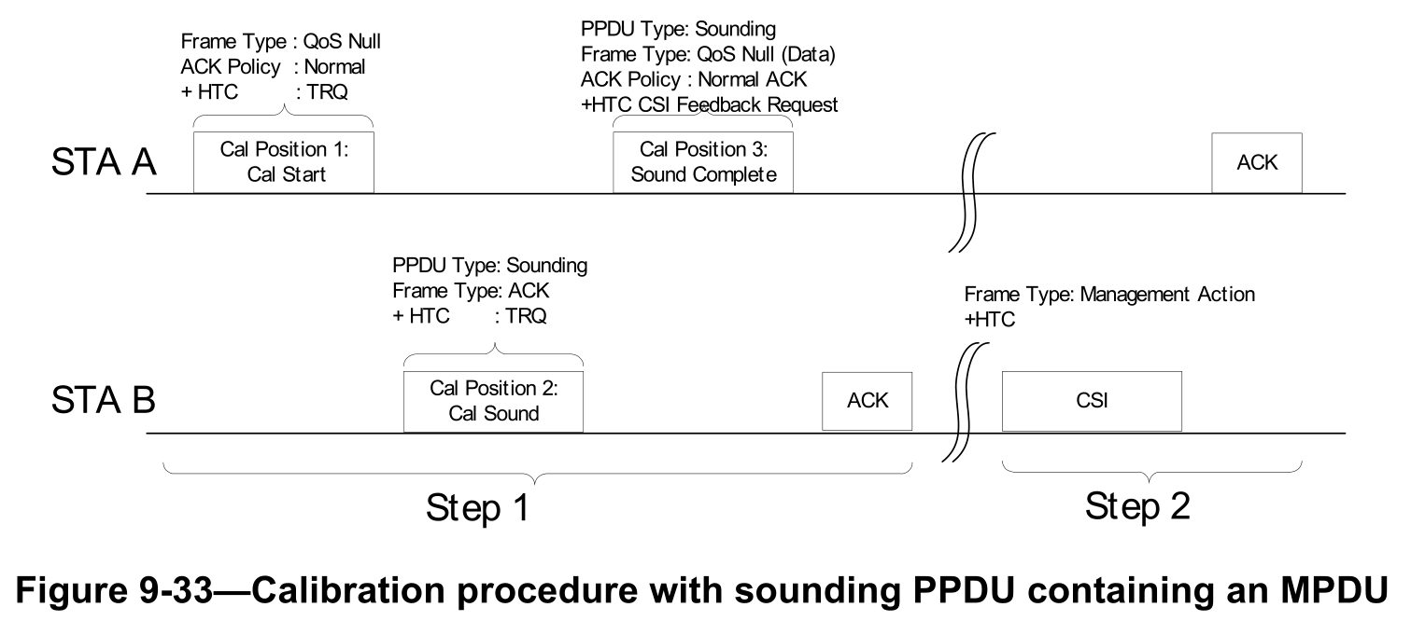
802.11n Implicit Sounding
High-overhead
Required inter-STA cooperation for calibration
Ref: [4,5,6,7]

Slide 23
Conclusions
Massive-MIMO can be practical
Massive-MIMO requires implicit sounding to be feasible
Implicit sounding is easily enabled in 802.11

Slide 24
References
[1] Clayton Shepard, Hang Yu, Narendra Anand, Erran Li, Thomas Marzetta, Richard Yang, Lin Zhong. "Argos: Practical Many-Antenna Base Stations," in Proc. ACM Int. Conf. Mobile Computing and Networking (MobiCom), August 2012.
[2] Clayton Shepard, Narendra Anand, and Lin Zhong. "Practical Performance of MU-MIMO Precoding in Many-Antenna Base Stations," in Proc. ACM workshop on Cellular networks (CellNet), June 2013.
[3] Clayton Shepard, Hang Yu, and Lin Zhong. "ArgosV2: A Flexible Many-Antenna Research Platform," Extended Abstract for demonstration in Proc. ACM Int. Conf. Mobile Computing and Networking (MobiCom), October 2013.
[4] 04/1404r2, Enhancements for 802.11: Features and Performance, John Ketchum.
[5] 04/1449r1, High-Throughput Enhancements for 802.11: PHY Supplement, John Ketchum
[6] 05/0414r1, Response to “No” Vote Comments on Calibration, John Ketchum
[7] IEEE 802.11n-2009

